Slide 1
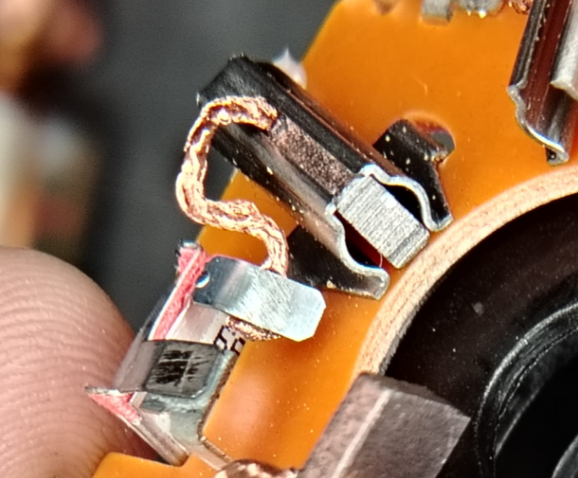
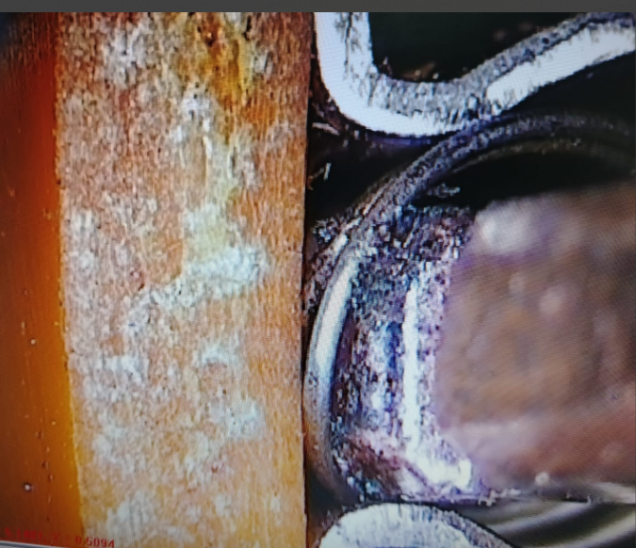
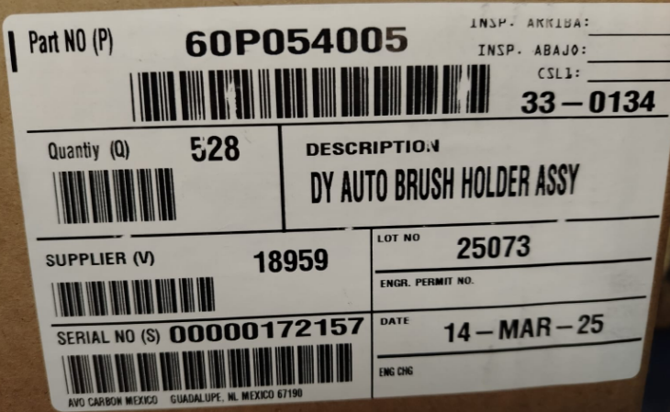
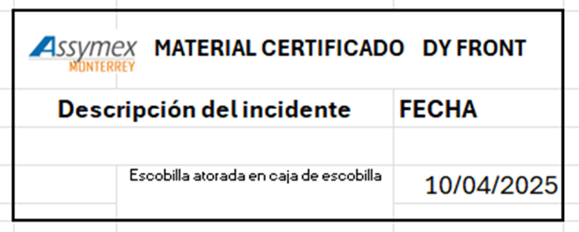
Carbon Brush stuck, trapped |  |  |  |  | Importance | Grade
1. (Problem Definition) |  |  | 1-2 Issue (photo) |  | 4. (C. Action)
Date of Issue | 10/4/25 |  |  |  | ◆ Improvement measures Quality alert than not assembly material manually Apr 11, 2025 Update work instruction mentioned not rework material in this process Apr 13, 2025 Create a procedure for reworked March 21, 2025 Update control plan March 21, 2025 Update PFMEA March 21, 2025
Location | DY AUTO MÉXICO
Product name | BRUSH HOLDER ASSY FWS 60P054005
Lot No | 14 Marzo 2025
Issue Description | Carbon Brush stuck, trapped in to the holder box
Occurrence quantity | 7
Recurrence history | 0
2. Containment measures |  |  | 3. R.C. Analysis |  | 5. Validation of measures [Validation of measures to be taken]
Containment 10-4-2025 – 832 pcs were removed Changed by Lot 7 Abril DY Auto Inventory: 70k pcs pending to be disposed AVO Containment action: |  |  | ◆ Root cause analysis the brush is mounted manually after the station of brush assembly without used the brush mounting device. Use example => ◆ Spill cause analysis There is no procedure for passing reworked material through the tester |  | TBD (Zero defects found in final inspection and containment station)
 |  |  |  |  | 6. Drill Deep Wide
 |  |  |  |  | 7. Lessons Learned
Certification label

