Slide 1
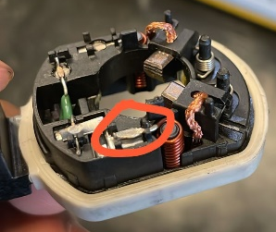
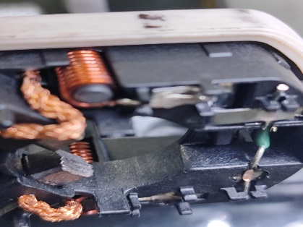
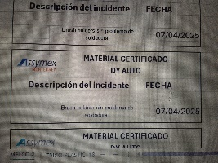
In brush holder assy cold solder between circuit and inductor |  |  |  |  | Importance | grade
1. (Problem Definition) |  |  | 1-2 Issue (photo) |  | 4. (C. Action)
Date of Issue | April 07, 2025 |  |  |  | ◆ Improvement measures - Add a digital pressure switch to weld air pressure - Add to the setup the digital pressure switch check of the air pressure on the welding machine
Location | DY AUTO MÉXICO
Product name | BRUSH HOLDER ASSY
Lot No | A25C28L2 (28-03-25)
Issue Description | DY AUTO 33-0129(60P058803) in brush holder assy cold solder between circuit and inductor in operation 20. Information on the production label in lot 25087 dated 28-03-25.
Occurrence quantity | 3
Recurrence history | 0
2. Containment measures |  |  | 3. R.C. Analysis |  | 5. Validation of measures [Validation of measures to be taken]
Containment 07-04-2025 Dy plant : 16,016 pcs / 0 defects found Assymex plant:3328 pcs/0defects |  |  | ◆ Root cause analysis It is not easy to read through the gauge bush the welding air pressure ◆ Spill cause analysis It is not easy to read through the gauge bush the welding air pressure
 |  |  |  |  | 6. Drill Deep Wide
 |  |  |  |  | 7. Lessons Learned
Certification label

