Slide 1


Slide 2

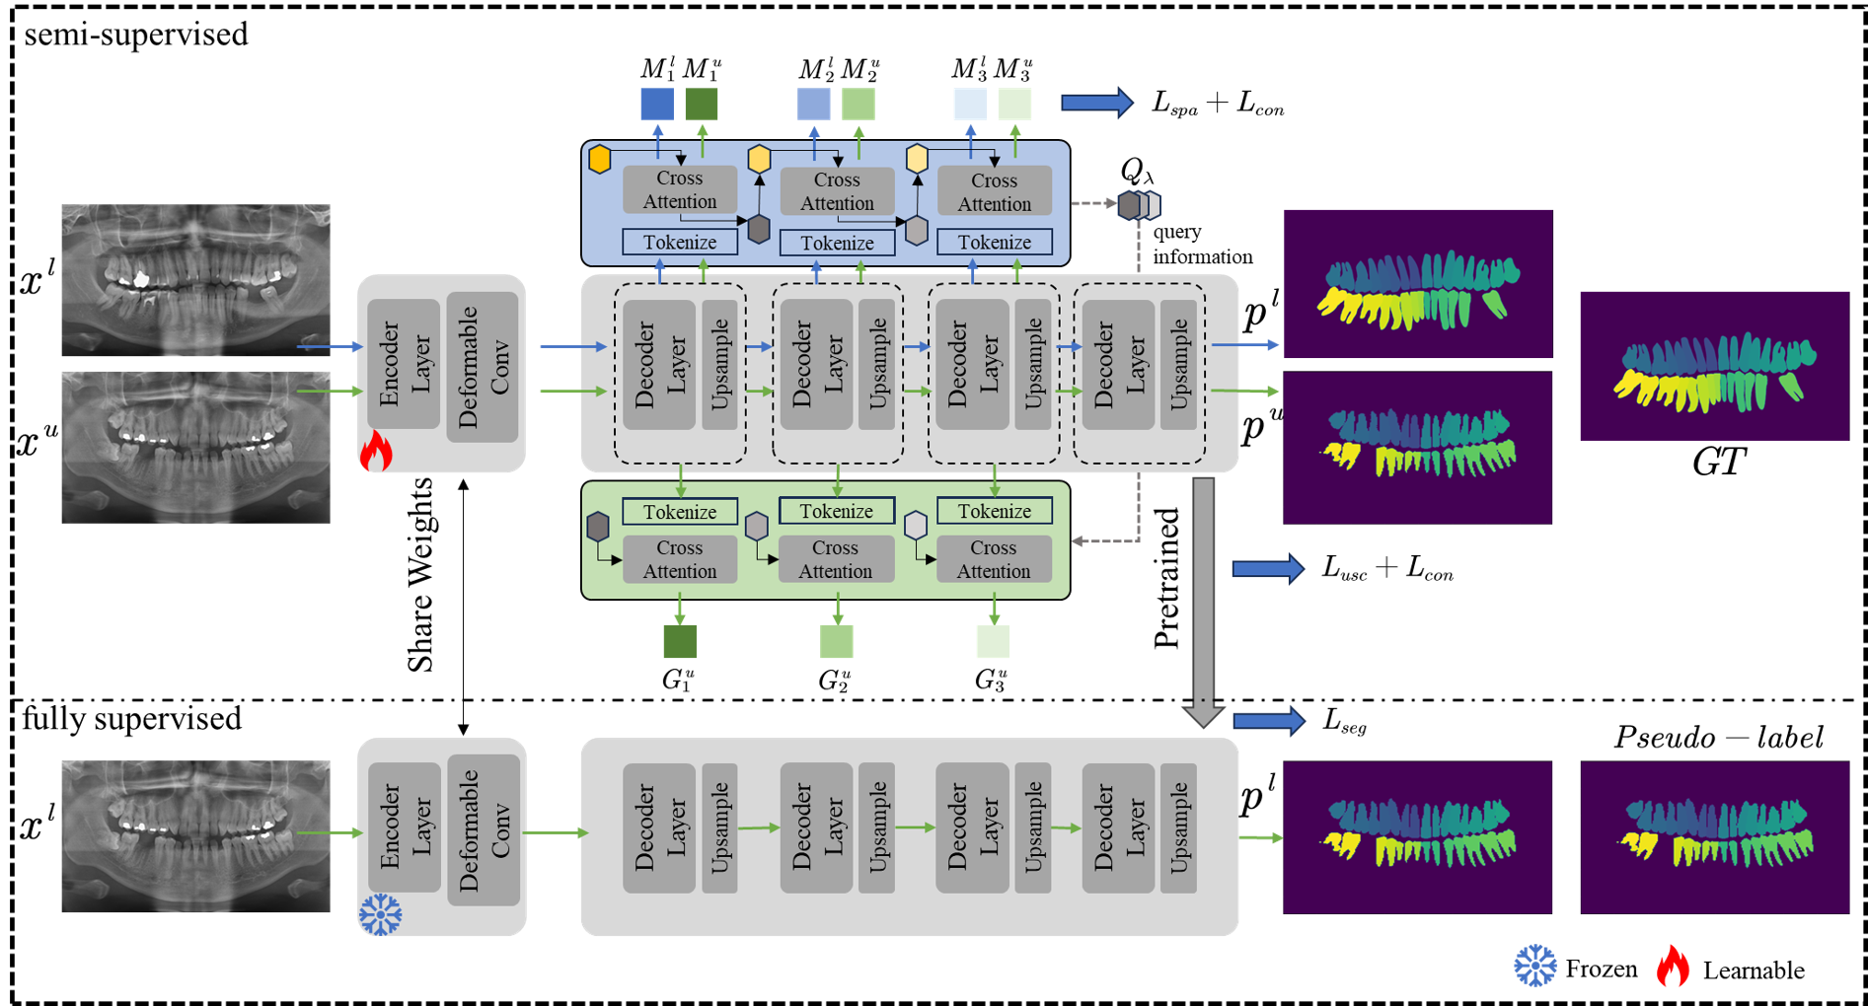
Overall Algorithm Workflow
Input labeled and unlabeled images into a feature extractor, which adaptively extracts defect features focused on the teeth area through deformable convolution.
Feed the extracted multi-scale features into a decoder, and predict the segmentation results of both labeled and unlabeled images using an intrinsic consistency learning module attached to the decoder, calculating loss for each scale separately.
Apply the network trained in the previous step to unlabeled images to generate pseudo-labels, and in the second phase, input labeled images along with pseudo-labeled images for conventional image segmentation.

Slide 3
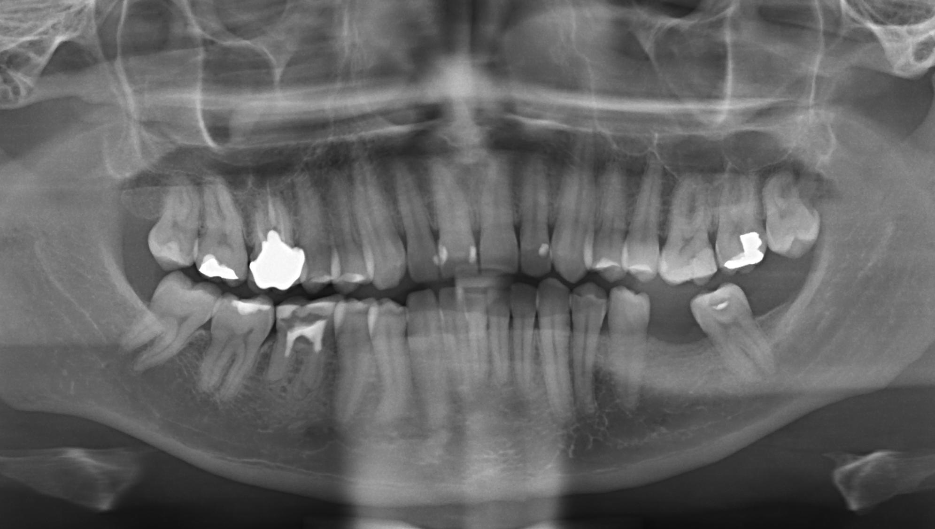
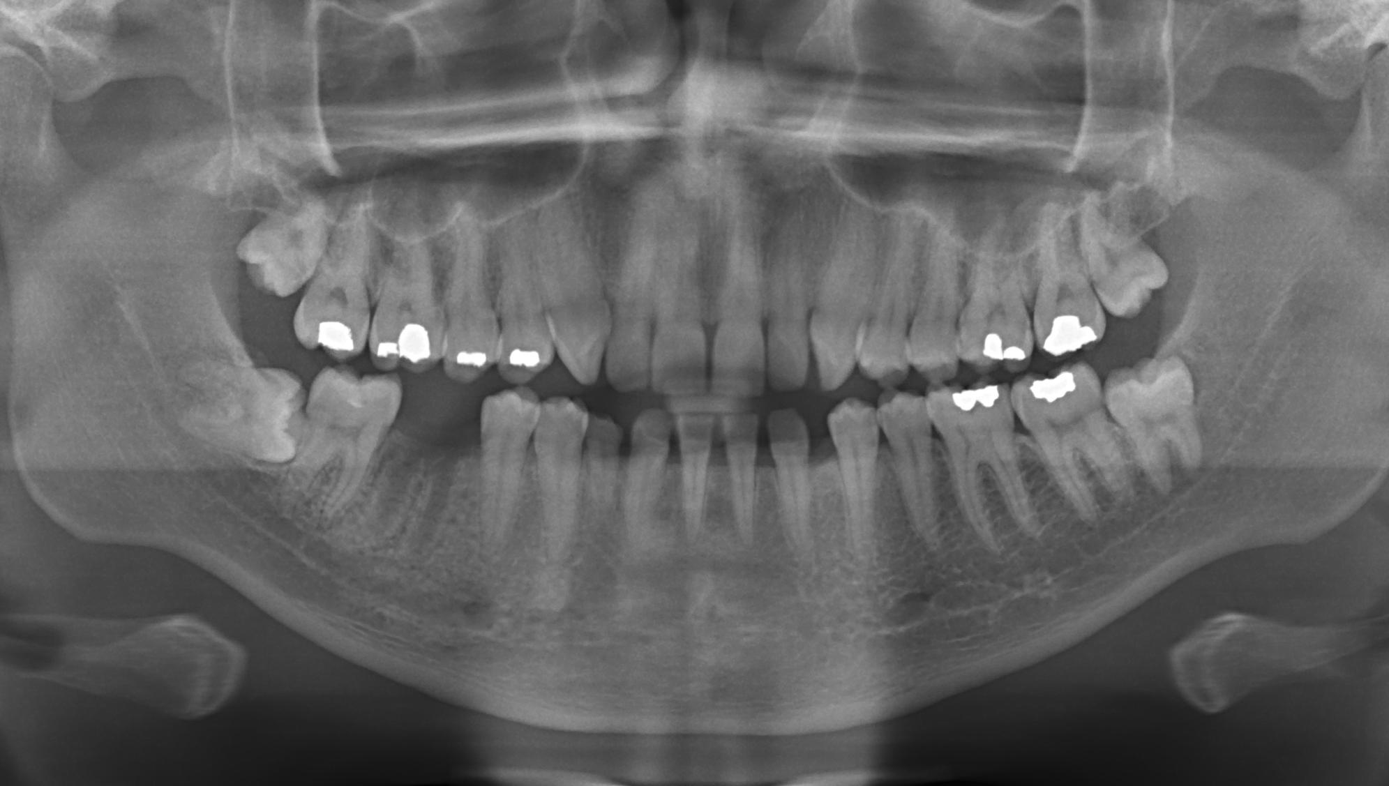
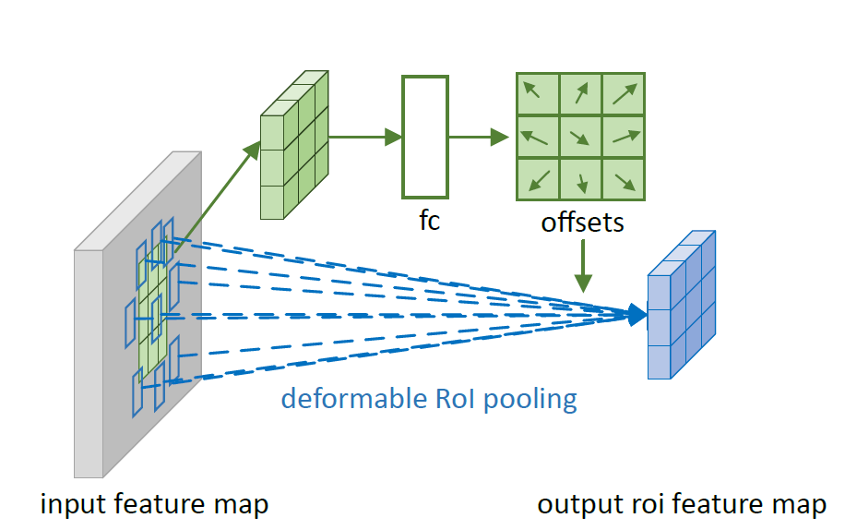
Stage 1
During the semi-supervised training phase, in the image encoding stage, we use deformable convolution to further focus the feature information on individual teeth, adaptively learning the relevant shape characteristics of the teeth.
Encoder
Layer
Deformable
Conv

Slide 4
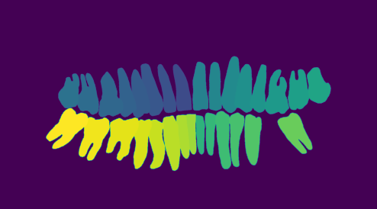
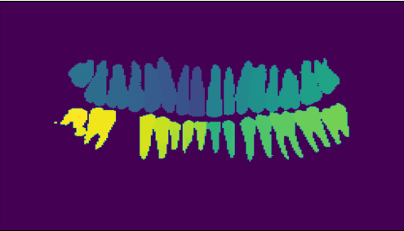
Stage 1
On the output feature map, by introducing initial query information, labeled and unlabeled features are used to generate the next-scale query information and predictions for each scale through the cross-attention mechanism and .
For unlabeled feature information, we directly use the query information
generated in the previous step through the cross-attention mechanism to produce unlabeled predictions for each scale.
Cross Attention
Cross Attention
Cross Attention
Tokenize
Tokenize
Tokenize
query information
Decoder
Layer
Upsample
Decoder
Layer
Upsample
Decoder
Layer
Upsample
Decoder
Layer
Upsample
Tokenize
Tokenize
Tokenize
Cross Attention
Cross Attention
Cross Attention
Evaluating Unlabeled Prediction Results
Evaluating Unlabeled Consistency
Evaluating Labeled Prediction Results

Slide 5
Stage 2
In the fully supervised training phase, the encoding phase of the entire network inherits the weights from the semi-supervised training phase, while the decoding phase employs a basic simple decoder to simplify the model structure as much as possible. In this part, we use the labeled data from the training set and other dental data predicted by the aforementioned semi-supervised training as input, obtaining the final model in a fully supervised manner.

