Slide 1

Semi-Supervised 2D dental image segmentation via Cross Teaching network
MICCAI STS 2024 Challenge Task 1
Team: lazyman

Slide 2

Introduction
• 2D Panoramic X-ray Segmentation plays a crucial role in providing reference material for auxiliary diagnosis or subsequent downstream tasks.
• This paper presents a teeth segmentation method based on a semi-supervised segmentation research via cross teaching between CNN and Transformer.
• Achieved an average instance Dice score of 87.07% and average instance NSD score of 41.08% for the teeth segmentation on the validation set.

Slide 3
Contribution
1. Simultaneously equipped with the local convolution mechanism of CNNs and the long-term attention mechanism of Transformer, enhancing feature extraction ability.
2. We simplify co-training from implicit consistency-regularization to cross-teaching, where one network predicts as pseudo-labels and end-to-end supervises the other network, enabling the model to remain stable under certain perturbations.

Slide 4
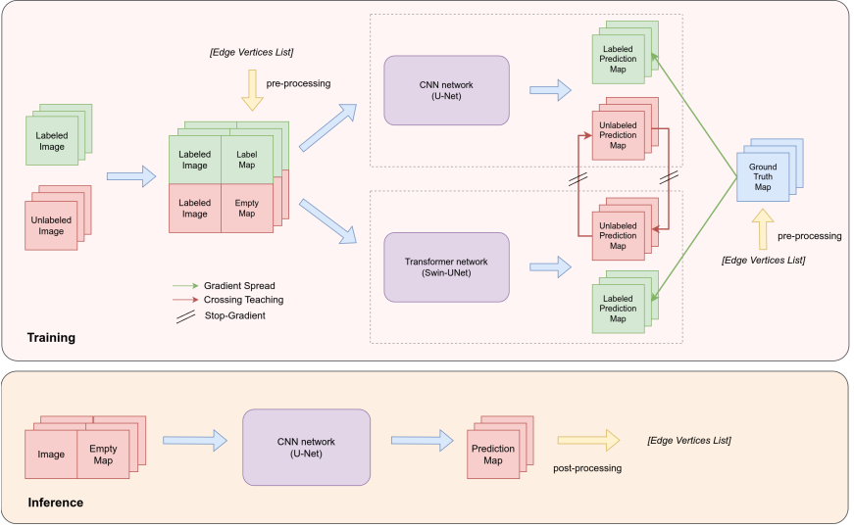
Method
We have adapted an existing cross-teaching mechanism based on CNN and Transformer for the current 2D X-ray dental image segmentation task. The specific method is mainly divided into two stages: training and inference.

Slide 5
Method
Pre-processing
Image Processing:
Convert the original X-ray JPEG images into 8-bit single-channel grayscale images and generate label maps that serve as ground truth.
Scale the image to 224×224 and proportionally scale the coordinates.
Label Generation:
Generate label maps using the contour coordinates and classification categories from the JSON annotations.
Initialize a blank 8-bit single-channel grayscale image (pixel values set to 0), and map the tooth label value to a classification value (0 ≤ t_{c} ≤ 52) using a label-to-category correspondence table.
Calculate the pixel area occupied by the tooth based on the contour point list and fill the area with the classification value.
Unlabeled Images:
The label map for unlabeled images is initialized as a full-zero grayscale image.
Model Training:
To enhance the model's generalization ability, the contours are not used directly for training; instead, the pixel area is filled with the classification value.

Slide 6
Method
Post-processing
The inference process requires post-processing. The results generated by inference are 8-bit single-channel grayscale images (where the pixel values occupied by each tooth correspond to the classification values). Therefore, the classification values are first converted to label values, and then edge extraction operations are performed on the polygonal pixel areas of tooth.
Edge extraction:if a pixel’s value is not 0, and the values of the four neighboring pixels are all the same as this pixel’s value,then this pixel is judged to be a non-edge pixel of the tooth polygonal area and needs to be updated to a value of 0 in the subsequent process. By traversing every point on the image, all non-0 value pixels on the image represent the edge points of each tooth, and the values of these pixels are the classification labels of teeth.

Slide 7
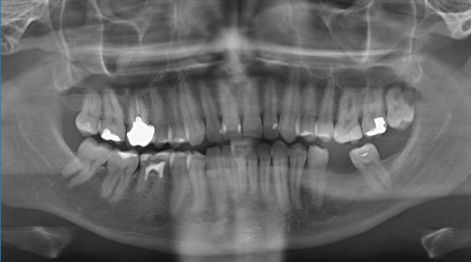
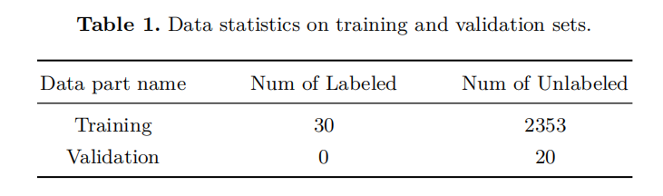
Datasets
The dataset used for training is provided by the competition, and the data
belongs to the 2D panoramic X-ray images category.

Slide 8
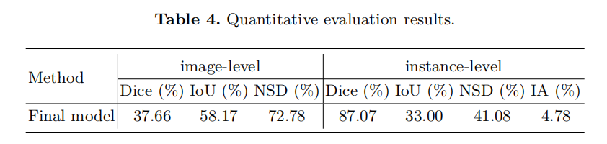
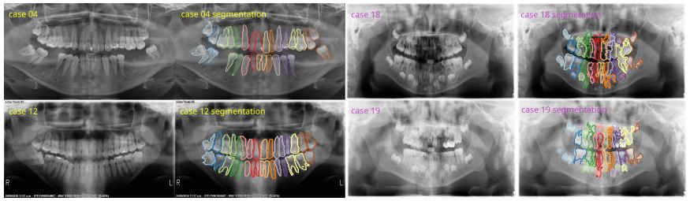
Results
The metrics scores on the validation set show in Table 4
Mainly includes these metrics:
(1) Dice Similarity Coefficient (DSC): instance-level and image-level
(2) Normalized Surface Distance (NSD): instance-level and image-level
(3) mean Intersection-over-Union (mIoU): instance-level and image-level
(4) Identification Accuracy (IA)

Slide 9
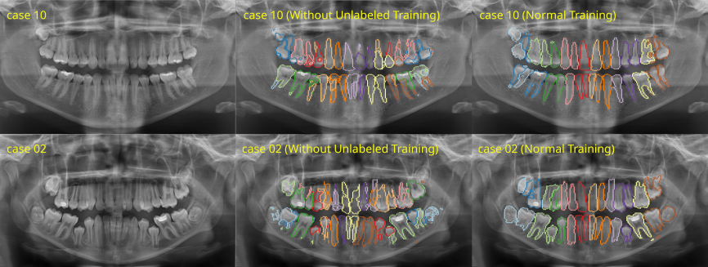
Results
Ablation studies
Ablation studies are also conducted to explore the impact of unlabeled image data on model performance.
We eliminate the cross teaching loss from the loss for unlabeled data. Additionally, only labeled image data was utilized for training. Training was halted when the model achieved the same Dice score as the complete model during epoch evaluation.
We compared the two cases,which clearly showed that if the unlabeled image data is utilized, the understanding of tooth shape and semantics between different teeth can be effectively improved during segmentation, avoiding the formation of broken segmentation edges.

Slide 10
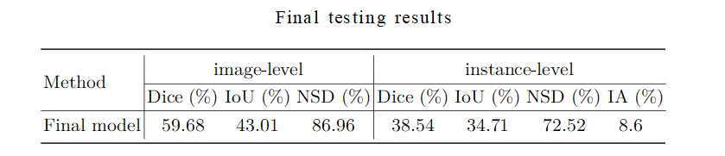
Results
The metrics scores on final testing set:
We obtained scores of 59.68% (image-level Dice), 43.01% (image-level IoU),
86.96% (image-level NSD), 38.54% (instance-level Dice), 34.71% (instance-level
IoU), 72.52% (instance-level NSD) and 8.6% IA on the official testing set.

Slide 11
Thanks for your attention!

