Slide 1


Slide 2

Precision Tooth Segmentation Using CBCT: From Coarse Structures to Fine Details
Notes:
"Good day, everyone. Today, I’ll be introducing Precision Tooth Segmentation Using CBCT: From Coarse Structures to Fine Details. This presentation outlines our approach to efficiently segmenting teeth in CBCT scans and refining the process for precise results, which is part of the STS24 Teeth Segmentation Challenge. I will take you through our step-by-step approach to improving the efficiency and accuracy of tooth segmentation using CBCT, or Cone Beam Computed Tomography. We focus on not only the accuracy, but also the efficiency of our algorithm, which are two rather important aspects to balance.

Slide 3
Dataset analysis
Tooth regions only occupy part of the CBCT
It’s important to keep CBCT region for tooth numbering
Our solution is to filter background first, detect teeth in whole teeth region, then refine each tooth
Notes:
Segmentation of teeth in CBCT images is a significant challenge, mainly because the tooth region only occupies a portion of the CBCT scan. This means we have to separate the teeth from surrounding structures like bone, tissue, and other non-relevant areas, otherwise they would take up a large portion of memory while serving little to our purpose. However, to correctly number and label the teeth, the entire CBCT region needs to be retained for context.

Slide 4
Teeth Region Localisation
Tooth Instance Segmentation
Tooth Refinement
Notes:
To achieve this, our approach is divided into three steps: first, we filter out the irrelevant background information; second, we focus on detecting the entire tooth region, including all individual teeth; and finally, we refine the segmentation of each tooth, ensuring accuracy and reducing errors in the finer details. These steps are critical to ensuring that we can handle both simple and complex cases in tooth analysis.

Slide 5
How to locate teeth region efficiently?
A simple Unet to segment foreground would solve this problem
Pro: Simple
Cons:
Time
In some scenario, postprocess is required to eliminate noise output
Notes:
First, let us discuss the locating of teeth. One’s immediate intuaition would be to use some sort of neural network to process the entire image. Indeed it would be easy to achieve with a simple 3D-Unet. However, that brings the first problem of lowered efficiency, and large computing resource overhead. Furthermore, introducing this network means we need to handle the input noises at this step, which is not ideal.

Slide 6
How to locate teeth region efficiently?
generate MIP (Maximum Intensity Projection), then use yolo to detect tooth reigon in 2D image
Pros:
Need no complicate postprocess
Cons:
Slight effort for labeling dataset
Notes:
To address this, we explored an alternative approach—generating Maximum Intensity Projections, or MIPs, from the 3D CBCT scan and applying YOLO, a real-time object detection model, to detect the tooth region in the 2D projection. This has the advantage of eliminating the need for complicated post-processing steps, but it does require more effort in labeling the dataset. Labeling is essential for the model to understand where teeth are located, but it would save us a lot of time and computing resource when it is done.

Slide 7
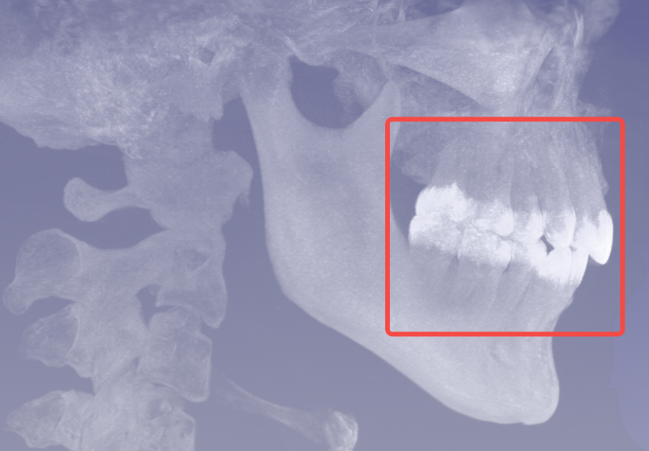
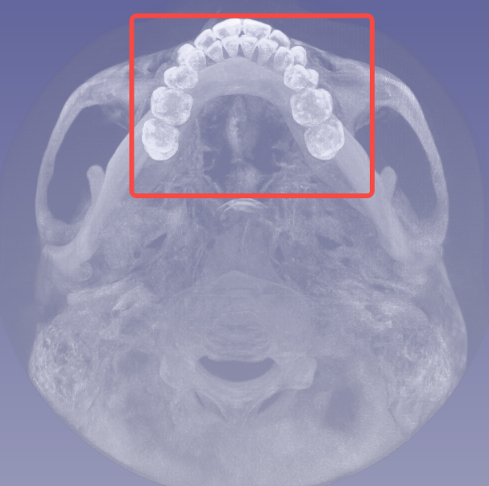
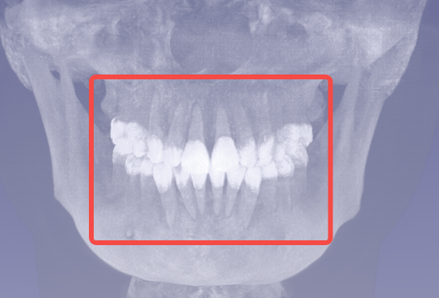
Notes:
Here are images demonstrating the tooth-region labels.

Slide 8
How to segment tooth?
A simple multi-class segmentation Unet would solve this problem
Pro: Simple
Cons:
Hard to distinguish different tooth In some scenarios
Cannot ultilize the instance information efficiently
Notes:
One we have cropped out the region with teeth in it, we then approach the teeth segmentation problem. Again, our intuition was to approach this as a multi-class semantic segmentation problem. but the challenge arises when we need to distinguish between individual teeth. In some cases, adjacent teeth can appear very similar in the scan, and the Unet struggles to separate them clearly. Additionally, this approach doesn’t make full use of the instance information, meaning the model may miss out on key details that would improve its accuracy

Slide 9
How to segment tooth?
It’s a typical instance segmentation task. We choose yolov8 as our framework.
The scenario is simple.
Pro: need no complicated postprocess to solve wrong outputs
Cons:
Takes lots of time on coding and debugging
The segmentation branch is weakier becasuse of computation limit
Notes:
If we disregard the dimension difference, this could be reduced to a typical instance segmentation task. For this, we decide to utilize the power of yolov8. The pros of this approach would be the pros of a mature instance segmentation algorithm, that is to so no complicated postprocesses are needed to solve wrong outputs. However, to adapt the existing code base to a higher dimension would require a lot of time. One more issue would remain that the segmentation branch will be weaker, because the computing power needed to scale from 2d to 3d is not trivial, and is thus limited.

Slide 10
How to segment tooth?
Replace 2D ops to 3D opts, like Conv, BN, ...
Extend 2D anchor assigner strategy to 3D

Slide 11
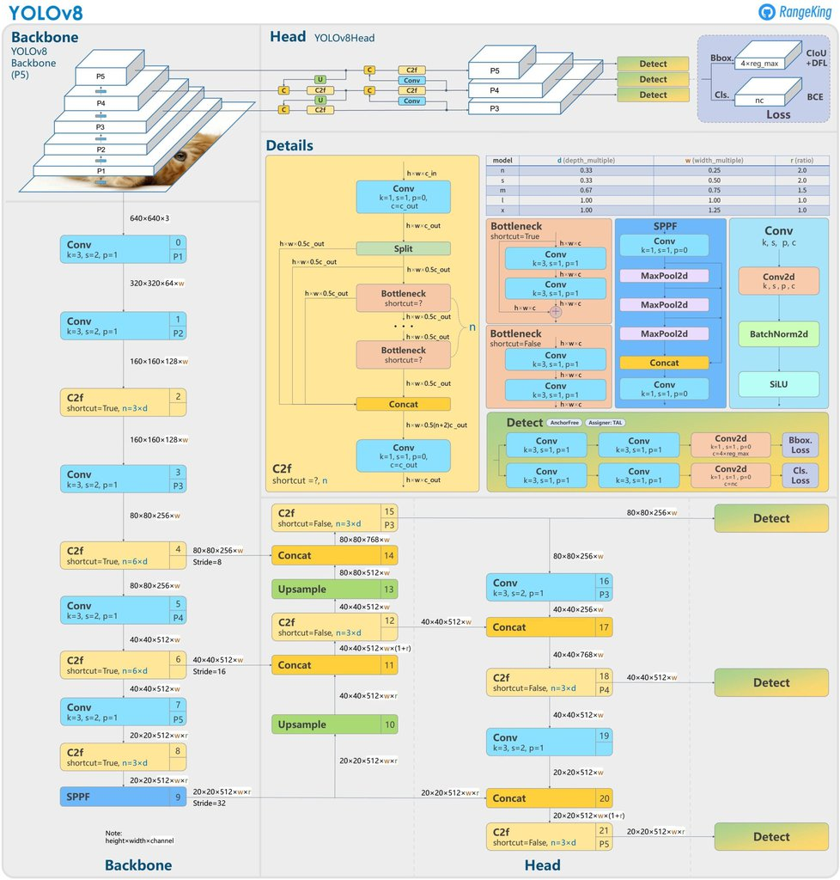
https://docs.ultralytics.com/models/yolov8/

Slide 12
How to refine tooth?
Simple Unet to refine tooth boundary
Input: Tooth patch and coarse prediction from YOLO
Output: Refined boundary
Notes:
"Once the individual teeth have been segmented, we need to refine their boundaries to ensure that the segmentation is as precise as possible. For this, we actually use a Unet-based approach, but with a specific focus on boundary refinement. The input to this model is a patch of the tooth, along with a coarse prediction generated from the earlier step—this could be a YOLO output, for example. The output is a finely detailed tooth boundary, which corrects any inaccuracies or coarse predictions from the earlier segmentation. By narrowing the focus to each tooth patch and using the coarse prediction as a starting point, the Unet is able to refine the details, giving us a highly accurate segmentation. This is crucial for applications where precise tooth boundaries are needed, such as orthodontics or dental surgery planning."

Slide 13
Pesudo-Label
we use annotated samples to train previous models, then inference unannotated samples
Merge 100 better samples with pesudo-label into training dataset
train models with pesudo-label for better generalization
Notes:
"In order to further improve the generalization of our model, we employ a technique known as pseudo-labeling. Here’s how it works: first, we train our model on a set of fully annotated, labeled samples. Once the model is trained, we use it to make predictions on a set of unannotated samples—these are scans where we don’t have the ground truth labels. From these predictions, we select the 100 best-performing samples, meaning the ones where the model’s predictions were the most accurate. We then merge these pseudo-labeled samples back into the training dataset. By training the model again on this expanded dataset, which now includes both real and pseudo-labeled data, we can improve its generalization, helping it perform better on new, unseen cases. This method allows us to leverage unannotated data more effectively and build a more robust model."

Slide 14
Thank you for listening!
Notes:
"To summarize, our approach to precision tooth segmentation in CBCT images involves several key steps: first, localizing the teeth region using simple segmentation methods like Unet or object detection techniques like YOLO; second, segmenting individual teeth using 3D operations to improve accuracy; and finally, refining the boundaries of each tooth for high-precision results. We also leverage pseudo-labeling to enhance the generalization of our model, making it more effective on a wider range of cases. Going forward, we plan to scale our model by training it on larger datasets and exploring more advanced 3D strategies. This will help us continue improving the accuracy and efficiency of tooth segmentation in CBCT scans. Thank you all for your attention, and I’m happy to take any questions."

