Slide 1





Coarse-to-Fine Pseudo Annotations for
Semi-supervised Teeth Segmentation
Xu Shi¹, Shengyin Yang², Jiacheng Wang^{3✉}, and Wentai Hou^{4✉}
¹The Affiliated Stomatological Hospital of Kunming Medical University, Yunnan Provincial Stomatology Hospital, Kunming 650032, China
²The First Dental Clinic of The Affiliated Stomatological Hospital of Kunming Medical University,
Yunnan Provincial Stomatology Hospital, Kunming 650231, China
³Manteia Technologies, Co., Ltd., Xiamen 361005, China
⁴The Third Affiliated Hospital of Kunming Medical University, Yunnan Cancer Hospital, Kunming 650118, China
jiachengw@manteia.com;houwentai@fudan.edu.cn
Notes:
Hello everyone, my name is Xu Shi. I come from The Affiliated Stomatological Hospital of Kunming Medical University. We are honored that our research team won the runner-up in the MICCAI STS2024 CBCT track. Our research project is Coarse-to-Fine Pseudo Annotations for Semi-supervised Teeth Segmentation. My teammates including Dr. Yang from The First Dental Clinic of The Affiliated Stomatological Hospital of Kunming Medical University. Dr. Wang from Manteia Technologies. And Dr. Hou from Yunnan Cancer Hospital.

Slide 2
I. Introduction
Notes:
first I will brefily introduce our work.

Slide 3

Introduction
Method
Experiments
Conclusion
A. Background
· 3D-CBCT
3D Cone-Beam Computed Tomography (CBCT) is a radiographic imaging technique that provides three-dimensional visualization of dental and maxillofacial structures, allowing for enhanced diagnostic accuracy and treatment planning.
· Semi-supervised learning
Semi-supervised learning is a machine learning method that combines a small amount of labeled data with a large amount of unlabeled data for training. This approach is particularly suitable for situations where obtaining labeled data is costly or difficult.
[1] https://www.codabench.org/competitions/3025/#/pages-tab.
[2] Bayome M, Park J H, Kim Y J, et al. 3D analysis and clinical applications of CBCT images[C]//Seminars in Orthodontics. WB Saunders, 2015, 21(4): 254-262.
[3] Zhou Z H, Zhou Z H. Semi-supervised learning[J]. Machine Learning, 2021: 315-341.
Notes:
Computer-aided diagnosis tools are becoming increasingly integral in modern dental practice, particularly for tasks like treatment planning and comprehensive prognosis evaluation. Among these tools, 2D panoramic X-ray imaging and 3D cone-beam computed tomography (CBCT) are effective methods for identi_x0002_fying conditions like invisible caries, impacted teeth, and supernumerary teeth in children. However, one of the main challenges is that manually identifying and annotating teeth in these images is time-consuming and labor-intensive. This results in a limited number of labeled datasets, which hampers the development of accurate deep-learning algorithms for automatic teeth segmentation and disease analysis. Semi-supervised learning has emerged as a promising alternative, as it can extract valuable information from unlabeled data to overcome this limitation. Despite its potential, significant challenges remain in optimizing these algorithms due to the scarcity of labeled cases and the complexity of dental image structures.

Slide 4
Introduction
Method
Experiments
Conclusion
B. Our Contribution
01
02
Our method achieved an average Dice score of 90.40% for the teeth segmentation on the validation set using a NVIDIA GeForce RTX 4090 Ti. The average running time was 13 seconds per image. The code will be available at
http://github.com/jcwang123
In this work, we propose a semi-supervised approach to teeth instance segmentation that leverages a small amount of labeled data alongside a larger, unlabeled dataset, which is called Coarse-to-Fine Pseudo annotations (CFP).
Competitive Performance
Novel Learning Framework
Notes:
In this project, we have two main contributions, including: 。。。 and 。。。 On the one hand
On the other hand

Slide 5
II. Method
Notes:
Next, I will introduce our method in detail.

Slide 6
Introduction
Method
Experiments
Conclusion
A. Pre-processing
· Data cleaning
Outliers or corrupted samples are removed or corrected to enhance the quality of the data, including the small teeth with pixels less than 36.
· Resampling
In the first stage of our pipeline, we resample the images to a uniform spacing of 0.47 mm, which is sufficient for coarse localization. In the second stage, we use a finer resampling resolution of 0.25 mm to capture detailed tooth structures and perform accurate segmentation.
· Normalization
We standardize the intensity values across the dataset by applying z-score normalization, where the intensity values are normalized based on the mean and standard deviation of the dataset.
· Data augmentation
Augmentation techniques such as rotation, flipping, and scaling are also employed to enhance model robustness and prevent overfitting.
Notes:
During the preprocessing stage:
First-Before model training, we perform data cleaning and statistical analysis to ensure the dataset’s consistency. This includes analyzing key characteristics such as the size, shape, and grey values of the teeth regions across the dataset. Outliers or corrupted samples are removed or corrected to enhance the quality of the data, including the small teeth with pixels less than 36.
Second-Since dental images often have anisotropic spacing, we apply resampling to normalize the voxel spacing across all images. In the first stage of our
pipeline, we resample the images to a uniform spacing of 0.47 mm, which is sufficient for coarse localization. In the second stage, we use a finer resampling resolution of 0.25 mm to capture detailed tooth structures and perform accurate segmentation.
Third-Intensity normalization is applied to ensure consistency in image brightness and contrast. We standardize the intensity values across the dataset
by applying z-score normalization, where the intensity values are normalized based on the mean and standard deviation of the dataset. This helps reduce variability due to different imaging conditions and improves model generalization.
Finally, -Additional preprocessing steps include cropping the region of interest (ROI) to focus on the dental area and reducing unnecessary background information. Augmentation techniques such as rotation, flipping, and scaling are also employed to enhance model robustness and prevent overfitting.

Slide 7
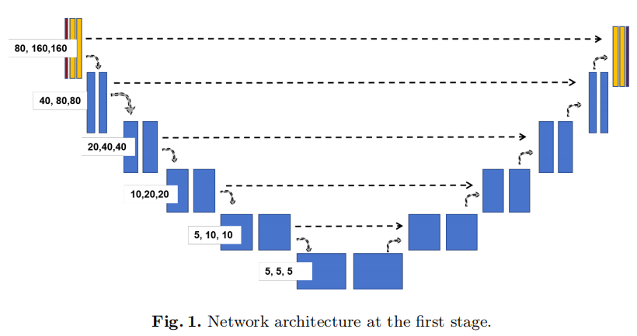
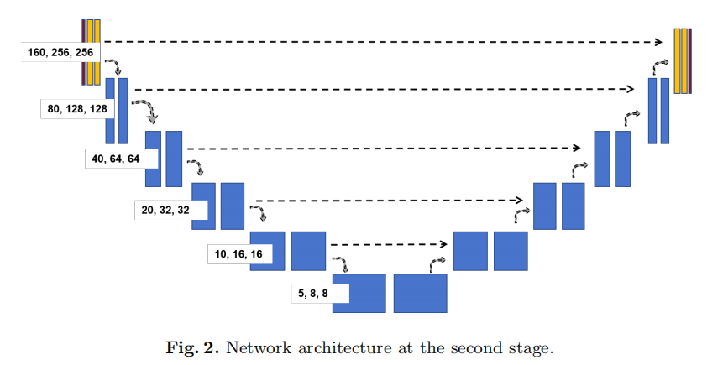
Introduction
Method
Experiments
Conclusion
B. Network Architecture
Notes:
Fig. 1 and Fig. 2 shows a typical example of 3D nnU-Net. In our modified version of the 3D nnU-Net, we replace the standard convolutional blocks with
residual convolutional modules. These residual blocks, first introduced in ResNet, consist of shortcut connections that bypass one or more convolutional layers. The key advantage of using residual modules is that they help mitigate the vanishing gradient problem, allowing the network to train deeper layers more effectively. This architecture change enables the model to learn more complex features while maintaining efficient gradient flow during training.
Each residual block in our modified nnU-Net contains: Two 3D convolutional layers, each followed by batch normalization and ReLU activation. A skip connection that directly adds the input to the output of the second convolution layer, effectively creating a residual mapping. By incorporating these residual blocks, the network can capture more refined features with better generalization and training stability, especially for the fine segmentation tasks required in dental imaging. This modification improves segmentation accuracy while preserving the flexibility and automated configuration capabilities of the original nnU-Net framework.
We use the summation between Dice loss and cross-entropy loss because compound loss functions have been proven to be robust in various medical image segmentation tasks.
After training the second-stage model, which performs teeth segmentation, we apply this model to the unlabeled images. The predictions from this stage
are treated as pseudo-labels. These pseudo-labels provide initial estimates of the tooth regions, which include rough segmentation boundaries and tooth IDs. To ensure the quality of the pseudo-labels, we perform confidence-based filtering. Predictions with high confidence scores are retained as reliable pseudo-labels, while low-confidence areas are either refined or discarded. This helps reduce the impact of noisy or incorrect predictions on the second-stage training. The second_x0002_stage model focuses on fine-grained segmentation and tooth classification. We use the high-confidence pseudo-labels from the first stage as training data for the second stage. This model performs detailed tooth segmentation and assigns tooth IDs more accurately, based on the refined input regions.

Slide 8
Introduction
Method
Experiments
Conclusion
C. Post-processing
· connected component analysis
After segmentation, we use connected component analysis to identify and remove small, isolated regions that are likely false positives. This technique groups connected pixels or voxels into distinct components. Components smaller than a predefined size threshold are eliminated, as they are typically noise or irrelevant structures. This step ensures that only valid tooth regions remain in the finaloutput, improving segmentation precision.
· Testing-time augmentation
We also apply testing-time augmentation (TTA) to improve the robustness of the final segmentation. The input images are augmented using transformations like rotations, flips, and scaling, and the model predicts segmentations for each augmented version. The final segmentation output is then obtained by averaging or voting across the augmented predictions. TTA helps reduce variability due to different orientations or scales, yielding a more reliable result.
Notes:
Our learning framework also includes two post-processing operations.

Slide 9
III. Experiments
Notes:
We conduced extensive experiments to evaluate our network, including Quantitative evaluation and Qualitative results.

Slide 10
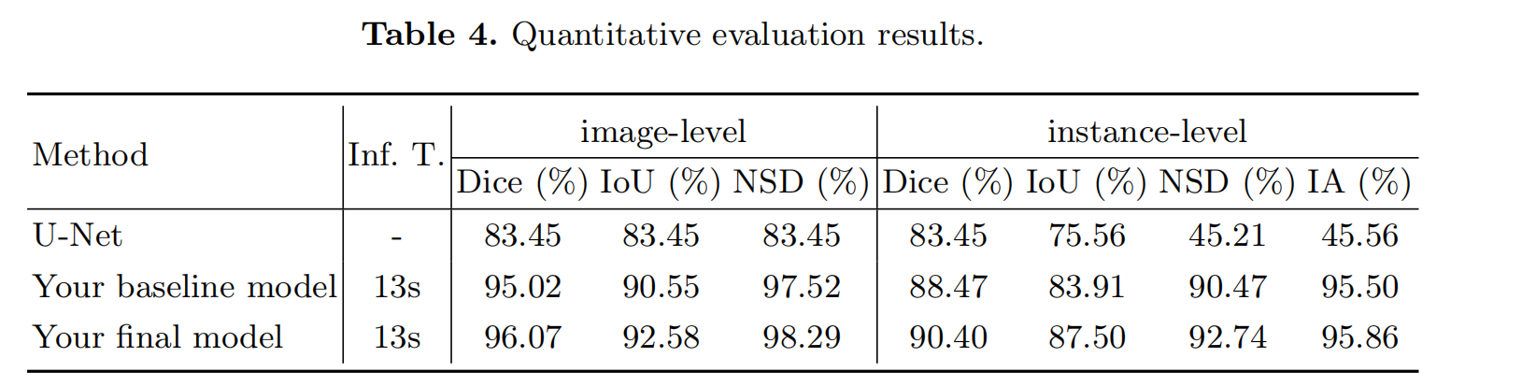
Introduction
Method
Experiments
Conclusion
A. Quantitative evaluation
Notes:
Using the unlabelled cases can slightly improve the performance. The main challenges lie in the choice of the training epochs on the combined dataset. It is noticed that in cases with incomplete anatomical structures, models are more likely to predict wrong teeth IDs.

Slide 11
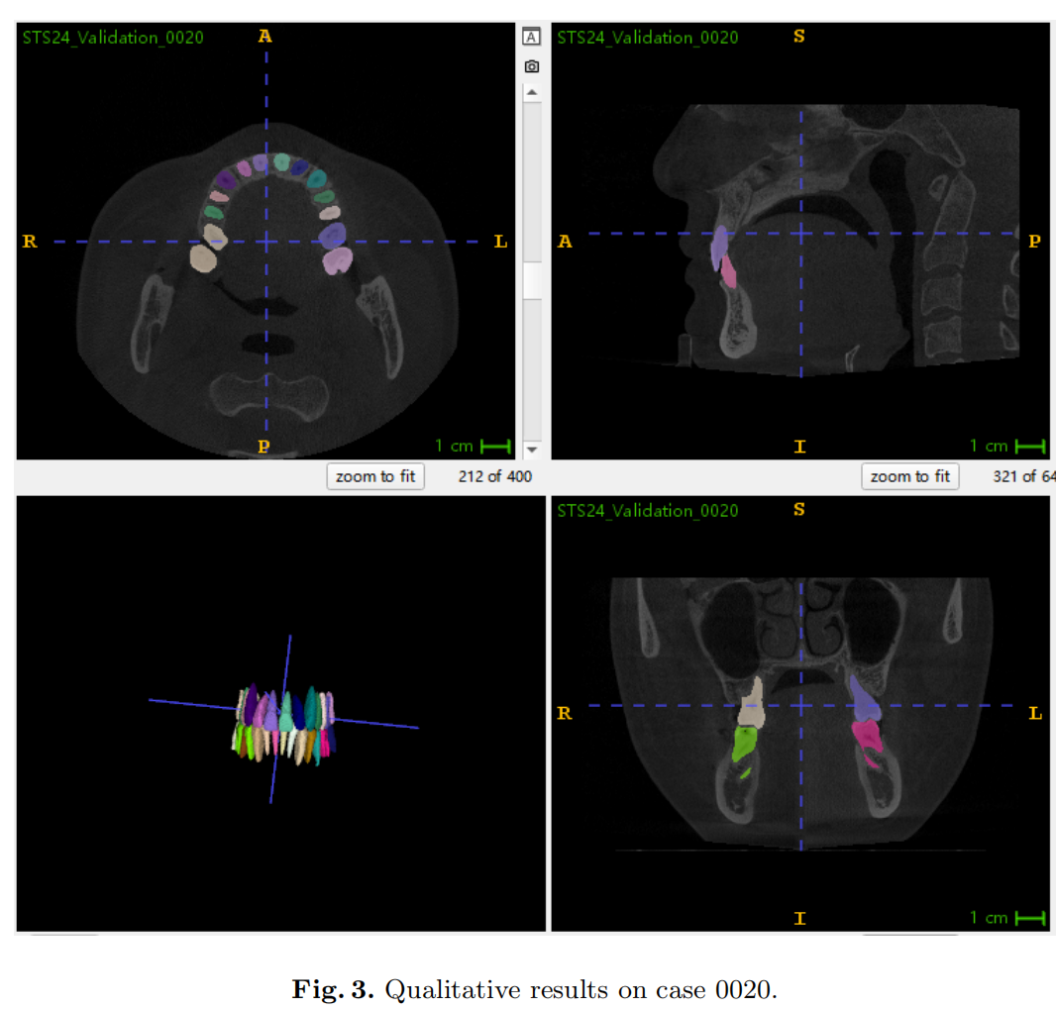
Introduction
Method
Experiments
Conclusion
C. Qualitative results
Notes:
In case 0020 in Fig. 3, most teeth can be correctly segmented and classified.

Slide 12
Q&A
Notes:
In this work, we have presented a semi-supervised learning method based on coarse-to-fine pseudo annotations. We test the method on a public challenge dataset. The results of the official validation set have indicated the improvements. However, most failure cases are wrongly classified and are hard to predict correctly after training on the pseudo annotations. The use of pseudo-labels mainly contributes to the improvement of segmentation metrics.
That’s all! Thanks for your listening! If you have any question, please feel free to contact us!

