Slide 1

Multi-stage dental visual detection based on
YOLOv8: Dental 3D CBCT
Team members：Dongdong Ma、Zhihao Zheng、Lian He、Jianhao Liu
Team name：madongdong

Slide 2

Outline
Abstract
Related Works
Method
Experiment
References

Slide 3
Abstract
Panoramic X-ray imaging (PXI) and cone beam computed tomography (CBCT) are becoming increasingly popular in dental treatment, increasing the demand for effective tooth segmentation. Although two-dimensional panoramic X-rays can de- tect hidden caries, three-dimensional CBCT has more advantages in orthodontic and endodontic treatment due to its low radiation and accurate three-dimensional images. However, the use of three-dimensional images faces challenges such as difficult data acquisition, radiation exposure, and metal artifacts. Tooth segmenta-ion still requires meticulous manual annotation, which is time-consuming and erro-rprone.
To this end, STS MICCAI 2024 held a 3D tooth segmentation challenge to ex- plore algorithms based on semi-supervised learning, aiming to reduce dependence on large amounts of labeled data and use unlabeled data for training. In the end, our team combined YOLOv8 with semi-supervised learning methods and obtained a validation set score of 0.77 in this competition, ranking 8th, and a test set score of 0.77.。

Slide 4
Related Works
Based on traditional method
Traditional methods rely on manually extracted geometric features. Although they provide basic boundary recognition, they have limitations in noise processing and automation.
Deep learning based methods
Deep learning still requires a large amount of labeled data and may be sensitive to specific conditions.
Point cloud based methods
Point cloud methods use 3D scanning data to process complex shapes more accurately, but still need to solve the problems of computational efficiency and data sparsity.
Multi-stage approach
The multi-stage method combines traditional techniques and deep learning, which improves accuracy but also increases model complexity and computational cost.
These methods have their own advantages and disadvantages, providing diverse solutions for 3D tooth instance segmentation.

Slide 5
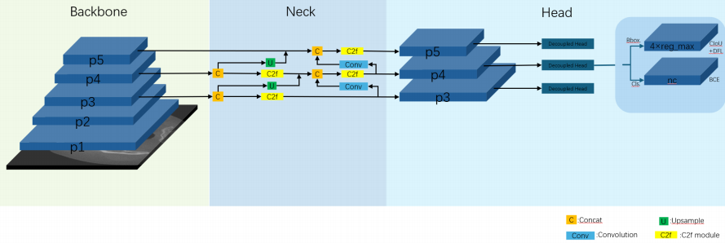
Method
YOLOv8 Architecture
YOLOv8 is the next major update of YOLOv5, which Ultralytics open-sourced on January 10, 2023, and currently supports image classification, object detection, and instance seg- mentation tasks. YOLOv8 builds on the success of previous YOLO versions and introdu-
ces new features and improvements to further improve performance and flexibility. It can run on a variety of hardware platforms from CPU to GPU.

Slide 6
Method
YOLOv8 achieves excellent detection accuracy while maintaining high speed and efficiency. The backbone architecture of YOLOv8 has been improved on the basis of YOLOv5, including the following key modifications:
1. Backbone & Neck: The backbone network and Neck part may refer to the design concept of YOLOv7 ELAN, replacing the C3 structure of YOLOv5 with the C2f structure with richer gradient flow, and adjusting the number of channels to improve the model performance.
2. Head: The Head part has been significantly changed compared to YOLOv5, replaced with the current mainstream decoupled head structure, separating the classification head and the detection head, and also changed from Anchor-Based to Anchor-Free.
3. Data enhancement: The data enhancement part of the training introduces the operation of turning off Mosiac augmentation in the last 10 epochs in YOLOX, which can effectively improve the accuracy.

Slide 7
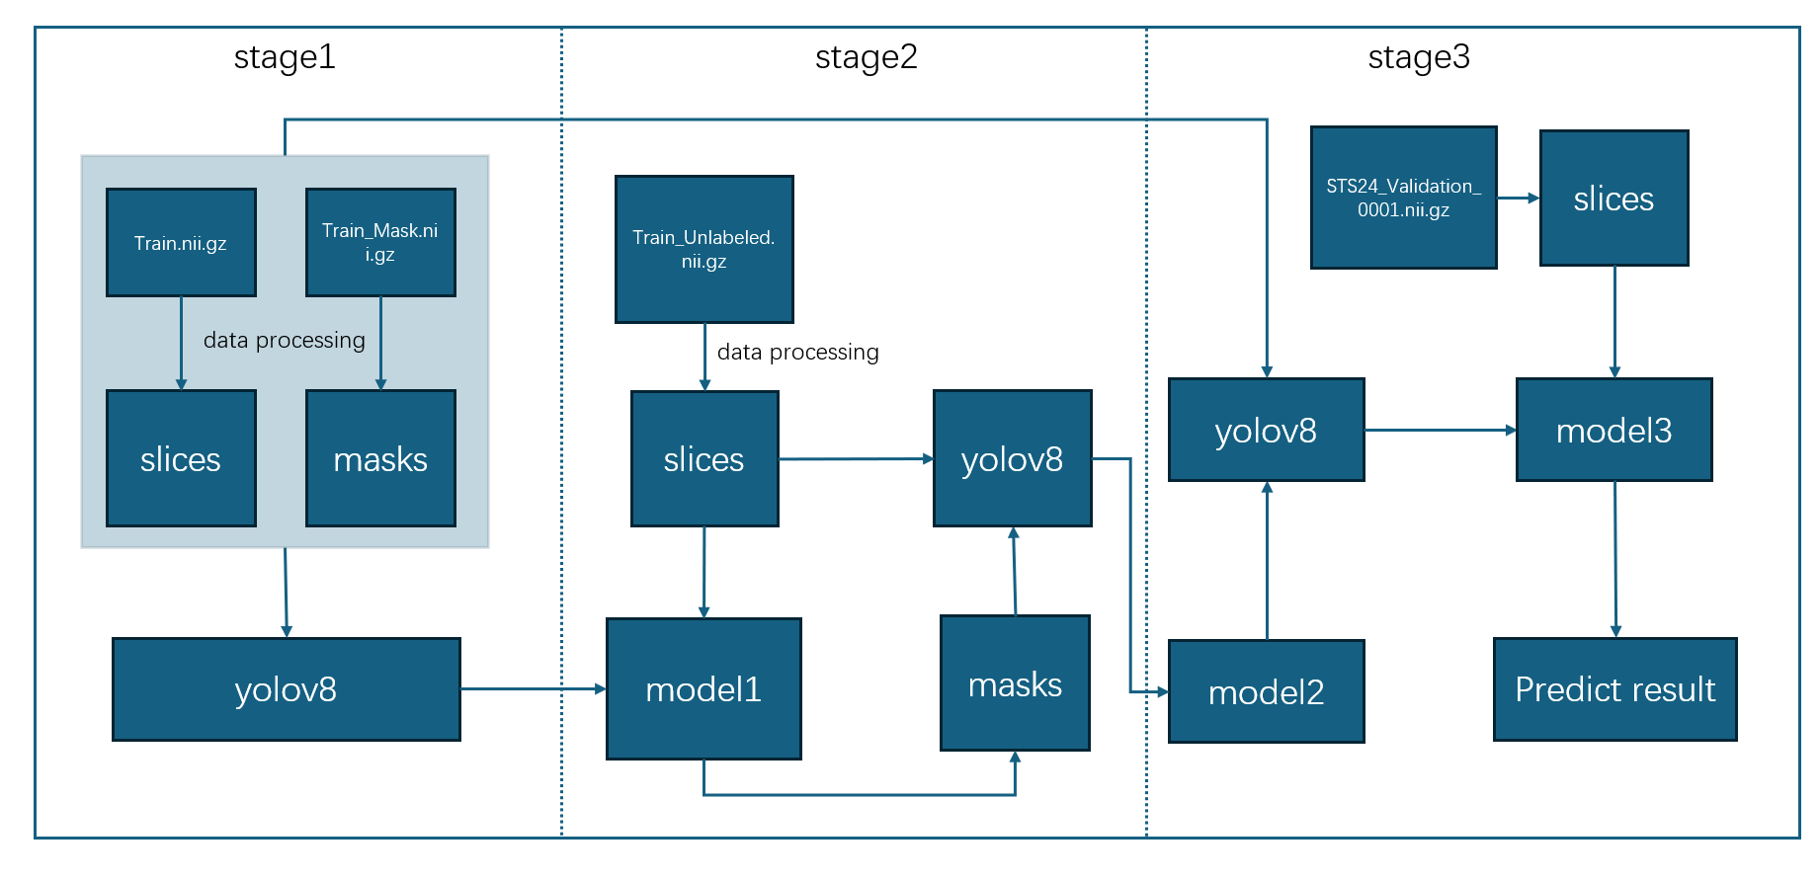
Method
2. Multi-stage training
Notes:
We first trained the labeled data in the training set to obtain Model 1, which has a certain predictive ability for dental data. Then, we used Model 1 to predict 300 unlabeled 3D CBCT sample data in the training set and obtained a large amount of pseudo labeled data. Then, we introduced a multi-stage learning method, which includes a rough training stage and a fine training stage. In the rough training phase, we reinitialized a new model and used 300 data points and their pseudo labels as input for the new model. After multiple iterations, we will obtain a rough training model weight model 2. Based on rough training of model weights, we collected high-quality training data from 30 labels for fine training to enable the model to learn better data distributions, and then obtained Model 3 for prediction.

Slide 8
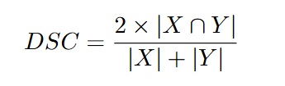
Experiment
1. Evaluation Metric
The Dice coefficient is a commonly used indicator to measure the segmentation quality in binary classification problems.
Wherein, X is the predicted segmentation result, Y is the ground truth, |X ∩ Y | represents the size of the intersection of X and Y , and |X| and |Y | represent the size of X and Y respectively.

Slide 9
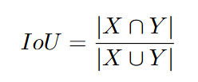
Experiment
1. Evaluation Metric
The intersection-over-union ratio is also called the Jaccard index, which is used to measure the overlap between the predicted segmentation result and the true annotation. The calculation formula is:
The definitions of X and Y are the same as those in the Dice coefficient.
Notes:
实施表明，仅使用这300个伪标签，在验证阶段提交验证结果后，我们就可以在比赛的综合评价指标上获得72%的分数。实验表明，经过精细训练阶段后，所获得的模型model3再次预测了验证集，得分为77%，提高了约6个百分点，验证了多阶段训练的有效性。

Slide 10
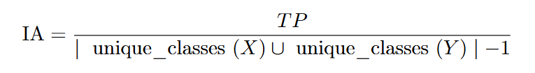
Experiment
1. Evaluation Metric
Normalized surface distance is a metric that measures the surface distance between the predicted segmentation result and the true annotation, and is usually used in conjunction with the Dice coefficient to tolerate a certain distance error. The calculation formula is:
Where, tolerance is the specified tolerance distance threshold.
Notes:
实施表明，仅使用这300个伪标签，在验证阶段提交验证结果后，我们就可以在比赛的综合评价指标上获得72%的分数。实验表明，经过精细训练阶段后，所获得的模型model3再次预测了验证集，得分为77%，提高了约6个百分点，验证了多阶段训练的有效性。

Slide 11
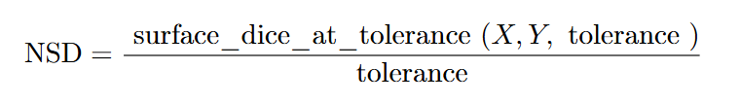
Experiment
1. Evaluation Metric
Instance accuracy is a metric that measures the quality of segmentation in instance segmentation tasks. It calculates the ratio of correctly classified instances with an intersection-over-union ratio greater than 0.5 to all instances:
Where T P is the number of correctly classified instances, unique_classes(X) and unique_classes(Y ) are the unique sets of classes in X and Y respectively.
Notes:
实施表明，仅使用这300个伪标签，在验证阶段提交验证结果后，我们就可以在比赛的综合评价指标上获得72%的分数。实验表明，经过精细训练阶段后，所获得的模型model3再次预测了验证集，得分为77%，提高了约6个百分点，验证了多阶段训练的有效性。

Slide 12
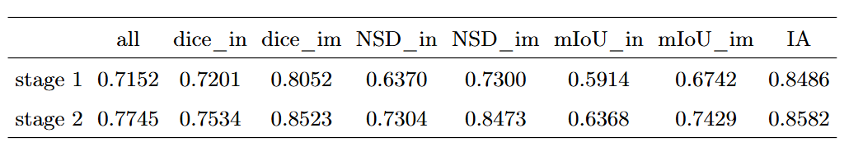
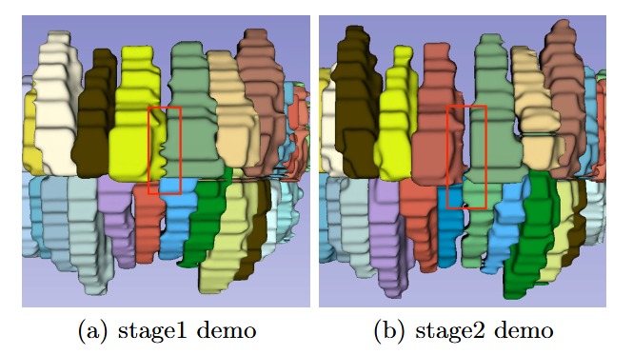
Experiment
2. Experiment result
This table shows the two prediction results obtained in the verification phase, where in stands for instance, im stands for image, IA stands for Identification Accuracy, stage 1 stands for the rough training phase, and stage 2 stands for the fine training phase.
Comparison of the results of the two stages
Notes:
The experiment shows that using only these 300 pseudo labels, after submitting the verification results during the verification phase, a score of 72% can be obtained on the comprehensive evaluation index of the competition. After a fine training phase, the obtained model Model 3 predicted the validation set again, scoring 77%, an improvement of about 6 percentage points, verifying the effectiveness of multi-stage training.

Slide 13
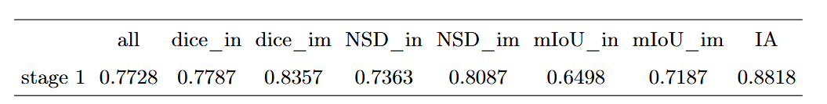
Experiment
2. Experiment result
This table is the predicted results obtained during the testing phase, and the predicted results are given by the competition officials

Slide 14
References
1. Zhao, M., Ma, L., Tan, W., & Nie, D. (2006). Interactive tooth segmentation of dental models. In IEEE Engineering in Medicine and Biology Conference (IMBC’06) (pp. 654–657) 2. Yuan, T., Liao, W., Dai, N., Cheng, X., & Yu, Q. (2010). Single-tooth modeling for 3D dental model 3. Sinthanayothin, C., & Tharanont, W. (2008). Orthodontics treatment simulation by teeth segmentation and setup. In International Conference on Electrical Engineering/Electronics, Computer, Telecommunications and Information Technology(ECTICON’08) (pp. 81–84) 4. Zou, B.-j., Liu, S.-j., Liao, S.-h., Ding, X., & Liang, Y. (2015). Interactive tooth partition of dental mesh base on tooth-target harmonic field. Computers in biology and medicine, 56, 132–144 5. Cui, Z., Li, C., & Wang, W. (2019). Toothnet: Automatic tooth instance segmentation and identification from cone beam ct images. In Proceedings of the IEEE/CVF Conference on Computer Vision and Pattern Recognition (pp. 6368–6377) 6. Rao, Y., Wang, Y., Meng, F., Pu, J., Sun, J., & Wang, Q. (2020). A symmetric fully convolutional residual network with dcrf for accurate tooth segmentation. IEEE Access, 8, 92028–92038 7. Lian, C., Wang, L., Wu, T.H., Liu, M., Durán, F., Ko, C.C., & Shen, D. (2019). Meshsnet: Deep multi-scale mesh feature learning for end-to-end tooth labeling on 3D dental surfaces. In Medical Image Computing and Computer Assisted Intervention – MICCAI 2019 (pp. 837–845). Springer. 8. Ashish, V., Noam, S., Niki, P., Jakob, U., Llion, J., Aidan N., G., Lukasz, K., & Illia, P. (2017) Attention is All You Need, Advances in neural information processing systems, 30: 5998-6008. 9. Zanjani, F. G., Moin, D. A., Verheij, B., Claessen, F., Cherici, T., Tan, T., et al. (2019). Deep Learning Approach to Semantic Segmentation in 3D Point Cloud Intra-oral Scans of Teeth. In International Conference on Medical Imaging with Deep Learning (MIDL). 10. Hao, J., Liao, W., Zhang, Y., Peng, J., Zhao, Z., Chen, Z., Zhou, B., Feng, Y.,Fang, B., Liu, Z., Zhao, Z. (2024). Toward clinically applicable 3-dimensional tooth segmentation via deep learning. Journal of Dental Research, 101(3), 304–311. 11. Jocher, G., Chaurasia, A., & Qiu, J. (2023). Ultralytics YOLO (Version 8.0.0)[Computer software]. https://github.com/ultralytics/ultralytics 12. Jocher, G. (2020). YOLOv5 by Ultralytics (Version 7.0) [Computer software]. https://doi.org/10.5281/zenodo.3908559

