Slide 1
MACHINE LEARNING MODEL DEPLOYMENT ON IBM CLOUD WATSON STUDIO
TEAM MEMBERS:
1.MATHAN.M
2.SENTHAMIL SELVAN.C
3.ARUN VISHVA.J.B
4.JAI PRAVEEN KUMAR S.V
5.DINESH.N
TITLE : Stock Market Prediction Using the Long Short-Term Memory Method

Slide 2
INTRODUCTION :
Watson Studio is one of the many services available under the Watson portfolio of IBM Cloud. It can be accessed from AI section of the catalog. The Lite plan which comes with a limit of 50 capacity unit-hours per month is free for developers. The plan includes single small compute environment with 1 vCPU and 4 GB RAM, which is good enough to experiment with the service.
Like most of the IBM Cloud services, we need to create an instance of Watson Studio which is associated with a specific billing plan and geographic location. As mentioned above, the Lite plan is a great way to explore the service.
Once the service instance is created, the next step is to create a project that acts as the logical container for the datasets, models, deployments, and API credentials. Each project type is pre-configured for a specific task typically performed by data scientists. The Standard type is a generic project for working on any type of asset. Each project may have additional collaborators with varying access levels.

Slide 3
Problem Definition:
The project involves training a machine learning model using IBM Cloud Watson Studio and deploying it as a web service. The goal is to become proficient in predictive analytics by creating a model that can predict outcomes in real-time. The project encompasses defining the predictive use case, selecting a suitable dataset, training a machine learning model,deploying the model as a web service, and integrating it into applications.
Design Thinking:
Predictive Use Case:
Define a use case for predictive analytics, such as predicting customer churn or product demand.

Slide 4
Dataset Selection:
Choose a relevant dataset to train the machine learning model.
Model Training:
Select a suitable machine learning algorithm and train the model using IBM Cloud Watson Studio.
Model Deployment:
the trained model as a web service using IBM Cloud Watson Studio’s deployment capabilities.
Integration:
Integrate the deployed model into applications or systems to make realtime predictions.

Slide 5
Learning Objectives
we will learn about the best ways possible to predict stock prices using a long-short-term memory (LSTM) for time series forecasting.
We will learn everything about stock market prediction using LSTM.
predictive use case
In businesses, maintaining cost plays an essential role in increasing revenue. It is difficult for an organization with a significant investment in equipment and infrastructure to manage capital outlay.
By analyzing the insights and metrics of the maintenance cycle of technical equipment, companies can set timelines for maintenance events and upcoming expenditure requirements by streamlining the maintenance cost and downtime. You can simplify your maintenance costs by performing actions that can increase the lifespan of your equipment.
Commonly, most systems become inoperable during maintenance. Predictive analytics use cases will help you with the best time to perform maintenance to avoid lost revenue and dissatisfied customers.

Slide 6
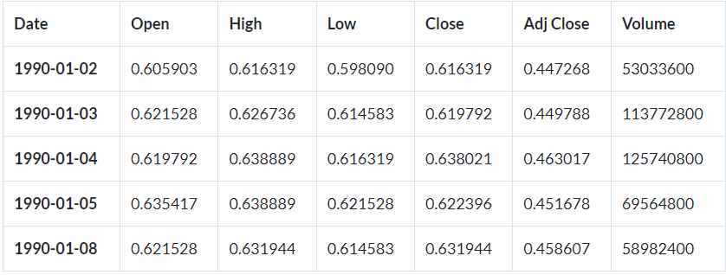
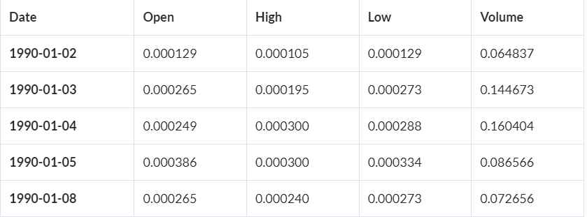
dataset selection

Slide 7
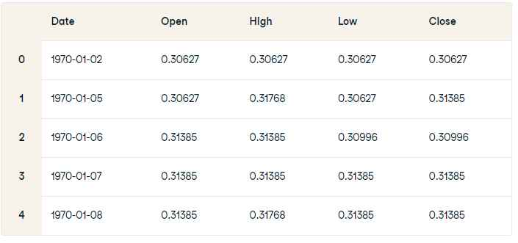

Slide 8
Building the model
In the neural network model, a LSTM with 50 input neurons and add a Dropout layer with forty percent ignorance viz 20 neurons will be ignored during training for regularization.
For the second and the third layer the model mimics the input layer with the same parameters thereby creating a stacked LSTM.
Building the model
The next layer is the output layer with one neuron. The output is computed based on an optimizer and loss function. The optimizer used is the ADAM or the Adaptive Moment Estimation optimizer provided in Equations 3 and 4.

Slide 9
Deployment process
Data Collection: Gather historical stock market data, including price and volume information. You can obtain this data from financial data providers, APIs, or websites.
Data Preprocessing: Clean and preprocess the data. This may involve handling missing values, normalizing data, and creating features that the LSTM model will use for prediction.
Model Development: Build and train an LSTM model using a deep learning framework like TensorFlow or PyTorch. Ensure you have a suitable architecture for time series prediction, including input sequences and target variables
Model Evaluation: Assess the model's performance on a validation dataset. Common evaluation metrics for regression tasks like stock price prediction include Mean Absolute Error (MAE), Mean Squared Error (MSE), and Root Mean Squared Error (RMSE).
Hyperparameter Tuning: Optimize the model's hyperparameters, such as the number of LSTM layers, hidden units, learning rate, and batch size, to improve its performance.

Slide 10
Backtesting: Conduct backtesting to assess how the model would have performed on historical data. This helps in understanding its potential profitability.
Deployment: Once you have a trained and validated model, you can deploy it in a production environment. The deployment process can vary depending on your specific use case, but here are some common options:
Web Application: Integrate the model into a web application that allows users to input stock data and receive predictions.
API: Create an API that serves predictions when queried with relevant data.
Real-Time Data Feeds: For high-frequency trading, you might need to set up a system that continuously receives real-time data and makes predictions.
Cloud Services: Utilize cloud platforms like AWS, GCP, or Azure to deploy and manage your model.

Slide 11
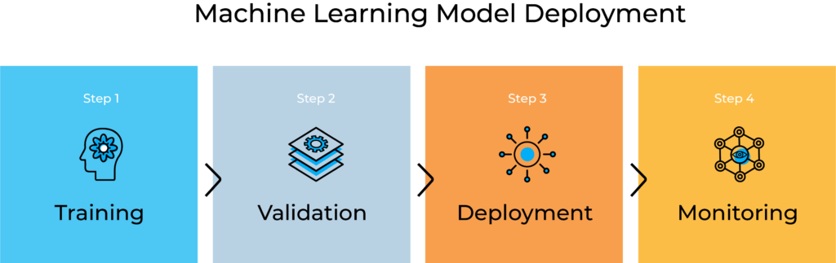

Slide 12
Conclusion
However, with the introduction of Machine Learning and its strong algorithms, the most recent market research and Stock Price Prediction using machine learning advancements have begun to include such approaches in analyzing stock market data. The Opening Value of the stock, the Highest and Lowest values of that stock on the same day, as well as the Closing Value at the end of the day are all indicated for each date. Furthermore, the total volume of the stocks in the market is provided; with this information, it is up to the job of a Machine Learning Data Scientist to look at the data and develop different algorithms that may help in finding appropriate stocks values.
Predicting the stock market was a time-consuming and laborious procedure a few years or even a decade ago. However, with the application of machine learning for stock market forecasts, the procedure has become much simpler. Machine learning not only saves time and resources but also outperforms people in terms of performance. it will always prefer to use a trained computer algorithm since it will advise you based only on facts, numbers, and data and will not factor in emotions or prejudice. It would be interesting to incorporate sentiment analysis on news & social media regarding the stock market in general, as well as a given stock of interest.

Slide 13


