Slide 1
Stock Market Prediction Using the Long Short-Term Memory Method
TEAM MEMBERS
DINESH.N
SENTHAMIL SELVAN.C
ARUN VISHVA.J.B
MATHAN.M
JAI PRAVEEN KUMAR.S.V

Slide 2
Introduction
Stock Market is a major factor that defines how successful a company is. Google, Apple and others are major players in the market and how these companies fare on the market can impact other companies.
So, how these companies do on the market in the future should be of great importance. This neural network attempts to do the same for Google's stock price from beginning of 2012 to the end of 2016 and predict upon data it has not been trained upon.
A specific kind of Neural Network called the Recurrent Neural Network has been used for the purpose. The RNN is a specially designed neural network that is used for time-series analysis viz., each layer predicts its output based on the output of the previous layer .

Slide 3
Methodology Used
This model consist of the following steps Step
Data Preparation The model will predict based on date and opening value. The opening value is the value the market opens at for that particular trade day. The data collected was normalized for values between 0 and 1 using Equation
xnew= x−xmin xmax−xmin
The scaled data is them recreated to a data structure with 40 and 60 time steps and 1 output which will be used as an input for the LSTM in which the output is decided by the previous 80 inputs and so on.
Then the data is reshaped based on three dimensions: number of stock prices, the number of time steps and the number of indicators.

Slide 4
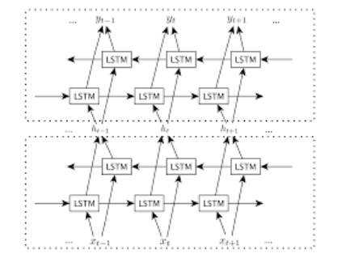
Building the model
In the neural network model, a LSTM with 50 input neurons and add a Dropout layer with forty percent ignorance viz 20 neurons will be ignored during training for regularization.
For the second and the third layer the model mimics the input layer with the same parameters thereby creating a stacked LSTM.
The next layer is the output layer with one neuron. The output is computed based on an optimizer and loss function. The optimizer used is the ADAM or the Adaptive Moment Estimation optimizer provided in Equations 3 and 4.
Fig. 1. Basic structure of a stacked LSTM.

Slide 5
Mt=β 1mt−1+(1−β 1)>¿
vt=β 2 vt−1+(1−β 2) g 2 t
where Mt is the first moment and vt is the second moment of the gradient and the loss function(error metric) used is Mean Squared Error (MSE).
Fitting the model
In this step data is fed to the, neural network and trained for prediction assigning random biases and weights
The output generated is compared with target values. The error obtained during each epoch is reduced through back propagation which adjusts the weights and biases of each neuron (node) present in the subsequent layers.

Slide 6
Why do you Need Time Series Models?
You would like to model stock prices correctly, so as a stock buyer you can reasonably decide when to buy stocks and when to sell them to make a profit.
This is where time series modelling comes in. You need good machine learning models that can look at the history of a sequence of data and correctly predict what the future elements of the sequence are going to be.
However, let's not go all the way believing that this is just a stochastic or random process and that there is no hope for machine learning.
Let's see if you can at least model the data, so that the predictions you make correlate with the actual behavior of the data.
In other words, you don't need the exact stock values of the future, but the stock price movements (that is, if it is going to rise of fall in the near future).

Slide 7
# Make sure that you have all these libaries available to run the code successfully
from pandas_datareader import data
import matplotlib.pyplot as plt
import pandas as pd
import datetime as dt
import urllib.request, json
import os
import numpy as np
import tensorflow as tf # This code has been tested with TensorFlow 1.6
from sklearn.preprocessing import MinMaxScaler

Slide 8
Downloading the Data
Alpha Vantage Stock API. Before you start, however, you will first need an API key, which you can obtain for freehere.
After that, you can assign that key to the api_keyvariable. In this tutorial, we will retrieve 20 years of historical data for the American Airlines stock.
As an optional reading, you may refer to this stock API starter guide
Use the data from this page. You will need to copy the Stocks folder in the zip file to your project home folder.
Stock prices come in several different flavors. They are
Open: Opening stock price of the day
Close: Closing stock price of the day
High: Highest stock price of the data
Low: Lowest stock price of the day

Slide 9
Getting Data from Kaggle
Data found on Kaggle is a collection of csv files and you don't have to do any preprocessing, so you can directly load the data into a Pandas DataFrame.
data_source = 'kaggle' # alphavantage or Kaggle
if data_source == 'alphavantage’:
# ====================== Loading Data from Alpha Vantage ==================================
api_key = '<your API key>' # American Airlines stock market prices ticker = "AAL“
# JSON file with all the stock market data for AAL from the last 20 years
url_string ="https://www.alphavantage.co/query?function=TIME_SERIES_DAILY&symbol=%s&outputsize=full&apikey=%s"%(ticker,api_key)
# Save data to this file
file_to_save = 'stock_market_data-%s.csv'%ticker

Slide 10
if not os.path.exists(file_to_save):
with urllib.request.urlopen(url_string) as url:
data = json.loads(url.read().decode())
# extract stock market data
data = data['Time Series (Daily)’]
df = pd.DataFrame(columns=['Date','Low','High','Close','Open']) for k,v in data.items():
date = dt.datetime.strptime(k, '%Y-%m-%d’)
data_row = [date.date(),float(v['3. low']),float(v['2. high']), float(v['4. close']),float(v['1. open'])]
df.loc[-1,:] = data_row
df.index = df.index + 1
print('Data saved to : %s'%file_to_save) df.to_csv(file_to_save)

Slide 11
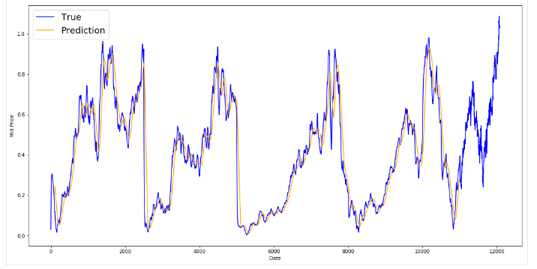
else: print('File already exists. Loading data from CSV') df = pd.read_csv(file_to_save)
else:
# ====================== Loading Data from Kaggle ==================================
# You will be using HP's data. Feel free to experiment with other data.
# But while doing so, be careful to have a large enough dataset and also pay attention to the data normalization
df = pd.read_csv(os.path.join('Stocks','hpq.us.txt'),delimiter=',',usecols=['Date','Open','High','Low','Close’])
print('Loaded data from the Kaggle repository')

Slide 12
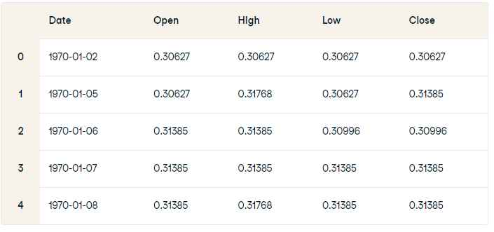
Data Exploration
Here you will print the data you collected in to the DataFrame. You should also make sure that the data is sorted by date, because the order of the data is crucial in time series modelling.
# Sort DataFrame by date
df = df.sort_values('Date')
# Double check the result
df.head()

Slide 13
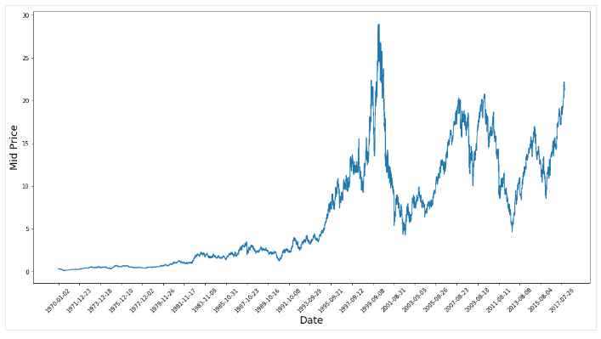
Data Visualization
Now let's see what sort of data you have. You want data with various patterns occurring over time.
plt.figure(figsize = (18,9))
plt.plot(range(df.shape[0]),(df['Low']+df['High'])/2.0)
plt.xticks(range(0,df.shape[0],500),df['Date'].loc[::500],rotation=45)
plt.xlabel('Date',fontsize=18)
plt.ylabel('Mid Price',fontsize=18)
plt.show()

Slide 14
Splitting Data into a Training set and a Test set
You will use the mid price calculated by taking the average of the highest and lowest recorded prices on a day.
# First calculate the mid prices from the highest and lowest
high_prices = df.loc[:,'High'].as_matrix()
low_prices = df.loc[:,'Low'].as_matrix()
mid_prices = (high_prices+low_prices)/2.0
Now you can split the training data and test data. The training data will be the first 11,000 data points of the time series and rest will be test data.
train_data = mid_prices[:11000]
test_data = mid_prices[11000:]

Slide 15
Conclusion
However, with the introduction of Machine Learning and its strong algorithms, the most recent market research and Stock Price Prediction using machine learning advancements have begun to include such approaches in analyzing stock market data. The Opening Value of the stock, the Highest and Lowest values of that stock on the same day, as well as the Closing Value at the end of the day are all indicated for each date. Furthermore, the total volume of the stocks in the market is provided; with this information, it is up to the job of a Machine Learning Data Scientist to look at the data and develop different algorithms that may help in finding appropriate stocks values.
Predicting the stock market was a time-consuming and laborious procedure a few years or even a decade ago. However, with the application of machine learning for stock market forecasts, the procedure has become much simpler. Machine learning not only saves time and resources but also outperforms people in terms of performance. it will always prefer to use a trained computer algorithm since it will advise you based only on facts, numbers, and data and will not factor in emotions or prejudice. It would be interesting to incorporate sentiment analysis on news & social media regarding the stock market in general, as well as a given stock of interest.

