Slide 1
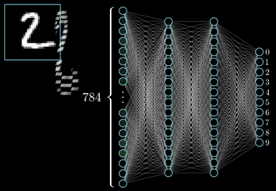

NeuralForge
A feedforward neural network engine built from scratch in Java
Name : Safwan Talukder Sindeed
Roll no. : 1720
Supervisor : Dr. Emon Kumar Dey
Course : Software Project Lab 1
Courtesy: 3Blue1Brown

Slide 2



Project Overview
The goal
The digit recognizer network
A complete feedforward neural network engine in Java, from matrices up to a working application.
From scratch
No machine learning libraries. Forward pass, backpropagation and training are all written by hand.
What it solves
Tabular data from CSV files (Iris) and handwritten digits (MNIST), with a drawing window.
784 pixels
128 neurons
10 digits
Simplified drawing: every neuron is connected to every neuron of the next layer

Slide 3



Methodology
Load and prepare data
Forward pass
Loss
Backward pass
Update weights
repeat for every mini-batch of 64 images, every epoch
Forward
Backward
Update and test
a = f(xW + b) in every layer. ReLU inside, Softmax at the end, cross-entropy as the loss.
The chain rule gives every gradient. Checked against numerical gradients.
w ← w − η · gradient (SGD). Accuracy is measured on unseen test data.

Slide 4
Implementation Progress
1
2
3
4
5
Foundation
Layers
Learning
Data
Application
Matrix class
Build scripts
Activations
Initializers
Dense layer Losses
Backpropagation
SGD
Gradient check
CSV pipeline
IDX reader
MNIST
Metrics
Save and load
Drawing window
Matrix tests passing
Forward pass works
XOR learned
Iris trained from a CSV
Demo working

Slide 5
Results
97.58%
MNIST test accuracy after 10 epochs
99.77%
top-3 accuracy: the right digit is almost always among the top three
93.3%
Iris test accuracy, 28 of 30 samples
784-128-10 network, SGD rate 0.1, batch 64, 60,000 train and 10,000 test images

Slide 6
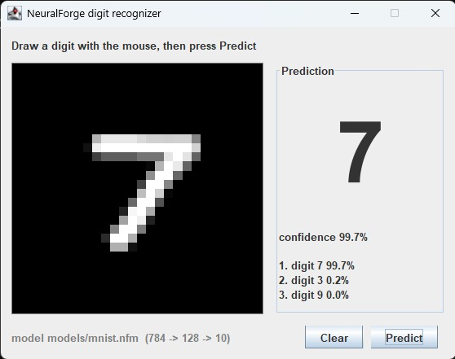
Live Demonstration
1
Run the tests
build.bat test 21 test classes
2
CSV pipeline on Iris
build.bat run iris load, split, scale, train
3
Evaluate the saved model
build.bat run eval confusion matrix
4
Draw a digit
build.bat run gui draw and predict
A 7 drawn with the mouse, read as 7 with 99.7% confidence

Slide 7
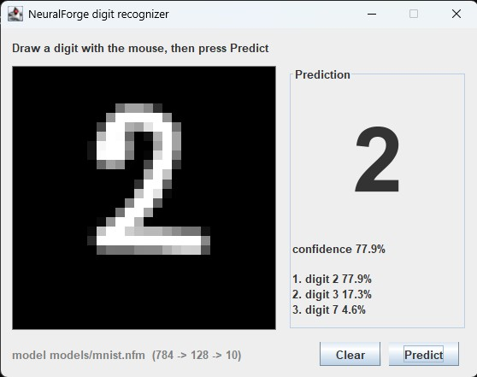
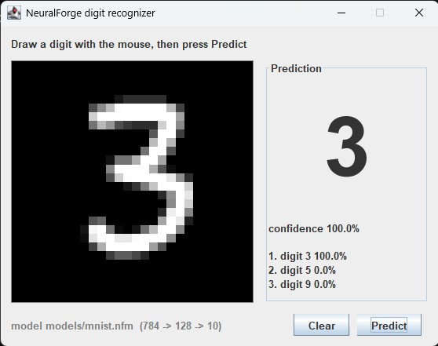
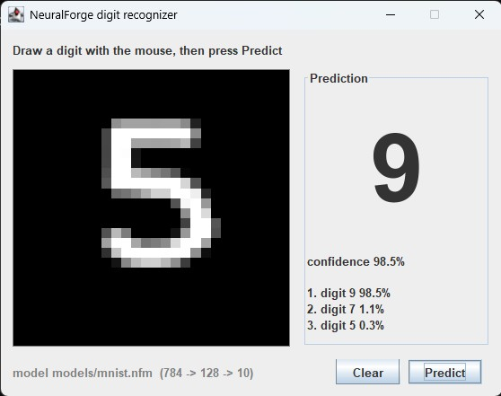
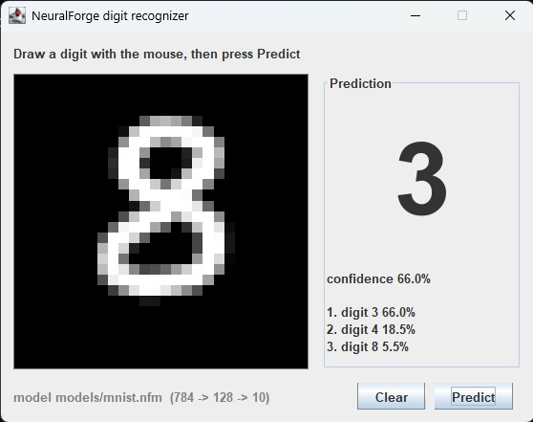
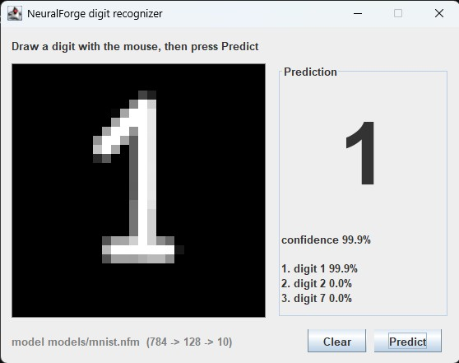
Predictions and Failure Cases

Slide 8



Remaining Work
Better training
Data and usability
Speed and delivery
• Optimizers: Momentum, RMSProp, Adam, decay
• Missing values, categories, auto task detection
• Performance and further MNIST tuning
• Regularization: L2, dropout, early stopping
• Config files and a CLI: train, predict, evaluate
• Test on 5 or more datasets, fix bugs
• Hyperparameter search with cross-validation
• GUI polish: centering, probability bars
• Docs, final report

Slide 9
Thank you

