Slide 1

LOG ANALYSIS

Slide 2
Objectives
Log analysis is an important function for monitoring and alerting, security policy compliance, auditing and regulatory compliance, security incident response and even forensic investigations.
Reduce Problem Diagnosis and Resolution Time. ...Benefits Reduce Customer Churn. . Improve Resource Usage & Production Infrastructure Costs. ... Better System Troubleshooting. ... Respond Better to Data Breaches and Other Cyber Security Incidents.

Slide 3
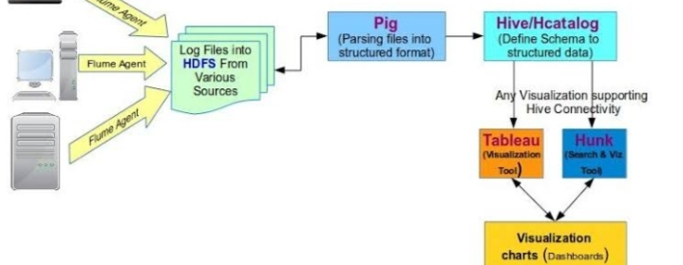
Architecture

