Slide 1
Hurricane Season:
An Historical Impact Analysis

Slide 2
Essential Questions:
How has hurricane season changed over the last 30 years?
Frequency of storms?
Intensity of storms?
What are some of the climatological changes which can be correlated with changes in hurricane statistics?
Ocean temperature?
Surface/land temperature?
Atmospheric CO2 concentrations?
What are the changing human impacts of hurricane season?
Number of hurricanes making landfall?
Number of hurricane related disaster declarations?

Slide 3
Methodology:
Data from Hurdat2 Database was filtered to isolate each storm from 1991-2020.
Each storm was analyzed for number of landfalls, and maximum recorded category rating (based on Saffir-Simpson Hurricane Wind Scale).
NOAA ocean temperature data was then appended to the dataset for the year of each storm.
NASA derived data from global-warming.org was appended to the dataset for land surface temperature and atmospheric CO2 levels.
FEMA data was filtered for number of hurricane-related disaster declarations per year measured.
Storms were compared over time for percentage of storms which made landfall vs. storms which made no landfall

Slide 4
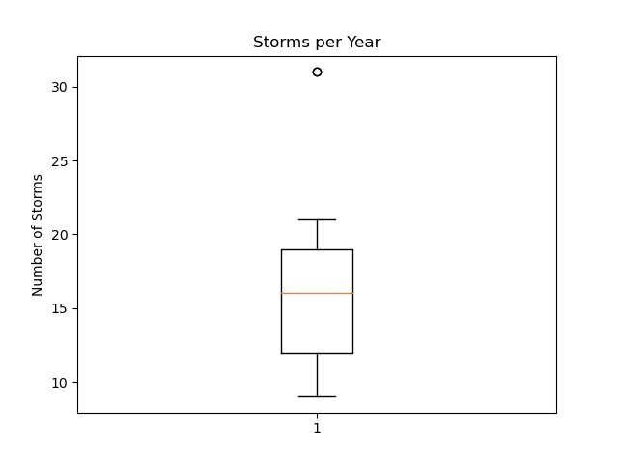
Storms Per Year (distribution)
Outlier years: 2005, 2020
Notes:
Mean 16.23 storms per year, Standard Deviation of 5.5, Outlier Years: 2005, 2020 – 31 each year

Slide 5
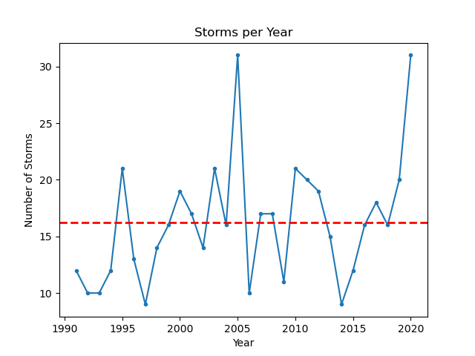
Section 1: Characterizing the Hurricane Seasons

Slide 6
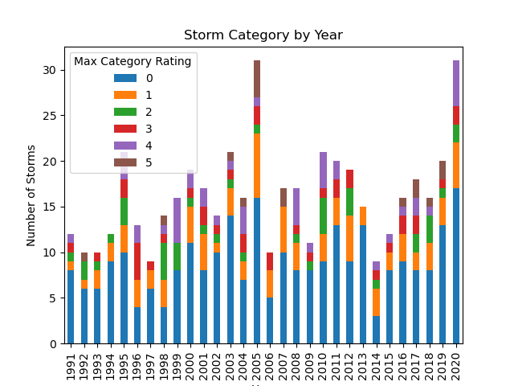
Section 1: Characterizing the Hurricane Seasons

Slide 7
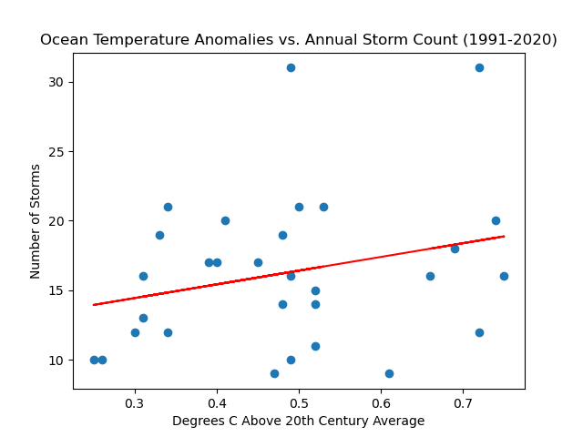
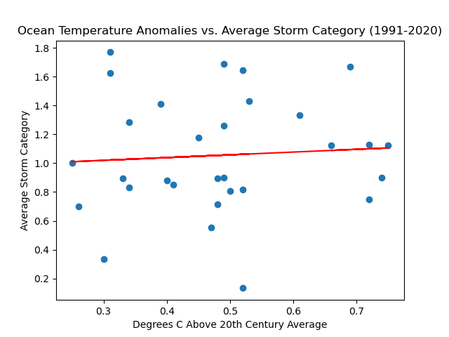
Section 2: Climatological impact: Ocean Surface Temperature
Sources: NOAA Hurdat2 Dataset (https://www.nhc.noaa.gov/data/), NOAA Global Time Series (https://www.ncei.noaa.gov/access/monitoring/climate-at-a-glance/global/time-series/globe/land_ocean)
Sources: NOAA Hurdat2 Dataset (https://www.nhc.noaa.gov/data/), NOAA Global Time Series (https://www.ncei.noaa.gov/access/monitoring/climate-at-a-glance/global/time-series/globe/land_ocean)
Notes:
First graph: R2 = 7% Second Graph: R2 = 0.49%

Slide 8
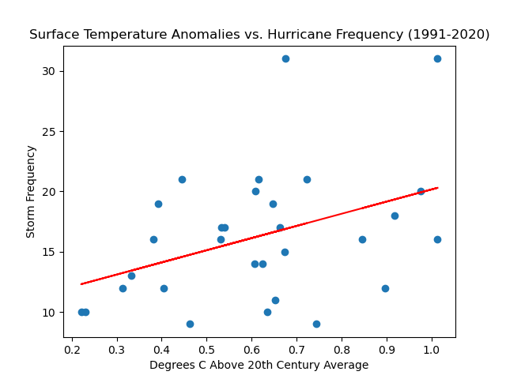
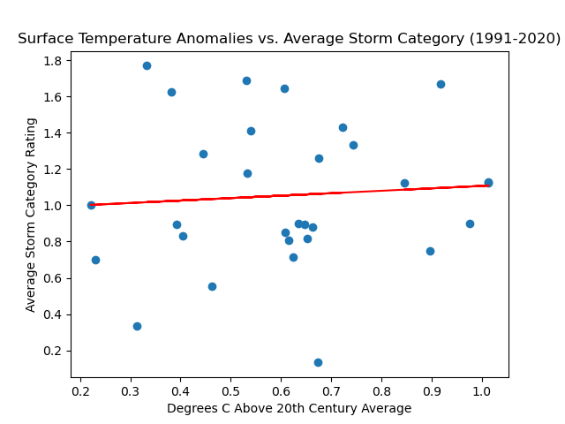
Section 2: Climatological impact: Land Surface Temperature
Sources: NOAA Hurdat2 Dataset (https://www.nhc.noaa.gov/data/), Global-Warming.org (https://global-warming.org/)
Sources: NOAA Hurdat2 Dataset (https://www.nhc.noaa.gov/data/), Global-Warming.org (https://global-warming.org/)
Notes:
First graph: R2 = 16.3% Second Graph: R2 = 0.54%

Slide 9
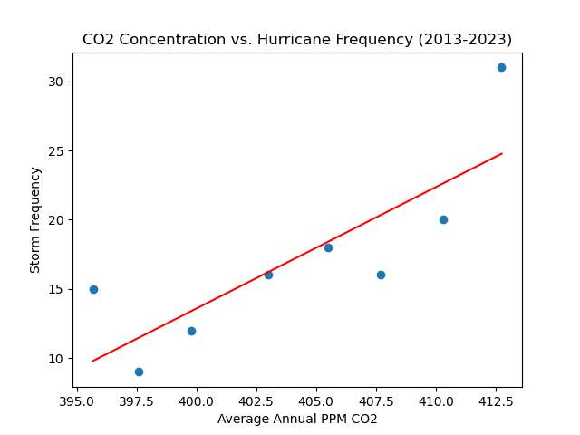
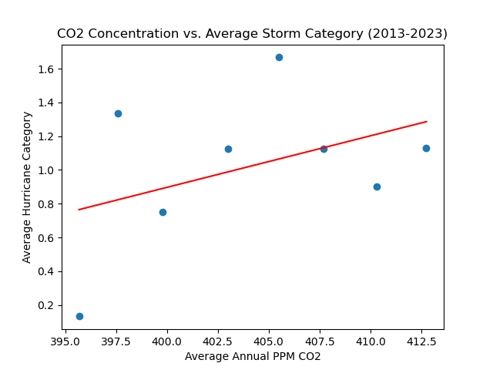
Section 2: Climatological impact: Atmospheric CO2 Concentration
Sources: NOAA Hurdat2 Dataset (https://www.nhc.noaa.gov/data/), Global-Warming.org (https://global-warming.org/)
Sources: NOAA Hurdat2 Dataset (https://www.nhc.noaa.gov/data/), Global-Warming.org (https://global-warming.org/)
Notes:
First graph: R2 = 66.8% Second Graph: R2 = 17.1%

Slide 10
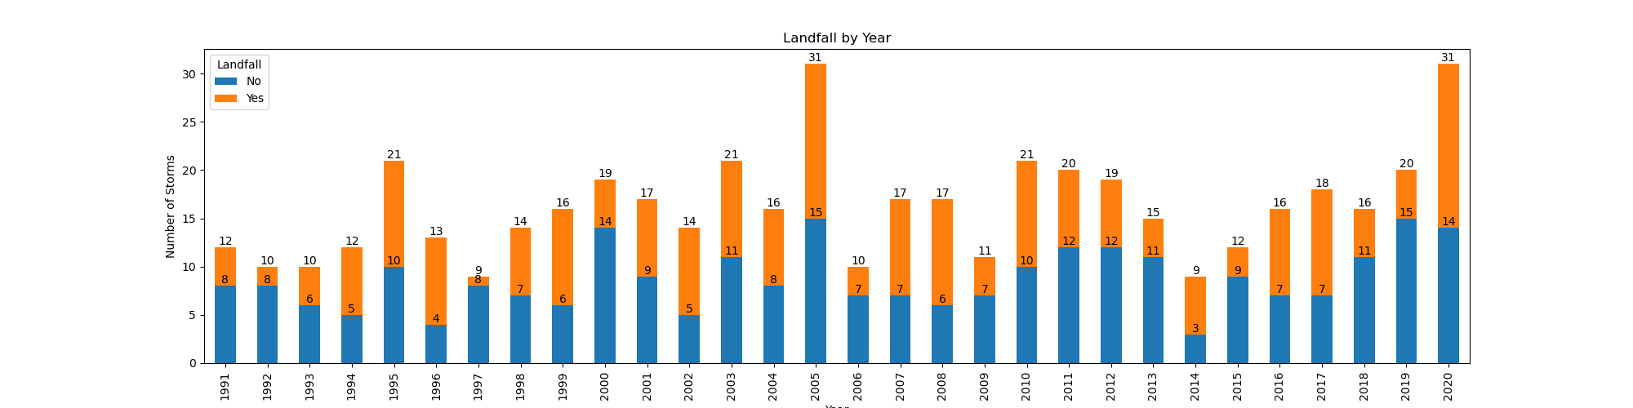
Section 3: Human Impact: Landfall vs. Non-Landfall Hurricanes

Slide 11
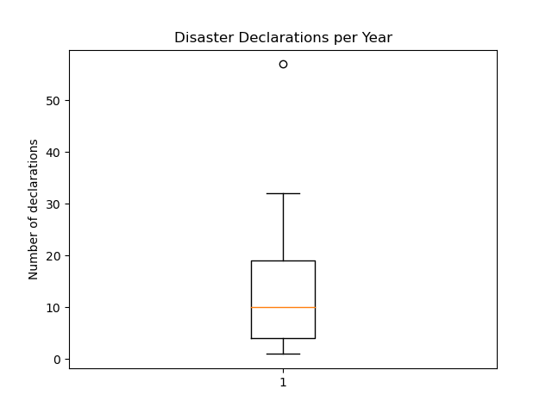
Disaster Declarations per Year (distribution)
Outlier years: 2005,
Notes:
Mean 16.23 storms per year, Standard Deviation of 5.5, Outlier Years: 2005, 2020 – 31 each year

Slide 12
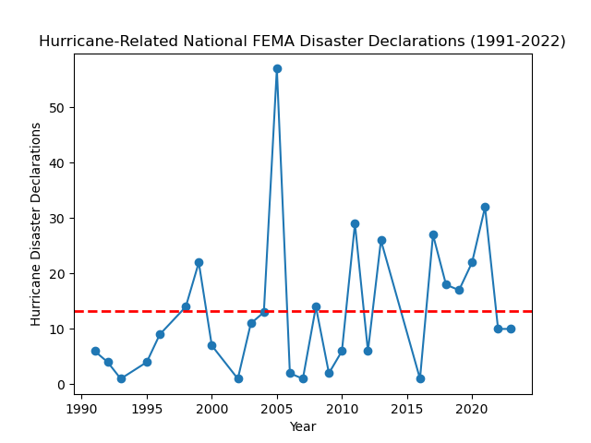
Section 3: Human Impact: FEMA Disaster Declarations
Sources: OpenFema (https://www.fema.gov/about/openfema/api)
Notes:
72..7% of all above average years in the last 15 years

Slide 13
Conclusions:
The frequency of hurricanes in the atlantic has almost doubled in the last 15 years when compared to the previous 15 years.</li>
The intensity and occurrence of landfall of storms remains constant over time as a percentage of overall storms observed.</li>
Ocean and land temperature averages show little to no correlation to the frequency or severity of hurricanes</li>
Atmospheric CO2 concentrations show substantial correlations to hurricane frequency and some correlation to hurricane severity</li>
The number of disaster declarations as a result of hurricanes has risen over time with a substantial spike in the last 15 years (as compared to the previous 15 years)</li>

Slide 14
QUESTIONS?

