Slide 1


Dynamic Complementary Conditions and Whole-Body Trajectory Optimization for Humanoid Robot Locomotion
Control problems in robotics : Under Actuated Robots
Candidato:
Bonsanto Pietro 2033935
Taliani Saverio 1841465
Anno accademico 22/23

Slide 2
Dynamic Complementary Conditions and Whole-Body Trajectory Optimization for Humanoid Robot Locomotion
Objectives:
Robot Locomotion on Flat surfaces
Introduction of complementary conditions in a Dynamic fashion
Planning using non task-specific constraints

Slide 3
Hierarchical control architecture
Trajectory optimization
Foothold trajectory generation from high-level commands
Simplified model control (receding horizon)
Generates desired centroidal quantities for stable walking
Whole body quadratic programming
Stabilizes the planned trajectories exploiting the full robot model

Slide 4
Approach
The control objectives of the simplified control model become parts of the trajectory optimization layer.
Nonlinear optimization gives:
Feasible footsteps
Whole-body robot trajectories
Benefit:
No need a priori knowledge of contacts
No a priori information on robot locomotion

Slide 5
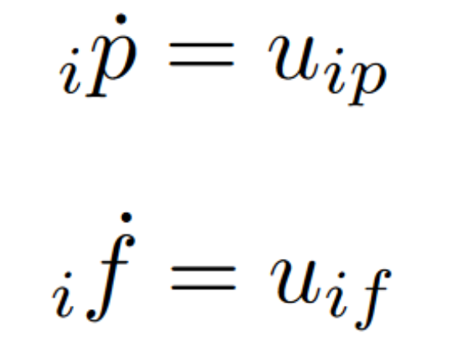
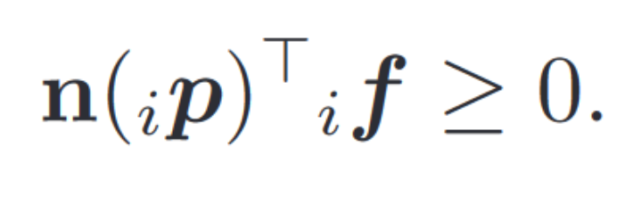
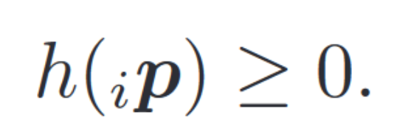
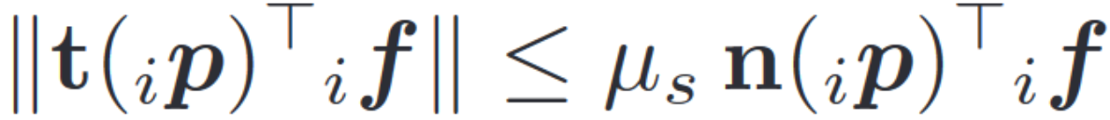
Background
Assumptions:
Full control on contact points’ velocity
Full control on contact forces’ derivarive
Constraints:
Static friction
Positivity of normal forces
Non-penetration

Slide 6
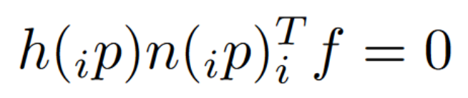

Background
Complementary conditions:
Specify that this force exists only if the point is in contact with the ground
Drawback: Small feasibility region
Solution: Relax the constraint
Constraints:
Friction
Positivity of normal forces
Non-penetration

Slide 7
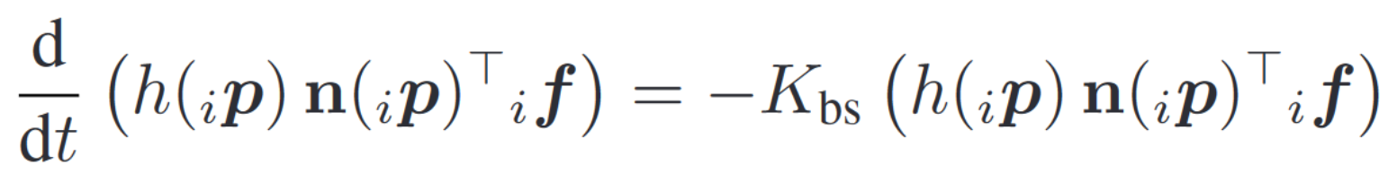
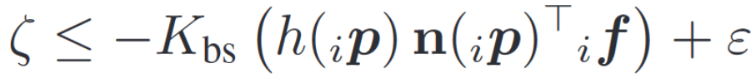
Contribution 1
Dynamic Complementary Conditions:
Baumgarte stabilization of CCs
Tends exponentially to zero
Still need a relaxation:
Constraints:
Friction
Positivity of normal forces
Non-penetration

Slide 8
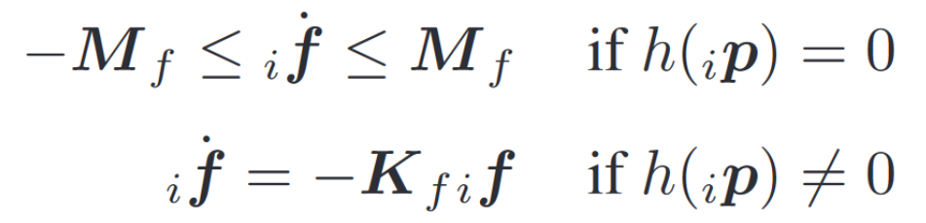
Contribution 1
Hyperbolic secant complementarity:
In contact → Bound on contact force variation
No contact → Reactive force vanishes exponentially
Constraints:
Friction
Positivity of normal forces
Non-penetration

Slide 9
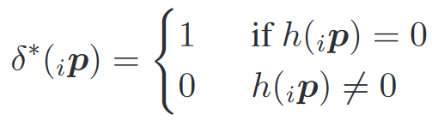
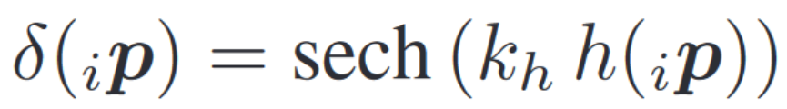
Contribution 1
Hyperbolic secant complementarity:
Cast in single constraint
Constraints:
Friction
Positivity of normal forces
Non-penetration

Slide 10
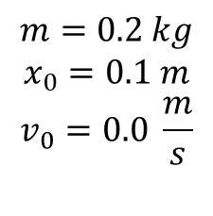
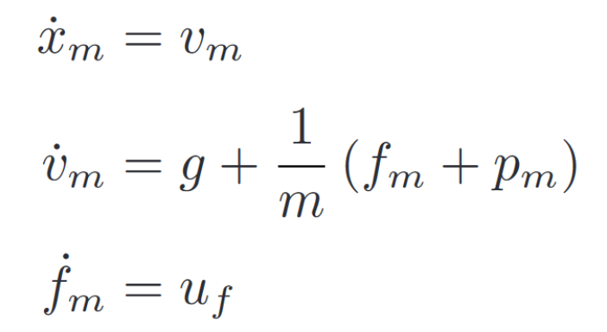
Toy-problem
A point mass falls from a given height thorward an infinitely rigid ground
The impact is completely inelastic
The mass is subject to ground reaction force and is actuate by a propeller
The overall dynamical system result in:

Slide 11
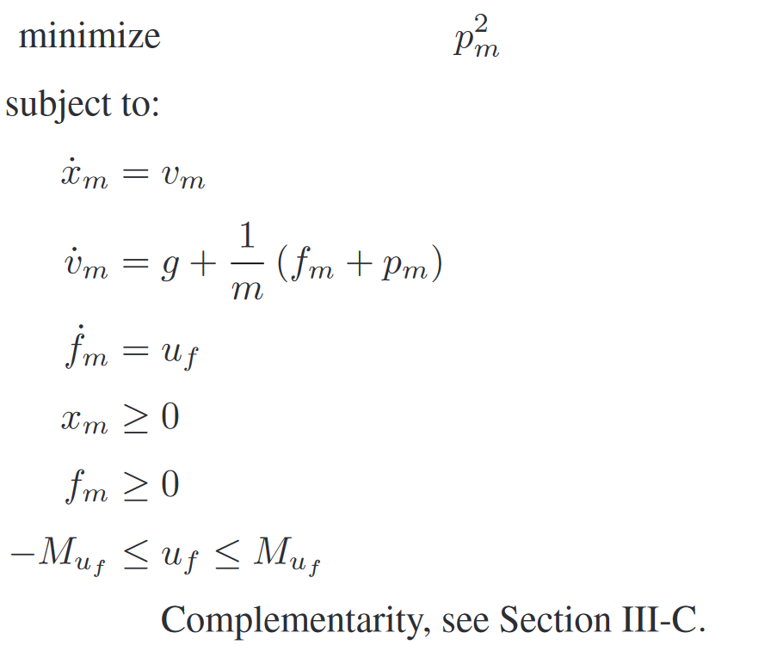
Toy-problem
We simulate a foot approaching the ground
It is a simple way to test different DCCs effect
The overall optimization problem to solve is:

Slide 12
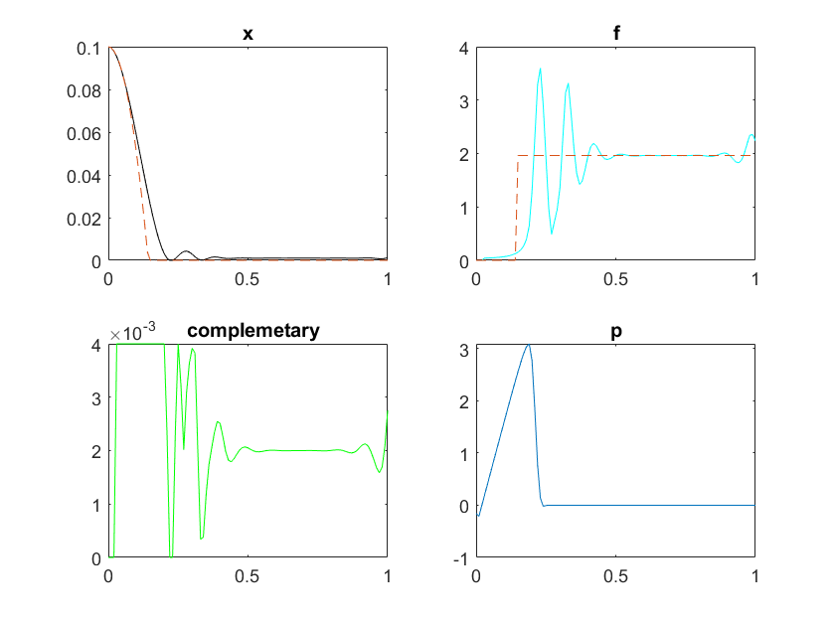
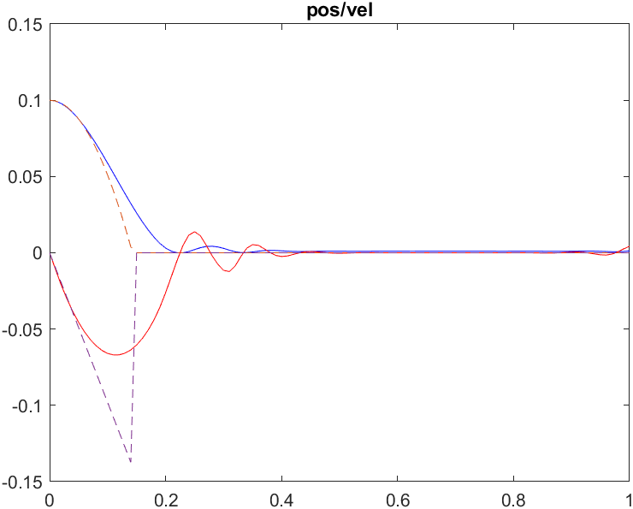
Toy-problem Relaxed CCs
Mean computational time: 0.9701 s

Slide 13
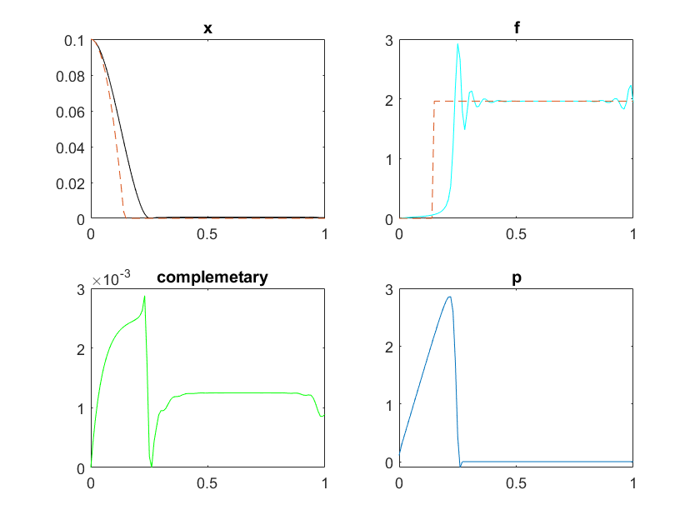
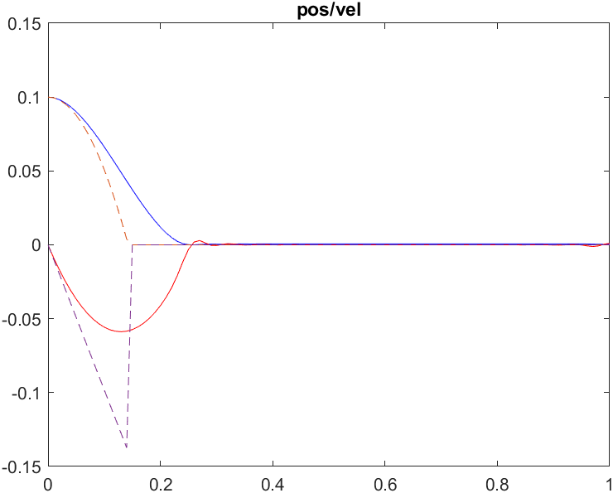
Toy-problem Dynamic CCs
Mean computational time: 1.0613 s

Slide 14
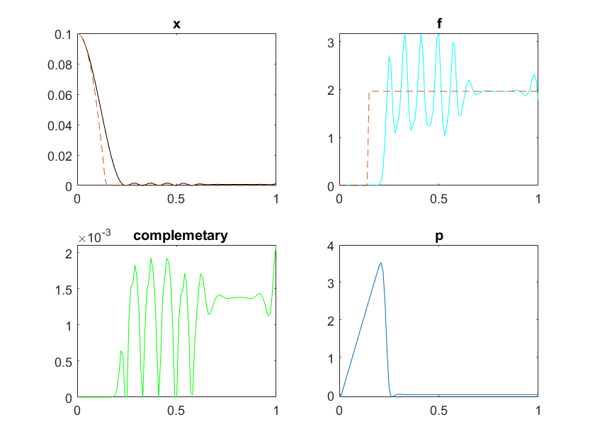
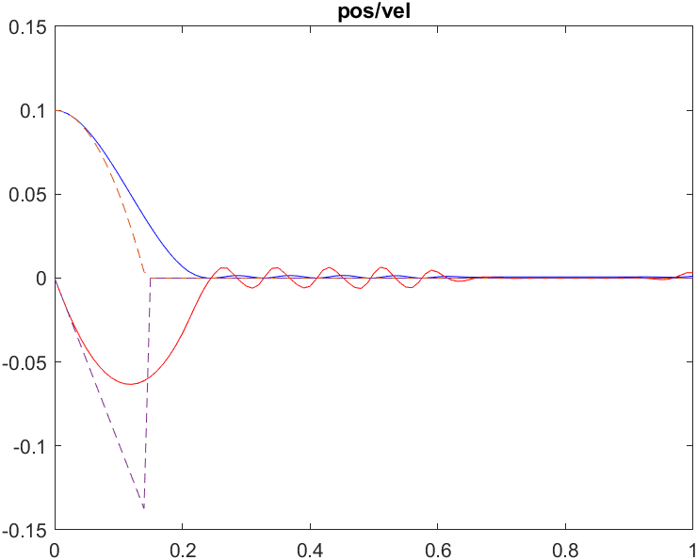
Toy-problem Hyperbolic secant CCs
Mean computational time: 1.6698 s

Slide 15
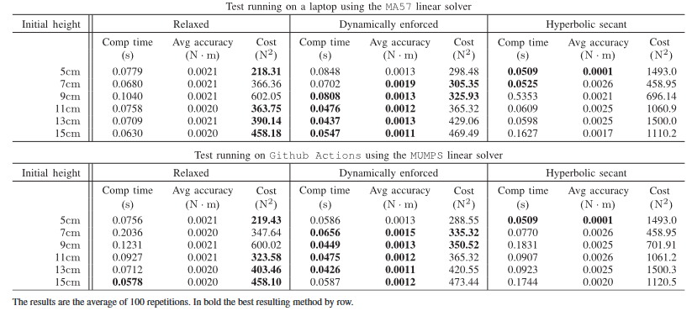
Toy-problem paper results

Slide 16
Toy-problem paper results
Best accuracy achieved by the dynamically enforced method except for the 5 cm case , in which the best behavior is the one referring to hyperbolic secant
Better performances w.r.t. computational time achieved with hyperbolic secant for heights lower than 9 cm
Higher use of propeller → less contact time
Dynamically enforced method provides the least variations in terms of computational time across the different heights

Slide 17
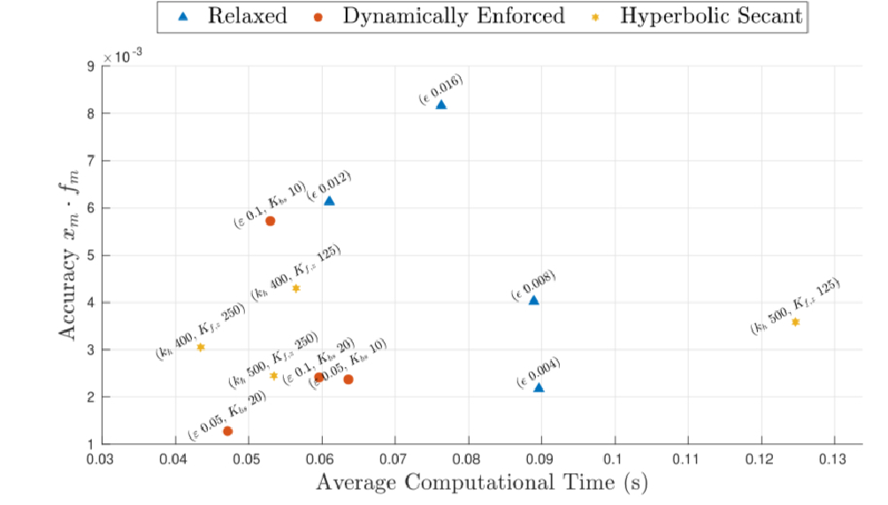

Toy-problem paper results
Parameter variations:
ε for the relaxed complementarity
K_{bs} for the dynamically enforced complementarity
K_{f,z} and K_{h} for the hyperbolic secant

Slide 18
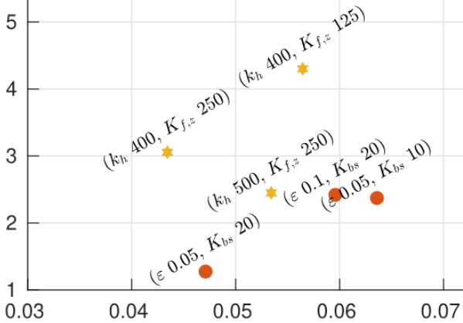
Toy-problem paper results
Parameter variations:
Best accuracy achieved by the Dynamically enforced method with ε =0.05 K_{f,z}=20
Fastest solution with hyperbolic secant with
K_{h}=400 K_{f,z}=250

Slide 19
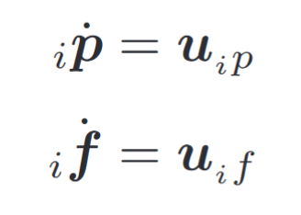
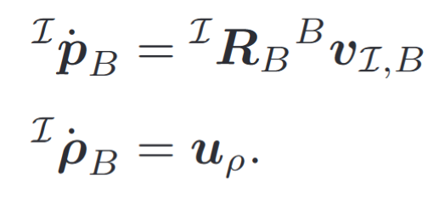
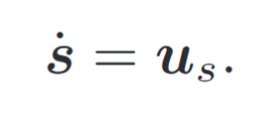
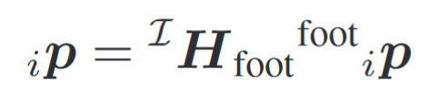
Nonlinear trajectory planning
Kinematic control
Full control over the derivative of the contact point's position and forces
Consider contact points constrained as a rigid body but independent from the control point of view
Controllability of joint velocities (backstepping hypothesis)
Dynamical evolution

Slide 20
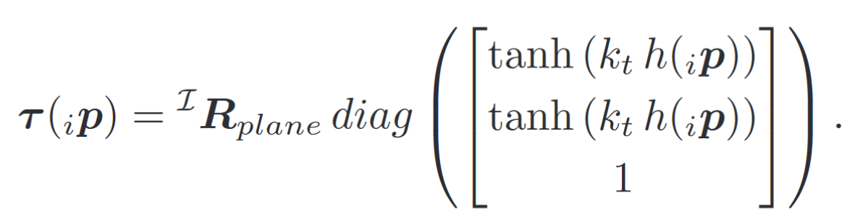
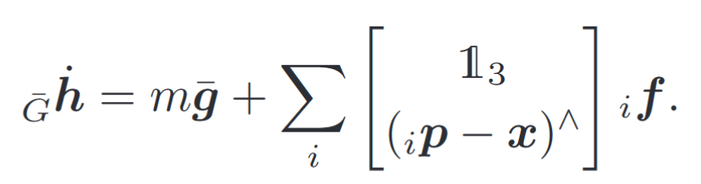
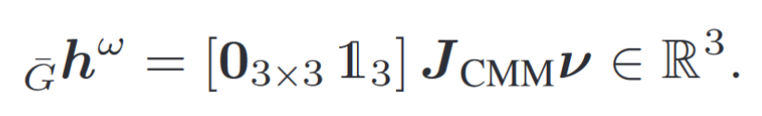
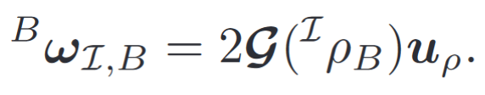
Nonlinear trajectory planning
Planar DCC
Prevents contact points to move on the walking plane
Reduces velocity when approaching the ground
Momentum control
Describe contact forces' effect on robot motion through centroidal dynamics
Use Centroidal Momentum Matrix (CMM)
ν contains body’s angular velocity that can be expressed using quaternion derivative to make appear explicitly the control input

Slide 21
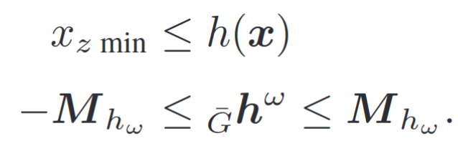
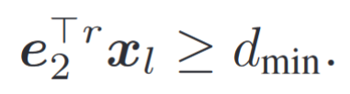
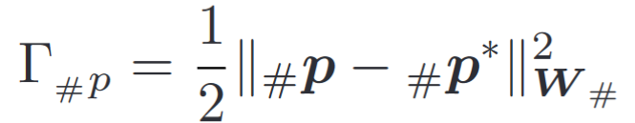
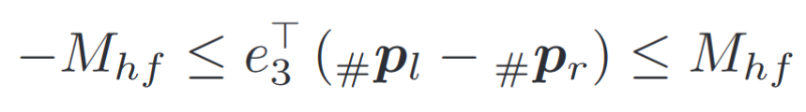
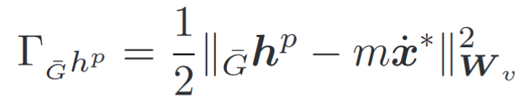
Nonlinear trajectory planning
Walking specific constraints
Avoid self collision by forbidding cross stepping
Limiting swing height
Avoid excessive motions
Task in cartesian space
Desired position of contact points centroid position
CoM linear velocity
Foot Yaw

Slide 22
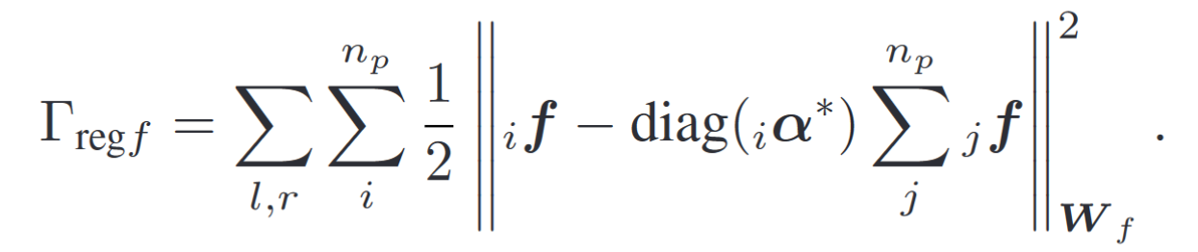
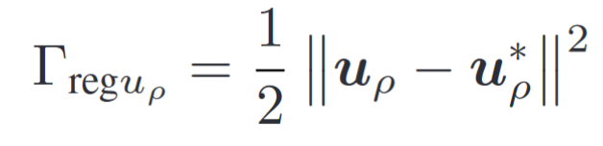
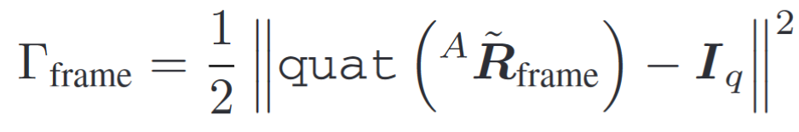
Nonlinear trajectory planning
Regularization Tasks
Frame orientation, the robot moves forward
Quaternion Derivative Regularization, track a desired angular velocity
Force regularization, assures that contact forces are similar one to each other

Slide 23
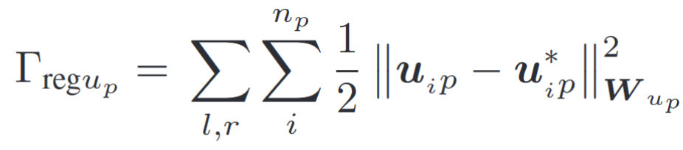
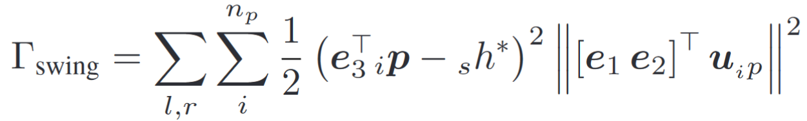
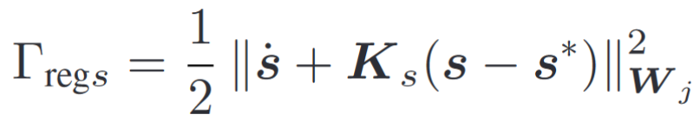
Nonlinear trajectory planning
Regularization Tasks
Joint regularization, avoid huge variations
Swing height, introduces robustness to ground asperity
Contact control regularization, avoid having contact forces near their limit value

Slide 24
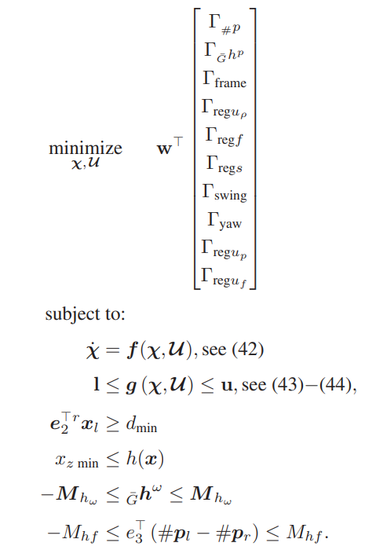
Nonlinear trajectory planning
Complete Optimal Control Problem

Slide 25
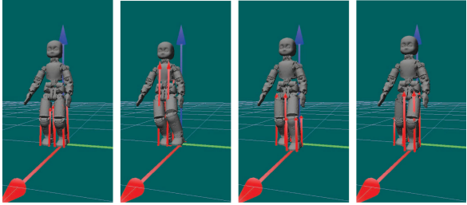
Nonlinear trajectory planning - validation
The whole problem has been casted in a C++ optimization problem to compare the effect the different complementary conditions in simulation.
Settings: 100ms integration step,
2s time horizon
Advantages: reduces variables
insertion of a higher frequency control loop.
For each foot four contact points are considered
The centroid of contact points is moved 10 cm along the walking direction
Desired CoM speed 5 cm/s

Slide 26
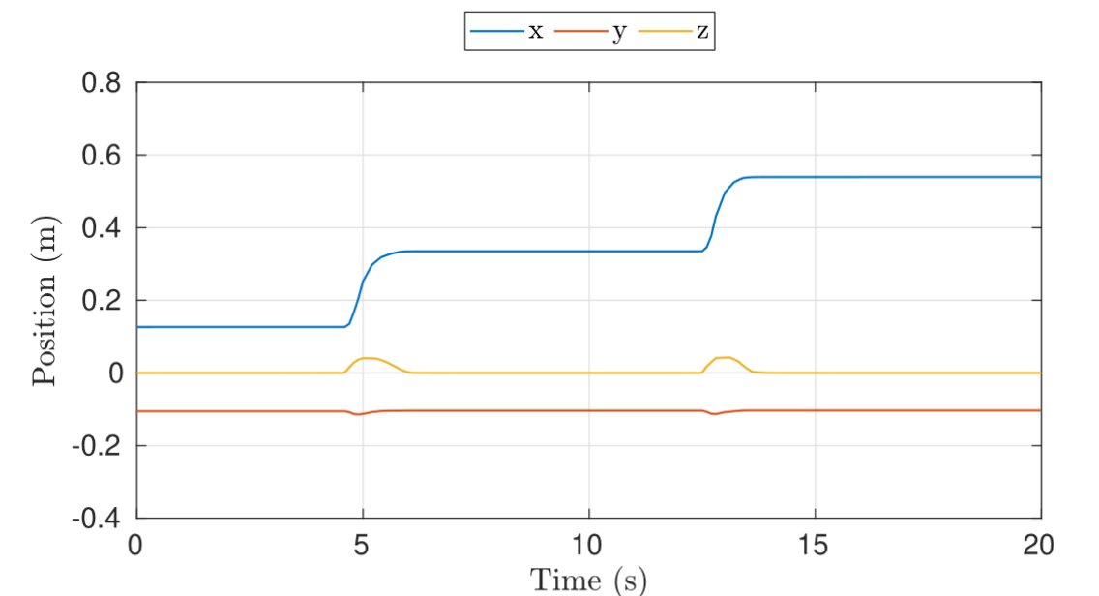
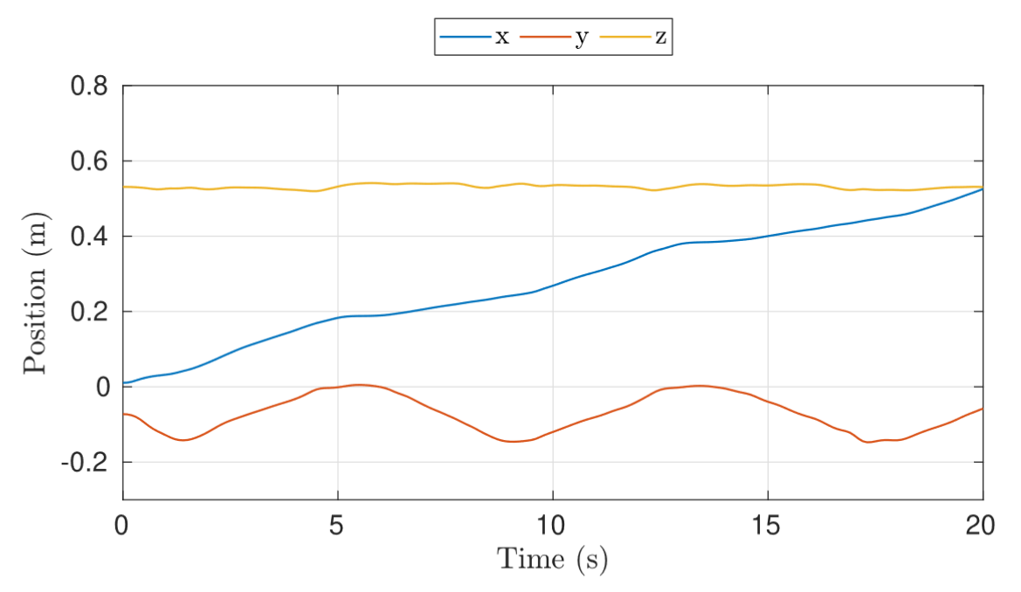
Nonlinear trajectory planning - validation
Relaxed complementarity
Steps are clearly visible even if it is not specified how toperform them and how they should last

Slide 27
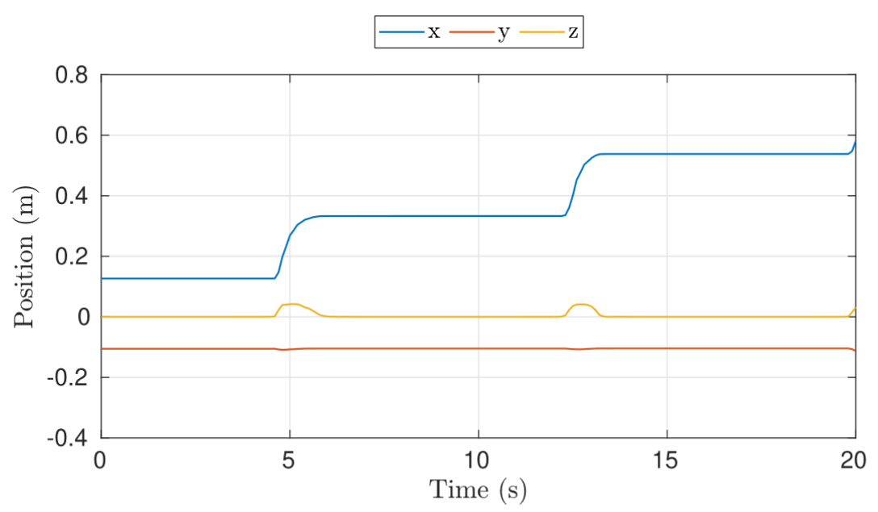
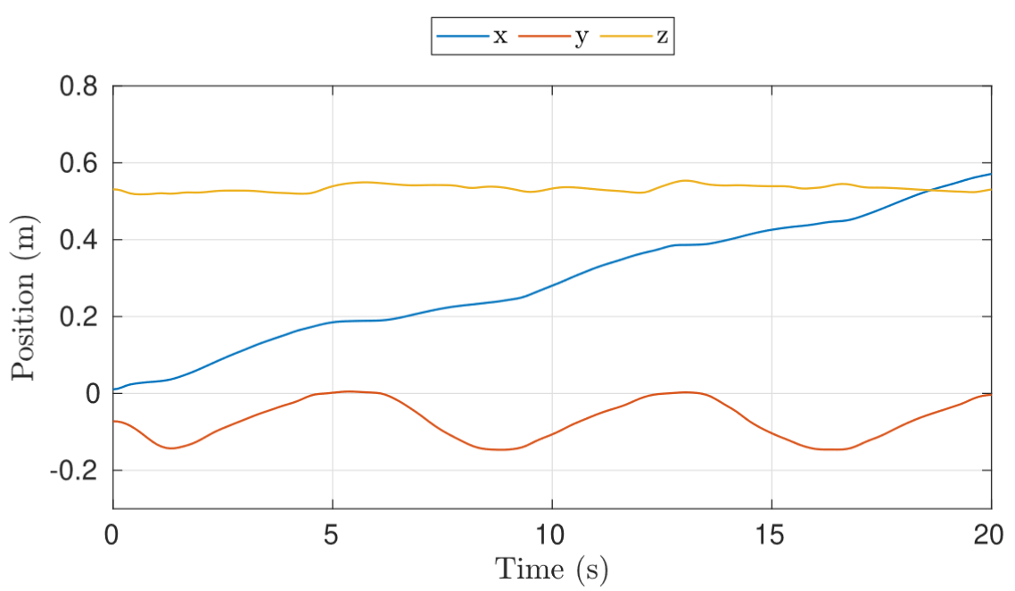
Nonlinear trajectory planning - validation
Dynamic complementarity
CoM height is almost costant
The position grows linearly in walking direction thanks to constant velocity task
The CoM oscillates in order to stay over the support area

Slide 28
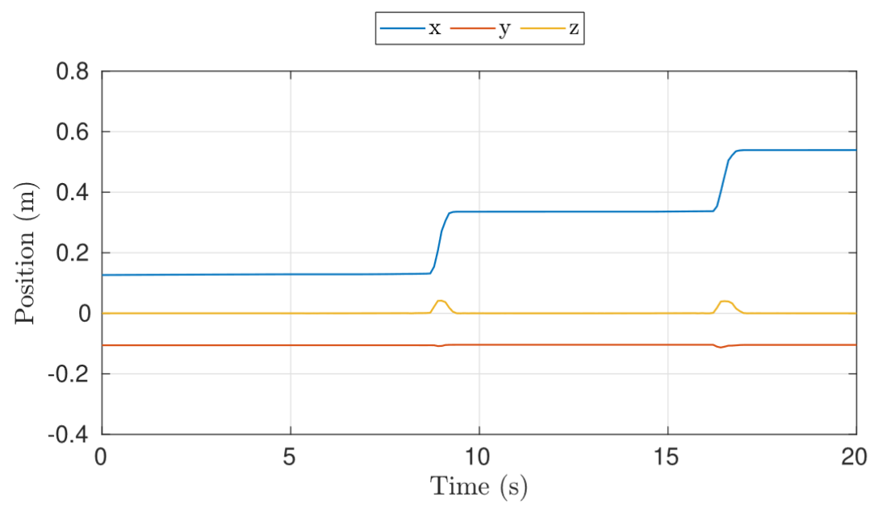
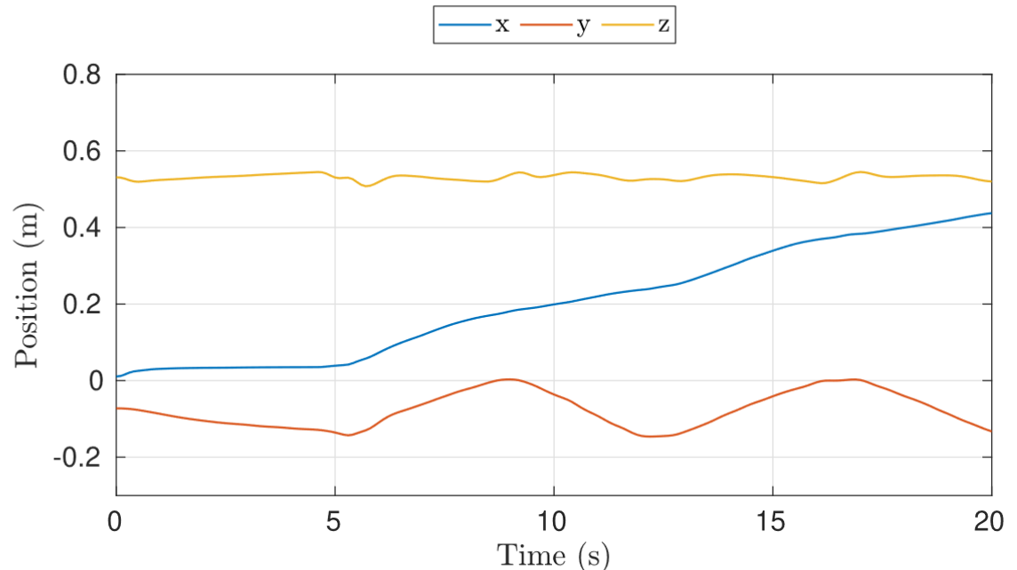
Nonlinear trajectory planning - validation
Hyperbolic complementarity
This approach brings some procrastination
The overall CoM position is fully decided by the solution

Slide 29
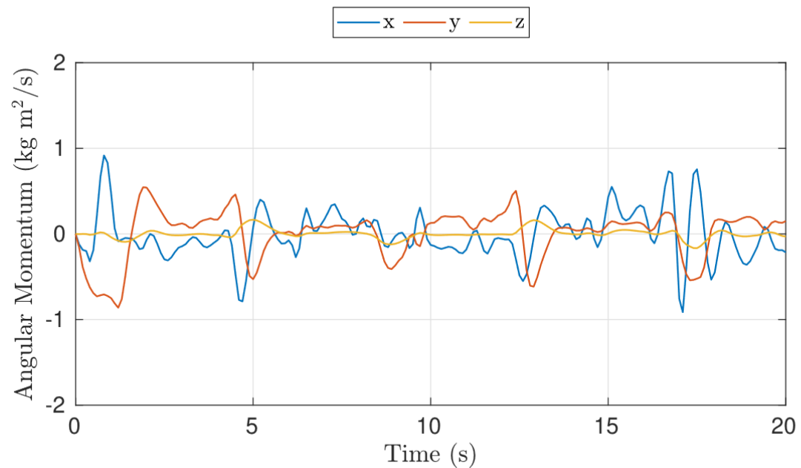



Nonlinear trajectory planning - validation
The angular momentum is always close to zero even if it is not direcly specified
Having no information on how to perform a step we can’t regulate swing time and we can encounter procrastinaton as with hc
This approach gives extreme importace to weight selection
Avoid procrastination: Time varing weight for centroid of contact point position
Avoid undesired motion: Decreasing weight on desired torso orientation

Slide 30

Nonlinear trajectory planning – CCs comparison
Best accuracy given by Dynamically CCs
Hyperbolic CCs are clearly worse than the others It doesn’t prevent the contact points to move
Hyperbolic secant is the fastest Possibly due to longer initial procrastination
The computational time increases in corrispondence of desired position variation

Slide 31
Nonlinear trajectory planning - CCs comparison
Comparison with different walking velocities
Changing walking velocity can have a strong impact on the solution and can bring the planner to fail.
Relaxed complementarity fails with 0.06 m/s
Hypebolic secant fails with 0.07 m/s
Dynamic enforced method appears to be more robust and consistent

Slide 32

Nonlinear trajectory planning - CCs comparison
Parameter variation
RC, ε is inversely proportional to computational time and accuracy
DC, gives better overall performance
HC, is highly sensitive to parameter variation

Slide 33
Conclusions
It is possible to generate walking trajectories by specifing a desireg target position
It is still not possible to implement it online due to computational time
DCCs provides the best tradeoff between computational time and accuracy

