Slide 1
CHRONIC KIDNEY DISEASE PREDICTION USING LOGISTIC REGRESSION
AI-101 MINI PROJECT · GROUP-26
GITHUB REPO
DOCUMENTATION LEAD
EXECUTION LEAD
Suda Tanishq Reddy
2026MCB1573
Abhishek
2026DAB1290
PRESENTATION LEAD
VIDEO LEAD
Prabhnoor Kataria
2026AIB1066
Davuluri Vinod
2026EEB1339
01
PREDICTIVE HEALTHCARE · MACHINE LEARNING · BINARY CLASSIFICATION
Notes:
Introduce the project: Chronic Kidney Disease prediction using Logistic Regression for the AI-101 Mini Project.

Slide 2


THE PROBLEM AND DATASET
THE PROBLEM
DATASET OVERVIEW
Chronic Kidney Disease (CKD) often develops gradually, making early identification challenging.
Analyzing patient health indicators can help identify potential CKD cases for timely medical evaluation.
We aim to use Machine Learning to predict whether a patient has CKD.
Dataset: | Chronic Kidney Disease Dataset
Dataset source: | Chronic_Kidney_Disease_data.csv
Records: | 1,659 patients
Features: | 54 columns
Target Variable: | Diagnosis (CKD / No CKD)
Algorithm: | Logistic Regression
AI-101 MINI PROJECT · DATASET SPECIFICATION & PROBLEM FORMULATION
02
Notes:
Present the motivation behind early CKD detection and walk through the dataset parameters, feature count, target variable, and the logistic regression modeling choice.

Slide 3





MODEL ARCHITECTURE & TECHNOLOGIES USED
INPUT DATA
DATA SPLITTING
DATA PREPROCESSING
CLASSIFICATION MODEL
OUTPUT
Chronic Kidney Disease dataset
1,659 patient records
54 columns
Target variable: Diagnosis
Column Transformer
Predicted Diagnosis
Binary Classification
Class 0 / Class 1
Train-test split
80% Training Data
20% Testing Data
Stratified sampling
Logistic Regression
Scikit-learn
Solver: liblinear
Maximum iterations: 12,828
NUMERICAL FEATURES
CATEGORICAL FEATURES
Median Imputation
Standard Scaling
Mode Imputation
One-Hot coding
Training: model learns from training data
Prediction: trained model generates predictions for testing data
LIBRARIES USED
Pandas
NumPy
Matplotlib
Seaborn
Scikit-learn
Load and manipulate data
Numerical and array operations
Plots and visualization
Statistical plots
Preprocess, train and evaluate
03

Slide 4
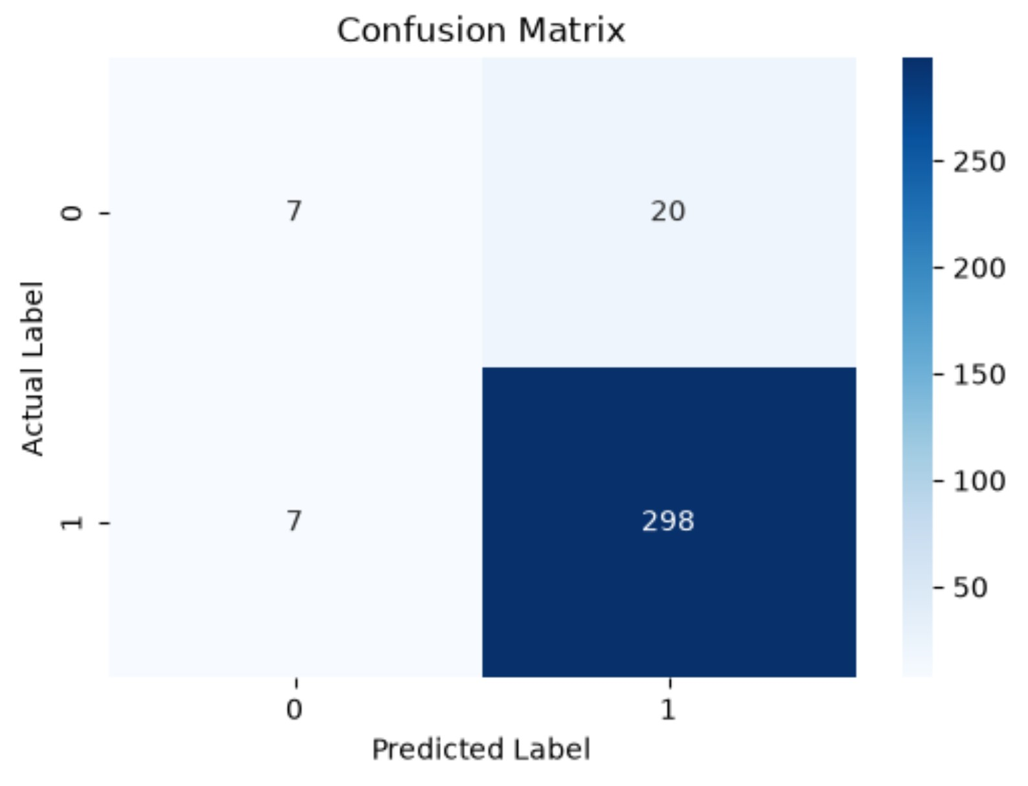
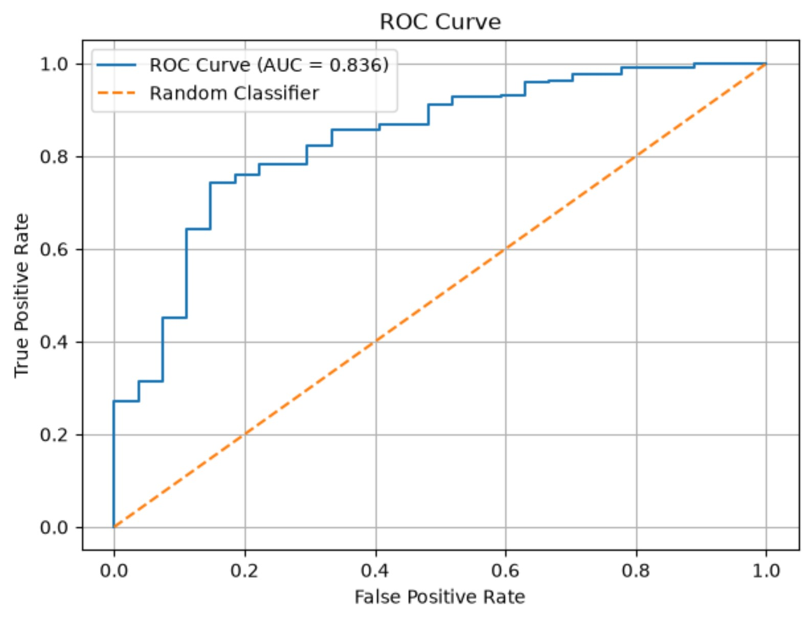
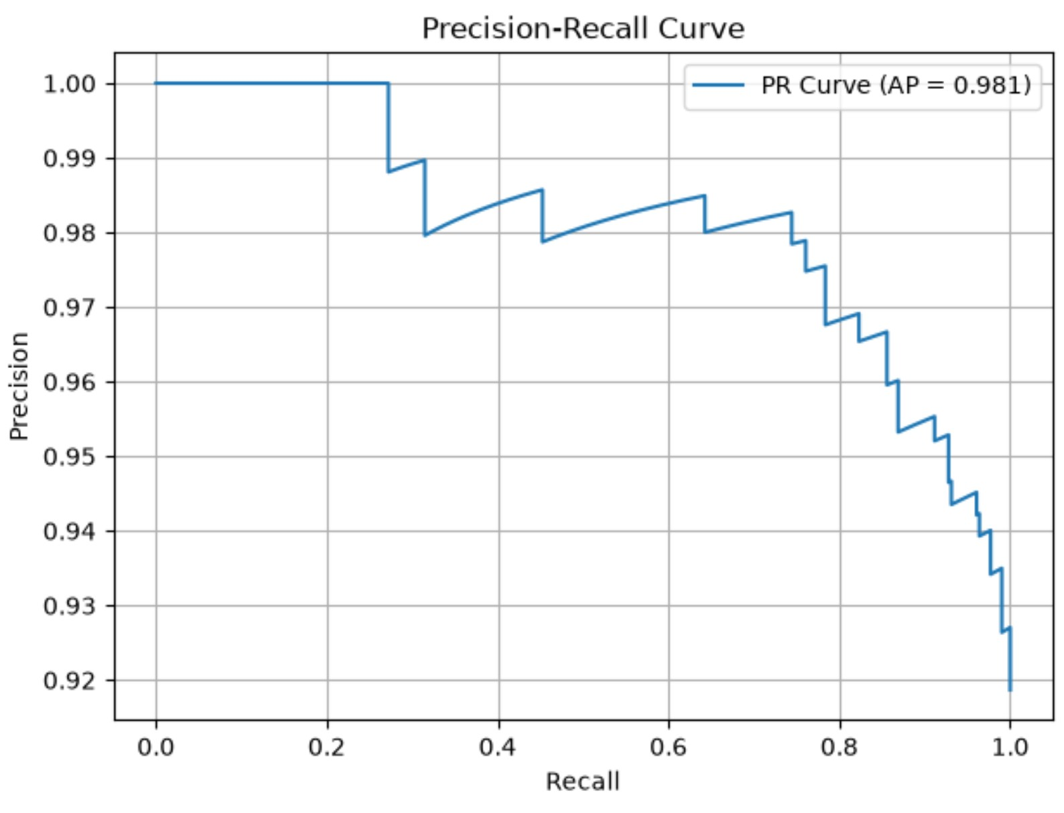
MODEL PERFORMANCE & EVALUATION
ACCURACY
PRECISION
RECALL
F1-SCORE
91.9%
94.0%
97.4%
95.7%
CONFUSION MATRIX
·ACTUAL × PREDICTED DIAGNOSIS
ROC CURVE
·ROC-AUC = 0.836
PRECISION–RECALL CURVE
·AVERAGE PRECISION = 0.981
KEY OBSERVATIONS
The model achieves 91.9% accuracy and demonstrates strong CKD detection, but struggles to identify non-CKD cases (26% recall).
This highlights the impact of class imbalance in the test dataset (305 CKD vs 27 non-CKD cases).
04
Notes:
The uploaded matrix [[7, 20], [7, 298]] gives 7 of 27 non-CKD cases correctly identified, about 26%, not 30%; the slide uses the matrix value. The three plot paths must be resolved to hosted sources on upload before they render.

Slide 5
PROJECT LEARNINGS & TEAM CONTRIBUTIONS
Chronic Kidney Disease Prediction using Logistic Regression.
WHAT WORKED
WHAT DIDN’T WORK AS EXPECTED
Scikit-learn preprocessing pipelines
Missing-value handling and feature scaling
Multiple evaluation metrics
Class imbalance affected minority-class detection
Accuracy alone gave an incomplete picture
Automatic feature-type detection needed closer inspection
SUDA TANISHQ REDDY
ABHISHEK
PRABHNOOR KATARIA
DAVULURI VINOD
DOCUMENTATION LEAD
EXECUTION LEAD
PPT LEAD
VIDEO LEAD
Dataset exploration
README architecture
Notebook integration
Github Repo
Conda environment
Dependency management
Preprocessing
Logistic Regression architecture
Model training
Presentation
Model evaluation
ROC/PR curves
Metrics analysis
Video demo
CHATGPT – LEARNING AND CODING ASSISTANCE | GAMMA AI – PRESENTATION DRAFTING AND DESIGN. OUTPUTS WERE REVIEWED AND ADAPTED BY THE TEAM.
05

