Slide 1
EDA Highlights
DACH responses are more complete compared with others.
40% of professional developers in DACH have a master’s degree.
Close to 40% are full stack developers, with another 15%+ on backend.
Around 70% of them did not use AI Agent.
Factors found to have strong correlation with compensation in the complete data set do not have such correlation in DACH. Only work and coding experience appear to have high correlation there.

Slide 2
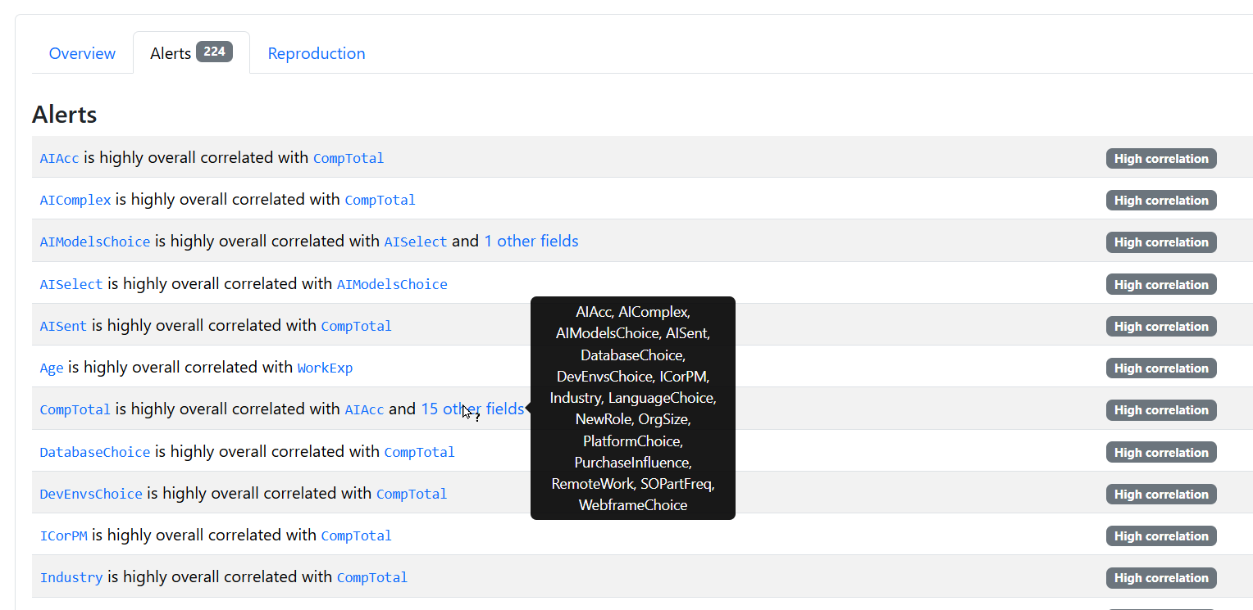
Correlation over the entire, original data set

Slide 3
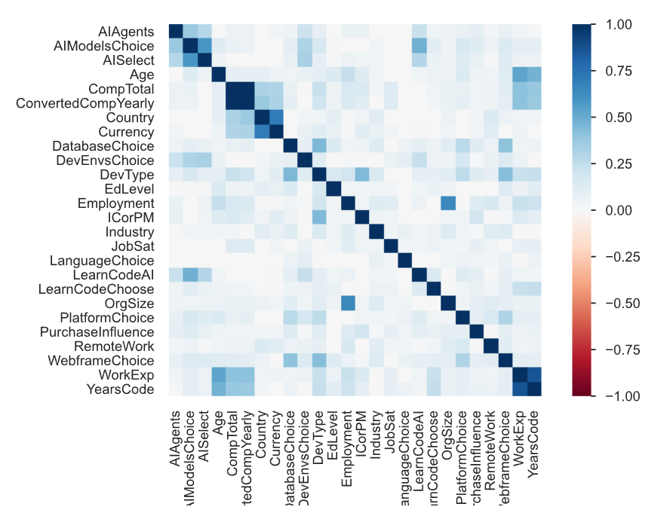
Correlations Heatmap:
DACH Professional Developers with Active Employment

