Slide 1
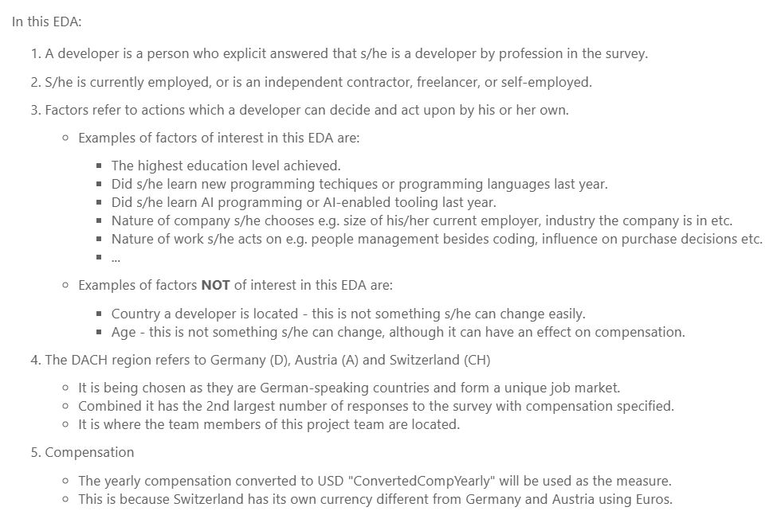
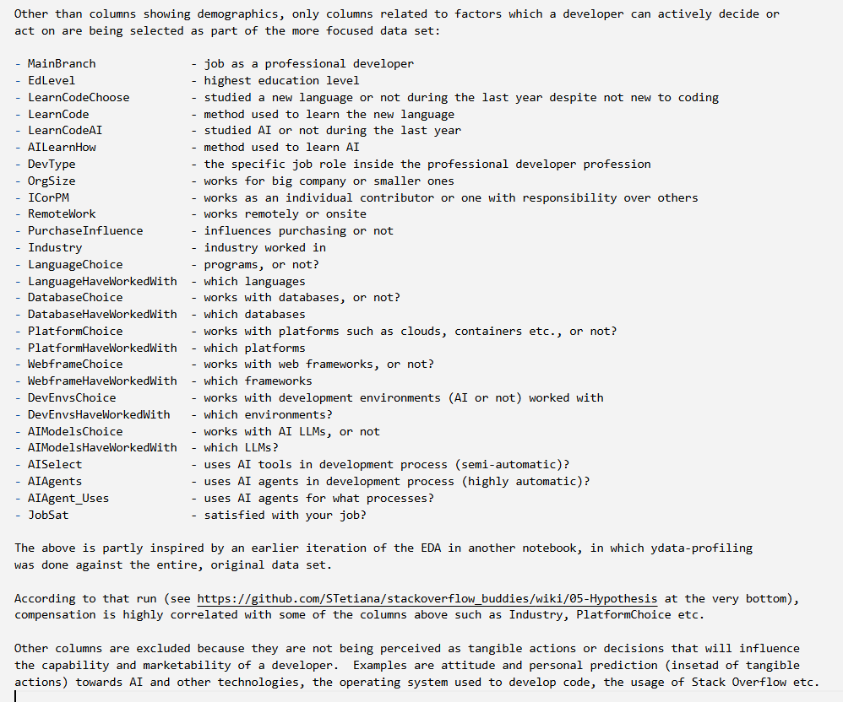
Going in position described in the notebook

Slide 2
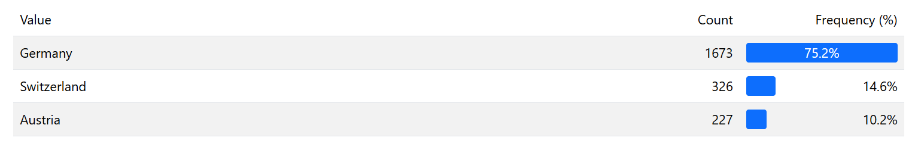
Only responses from the DACH Region included

Slide 3
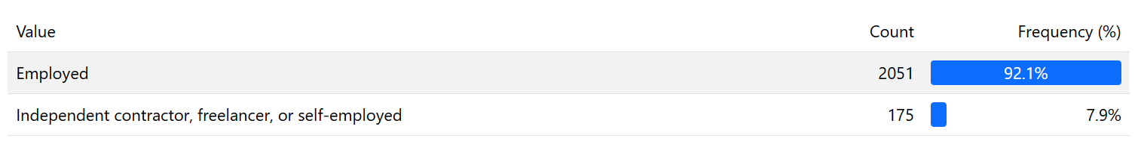
Only respondants with employment included

Slide 4
Only professional developers included

Slide 5
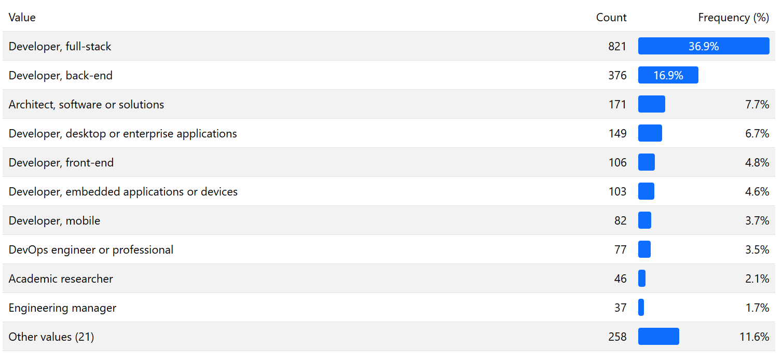
Nature of their development work

Slide 6
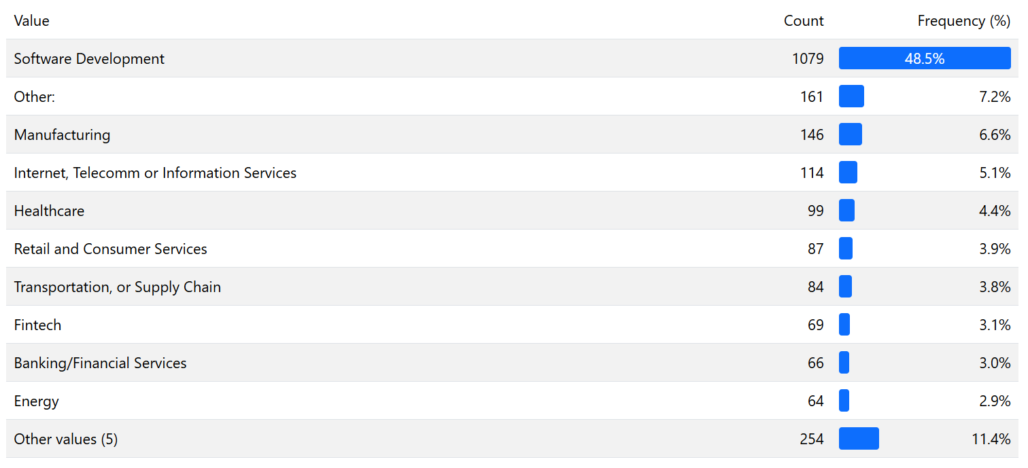
Industry they are in

Slide 7
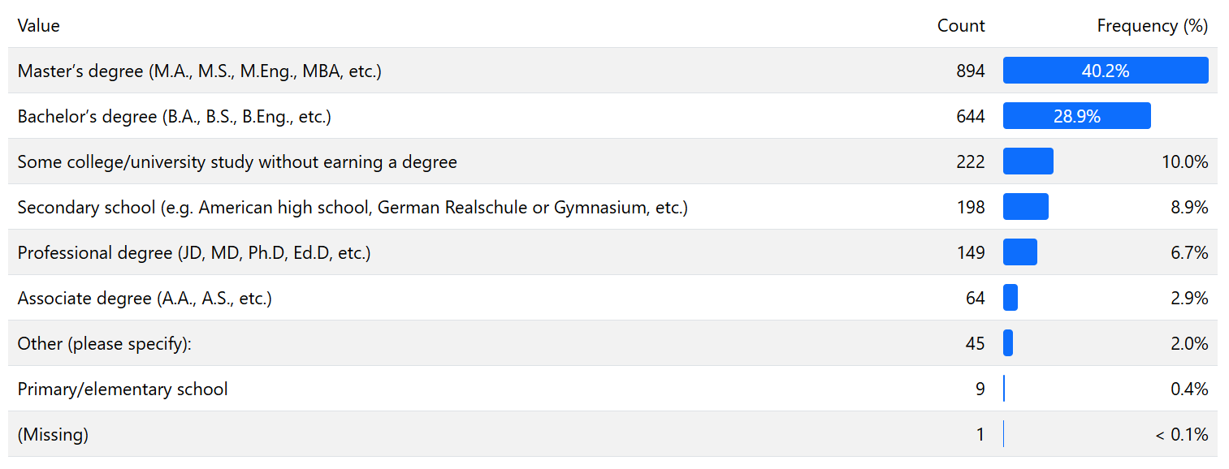
The highest level of education they have

Slide 8
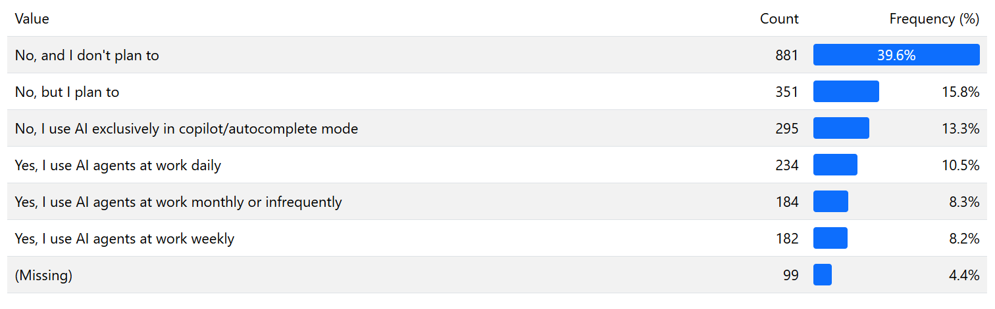
Almost 70% of them don’t use AI agents so far

Slide 9
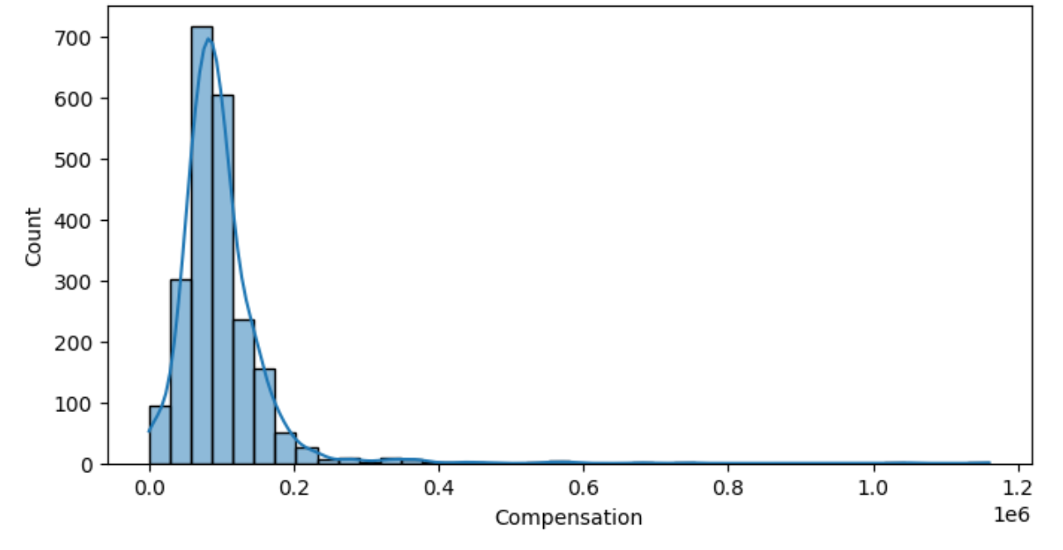
A long tail of outliers in terms of compensation

Slide 10
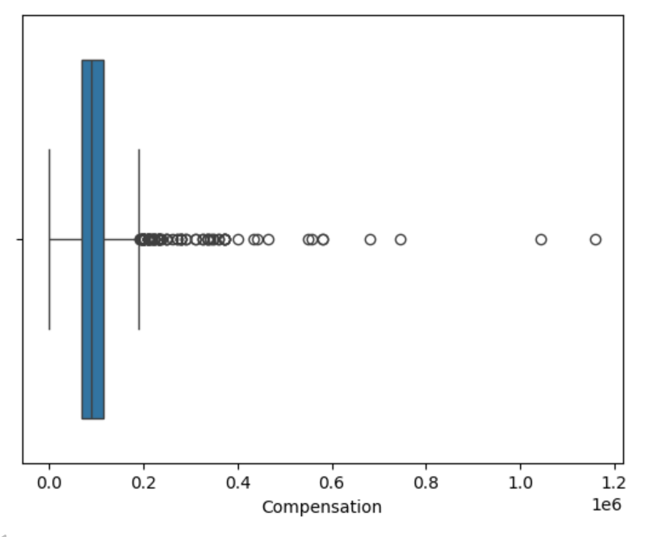
A long tail of outliers in terms of compensation

Slide 11
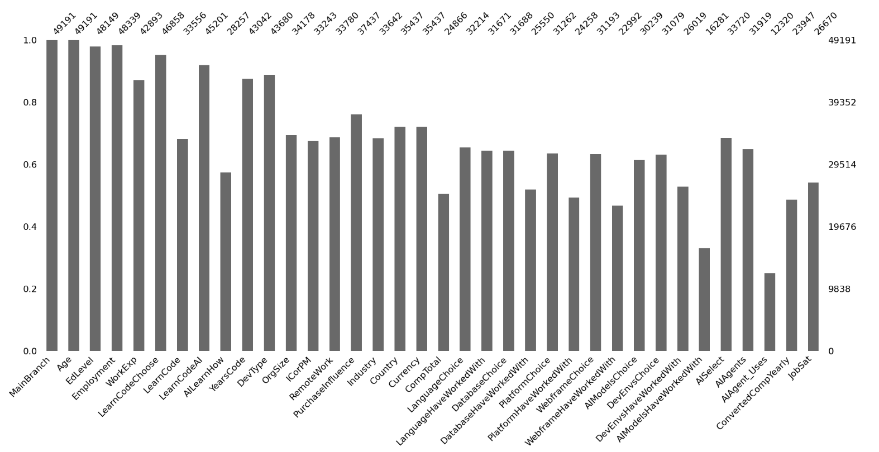
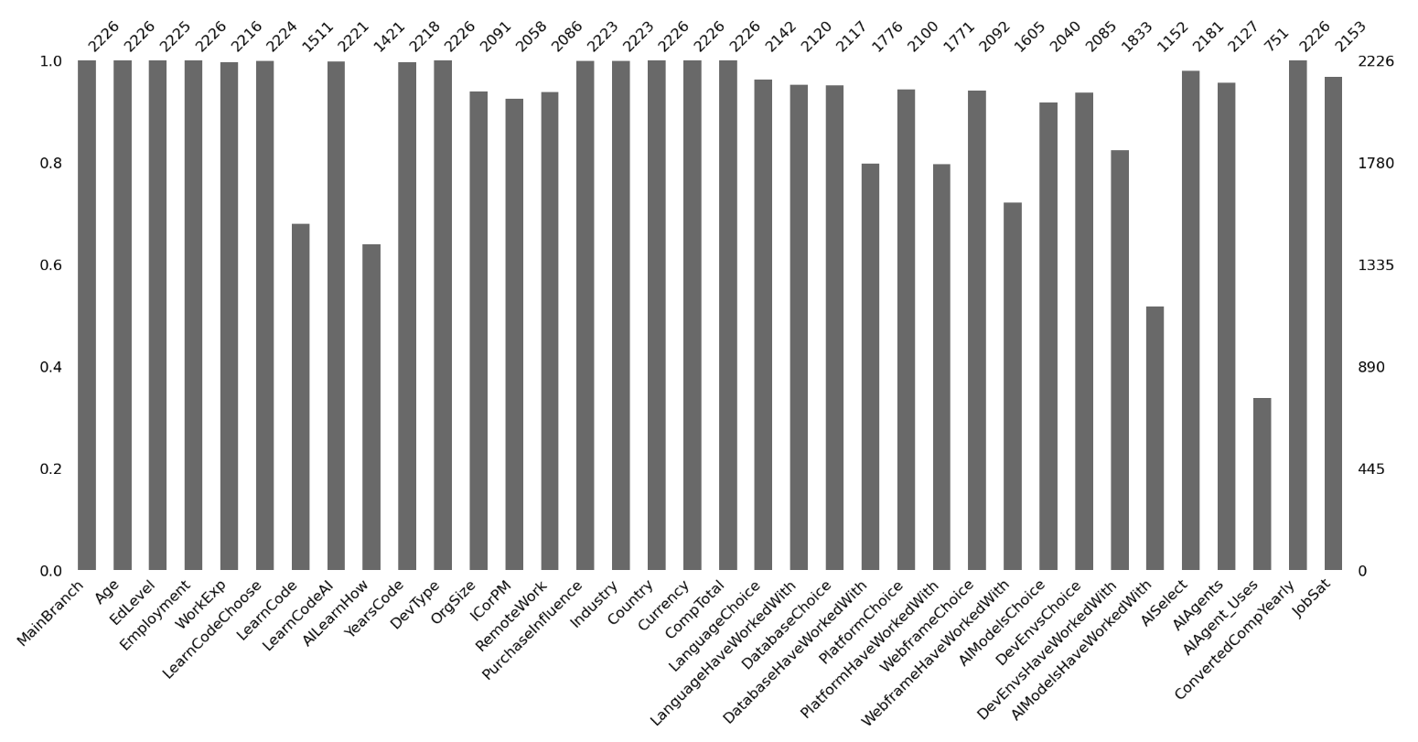
DACH provides more complete responses
All locations
DACH

