Slide 1

From PRs to Performance
Using metrics and AI to coach stronger engineering teams
Notes:
b

Slide 2
Eric Martin
Director of Software Engineering, KODE Health
Metrics should start conversations, not end careers.
Momentum 2026
Notes:
"How many of you have been in a meeting where someone pulled up a dashboard and every engineer in the room got *real* quiet? Yeah. That's the meeting we're trying to *not* have. Today I'm going to show you a different approach; one where metrics actually help your team instead of making them update their LinkedIn profile."

Slide 3
01
PROBLEMS WITH METRICS
Why many scoreboards kill morale.
SECTION 01 / 07

Slide 4
Why most engineering metrics fail in practice
Metrics Ignored
Individual Scoreboards
Dashboards exist, but leadership still decides on vibes.
Overcorrecting into per-engineer rankings that breed fear.
Velocity Without Context
Optimize for the Metric
A number you argue about in retro, not one that drives decisions.
Engineers game the measure instead of pursuing the outcome.
“What gets measured gets gamed.” — Goodhart’s Law
Eric Martin
From PRs to Performance
Momentum 2026
Notes:
"Let me paint you a picture. You're an engineering director. Your VP asks, 'How productive is the team?' And you have two options. Option A: 'I think they're doing great, based on vibes.' Option B: you pull up a spreadsheet that makes your engineers feel like they're being graded on a curve in college. Neither of these is leadership. Both of these are what most organizations actually do.”
"I've seen teams where one senior engineer figured out that splitting a 5-point story into five 1-point stories made their velocity look incredible. Technically true. Practically useless. And the worst part? Nobody could call it out because the metric was the metric.”
Goodhart was a U.K. economist/banker. Observed banks/markets will work to “game” metrics once just an observation to make an informed decision.
*****************************************************************
"You ever sit in one of those meetings where there's a 40-tab dashboard up on the screen, and the VP just goes, 'Yeah... it FEELS like the team's slowing down'?
Cool. Cool cool cool. I spent six weeks wiring up Grafana so you could have a hunch."
*****************************************************************

Slide 5
Where our approach fits in the landscape
We didn't invent this. We borrowed the best ideas and tuned them for coaching.
BENCHMARK
FRAMEWORK
THIS TALK
DORA
SPACE
Our take
Google research · 4 metrics
Microsoft research · 5 dimensions
3 tiers · 1:1-ready
— Deployment frequency
— Lead time for changes
— Change failure rate
— Time to restore
— Satisfaction
— Performance
— Activity
— Communication
— Efficiency
— Outcomes
— System Signals
— Behaviors
Is the delivery system healthy?
How to measure without weaponizing.
What do I say Monday morning?
A simplification of SPACE with DORA-style thinking underneath; tuned for coaching conversations.
Eric Martin
From PRs to Performance
Momentum 2026
Notes:
"Quick landscape check, because I know some of you have DORA dashboards and SPACE slides in your own organizations. DORA: Google's research, four metrics, tells you if your delivery system is healthy at the team level. Excellent for benchmarking. SPACE: published in 2021, partly as a warning against using DORA as an individual scoreboard, says always pair quantitative with qualitative; also, excellent. Neither of them, on their own, tells you what to say in Monday's 1:1. That's the gap."
"Every organization is different. What works for us isn't meant to diminish DORA or SPACE, we borrowed heavily from both. Think of what I'm showing you as a simplification of SPACE; fewer dimensions, easier to explain to a busy director, with DORA-style thinking underneath about pairing speed with quality. Tuned for the coaching conversation, not the board deck. Use what works for your team."

Slide 6
THE FRAMEWORK
Outcomes vs. System Signals vs. Behaviors
LAGGING
LEADING
QUALITATIVE
Outcomes
System Signals
Behaviors
Did we ship? Did customers adopt it? Did revenue move?
Velocity trends, hours-per-point, time-to-merge, review rounds.
Code review depth, testing habits, collaboration patterns.
The rearview mirror.
The dashboard gauges.
The engine light.
Most orgs only measure outcomes, then wonder why they can't course-correct.
Eric Martin
From PRs to Performance
Momentum 2026
Notes:
"Here's the mental model I want you to take away today. Outcomes tell you what happened; they're the rearview mirror. System signals tell you what's *about to* happen; they're the dashboard gauges. And behaviors tell you *why* things are happening; they're the engine light. Most organizations only measure outcomes, then wonder why they can't course-correct. It's like driving by only looking in the rearview mirror. Which, incidentally, is also how my teenager drives."

Slide 7
THE DASHBOARD BLUEPRINT
What we built
Web Application, DB, Background Jobs, Charting, AI
INPUT
ENGINE
OUTPUT
GitHub + Linear
Kollator
Dashboards
PR events, reviews, stories, cycles
Rails · Postgres · Sidekiq · Claude
Velocity, quality, coaching
—
AI layer sits ON TOP of existing data
—
Weekly pipeline: classify, score, coach, analyze
—
Monday morning; fresh data/analysis
Eric Martin
From PRs to Performance
Momentum 2026
Notes:
"Here's what I actually built. Nothing revolutionary about the architecture. You have your project management tool; we use Linear, but this works with Jira or whatever your team has Stockholm Syndrome about. You have GitHub. And you have a Rails app that pulls data from both, runs some calculations, and adds an AI analysis layer on top. The key insight: the AI doesn't generate the metrics. The AI *interprets* the metrics. Big difference. And all of this is automated; there's a single weekly pipeline job that runs on Sunday night, classifies new PR comments, recalculates scores, generates coaching summaries, and produces a trend analysis. By Monday morning, the dashboard is current. Nobody has to remember to press a button."

Slide 8
02
VELOCITY, ESTIMATION, AND FORECASTING
SECTION 02 / 07

Slide 9
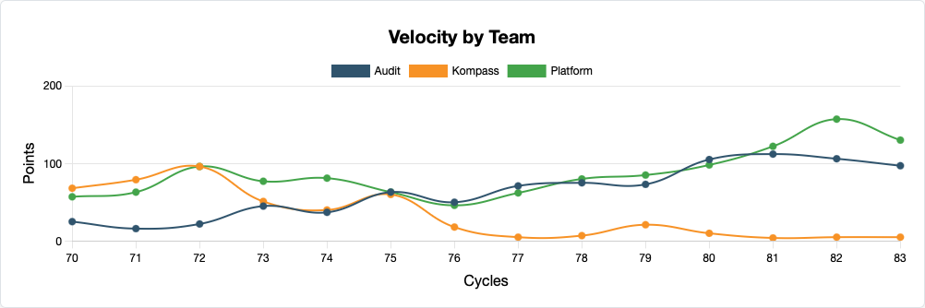
SECTION 02 · VELOCITY
Team Velocity Dashboard
780 × 260
Eric Martin
From PRs to Performance
Momentum 2026
Notes:
"This is the main dashboard. Two charts I want you to focus on. On the left, velocity by team over our two-week cycles. On the right, and this is the one that changed how I think about estimation, hours per point. This tells you how much calendar time one story point costs. If your team says a task is 3 points and your hours-per-point is 5, that's a day and a half of work. If another team's hours-per-point is 3, that same 3-point task takes about a day. Neither is wrong, but you need to know the conversion rate, or your forecasting is just astrology with a spreadsheet."

Slide 10
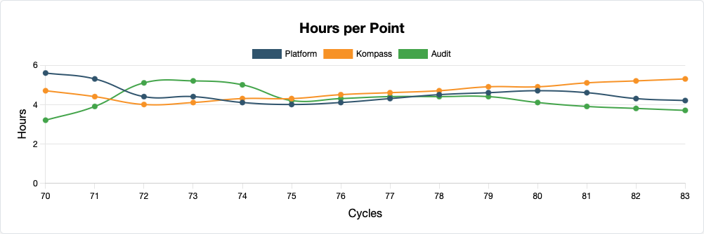
SECTION 02 · VELOCITY
Hours per point · the predictor
— SAME EFFORT. DIFFERENT CALIBRATION.
Raw velocity hides this. Hours per point exposes it and stops the "that team ships more" argument dead.
Trending up? Estimation is drifting. Trending down? Getting efficient or cutting corners. Check quality.
Eric Martin
From PRs to Performance
Momentum 2026
Notes:
"Hours per point is my single favorite metric in this entire system, and I say that knowing it sounds like I'm picking a favorite child. Here's why. If Team A ships 50 points in a cycle and Team B ships 30, your instinct is to say Team A is more productive. But if Team A's hours-per-point is 3 and Team B's is 5, then Team A spent 150 hours and Team B spent 150 hours. Same effort, different calibration. Every VP I've shown this to has had a lightbulb moment. It's the metric that stops the 'well, that team ships more points' argument dead in its tracks."

Slide 11
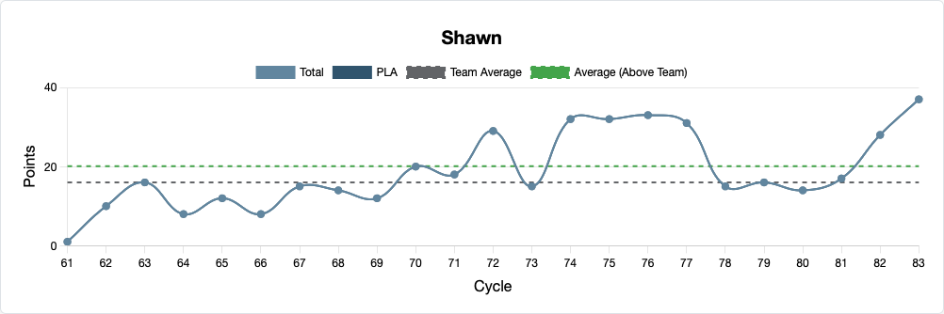
SECTION 02 · VELOCITY
Individual Velocity · No Leaderboards
—
The question isn't "who's fastest?" It's "is this pattern changing, and should I ask about it?"
Team average line for context · no ranking · a conversation starter, not a verdict.
Eric Martin
From PRs to Performance
Momentum 2026
Notes:
"Now here's where it gets sensitive, and where most organizations mess it up. Individual velocity. Notice what I'm NOT doing here: I'm not ranking people. I'm not comparing Alice to Bob. Each chart shows one person's velocity over time, with a team average line for context. The question isn't 'who's fastest?' The question is 'is this person's pattern changing, and should I ask about it?' If someone who was consistently above average drops for three cycles, that's not a performance problem; that's a conversation starter. Maybe they're onboarding someone. Maybe they're dealing with tech debt. Maybe they're burning out. The metric doesn't tell you why. It tells you to *ask.*"

Slide 12
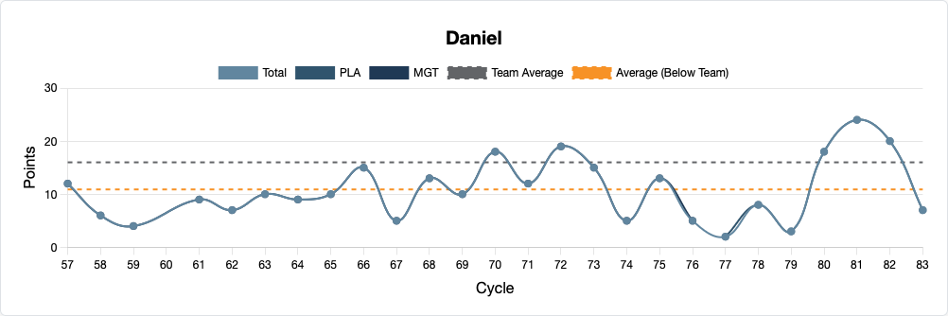
SECTION 02 · VELOCITY
Individual Velocity · No Leaderboards
—
The question isn't "who's fastest?" It's "is this pattern changing, and should I ask about it?"
Team average line for context · no ranking · a conversation starter, not a verdict.
Eric Martin
From PRs to Performance
Momentum 2026
Notes:
"Now here's where it gets sensitive, and where most organizations mess it up. Individual velocity. Notice what I'm NOT doing here: I'm not ranking people. I'm not comparing Alice to Bob. Each chart shows one person's velocity over time, with a team average line for context. The question isn't 'who's fastest?' The question is 'is this person's pattern changing, and should I ask about it?' If someone who was consistently above average drops for three cycles, that's not a performance problem; that's a conversation starter. Maybe they're onboarding someone. Maybe they're dealing with tech debt. Maybe they're burning out. The metric doesn't tell you why. It tells you to *ask.*"

Slide 13
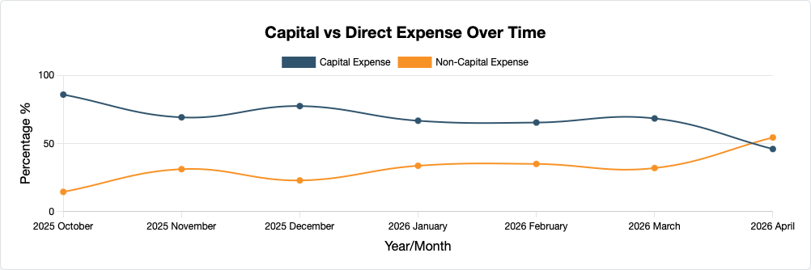
SECTION 02 · VELOCITY
Capital vs Expense
Eric Martin
From PRs to Performance
Momentum 2026
Notes:
"Hours per point is my single favorite metric in this entire system, and I say that knowing it sounds like I'm picking a favorite child. Here's why. If Team A ships 50 points in a cycle and Team B ships 30, your instinct is to say Team A is more productive. But if Team A's hours-per-point is 3 and Team B's is 5, then Team A spent 150 hours and Team B spent 150 hours. Same effort, different calibration. Every VP I've shown this to has had a lightbulb moment. It's the metric that stops the 'well, that team ships more points' argument dead in its tracks."

Slide 14
03
SIGNALS THAT REVEAL QUALITY AND RISK
Not what shipped · how it got there
SECTION 03 / 07

Slide 15
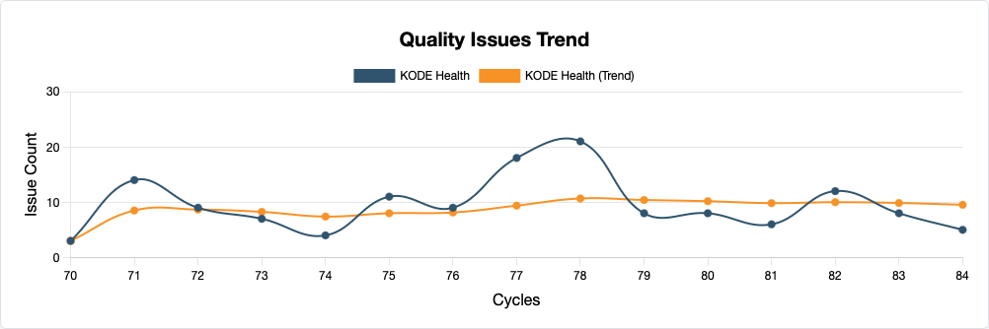
SECTION 03 · QUALITY SIGNALS
Quality Trends
Eric Martin
From PRs to Performance
Momentum 2026
Notes:
"Four charts, four stories. Review rounds tells you how many back-and-forth cycles a PR goes through before merge. If this number is creeping up, your team might be shipping less-ready PRs, or your reviewers might be getting pickier; worth investigating. Time to merge; how long from PR open to merged. Changes requested rate; what percentage of PRs get pushed back. And time to first review, this is the collaboration metric. If PRs sit for 18 hours before anyone looks at them, you have a review culture problem, not a code quality problem."

Slide 16
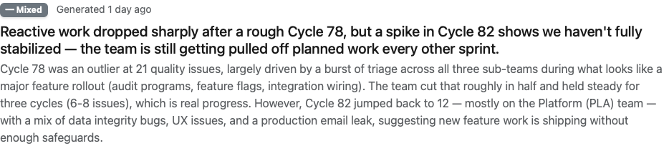
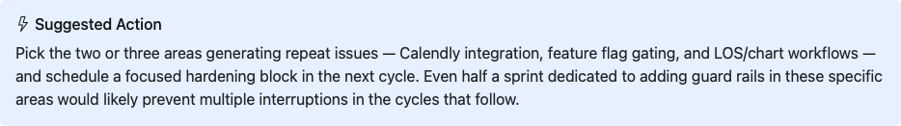
SECTION 03 · QUALITY SIGNALS
Quality AI Analysis
Eric Martin
From PRs to Performance
Momentum 2026
Notes:
"Four charts, four stories. Review rounds tells you how many back-and-forth cycles a PR goes through before merge. If this number is creeping up, your team might be shipping less-ready PRs, or your reviewers might be getting pickier; worth investigating. Time to merge; how long from PR open to merged. Changes requested rate; what percentage of PRs get pushed back. And time to first review, this is the collaboration metric. If PRs sit for 18 hours before anyone looks at them, you have a review culture problem, not a code quality problem."

Slide 17
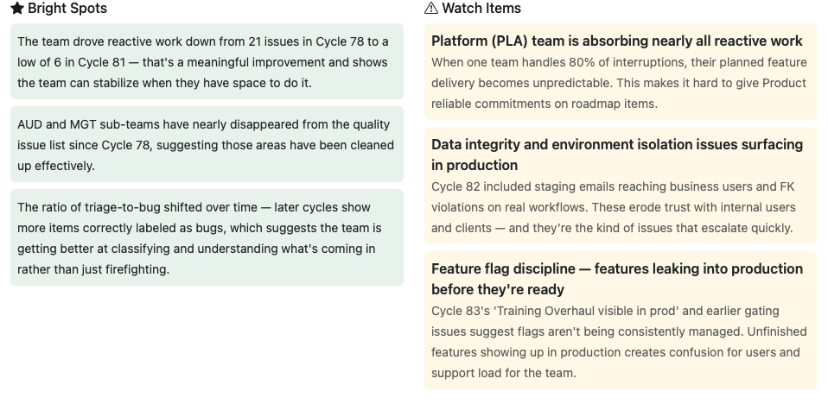
SECTION 03 · QUALITY SIGNALS
Quality AI Analysis
Eric Martin
From PRs to Performance
Momentum 2026
Notes:
"Four charts, four stories. Review rounds tells you how many back-and-forth cycles a PR goes through before merge. If this number is creeping up, your team might be shipping less-ready PRs, or your reviewers might be getting pickier; worth investigating. Time to merge; how long from PR open to merged. Changes requested rate; what percentage of PRs get pushed back. And time to first review, this is the collaboration metric. If PRs sit for 18 hours before anyone looks at them, you have a review culture problem, not a code quality problem."

Slide 18
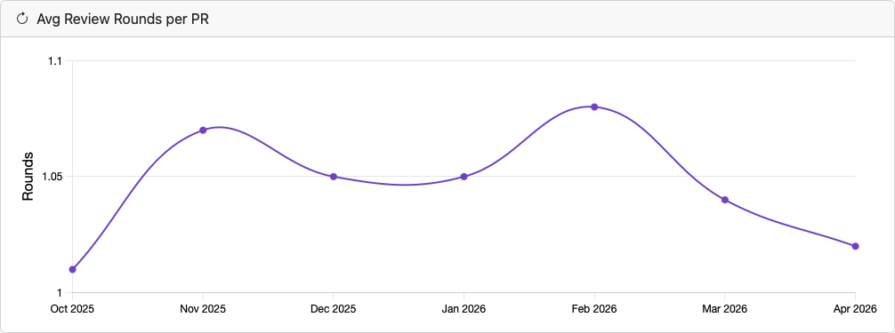
SECTION 03 · PR SIGNALS
Review & rework patterns
— AVG REVIEW ROUNDS
— TIME TO MERGE
— CHANGES REQUESTED
— TIME TO FIRST REVIEW
Back-and-forth cycles per PR.
PR open → merged.
% of PRs pushed back.
Collaboration health.
Eric Martin
From PRs to Performance
Momentum 2026
Notes:
"Four charts, four stories. Review rounds tells you how many back-and-forth cycles a PR goes through before merge. If this number is creeping up, your team might be shipping less-ready PRs, or your reviewers might be getting pickier; worth investigating. Time to merge; how long from PR open to merged. Changes requested rate; what percentage of PRs get pushed back. And time to first review, this is the collaboration metric. If PRs sit for 18 hours before anyone looks at them, you have a review culture problem, not a code quality problem."

Slide 19
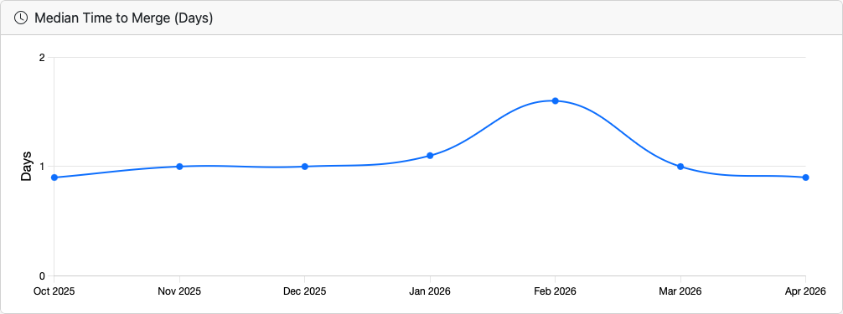
SECTION 03 · PR SIGNALS
Review & rework patterns
— AVG REVIEW ROUNDS
— TIME TO MERGE
— CHANGES REQUESTED
— TIME TO FIRST REVIEW
Back-and-forth cycles per PR.
PR open → merged.
% of PRs pushed back.
Collaboration health.
Eric Martin
From PRs to Performance
Momentum 2026
Notes:
"Four charts, four stories. Review rounds tells you how many back-and-forth cycles a PR goes through before merge. If this number is creeping up, your team might be shipping less-ready PRs, or your reviewers might be getting pickier; worth investigating. Time to merge; how long from PR open to merged. Changes requested rate; what percentage of PRs get pushed back. And time to first review, this is the collaboration metric. If PRs sit for 18 hours before anyone looks at them, you have a review culture problem, not a code quality problem."

Slide 20
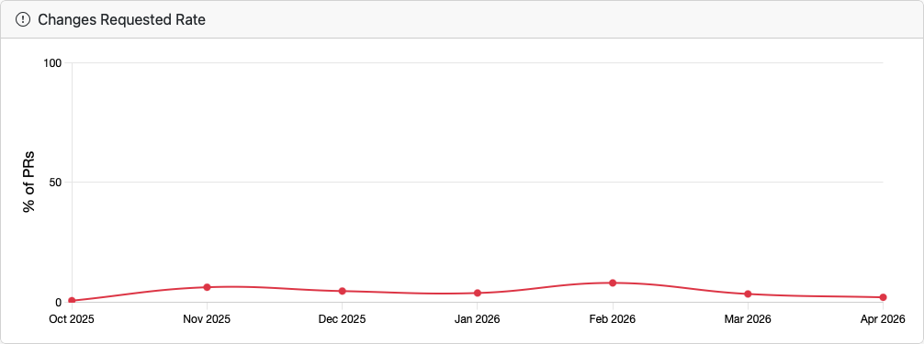
SECTION 03 · PR SIGNALS
Review & rework patterns
— AVG REVIEW ROUNDS
— TIME TO MERGE
— CHANGES REQUESTED
— TIME TO FIRST REVIEW
Back-and-forth cycles per PR.
PR open → merged.
% of PRs pushed back.
Collaboration health.
Eric Martin
From PRs to Performance
Momentum 2026
Notes:
"Four charts, four stories. Review rounds tells you how many back-and-forth cycles a PR goes through before merge. If this number is creeping up, your team might be shipping less-ready PRs, or your reviewers might be getting pickier; worth investigating. Time to merge; how long from PR open to merged. Changes requested rate; what percentage of PRs get pushed back. And time to first review, this is the collaboration metric. If PRs sit for 18 hours before anyone looks at them, you have a review culture problem, not a code quality problem."

Slide 21
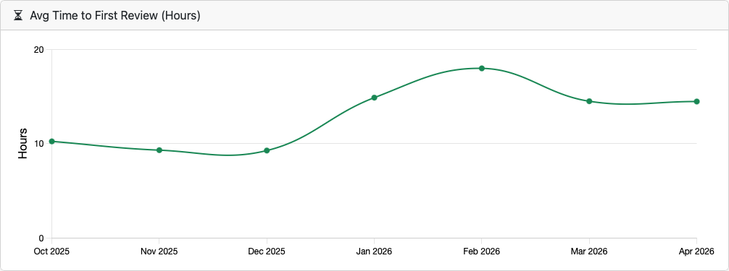
SECTION 03 · PR SIGNALS
Review & rework patterns
— AVG REVIEW ROUNDS
— TIME TO MERGE
— CHANGES REQUESTED
— TIME TO FIRST REVIEW
Back-and-forth cycles per PR.
PR open → merged.
% of PRs pushed back.
Collaboration health.
Eric Martin
From PRs to Performance
Momentum 2026
Notes:
"Four charts, four stories. Review rounds tells you how many back-and-forth cycles a PR goes through before merge. If this number is creeping up, your team might be shipping less-ready PRs, or your reviewers might be getting pickier; worth investigating. Time to merge; how long from PR open to merged. Changes requested rate; what percentage of PRs get pushed back. And time to first review, this is the collaboration metric. If PRs sit for 18 hours before anyone looks at them, you have a review culture problem, not a code quality problem."

Slide 22
04
AI-ASSISTED QUALITY ANALYSIS,
RESPONSIBLY
Classification is a signal, not a verdict.
SECTION 04 / 07
Notes:
"We're going to use AI to classify code quality. Not JUDGE it. CLASSIFY it.
Big difference. Judging is what your tech lead does on Slack at 11pm.
Classifying is what the robot does. Politely. In a JSON response."

Slide 23
AI as your analytics engineer · not your judge
01
02
Classifies every PR comment
Scores four dimensions
Bug? Missing test? Design issue? Praise?
Testing, Code Quality, Collaboration, and Standards; weighted per your priorities.
03
04
Generates coaching summaries
Flags its own uncertainty
Talking points for 1:1 prep; never verdicts, always questions.
Every classification ships with a confidence score. Low confidence = verify.
Eric Martin
From PRs to Performance
Momentum 2026
Notes:
"Here's the part where half of you get excited and the other half get nervous. We're using Claude to analyze PR review comments. Not to replace code review. Not to judge engineers. To classify and pattern-match at a scale no human can do manually. Every PR review comment gets categorized, is this pointing out a bug? A missing test? A design issue? Praise? That classification feeds into per-engineer scoring across four dimensions. But, and this is the most important 'but' in this entire talk, every score comes with a confidence rating. Because if the AI is only 50% sure that comment was about a missing test, you should probably check before you bring it up in a 1:1."

Slide 24
How we prompt the AI
The classification prompt · simplified but faithful to what runs
SYSTEM
You are a code review analyst specializing
in PR comment classification.
Classify each comment into exactly these categories:
bug_found | security_issue | missing_tests
design_issue | dry_violation | style_issue
praise | learning | nitpick | neutral ...
Return JSON: category, confidence (0.0-1.0),
reasoning.
Eric Martin
From PRs to Performance
Momentum 2026
Notes:
"Here's the actual prompt, simplified for the slide but this is what runs. Notice a few things. First, we're asking for exactly one category per comment. No ambiguity. Second, we ask for a confidence score between 0 and 1. And third, we ask for reasoning, a brief explanation of why it chose that category. The reasoning is important because when I spot-check the AI's work, and you should always spot-check, I can see if it understood the comment or got confused. The model is Claude Opus, which costs more than Haiku but gave us about 5 percentage points more accuracy on the ambiguous categories."

Slide 25
Four dimensions · deliberately weighted
These are editorial choices. Pick weights that match YOUR team's values.
30%
25%
25%
20%
TESTING
CODE QUALITY
COLLABORATION
STANDARDS
Testing habits have the highest leverage to improve.
Security issues, design patterns, first-pass approval rate.
PR size, praise received,
review engagement.
Design, DRY, indexing,
style discipline.
Eric Martin
From PRs to Performance
Momentum 2026
Notes:
"Four dimensions, deliberately weighted. Testing is 30%, that's the heaviest weight because in my experience, testing habits are the highest-leverage behavior to improve. Code quality is 25%, bugs found, security issues. Collaboration is 25%, PR size, praise received, review engagement. Standards is 20%, design issues, DRY violations. I'm making an opinionated statement with these weights: I care more about whether you write tests than whether your code follows every design pattern. You should set weights that match YOUR team's values."

Slide 26
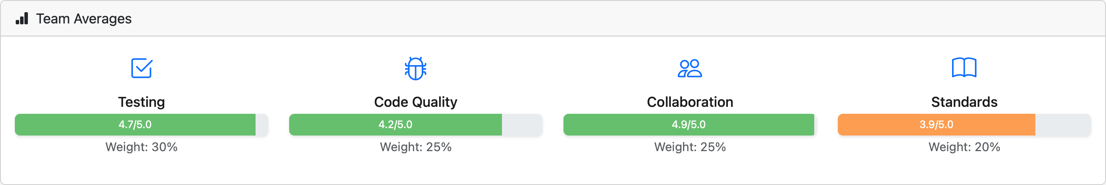
Team averages
TESTING
CODE QUALITY
COLLABORATION
STANDARDS
4.7 / 5
4.2 / 5
4.9 / 5
3.9 / 5
Eric Martin
From PRs to Performance
Momentum 2026
Notes:
"The team averages give you the 10,000-foot view. Testing at 4.7 out of 5, our team is pretty solid on testing. Standards at 3.7, that's our growth area. Then the per-engineer table. And notice the Trend column, those green arrows mean improving, red means declining. I don't use this table for performance reviews. I use it for 1:1 prep. If I see someone declining over two periods, I know to ask about it. Not accuse. Ask."

Slide 27
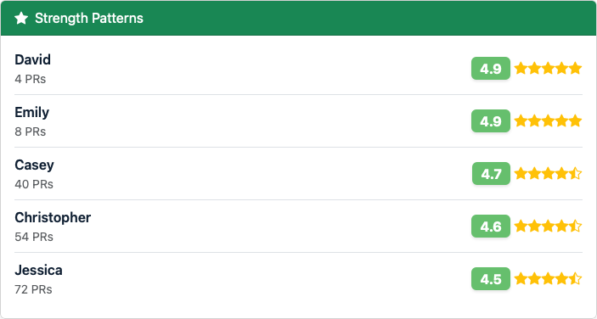
Team · Strength Patterns
Eric Martin
From PRs to Performance
Momentum 2026
Notes:
"The team averages give you the 10,000-foot view. Testing at 4.7 out of 5, our team is pretty solid on testing. Standards at 3.7, that's our growth area. Then the per-engineer table. And notice the Trend column, those green arrows mean improving, red means declining. I don't use this table for performance reviews. I use it for 1:1 prep. If I see someone declining over two periods, I know to ask about it. Not accuse. Ask."

Slide 28
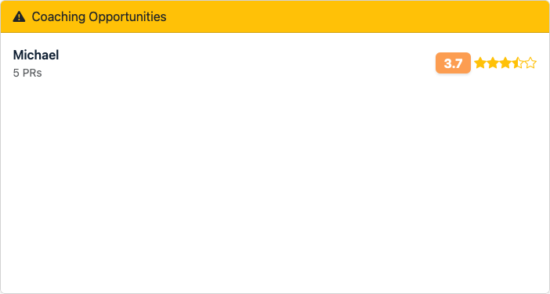
Team · Coaching Opportunities
Eric Martin
From PRs to Performance
Momentum 2026
Notes:
"The team averages give you the 10,000-foot view. Testing at 4.7 out of 5, our team is pretty solid on testing. Standards at 3.7, that's our growth area. Then the per-engineer table. And notice the Trend column, those green arrows mean improving, red means declining. I don't use this table for performance reviews. I use it for 1:1 prep. If I see someone declining over two periods, I know to ask about it. Not accuse. Ask."

Slide 29
05
HOW TO APPLY
THE SIGNALS
From notice → contextualize → conversation.
SECTION 05 / 07

Slide 30
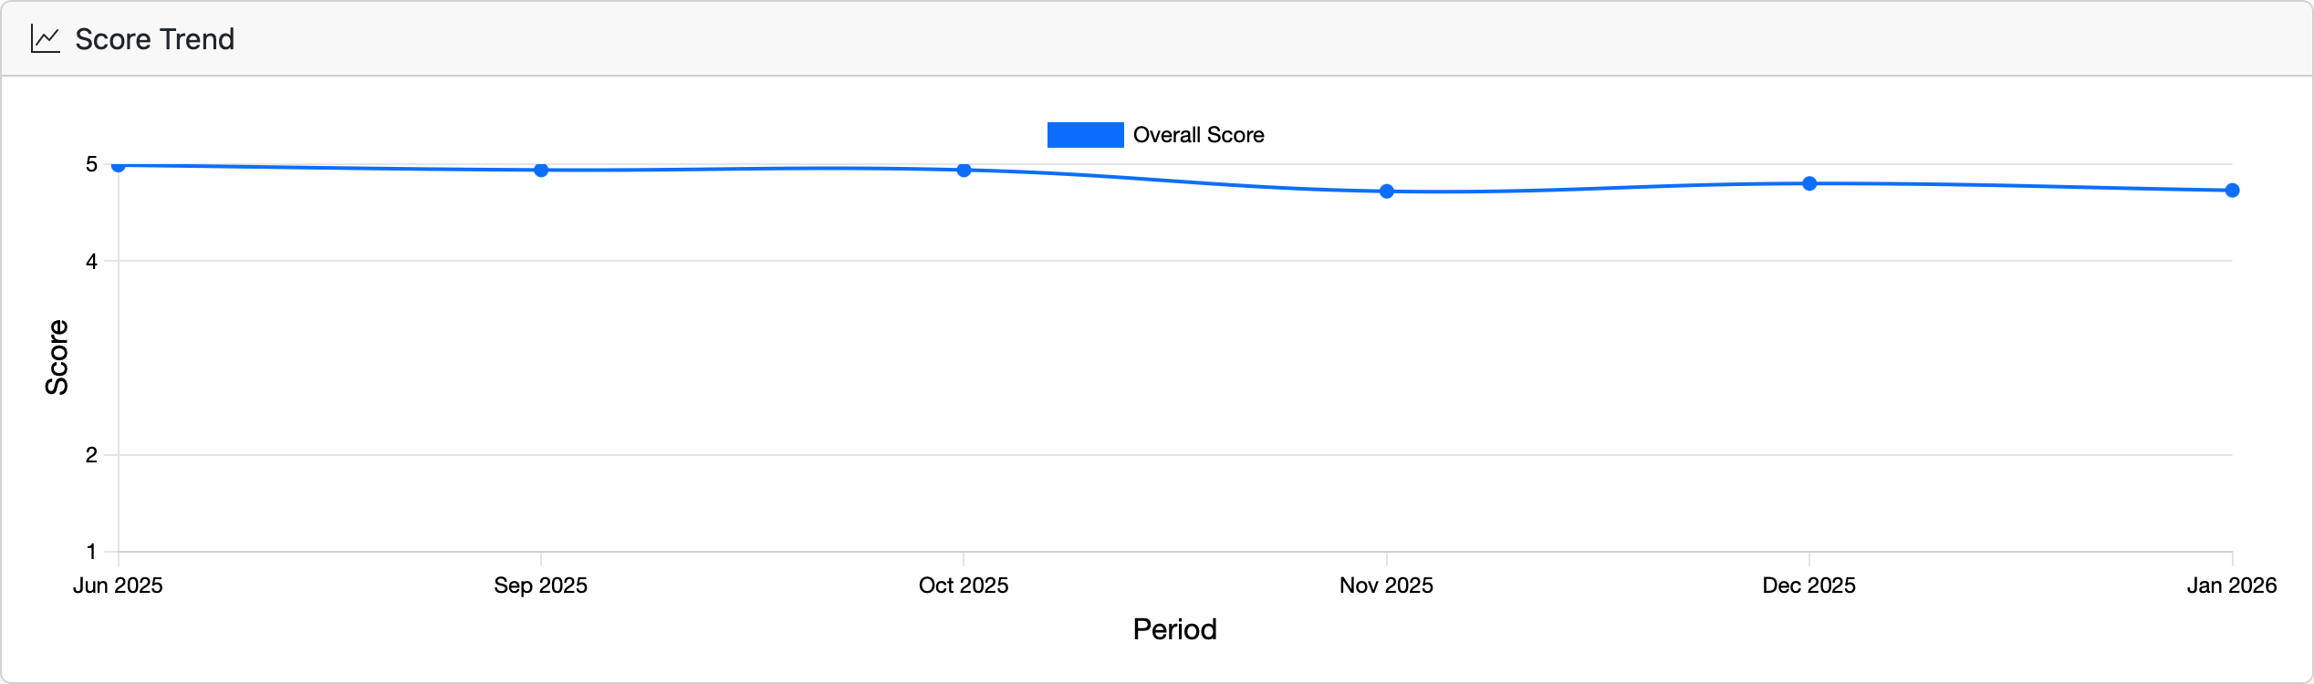
One engineer · at a glance
Team context, PR signals, AI coaching suggestions; all on one page.
TEAM CONTEXT
PR SIGNALS
COACHING PROMPT
SCORE BREAKDOWN
Eric Martin
From PRs to Performance
Momentum 2026
Notes:
"This is what you see when you click into an individual engineer. Team context; they're in the 100th percentile, with deltas showing how they compare. PR signals; 3.1 average review rounds, 67.9% first-pass approval. And look at the Coaching Prompt card on the right; the AI is already suggesting a specific PR to discuss and what to watch for. The four score cards below give you the breakdown. This person is 5.0 on code quality and collaboration, 4.7 on testing, 4.3 on standards. That standards score tells me they might benefit from pairing on architecture decisions. Not because they're bad; because that's their growth edge."

Slide 31
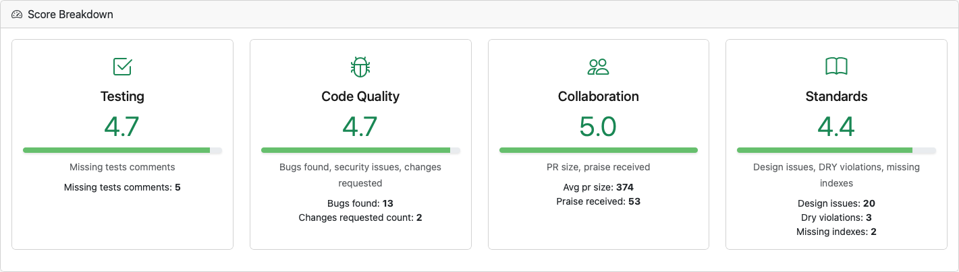
One engineer · at a glance
Team context, PR signals, AI coaching suggestions; all on one page.
TEAM CONTEXT
PR SIGNALS
COACHING PROMPT
SCORE BREAKDOWN
Eric Martin
From PRs to Performance
Momentum 2026
Notes:
"This is what you see when you click into an individual engineer. Team context; they're in the 100th percentile, with deltas showing how they compare. PR signals; 3.1 average review rounds, 67.9% first-pass approval. And look at the Coaching Prompt card on the right; the AI is already suggesting a specific PR to discuss and what to watch for. The four score cards below give you the breakdown. This person is 5.0 on code quality and collaboration, 4.7 on testing, 4.3 on standards. That standards score tells me they might benefit from pairing on architecture decisions. Not because they're bad; because that's their growth edge."

Slide 32
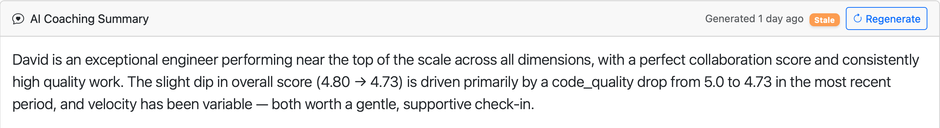
One engineer · at a glance
Team context, PR signals, AI coaching suggestions; all on one page.
TEAM CONTEXT
PR SIGNALS
COACHING PROMPT
SCORE BREAKDOWN
Eric Martin
From PRs to Performance
Momentum 2026
Notes:
"This is what you see when you click into an individual engineer. Team context; they're in the 100th percentile, with deltas showing how they compare. PR signals; 3.1 average review rounds, 67.9% first-pass approval. And look at the Coaching Prompt card on the right; the AI is already suggesting a specific PR to discuss and what to watch for. The four score cards below give you the breakdown. This person is 5.0 on code quality and collaboration, 4.7 on testing, 4.3 on standards. That standards score tells me they might benefit from pairing on architecture decisions. Not because they're bad; because that's their growth edge."

Slide 33
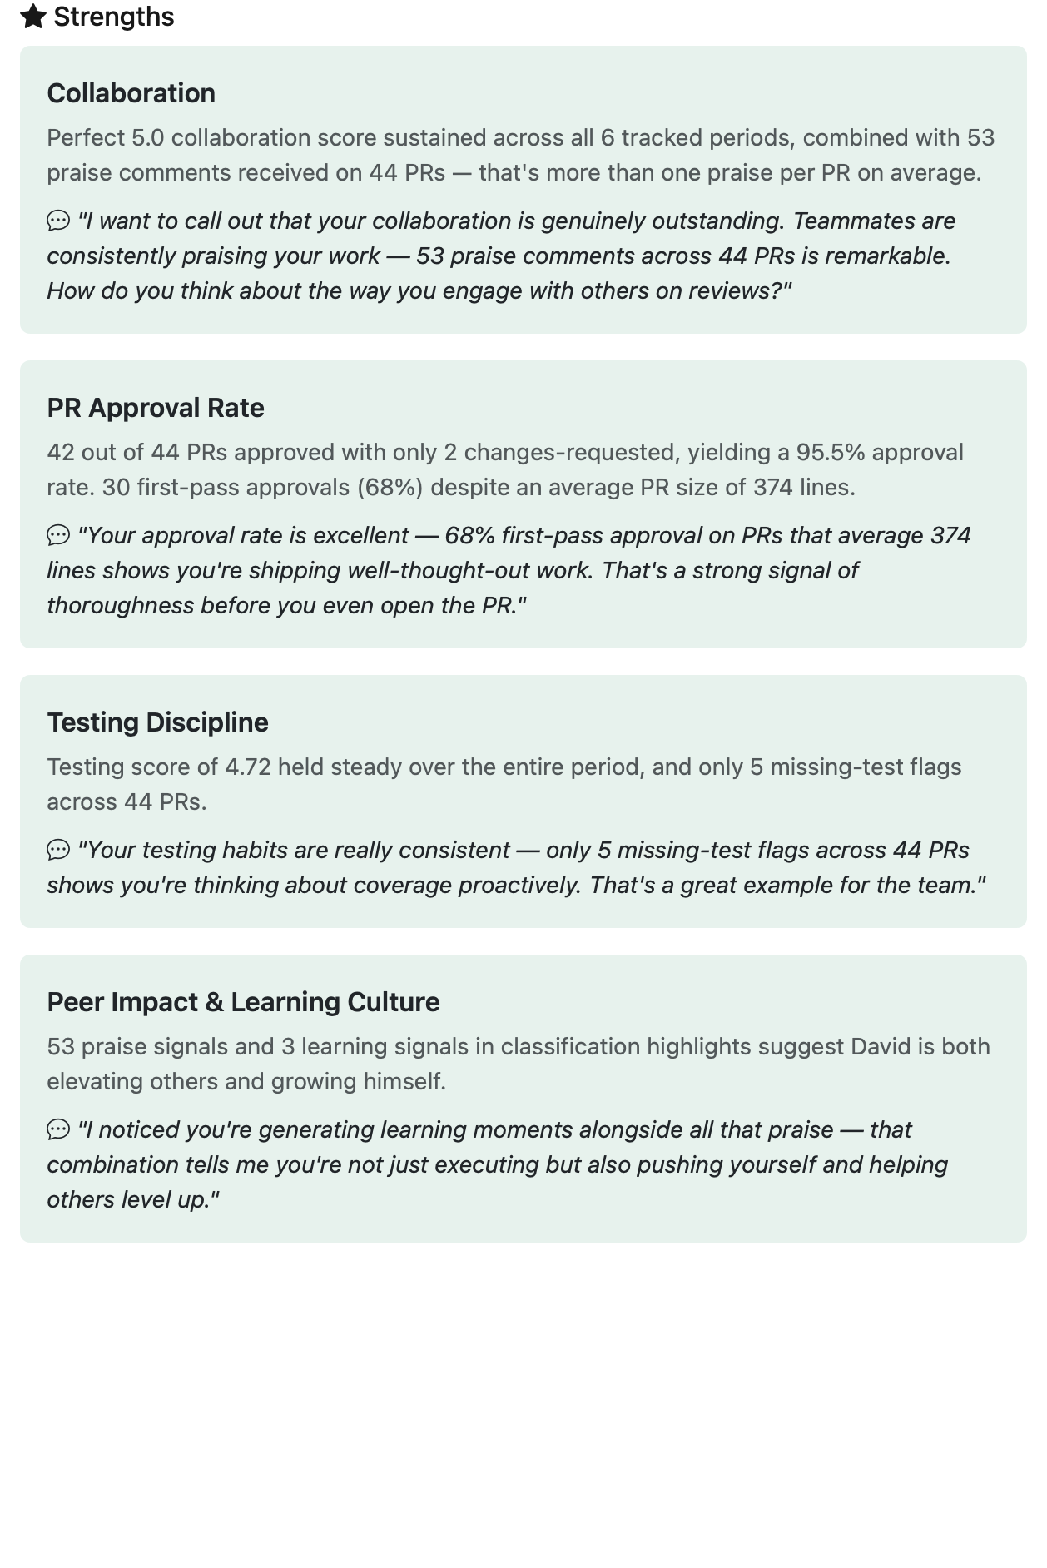
One engineer · at a glance
Team context, PR signals, AI coaching suggestions; all on one page.
TEAM CONTEXT
PR SIGNALS
COACHING PROMPT
SCORE BREAKDOWN
Eric Martin
From PRs to Performance
Momentum 2026
Notes:
"This is what you see when you click into an individual engineer. Team context; they're in the 100th percentile, with deltas showing how they compare. PR signals; 3.1 average review rounds, 67.9% first-pass approval. And look at the Coaching Prompt card on the right; the AI is already suggesting a specific PR to discuss and what to watch for. The four score cards below give you the breakdown. This person is 5.0 on code quality and collaboration, 4.7 on testing, 4.3 on standards. That standards score tells me they might benefit from pairing on architecture decisions. Not because they're bad; because that's their growth edge."

Slide 34
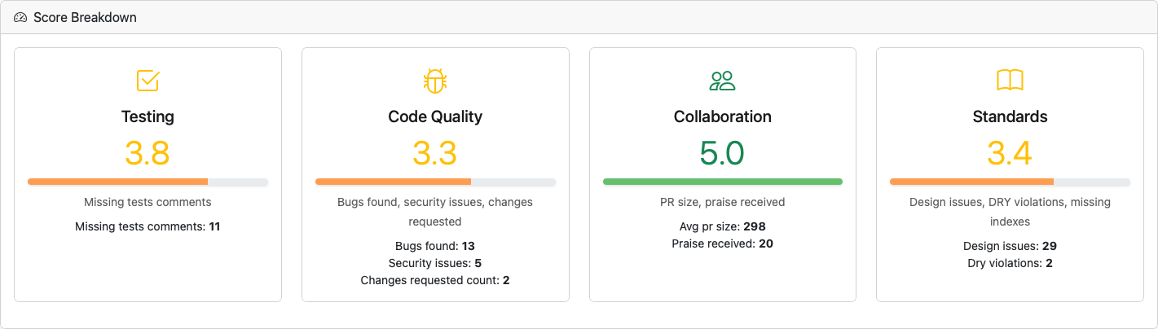
One engineer · at a glance
Team context, PR signals, AI coaching suggestions; all on one page.
TEAM CONTEXT
PR SIGNALS
COACHING PROMPT
SCORE BREAKDOWN
Eric Martin
From PRs to Performance
Momentum 2026
Notes:
"This is what you see when you click into an individual engineer. Team context; they're in the 100th percentile, with deltas showing how they compare. PR signals; 3.1 average review rounds, 67.9% first-pass approval. And look at the Coaching Prompt card on the right; the AI is already suggesting a specific PR to discuss and what to watch for. The four score cards below give you the breakdown. This person is 5.0 on code quality and collaboration, 4.7 on testing, 4.3 on standards. That standards score tells me they might benefit from pairing on architecture decisions. Not because they're bad; because that's their growth edge."

Slide 35
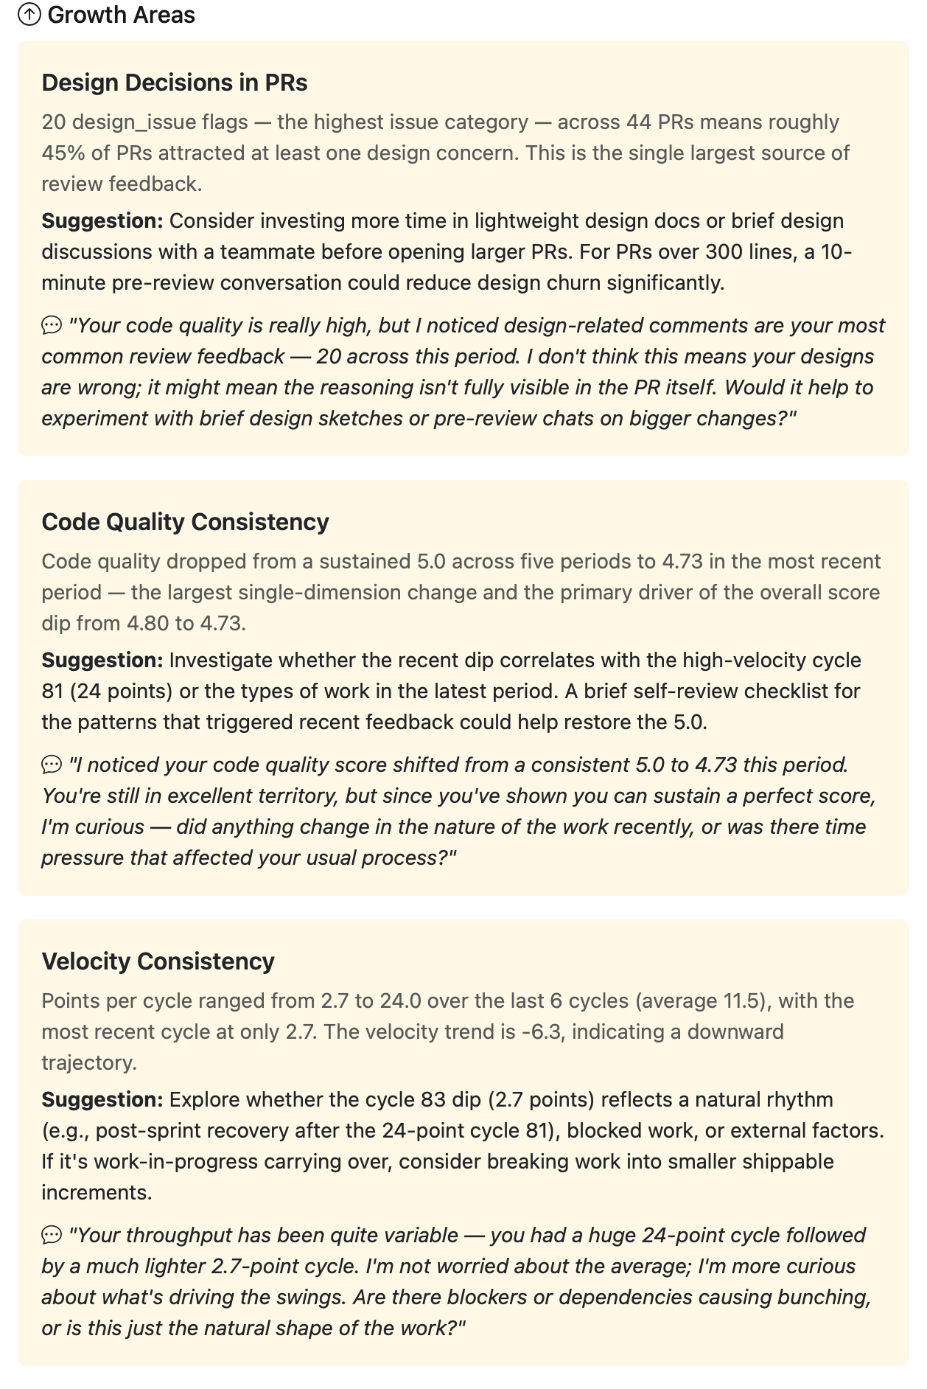
One engineer · at a glance
Team context, PR signals, AI coaching suggestions; all on one page.
TEAM CONTEXT
PR SIGNALS
COACHING PROMPT
SCORE BREAKDOWN
Eric Martin
From PRs to Performance
Momentum 2026
Notes:
"This is what you see when you click into an individual engineer. Team context; they're in the 100th percentile, with deltas showing how they compare. PR signals; 3.1 average review rounds, 67.9% first-pass approval. And look at the Coaching Prompt card on the right; the AI is already suggesting a specific PR to discuss and what to watch for. The four score cards below give you the breakdown. This person is 5.0 on code quality and collaboration, 4.7 on testing, 4.3 on standards. That standards score tells me they might benefit from pairing on architecture decisions. Not because they're bad; because that's their growth edge."

Slide 36
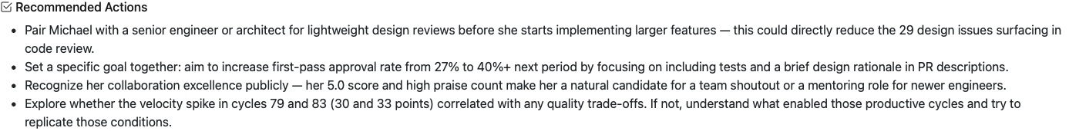
One engineer · at a glance
Team context, PR signals, AI coaching suggestions; all on one page.
TEAM CONTEXT
PR SIGNALS
COACHING PROMPT
SCORE BREAKDOWN
Eric Martin
From PRs to Performance
Momentum 2026
Notes:
"This is what you see when you click into an individual engineer. Team context; they're in the 100th percentile, with deltas showing how they compare. PR signals; 3.1 average review rounds, 67.9% first-pass approval. And look at the Coaching Prompt card on the right; the AI is already suggesting a specific PR to discuss and what to watch for. The four score cards below give you the breakdown. This person is 5.0 on code quality and collaboration, 4.7 on testing, 4.3 on standards. That standards score tells me they might benefit from pairing on architecture decisions. Not because they're bad; because that's their growth edge."

Slide 37
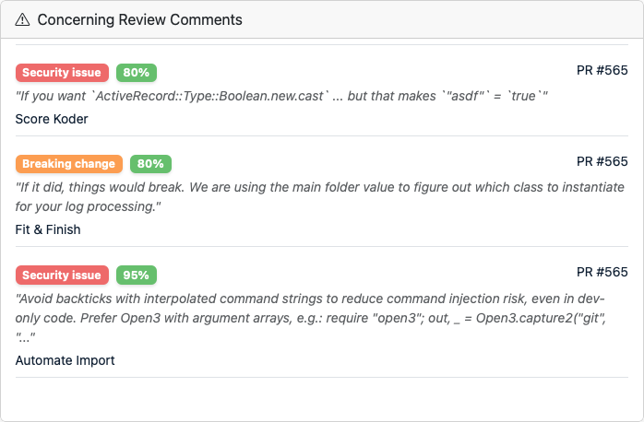
One engineer · at a glance
Team context, PR signals, AI coaching suggestions; all on one page.
TEAM CONTEXT
PR SIGNALS
COACHING PROMPT
SCORE BREAKDOWN
Eric Martin
From PRs to Performance
Momentum 2026
Notes:
"This is what you see when you click into an individual engineer. Team context; they're in the 100th percentile, with deltas showing how they compare. PR signals; 3.1 average review rounds, 67.9% first-pass approval. And look at the Coaching Prompt card on the right; the AI is already suggesting a specific PR to discuss and what to watch for. The four score cards below give you the breakdown. This person is 5.0 on code quality and collaboration, 4.7 on testing, 4.3 on standards. That standards score tells me they might benefit from pairing on architecture decisions. Not because they're bad; because that's their growth edge."

Slide 38
From numbers to conversation
AI-generated coaching summary with guardrails in the prompt.
You are an engineering leadership coach.
Analyze this engineer's metrics and generate
a coaching summary for their manager's 1:1.
Input: current scores, score history, PR metrics,
velocity data, classification highlights.
Return: overall assessment, strengths (with evidence),
growth areas (with talking points), velocity assessment,
recommended actions, conversation opener.
Guidelines:
- Frame growth areas as opportunities, not criticisms
- Reference actual numbers from the data
- If scores are improving, acknowledge the progress
Eric Martin
From PRs to Performance
Momentum 2026
Notes:
"This is the coaching prompt. The one that takes all that quantitative data and turns it into a conversation guide. Notice the guardrails baked into the prompt: 'Frame growth areas as opportunities, not criticisms.' 'Reference actual numbers.' 'If scores are improving, acknowledge the progress.' The AI doesn't decide what to do. It gives you talking points. You decide what's actually relevant based on context the AI doesn't have, like the fact that this person just got back from parental leave, or they're leading a new initiative that doesn't show up in PR metrics."

Slide 39
From signal to action
Five steps to use the data without becoming THAT boss
1.
2.
3.
4.
5.
Notice
Contextualize
Discuss
Support
Track
The dashboard flags a pattern; a declining score, creeping rework, a timing shift.
Before you say anything, ask yourself if there's an obvious explanation.
Use the coaching summary talking points in your next 1:1, not the raw numbers.
Pair programming, targeted training, workload adjustment. This is where leadership happens.
Check the next cycle. Did support move the signal? Iterate if not.
Support first, not escalate. If your first instinct is a PIP, you've missed the point.
Eric Martin
From PRs to Performance
Momentum 2026
Notes:
"And here's how you actually USE all of this without becoming Big Brother. Five steps.
1. Notice: the dashboard flagged something.
2. Contextualize: before you say anything, ask yourself if there's an obvious explanation.
3. Discuss: use the coaching summary, not the raw numbers, in your 1:1.
4. Support: this is where leadership actually happens.
5. Track: check back next cycle.
Notice I said 'support,' not 'put on a PIP.' If your first instinct when you see a metric dip is to escalate, you've missed the entire point. These are coaching tools. If you use them as weapons, your best engineers will leave. And they should."

Slide 40
06
GUARDRAILS
FOR TRUST
Without them, none of this works.
SECTION 06 / 07

Slide 41
Guardrails that make this work
Privacy, transparency, automation; built in, not bolted on.
1.
Presentation mode
4.
Confidence on everything
One-click anonymization for demos and cross-team sharing
Every classification ships with a confidence score. Low confidence = manually verify.
2.
Engineers see their own data
5.
Multi-dimensional Scoring & Trends
Access-controlled, not hidden. Transparency breeds trust; hiding metrics breeds suspicion.
Can’t game all metrics. We watch the slope, not the snapshot.
3.
Including Human Relationships
Using real human communication in data and analytics
— If engineers don't trust the system, it doesn't matter how good the metrics are.
Eric Martin
From PRs to Performance
Momentum 2026
Notes:
"Let me talk about trust, because without it, none of this works. First, presentation mode. One click in the nav bar and every name becomes an alias. Even team names get anonymized; Platform becomes Alpha, Kompass becomes Bravo, Audit becomes Charlie, so I can demo this to the whole company, or post a screenshot in a blog, without exposing individual data or org structure. Second, the UI literally says 'AI-assisted, not truth' on every page. Third, confidence badges. Fourth, and this is the one most organizations get wrong, engineers can see their own data. Transparency breeds trust. If you hide the metrics from the people being measured, they'll assume the worst. If you show them, they'll help you make the metrics better. And fifth, automation. A weekly pipeline regenerates everything on Sunday night, so nobody has to remember to press a button. If the data is always current, nobody can argue 'well, those numbers are stale.'"

Slide 42
07
BUILD THIS
YOURSELF
The stack is straightforward. The conversation with your team is the hard part.
SECTION 07 / 07

Slide 43
5-phase build plan
Web App Framework, DB, background jobs, charting framework, and AI API
Phase 1
Phase 2
Phase 3
Phase 4
Phase 5
Ongoing
Connect data
Velocity math
PR analysis
AI classification
Scoring & coaching
Calibrate
Sync services for GitHub and Linear/Jira APIs.
Points, hours-per-point, chart dashboard.
Rework patterns, review cycle metrics.
Comment categorization with AI.
Confidence labels, coaching summaries.
Iterate and communicate
THE HARDEST PART
isn't the code.
It's the conversation with your team about why.
Eric Martin
From PRs to Performance
Momentum 2026
Notes:
"You can build this. Seriously. The tech stack is straightforward; web app framework, DB, background jobs, charts for visualization, and AI API for the AI layer. The total API cost for classifying all our PR comments is about the same as your team's monthly coffee budget. The hardest part isn't the code. It's the conversation with your team about WHY you're doing it. Have that conversation first. Get their input on what dimensions matter. Let them help calibrate. If they feel ownership over the system, they'll trust it.”
"I'm gonna show you how to build this yourself. It's not that hard.
I mean — it WAS hard. For me. I did it.
But for YOU? Probably fine.”
(beat) "That's the most honest sentence in any conference talk you'll see today."

Slide 44
What to remember tomorrow morning
Three things to take with you.
3.
Guardrails are a feature.
Credibility through transparency, confidence labels, and access control — with hours-per-point as your constant against time.
2.
Three tiers.
Outcomes are the rearview mirror. System signals are the dashboard. Behaviors are the engine light.
1.
Start conversations, not end careers.
If your first instinct when a metric dips is to escalate, you've missed the entire point.
Eric Martin
From PRs to Performance
Momentum 2026
Notes:
"Five things to take with you.
The three-tier framework; know the difference between outcomes, signals, and behaviors.
Hours-per-point. To calculate it this week.
AI confidence labels: if you add AI to your metrics, add confidence, or you'll create a monster.
Guardrails: presentation mode, transparency, access control.
I cannot stress this enough; these metrics should start conversations. If the first thing you do with this data is put someone on a performance improvement plan, you've failed. If the first thing you do is have a curious, supportive 1:1 where you ask 'Hey, I noticed a pattern. What's going on and how can I help?’, you've succeeded."

Slide 45

SCAN →
Thank you
Metrics should start conversations, not end careers.
Questions?
Let's connect.
Eric Martin
Director of Software Engineering, KODE Health
linkedin.com/in/ericemartin1
From PRs to Performance
Momentum 2026
Notes:
"Thank you. I'll be around for questions. And if anyone asks me to rank my engineers using this data, I will politely but firmly point you to slide 4. Alright, what questions do you have?"

Slide 46
GO HOME AND BUILD THIS
YOURSELF
Now! Why are you still here?

Slide 48
SECTION 02 · VELOCITY
Hours per point · the great equalizer
TEAM A
TEAM B
50
30
points shipped
points shipped
× 3 hrs/pt
× 5 hrs/pt
= 150 hours
= 150 hours
— SAME EFFORT. DIFFERENT CALIBRATION.
Raw velocity hides this. Hours per point exposes it, and stops the "that team ships more" argument dead.
Trending up? Estimation is drifting. Trending down? Getting efficient, or cutting corners. Check quality.
Eric Martin
From PRs to Performance
Momentum 2026
Notes:
"Hours per point is my single favorite metric in this entire system, and I say that knowing it sounds like I'm picking a favorite child. Here's why. If Team A ships 50 points in a cycle and Team B ships 30, your instinct is to say Team A is more productive. But if Team A's hours-per-point is 3 and Team B's is 5, then Team A spent 150 hours and Team B spent 150 hours. Same effort, different calibration. Every VP I've shown this to has had a lightbulb moment. It's the metric that stops the 'well, that team ships more points' argument dead in its tracks."

Slide 49
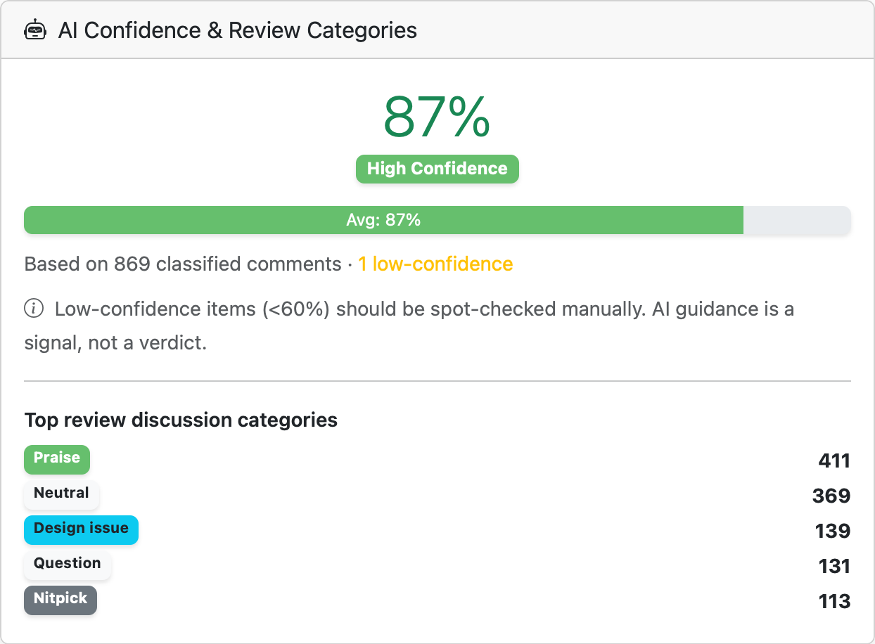
Confidence
Eric Martin
From PRs to Performance
Momentum 2026
Notes:
"This is how you keep AI from becoming 'truth.' Every classification has a confidence score. 86% overall, that's our team average. High confidence. But see that 50% badge on the 'Missing tests' classification? That means the AI wasn't sure. And honestly, when I spot-checked that one, it was a comment asking 'should we add a test for this?', which is technically a question, not a missing-test flag. The AI got confused. That's fine. That's why we show the confidence. Low-confidence items, anything under 60%, should be manually verified before you act on them. The dashboard literally tells you: 'AI guidance is a signal, not a verdict.'"

Slide 50
Calibration is important
How to know if your AI is actually helping.
9,600+
83%
COMMENTS CLASSIFIED
AVG CONFIDENCE
HIGHEST CONFIDENCE
LOWEST CONFIDENCE
praise — 89%
bug_found — 87%
neutral — 78%
nitpick — 78%
Eric Martin
From PRs to Performance
Momentum 2026
Notes:
"Calibration is not optional. It's the difference between a useful tool and a dangerous one. Here's our actual numbers. 9,600 comments classified. 83% average confidence. The AI is most confident on praise and bugs, because 'great job!' and 'this will crash in production' are hard to misinterpret. It's least confident on neutral comments and nitpicks, because 'you could also do it this way' could be a nitpick, a design suggestion, or just thinking out loud. Knowing this lets me ignore the categories where the AI struggles and trust the ones where it's reliable."

Slide 51
The AI classifies · The math scores
STAGE 01 · AI
STAGE 02 · MATH
Claude classifies comments.
Deterministic weights score.
INPUT
WEIGHTS (PER OCCURRENCE)
security_issue −3.0
missing_tests −2.5
bug_found −2.0
design_issue −1.0
praise +0.3
"This will crash in prod if X is nil"
↓
OUTPUT
bug_found · confidence 0.87
Eric Martin
From PRs to Performance
Momentum 2026
Notes:
"This is the slide that separates this system from the black-box AI products you've seen pitched. A lot of AI dashboards give you a score and say 'trust us, the model decided.' That's how you lose engineers. Here's how it actually works. The AI does one job, classification. It reads a comment and tags it. Is this a bug? A missing test? A design concern? A compliment? That's it. That's the only place Claude makes a decision."
"Then the scoring is just math. Every bug_found is worth minus 2 points. Every missing_tests is worth minus 2.5. Every praise is worth plus 0.3. We count them up per engineer, normalize per PR so someone who ships 50 PRs isn't penalized compared to someone who ships 5, then we weight the four dimensions and produce the final score."
"Why does this matter? Because when an engineer asks 'why is my code quality a 4.2 instead of a 4.5?', I can answer. I can pull up every bug_found comment that hit their PRs, show them the classifications, show them the weights, and walk them through the arithmetic. If an AI produced the final score directly, I couldn't do that. And that lack of transparency is exactly why so many engineering metrics dashboards fail."
"One more thing. You can change these weights. If your team's priority is security, crank up security_issue to -5. If you care more about design than testing, swap the dimension weights. These numbers are editorial choices, opinions, not truth. Make them *your* opinions, and be prepared to defend them."
"And notice at the bottom: three categories that are classified but *not* currently scored, `breaking_change`, `documentation`, and `nitpick`. I'm showing you that on purpose. If I hid it, someone in this audience would go read the code later and catch me. The AI still tags these categories, they're useful for trend analysis on the dashboard, but I haven't decided how much they should affect individual scores yet. That's the honest answer. Transparency includes being transparent about what's *not* done."

Slide 52
THE METRICS GRAVEYARD
Metrics to bury
What NOT to measure.
Lines of code
Individual velocity as a ranking
Congratulations! You just incentivized copy-paste. A senior who deletes 2,000 lines in a refactor looks unproductive. Every other measure says they're the MVP.
The moment velocity becomes a leaderboard; it stops measuring output and starts measuring gaming skill. Goodhart's Law in action.
PR turnaround time, no context
Commit frequency
Some PRs should take longer. A one-line typo fix and a 40-file migration are not the same PR. Treating them the same penalizes careful review.
Your Git history is not a fitness tracker. This metric just teaches engineers that `git commit -m "wip"` fifteen times a day is what success looks like.
Eric Martin
From PRs to Performance
Momentum 2026
Notes:
"Before I show you what TO measure, let's have a moment of silence for the metrics we need to bury. Lines of code. I once had a developer who deleted 2,000 lines in a refactor. By lines-of-code metrics, he had a negative productivity week. By every other measure, he was the most productive person on the team. Commit frequency; if you're measuring this, you're basically telling your engineers that `git commit -m 'wip'` fifteen times a day is what success looks like. Stop it."

Slide 53
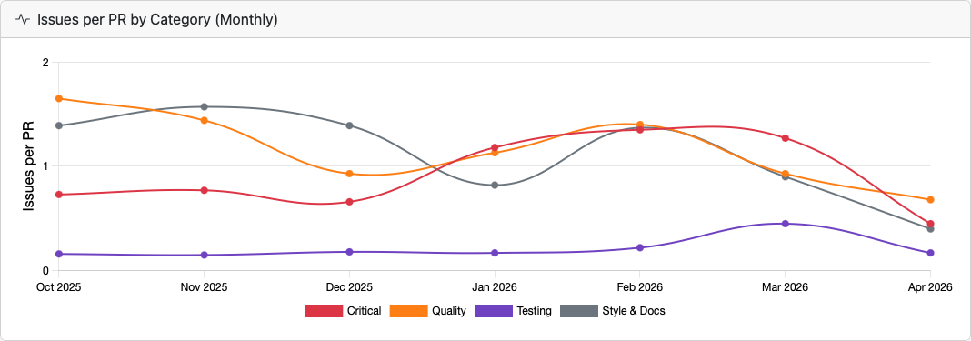
SECTION 03 · PR SIGNALS
Standards drift · is the codebase getting better or worse?
CRITICAL
QUALITY
TESTING
STYLE & DOCS
Each line = issue category, normalized per PR. Shipping more shouldn't spike the chart.
Eric Martin
From PRs to Performance
Momentum 2026
Notes:
"This is the one that tells you if your codebase is getting better or worse over time. Standards drift. Each line represents a category of issues found in PR reviews, normalized per PR so that months where you ship more don't artificially spike. If that red 'Critical' line is trending up, you have a growing quality problem. If the purple 'Testing' line is dropping, your team is getting better at including tests. The normalization is key, it answers 'are we finding more issues per PR?' not just 'are we finding more issues because we shipped more PRs?'"

