Slide 1
An Introduction To Bayesian Statistics
Simon Thornewill von Essen
Data Analyst, Goodgame Studios
@sthornewillve 🐍

Slide 2
How do we estimate the probability?
Classical: By considering equal outcomes
Frequentist: Relative Frequency over time
Bayesian: By updating our beliefs for each obs.

Slide 3
Coin Toss: Classical Est.
Coin
|
------
| |
H T
0.5 0.5

Slide 4
Dice: Classical Est.
Dice
|
--------------------------
| | | | | |
1 2 3 4 5 6
0.16 0.16 0.16 0.16 0.16 0.16

Slide 5
Classical Stats
Requirements
All Outcomes are known
Outcomes are assumed to be equally likely
Advantages
Fast Estimation
Easy to understand
Disadvantages
High Bias
Outcomes must be known
Cannot create sophisticated (high variance) models

Slide 6
How do we estimate the probability?
Classical
Frequentist
Bayesian

Slide 7
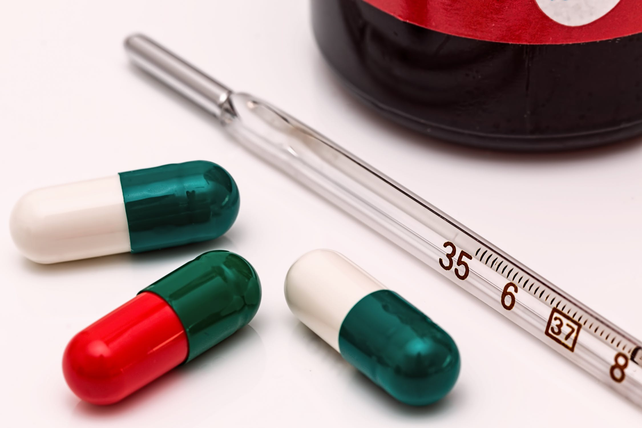
Thermometer Calibration: Frequentist Est.
Calibrating Thermometer to show accurate values
Follows a Normal Distribution
Frequentist Approach:
Take many readings and use the expectation value (mean) to find value over time.

Slide 8
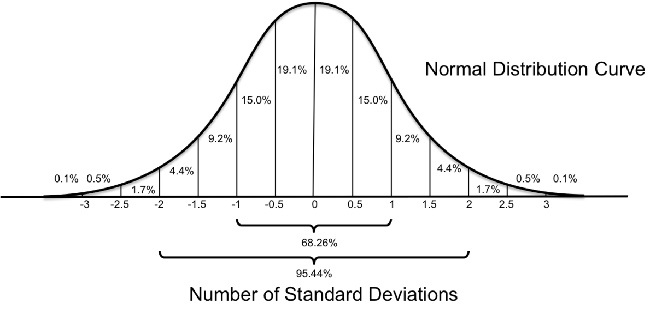
Thermometer Calibration: Frequentist Est.
Confidence Interval:
From sample mean and standard deviation, calculate an interval
“Interval that contains the true parameter some percent of the time”

Slide 9
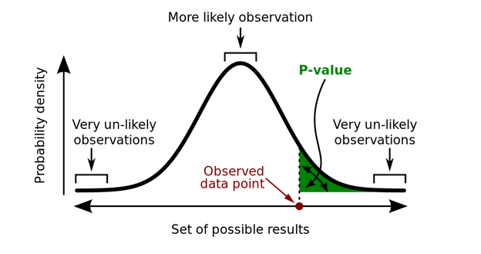
Probability of Rain: Frequentist Est.
P-value:
Probability of data given a parameter
“The probability that outcome is due to random chance given that there is no difference between experimental groups”
P(X | μ)

Slide 10
Thermometer Calibration: Test
Mean thermometer temp is higher than assumed param, P-value = 0.001 (highly significant), Does this mean that the probability of mean thermometer temp is 0.999?
❌
2. 95% Confidence interval is [98°C, 102 °C] and mean = 100°C, Does this mean that 100°C will fall inside this interval 95% of the time?
❌

Slide 11
Thermometer Calibration: Test
Mean thermometer temp is higher than assumed param, P-value = 0.001 (highly significant), Probability of getting this result given no difference in experimental groups is 0.001
2. 95% Confidence interval is [98°C, 102 °C] and mean = 100°C, Interval will contain the parameter 95% of the time

Slide 12
Thermometer Calibration: Test Learnings
Frequentism expects that parameters exist and are fixed, the probabilities are the likelihood of our data given these expectations
Repeated Experiments
Mean

Slide 13

Thermometer Calibration: Test Learnings
Child doesn’t move, but you will only take a picture of them 95% of the time

Slide 14
Frequentist Stats
Requirements
Possibility to perform experiments indefinitely
Parameters are assumed to be specific values
Able to estimate params given enough experiments
Advantages
Works well for simulations
“Objective”
Disadvantages
Requires large sample size
Does not allow for integration of domain knowledge
P-values and confidence intervals are unintuitive
Difficult to communicate

Slide 15
Frequentist Stats Disav. Cont.
What if?
Amount of data you have is limited?
You have relevant and applicable prior information
“Infinite” experiments are not possible? (Cost, feasibility)
Stakeholders have a hard time understanding frequentist logic?
Children never stay still and assuming they don’t is blasphemy
✔️
✔️
✔️
✔️
✔️

Slide 16
How do we estimate the probability?
Classical
Frequentist
Bayesian

Slide 17
Bayes Theorem

Slide 18
How

Slide 19
Foreshadow MCMC

Slide 20
Conclusion and “Call to Action”

Slide 21
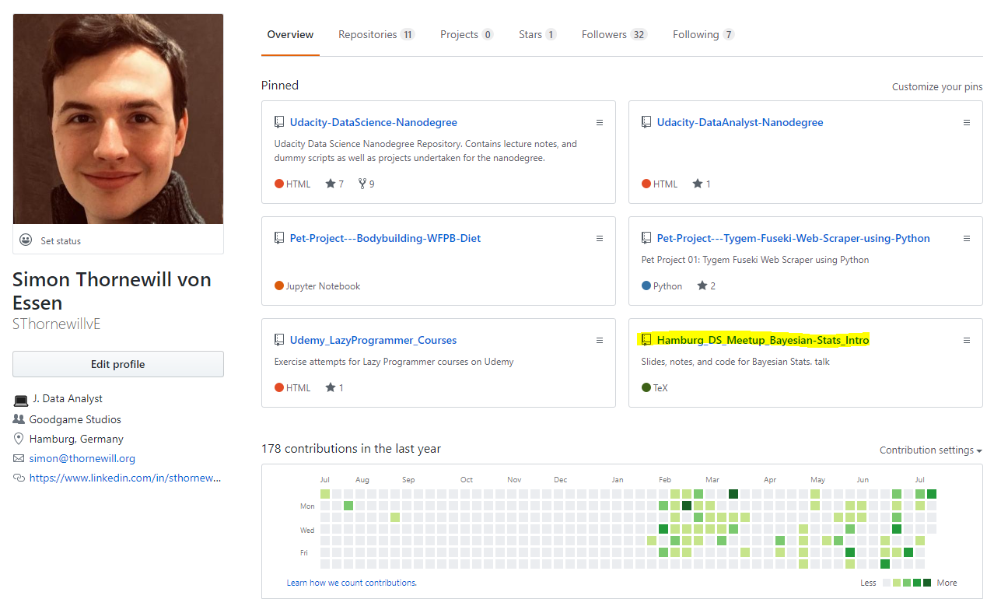

Find Slides on Github
https://cutt.ly/zGqux9

Slide 22
Find me on Social Media!
@sthornewillve

