Slide 1
An Introduction To Bayesian Statistics
Simon Thornewill von Essen
Data Analyst, Goodgame Studios
@sthornewillve 🐍

Slide 2
How do we estimate the probability?
Classical: By considering equal outcomes
Frequentist: Relative Frequency over time
Bayesian: By updating our beliefs for each obs.

Slide 3
Coin Toss: Classical Est.
Coin
|
------
| |
H T
0.5 0.5

Slide 4
Dice: Classical Est.
Dice
|
--------------------------
| | | | | |
1 2 3 4 5 6
0.16 0.16 0.16 0.16 0.16 0.16

Slide 5
Classical Stats
Requirements
All Outcomes are known
Outcomes are assumed to be equally likely
Advantages
Fast Estimation
Easy to understand
Disadvantages
High Bias
Outcomes must be known
Cannot create sophisticated (high variance) models

Slide 6
How do we estimate the probability?
Classical
Frequentist
Bayesian

Slide 7
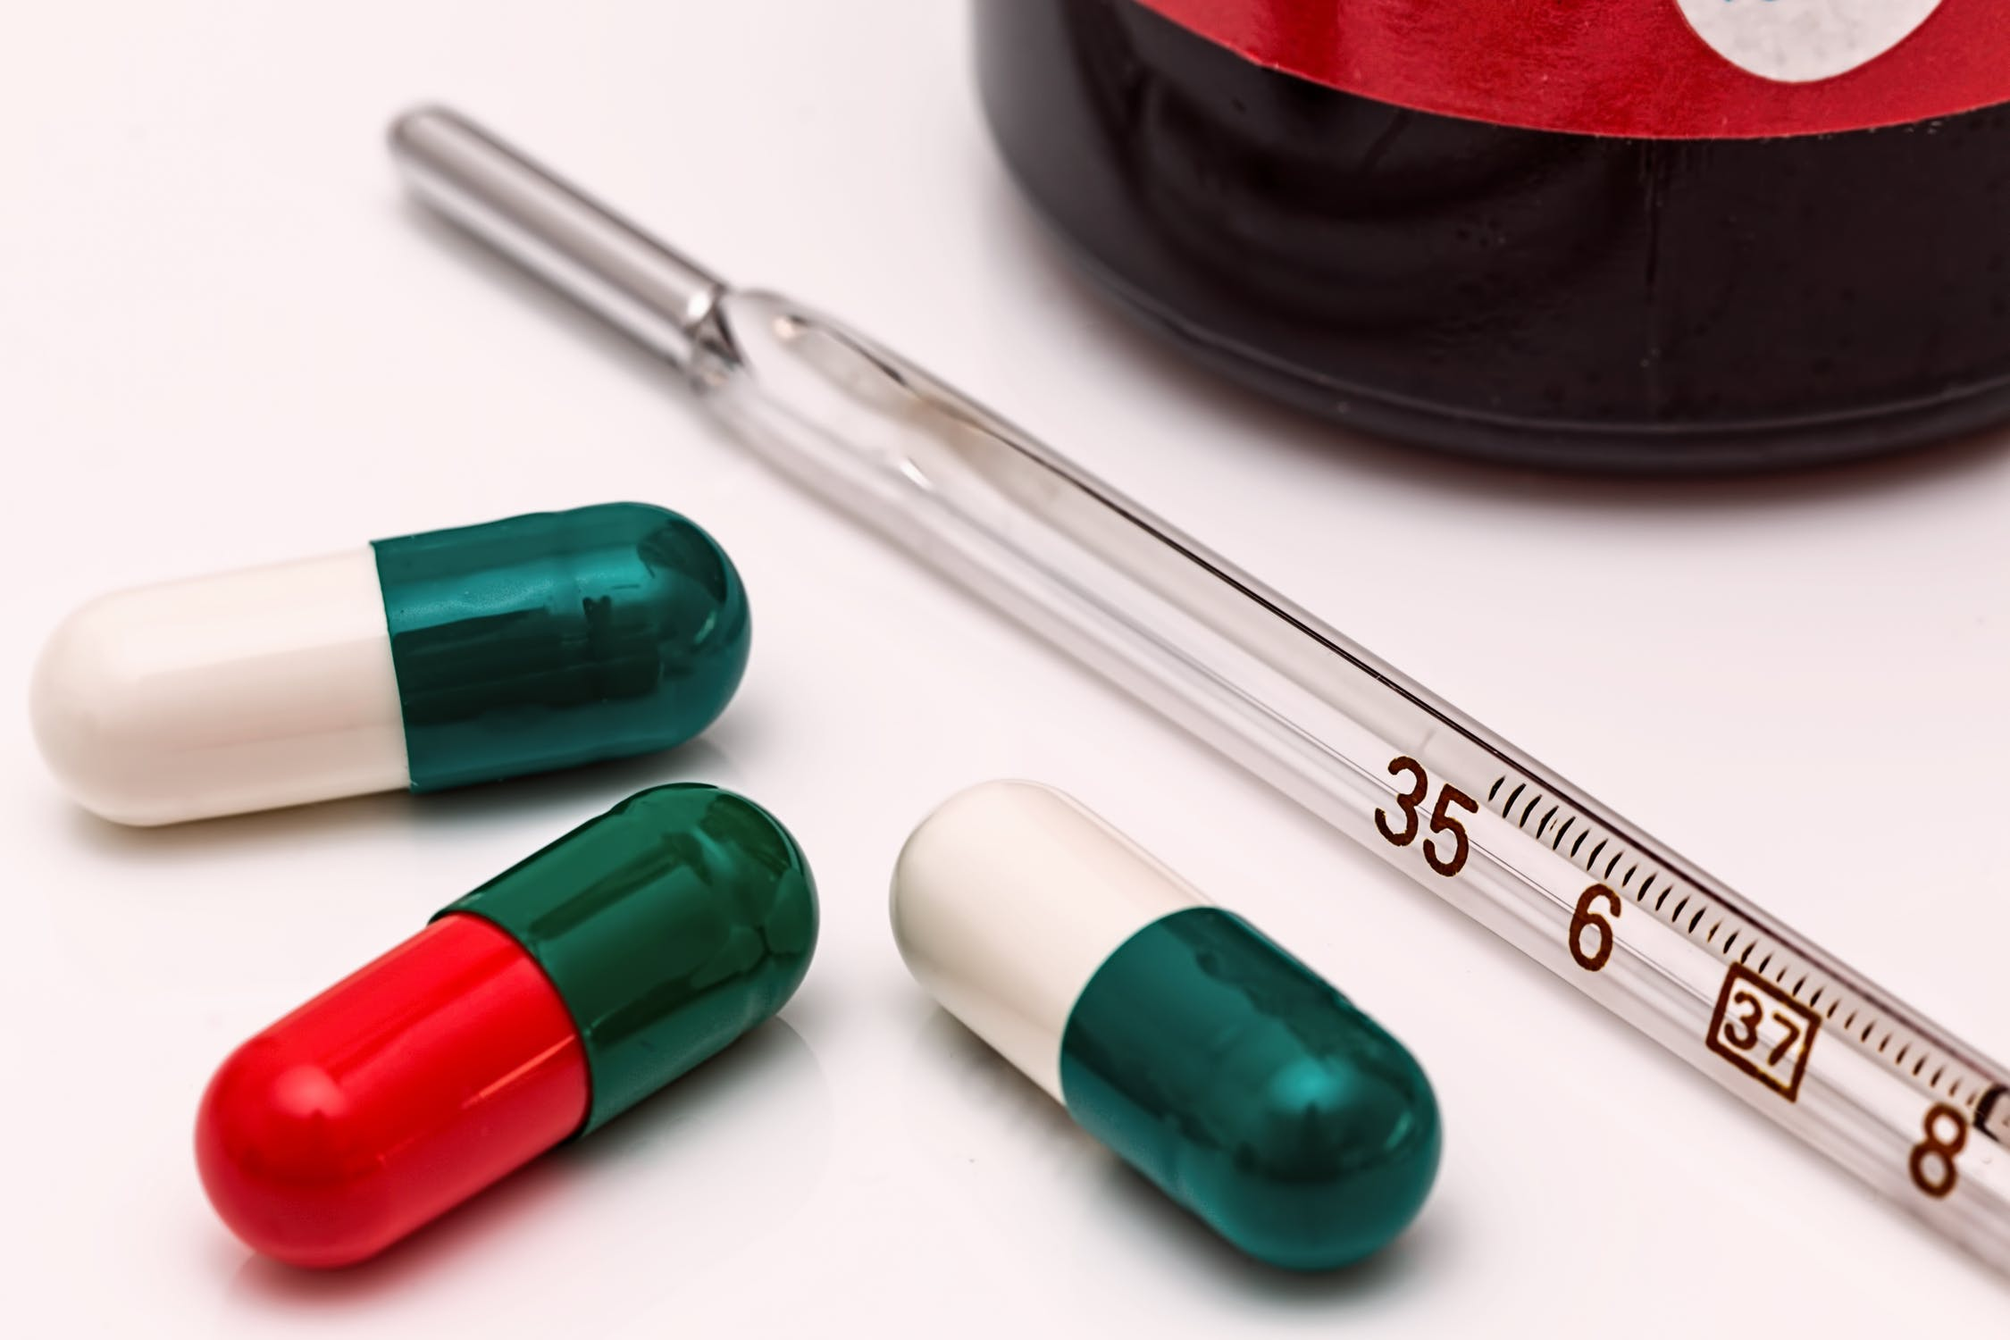
Thermometer Calibration: Frequentist Est.
Calibrating Thermometer to show accurate values
Follows a Normal Distribution
Frequentist Approach:
Take many readings and use the expectation value (mean) to find value over time.

Slide 8

Thermometer Calibration: Frequentist Est.
Confidence Interval:
From sample mean and standard deviation, calculate an interval
“Interval that contains the true parameter some percent of the time”

Slide 9
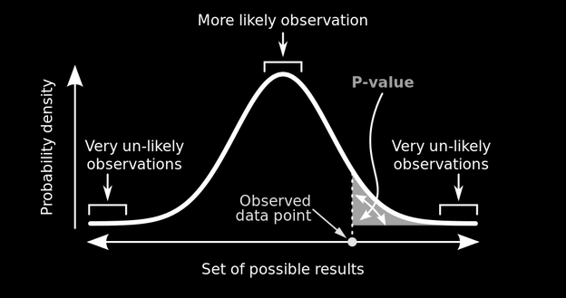
Probability of Rain: Frequentist Est.
P-value:
Probability of data given a parameter
“The probability that outcome is due to random chance given that there is no difference between experimental groups”
P(X | μ)

Slide 10
Thermometer Calibration: Test
Mean thermometer temp is higher than assumed param, P-value = 0.001 (highly significant), Does this mean that the probability of mean thermometer temp is 0.999?
❌
2. 95% Confidence interval is [98°C, 102 °C] and mean = 100°C, Does this mean that 100°C will fall inside this interval 95% of the time?
❌

Slide 11
Thermometer Calibration: Test
Mean thermometer temp is higher than assumed param, P-value = 0.001 (highly significant), Probability of getting this result given no difference in experimental groups is 0.001
2. 95% Confidence interval is [98°C, 102 °C] and mean = 100°C, Interval will contain the parameter 95% of the time

Slide 12
Thermometer Calibration: Test Learnings
Frequentism expects that parameters exist and are fixed, the probabilities are the likelihood of our data given these expectations
Repeated Experiments
Mean

Slide 13

Thermometer Calibration: Test Learnings
Child doesn’t move, but you will only take a picture of them 95% of the time

Slide 14
Frequentist Stats
Requirements
Possibility to perform experiments indefinitely
Parameters are assumed to be specific values
Able to estimate params given enough experiments
Advantages
Works well for simulations
“Objective”
Disadvantages
Requires large sample size
Does not allow for integration of domain knowledge
P-values and confidence intervals are unintuitive
Difficult to communicate

Slide 15
Frequentist Stats Disav. Cont.
What if?
Amount of data you have is limited?
You have relevant and applicable prior information
“Infinite” experiments are not possible? (Cost, feasibility)
Stakeholders have a hard time understanding frequentist logic?
Children never stay still and assuming they don’t is blasphemy
✔️
✔️
✔️
✔️
✔️

Slide 16
How do we estimate the probability?
Classical
Frequentist
Bayesian

Slide 17
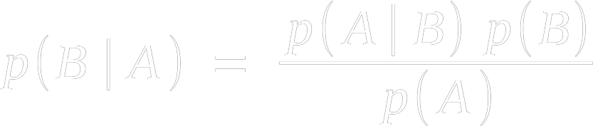
Bayes Theorem
Goal: Invert a likelihood
likelihood
prior
posterior
normalisation

Slide 18


Bayes Theorem: Derivation
The Same
∴

Slide 19

Bayes Theorem: Alternate View
𝜃 = Parameter,
X = Data
p(𝜃 | X): Prob. Param given Dat.
p(B): Prior
p(A | B): Freq. Likelihood
p(A): Normalisation Const.
✔️
Problem:
How to calculate p(X)
How to calculate p(𝜃)

Slide 20


Bayes Theorem: How to Calculate P(X)?
What is p(X)?
Sum of all possible numerators
Yes, this can get difficult

Slide 21
Bayes Theorem: How to Calculate P(𝜃)?
Create Your Own
Take Previous P(𝜃 | X)

Slide 22
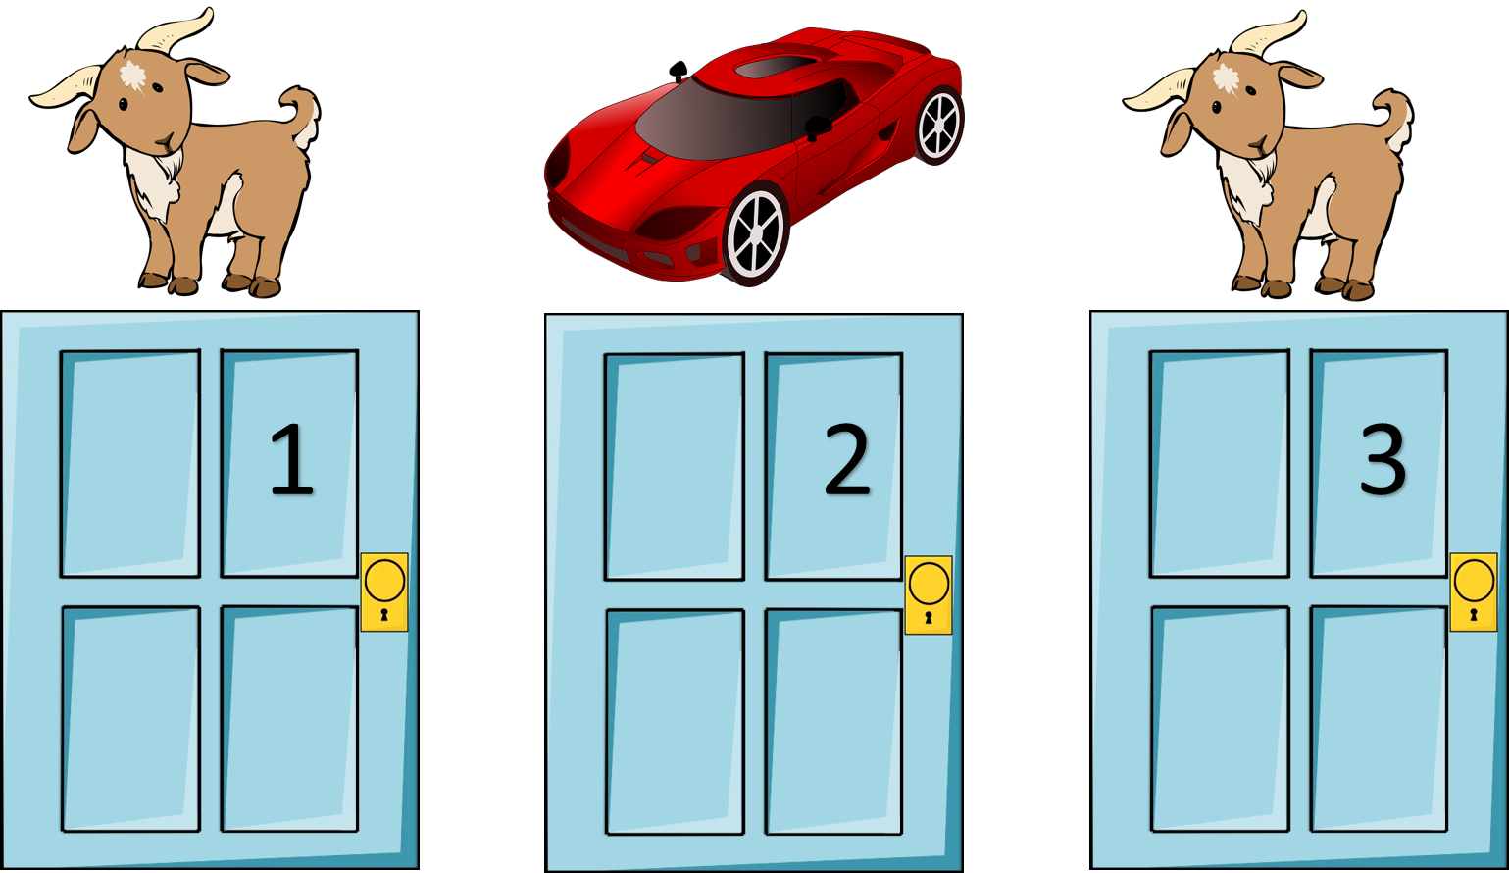
How!?: Part 1 - Discrete Case
The Monty Hall Problem:
You Pick Door 1
Monty opens door 2 to reveal a goat
Should you switch to door 3?

Slide 23
How!?: Part 1 - Priors
Hypothesis i | Prior p(𝜃_{i})
Car Behind 1 | 1/3
Car Behind 2 | 1/3
Car Behind 3 | 1/3

Slide 24
How!?: Part 1 - Likelihoods Given Priors
Hypothesis i | Prior p(𝜃_{i}) | Likelihood p(X | 𝜃_{i})
Car Behind 1 | 1/3 | 1/2
Car Behind 2 | 1/3 | 0.0
Car Behind 3 | 1/3 | 1.0

Slide 25

How!?: Part 1 - Likelihoods Given Priors
Hypothesis i | Prior p(𝜃_{i}) | Likelihood p(X | 𝜃_{i}) | Prior * Likelihood
Car Behind 1 | 1/3 | 1/2 | 1/6
Car Behind 2 | 1/3 | 0.0 | 0.0
Car Behind 3 | 1/3 | 1.0 | 1/3
= 1/6 + 0 + 2/6
= 3/6
= 1/2
* This is the Dot Product of p(𝜃_{i}) and p(X | 𝜃_{i})

Slide 26
How!?: Part 1 - Likelihoods Given Priors
Hypothesis i | Prior p(𝜃_{i}) | Likelihood p(X | 𝜃_{i}) | Prior * Likelihood | Posterior
Car Behind 1 | 1/3 | 1/2 | 1/6 | 1/3
Car Behind 2 | 1/3 | 0.0 | 0.0 | 0
Car Behind 3 | 1/3 | 1.0 | 1/3 | 2/3
= 1/6 + 2/6
= 3/6
= 1/2
* This is the Dot Product of p(𝜃_{i}) and p(X | 𝜃_{i})

Slide 27

How!?: Part 1 - Discrete Case Recap
Steps:
Pick Prior (Often Uniform)
Multiply by Frequentist Likelihood
Divide by Normalisation constant

Slide 28
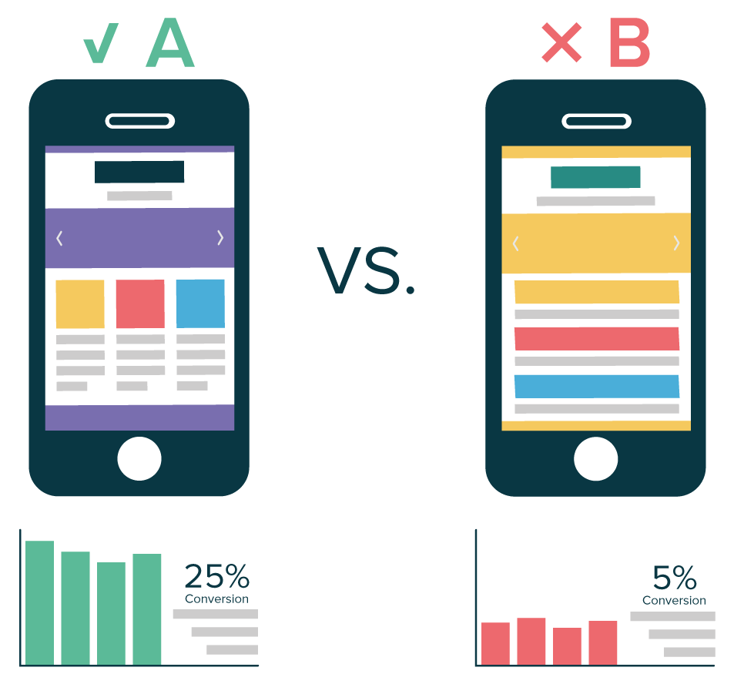
How!?: Part 2 - Continuous Case
AB Testing Revisited:
Two variants
What is the probability of the parameters for each variant given the data?
Time for Bayesian Statistics!

Slide 29

How!?: Part 2 - Continuous Case
AB Test:
For people randomly placed in control/test
Track conversions (1/0)
What is our Likelihood?
Bernoulli

Slide 30

How!?: Part 2 - Continuous Case
Prior?:
Uninformed Prior
Indicator Function

Slide 31
How!?: Part 2 - Continuous Case
Notes:
Quick and Dirty: Multiply Prior by Likelihood

Slide 32

How!?: Part 2 - Continuous Case
Notes:
For accurate, divide by the likelihood of the data at each point
Integral is gnarly, but we can make it equal to 1 to make it disappear

Slide 33


How!?: Part 2 - Continuous Case
Notes:
Make integral equal to one by adding A coefficient

Slide 34

How!?: Part 2 - Continuous Case
Notes:
Equation simplifies massively

Slide 35


How!?: Part 2 - Continuous Case
Notes:
Et Voila. A function that is easy to import from numpy

Slide 36
Conjugate Priors
Beta distribution is example of conj. Prior
Use it and you will get the same distribution in posterior
Once the math is done, never do it again
Update functions using data as it appears

Slide 37
Conjugate Priors
https://en.wikipedia.org/wiki/Conjugate_prior#Table_of_conjugate_distributions
(Just Google “conjugate priors table wikipedia”)

Slide 38
Conjugate Priors
https://en.wikipedia.org/wiki/Conjugate_prior#Table_of_conjugate_distributions
(Just Google “conjugate priors table wikipedia”)

Slide 39
Demo:
Conjugate Priors

Slide 40
Foreshadow: MCMC
Integrating is hard

Slide 41
Conclusion and “Call to Action”

Slide 42
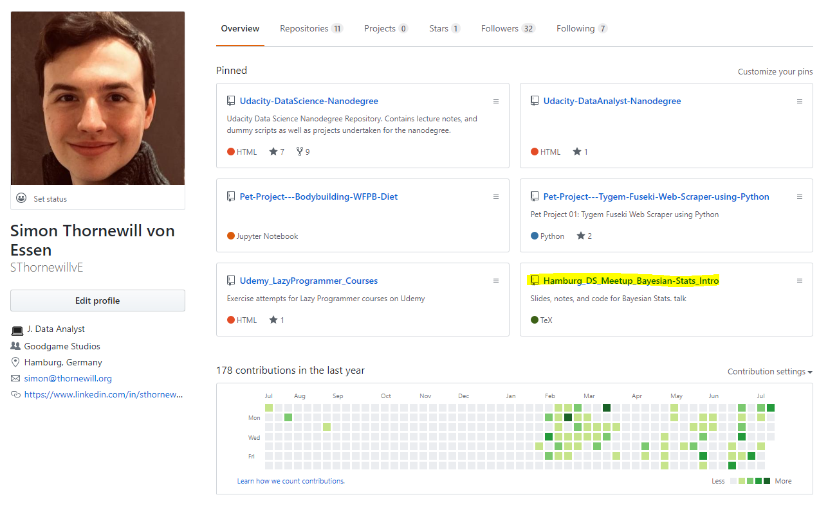

Find Slides on Github
https://cutt.ly/zGqux9

Slide 43
Find me on Social Media!
@sthornewillve

