Slide 1
An Introduction To Bayesian Statistics
Simon Thornewill von Essen
Data Analyst, Goodgame Studios
@sthornewillve 🐍

Slide 2
How do we estimate the probability?
Classical: By considering equal outcomes
Frequentist: Relative Frequency over time
Bayesian: By updating our beliefs for each obs.

Slide 3
Coin Toss: Classical Est.
Coin
|
------
| |
H T
0.5 0.5

Slide 4
Dice: Classical Est.
Dice
|
--------------------------
| | | | | |
1 2 3 4 5 6
0.16 0.16 0.16 0.16 0.16 0.16

Slide 5
Classical Stats
Requirements
All Outcomes are known
Outcomes are assumed to be equally likely
Advantages
Fast Estimation
Easy to understand
Disadvantages
High Bias
Outcomes must be known
Cannot create sophisticated (high variance) models

Slide 6
How do we estimate the probability?
Classical
Frequentist
Bayesian

Slide 7
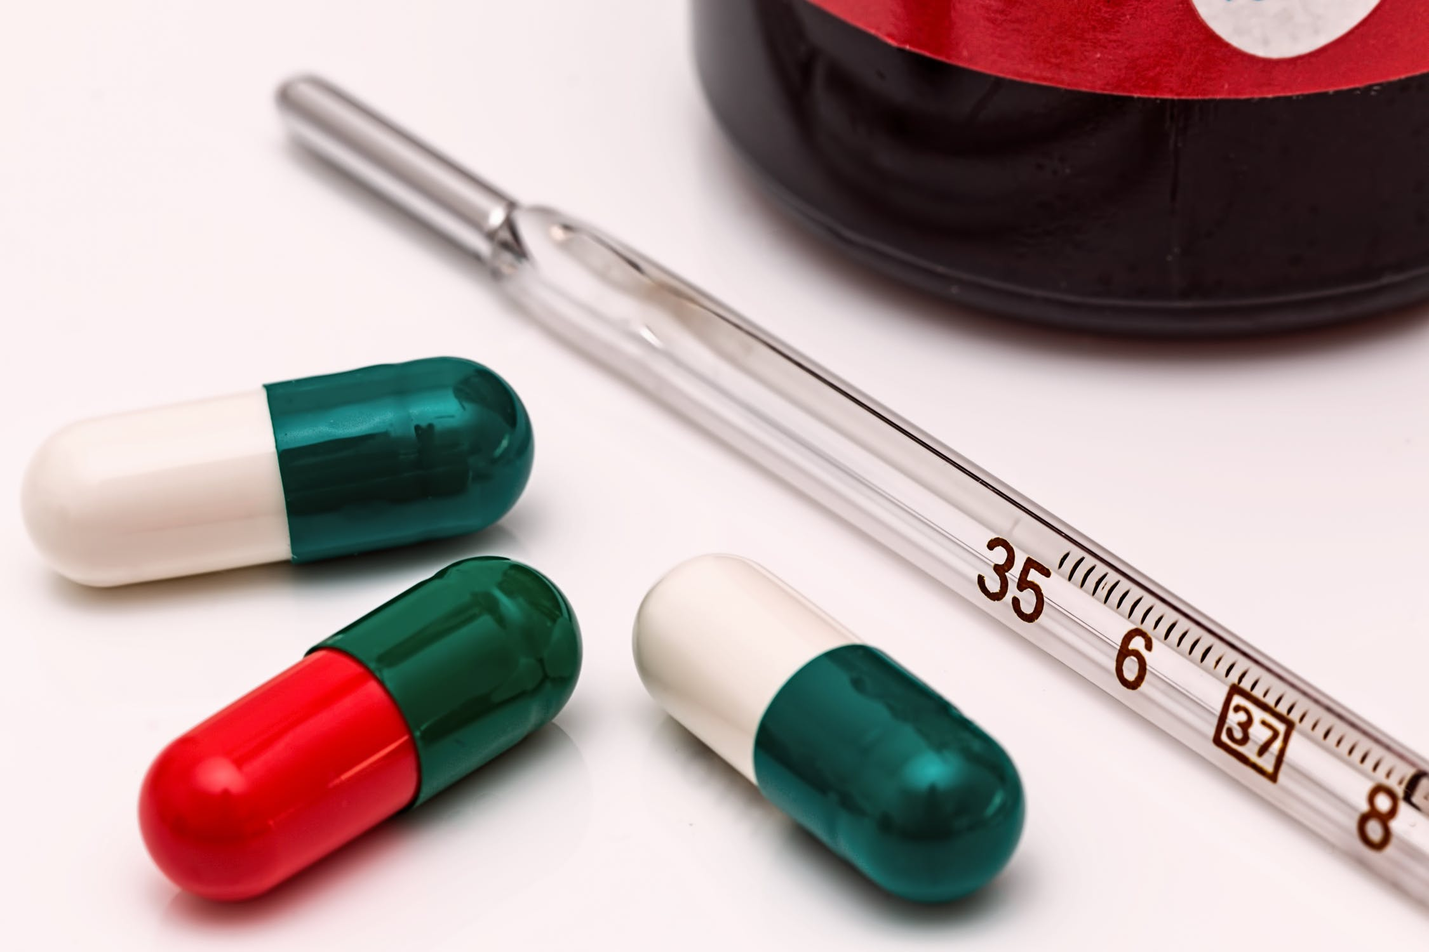
Thermometer Calibration: Frequentist Est.
Calibrating Thermometer to show accurate values
Follows a Normal Distribution
Frequentist Approach:
Take many readings and use the expectation value (mean) to find value over time.

Slide 8

Thermometer Calibration: Frequentist Est.
Confidence Interval:
From sample mean and standard deviation, calculate an interval
“Interval that contains the true parameter some percent of the time”

Slide 9
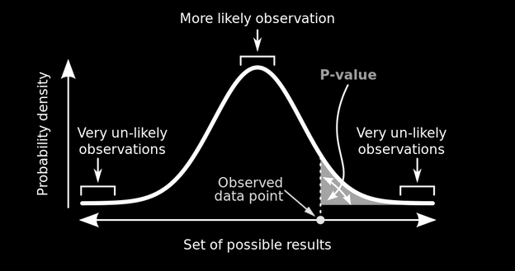
Probability of Rain: Frequentist Est.
P-value:
Probability of data given a parameter
“The probability that outcome is due to random chance given that there is no difference between experimental groups”
P(X | μ)

Slide 10
Thermometer Calibration: Test
Mean thermometer temp is higher than assumed param, P-value = 0.001 (highly significant), Does this mean that the probability of mean thermometer temp is 0.999?
❌
2. 95% Confidence interval is [98°C, 102 °C] and mean = 100°C, Does this mean that 100°C will fall inside this interval 95% of the time?
❌

Slide 11
Thermometer Calibration: Test
Mean thermometer temp is higher than assumed param, P-value = 0.001 (highly significant), Probability of getting this result given no difference in experimental groups is 0.001
2. 95% Confidence interval is [98°C, 102 °C] and mean = 100°C, Interval will contain the parameter 95% of the time

Slide 12
Thermometer Calibration: Test Learnings
Frequentism expects that parameters exist and are fixed, the probabilities are the likelihood of our data given these expectations
Repeated Experiments
Mean

Slide 13

Thermometer Calibration: Test Learnings
Child doesn’t move, but you will only take a picture of them 95% of the time

Slide 14
Frequentist Stats
Requirements
Possibility to perform experiments indefinitely
Parameters are assumed to be specific values
Able to estimate params given enough experiments
Advantages
Works well for simulations
“Objective”
Disadvantages
Requires large sample size
Does not allow for integration of domain knowledge
P-values and confidence intervals are unintuitive
Difficult to communicate

Slide 15
Frequentist Stats Disav. Cont.
What if?
Amount of data you have is limited?
You have relevant and applicable prior information
“Infinite” experiments are not possible? (Cost, feasibility)
Stakeholders have a hard time understanding frequentist logic?
Children never stay still and assuming they don’t is blasphemy
✔️
✔️
✔️
✔️
✔️

Slide 16
How do we estimate the probability?
Classical
Frequentist
Bayesian

Slide 17
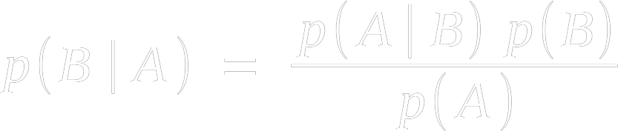
Bayes Theorem
Goal: Invert a likelihood
likelihood
prior
posterior
normalisation

Slide 18


Bayes Theorem: Derivation
The Same
∴

Slide 19

Bayes Theorem: Alternate View
𝜃 = Parameter,
X = Data
p(𝜃 | X): Prob. Param given Dat.
p(B): Prior
p(A | B): Freq. Likelihood
p(A): Normalisation Const.
✔️
Problem:
How to calculate p(X)
How to calculate p(𝜃)

Slide 20


Bayes Theorem: How to Calculate P(X)?
What is p(X)?
Sum of all possible numerators
Yes, this can get difficult

Slide 21
Bayes Theorem: How to Calculate P(𝜃)?
Create Your Own
Take Previous P(𝜃 | X)

Slide 22
Bayes Theorem: How to Calculate P(𝜃)?
Are you Baking your biases into your model?
Notes:
Making Biases explicit
With enough data, bayesian and frequentist likelihoods are equivalent such that priors are “washed out”

Slide 23
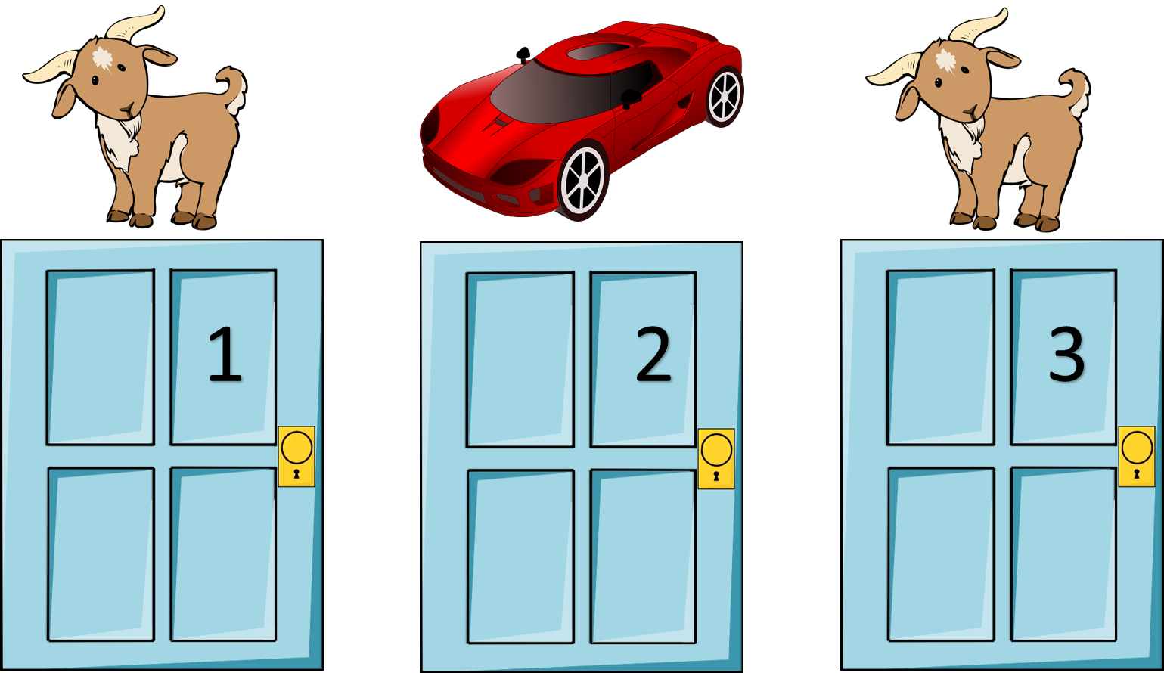
How!?: Part 1 - Discrete Case
The Monty Hall Problem:
You Pick Door 1
Monty opens door 2 to reveal a goat
Should you switch to door 3?

Slide 24
How!?: Part 1 - Priors
Hypothesis i | Prior p(𝜃_{i})
Car Behind 1 | 1/3
Car Behind 2 | 1/3
Car Behind 3 | 1/3

Slide 25
How!?: Part 1 - Likelihoods Given Priors
Hypothesis i | Prior p(𝜃_{i}) | Likelihood p(X | 𝜃_{i})
Car Behind 1 | 1/3 | 1/2
Car Behind 2 | 1/3 | 0.0
Car Behind 3 | 1/3 | 1.0

Slide 26

How!?: Part 1 - Likelihoods Given Priors
Hypothesis i | Prior p(𝜃_{i}) | Likelihood p(X | 𝜃_{i}) | Prior * Likelihood
Car Behind 1 | 1/3 | 1/2 | 1/6
Car Behind 2 | 1/3 | 0.0 | 0.0
Car Behind 3 | 1/3 | 1.0 | 1/3
= 1/6 + 0 + 2/6
= 3/6
= 1/2
* This is the Dot Product of p(𝜃_{i}) and p(X | 𝜃_{i})

Slide 27
How!?: Part 1 - Likelihoods Given Priors
Hypothesis i | Prior p(𝜃_{i}) | Likelihood p(X | 𝜃_{i}) | Prior * Likelihood | Posterior
Car Behind 1 | 1/3 | 1/2 | 1/6 | 1/3
Car Behind 2 | 1/3 | 0.0 | 0.0 | 0
Car Behind 3 | 1/3 | 1.0 | 1/3 | 2/3
= 1/6 + 2/6
= 3/6
= 1/2
* This is the Dot Product of p(𝜃_{i}) and p(X | 𝜃_{i})

Slide 28

How!?: Part 1 - Discrete Case Recap
Steps:
Pick Prior (Often Uniform)
Multiply by Frequentist Likelihood
Divide by Normalisation constant

Slide 29
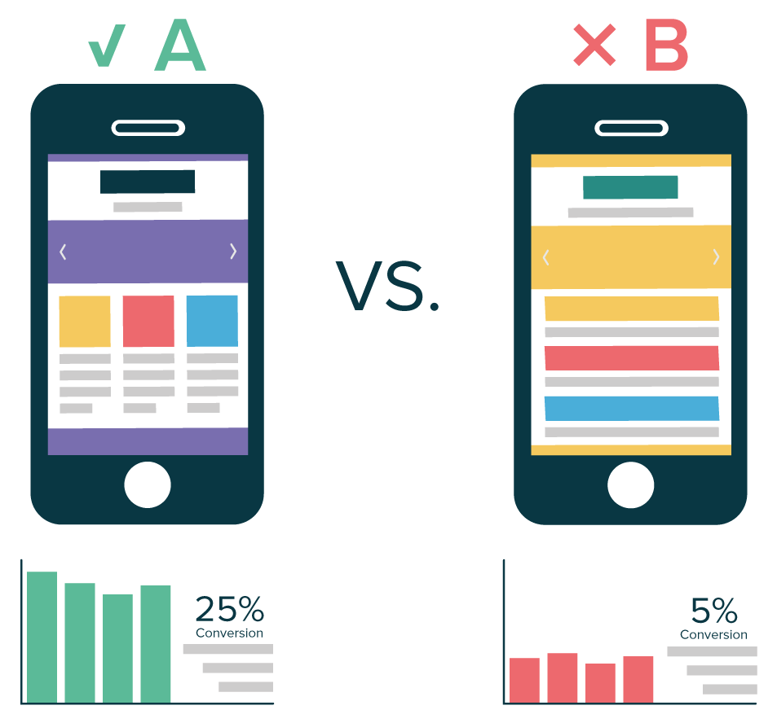
How!?: Part 2 - Continuous Case
AB Testing Revisited:
Two variants
What is the probability of the parameters for each variant given the data?
Time for Bayesian Statistics!

Slide 30

How!?: Part 2 - Continuous Case
AB Test:
For people randomly placed in control/test
Track conversions (1/0)
What is our Likelihood?
Bernoulli

Slide 31

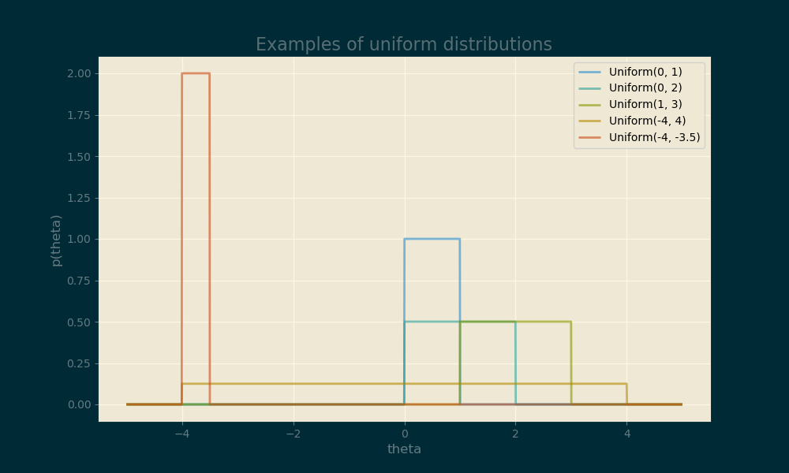
How!?: Part 2 - Continuous Case
Prior?:
Uninformed Prior
Uniform distribution
Represented by Indicator Function

Slide 32
How!?: Part 2 - Continuous Case
Notes:
Quick and Dirty: Multiply Prior by Likelihood

Slide 33

How!?: Part 2 - Continuous Case
Notes:
For accurate, divide by the likelihood of the data at each point
Integral is gnarly, but we can make it equal to 1 to make it disappear

Slide 34


How!?: Part 2 - Continuous Case
Notes:
Make integral equal to one by adding A coefficient

Slide 35

How!?: Part 2 - Continuous Case
Notes:
Equation simplifies massively

Slide 36


How!?: Part 2 - Continuous Case
Notes:
Et Voila. A function that is easy to import from numpy

Slide 37
Conjugate Priors
Beta distribution is example of conj. Prior
Use it and you will get the same distribution in posterior
Once the math is done, never do it again
Update functions using data as it appears

Slide 38
Conjugate Priors
https://en.wikipedia.org/wiki/Conjugate_prior#Table_of_conjugate_distributions
(Just Google “conjugate priors table wikipedia”)

Slide 39
Conjugate Priors
https://en.wikipedia.org/wiki/Conjugate_prior#Table_of_conjugate_distributions
(Just Google “conjugate priors table wikipedia”)

Slide 40
Posteriors - What Now?
Estimation of Parameters
Credible Intervals
Check priors

Slide 41
Demo:
Conjugate Priors

Slide 42
Foreshadow: MCMC
Integrating is hard

Slide 43
Bayesian Stats
Advantages
Incorporation of Domain Knowledge
Estimation in the case of little data (specific circumstances)
Allows for models of as little or high complexity as necessary
Parameters are distributions
Easier to communicate
Disadvantages
Steeper learning curve
Mathematics can be difficult in continuous case
Workarounds can be computationally expensive
Criticisms of being less “objective”
Estimations become the same as frequentist estimations with high sample sizes (redundant)

Slide 44
Conclusion and “Call to Action”
Remember differences between F and B to understand both
Understand that it’s not as difficult as it looks
Practice makes perfect
Sources to get started
Remember when you should consider it
Might not be necessary

Slide 45
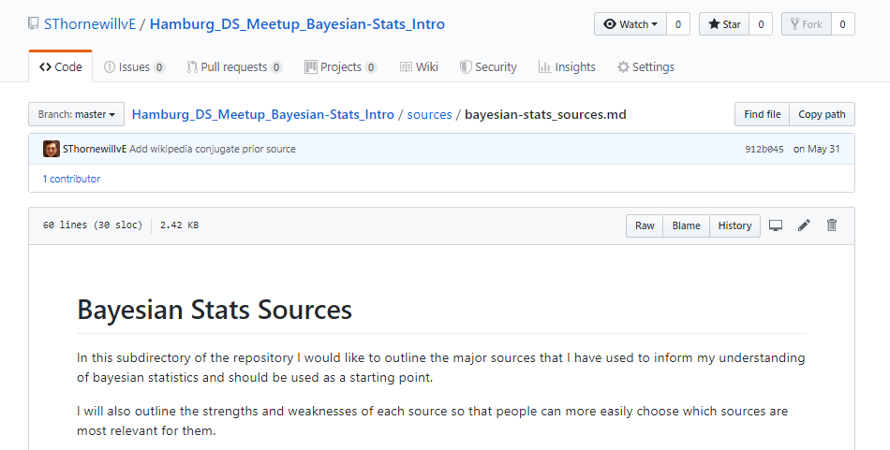
Resources for further learning

Slide 46
Resources for further learning
Mathematical Understanding: “Bayesian Stats: From Concept to Data Analysis”, U of Santa Cruz
Intuition between Bayesianism & Frequentism: “Frequentism and Bayesianism”, Scipy - Jake Vander Plas

Slide 47
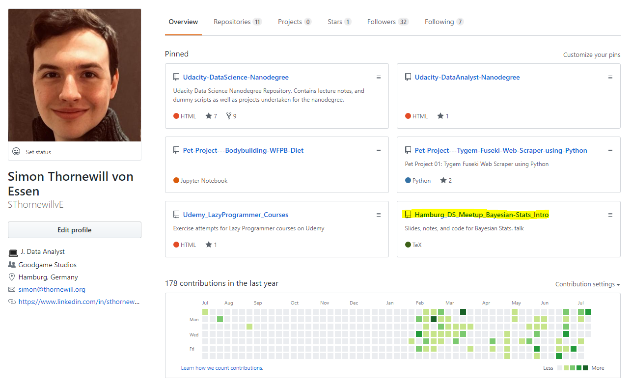

Find Slides on Github
https://cutt.ly/zGqux9

Slide 48
Find me on Social Media!
@sthornewillve

