Slide 1
An Introduction To Bayesian Statistics
Simon Thornewill von Essen
Data Analyst, Goodgame Studios
@sthornewillve 🐍

Slide 2
Why

Slide 3
Bayes Theorem

Slide 4
How

Slide 5
Foreshadow MCMC

Slide 6
Conclusion and “Call to Action”

Slide 7
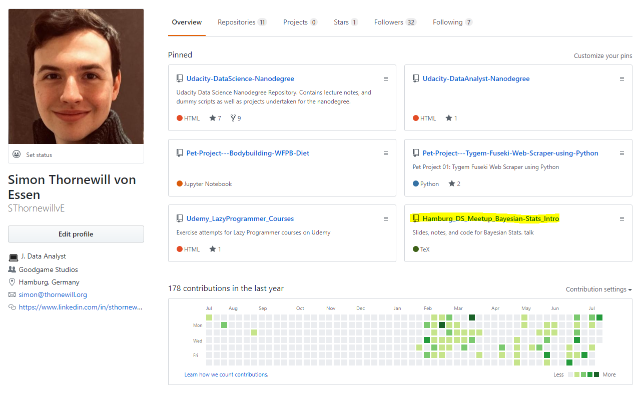
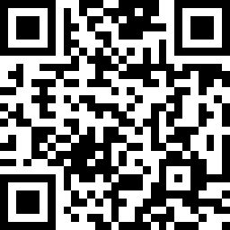
Find Slides on Github
https://cutt.ly/zGqux9

Slide 8
Find me on Social Media!
@sthornewillve

