Slide 1
An Introduction To Bayesian Statistics
Simon Thornewill von Essen
Data Analyst, Goodgame Studios
@sthornewillve 🐍

Slide 2
Why

Slide 3
How do we estimate the probability?
Classical: By considering equal outcomes
Frequentist: Relative Frequency over time
Bayesian: By updating our beliefs for each obs.

Slide 4
Coin Toss: Classical Est.
Coin
|
------
| |
H T
0.5 0.5

Slide 5
Dice: Classical Est.
Dice
|
--------------------------
| | | | | |
1 2 3 4 5 6
0.16 0.16 0.16 0.16 0.16 0.16

Slide 6
Classical Stats
Requirements
All Outcomes are known
Outcomes are assumed to be equally likely
Advantages
Fast Estimation
Easy to understand
Disadvantages
High Bias
Outcomes must be known
Cannot create sophisticated (high variance) models

Slide 7
How do we estimate the probability?
Classical
Frequentist
Bayesian

Slide 8
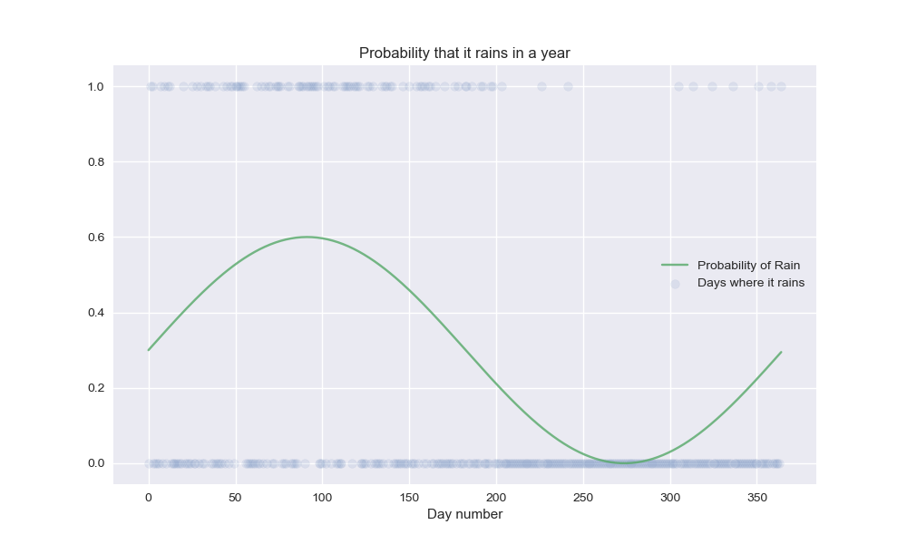
Probability of Rain: Frequentist Est.

Slide 9
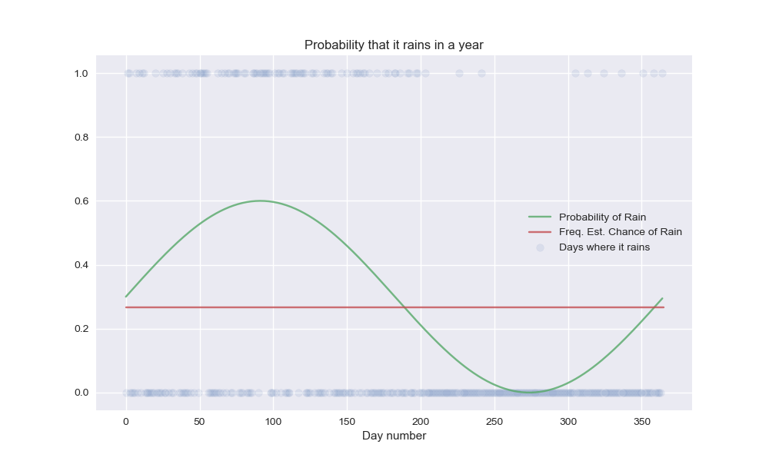
Probability of Rain: Frequentist Est.

Slide 10
How do we estimate the probability?
Classical: By considering equal outcomes
Frequentist: Relative Frequency over time
Bayesian: By updating our beliefs for each obs.

Slide 11
Bayes Theorem

Slide 12
How

Slide 13
Foreshadow MCMC

Slide 14
Conclusion and “Call to Action”

Slide 15
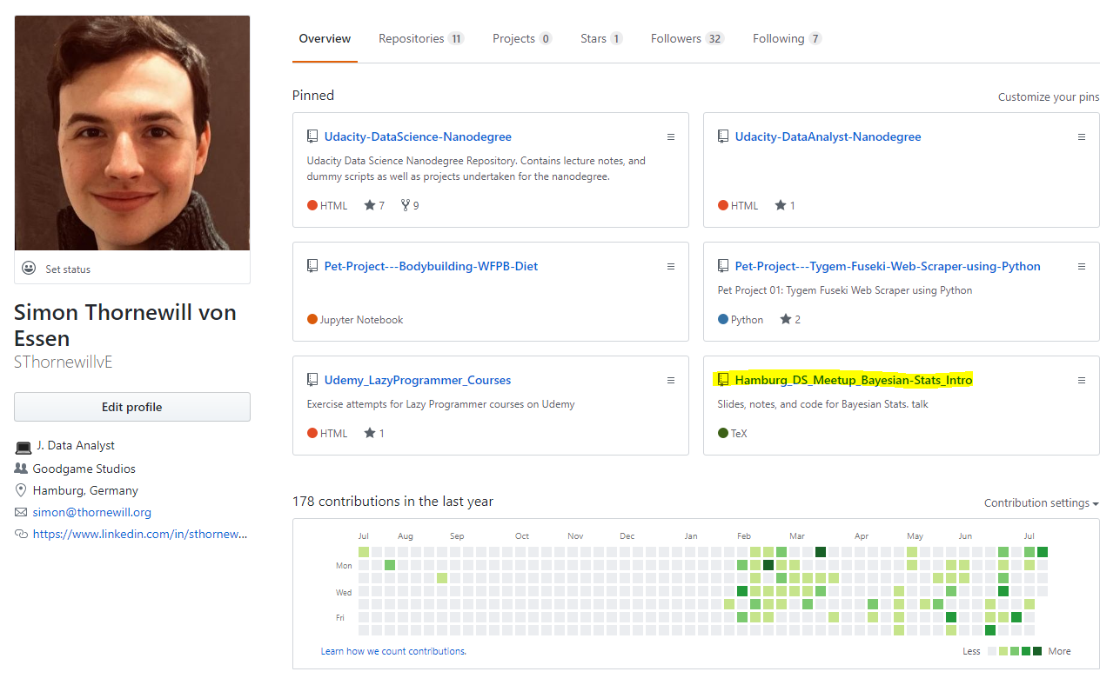
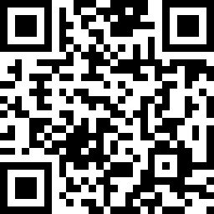
Find Slides on Github
https://cutt.ly/zGqux9

Slide 16
Find me on Social Media!
@sthornewillve

