Slide 1
避圈法(Kruskal方法)求最小支撑树
v₃
5
v₅
W=[0 5 6 0 0 0;
5 0 1 2 7 0;
6 1 0 0 5 0;
0 2 0 0 3 4;
0 7 5 3 0 4;
0 0 0 4 4 0]
6
4
v₁
1
7
3
v₆
5
2
4
v₂
v₄

Slide 2
%课本302页，例8
W=[0 5 6 0 0 0;
5 0 1 2 7 0;
6 1 0 0 5 0;
0 2 0 0 3 4;
0 7 5 3 0 4;
0 0 0 4 4 0]
n=length(W);
W=noedge(W); %无边的权改成无穷大，即inf
T=zeros(n); %最小树的权矩阵，初值为zeros(n)
WW=W; %WW仅仅为了找出实际的边数m
for i=1:n
for j=1:n
if W(i,j)==inf WW(i,j)=0;
end
end
end
m=((nnz(WW))/2); %实际的边数m
j=0; %当前最小树所含的边数

Slide 3
nnz
n = nnz(X)
Number of nonzero matrix elements
Description
n = nnz(X) returns the number of nonzero elements in matrix X.

Slide 4
for i=1:m
if j<(n-1) %如果树的边数不足n-1,则执行下面代码 %%%%%%%%选出最小权的边 W(a,b) %%%%%%%%%%%
minw=inf; a=0; b=0;
for k=1:n
for s=(k+1):n
if W(k,s)<=minw
minw=W(k,s); a=k; b=s;
end
end
end
%%%%%%%%选出最小权的边 W(a,b) %%%%%%%%%%%
T(a,b)=W(a,b); T(b,a)=W(a,b); %最小权的边 W(a,b)添加进T中
%马上检查是否T中含圈
f=0; %第一次当然不含圈，所以f=0.后面若有圈，则用f=1表示

Slide 5
%%%%%%%%判断是否出现圈%%%%%%%
P=zeros(2,m); y=0;
for i=1:n
for v=(i+1):n
if T(i,v)~=0 y=y+1; P(1,y)=i; P(2,y)=v;
end
end
end
for y=1:m
if P(1,y)<P(2,y)
for s=(y+1):m
if P(1,s)==P(2,y) P(1,s)=P(1,y);
elseif P(2,s)==P(2,y) P(2,s)=P(1,y);
end
end
P(2,y)=P(1,y);
elseif P(2,y)<P(1,y)
for s=(y+1):m
if P(1,s)==P(1,y) P(1,s)=P(2,y);
elseif P(2,s)==P(1,y) P(2,s)=P(2,y);
end
end
P(1,y)=P(2,y);
elseif (P(1,y)+P(2,y))~=0
f=1; %表示T中存在圈
break
end
end
%%%%%%%%判断是否出现圈%%%%%%%

Slide 6
if f==1 T(a,b)=0; T(b,a)=0; %若含圈，则刚刚加入的边应去掉
else j=j+1; %否则，即不含圈，则边数累加一次
end
W(a,b)=inf; %表示这条边已经考虑过了，取inf则不会再被考虑
else %即已经满足点边关系，即边数=点数减一
MST=T; %最小树记录在MST中
dianshu=n
node=input('Enter the node coordinate:node=')
% node coordinate 表示节点坐标，可如下输入
% 6个节点 [-2 0;-1 2;1 4;2 0;1 -4;-1 -2]
% 10个节点[-3,0;-2,3;-2,-2;-1,1;-1,-1;1,1;1,-1;2,2;2,-3;3,0]
input(‘The weight adjacent matrix of the Minimum Spanning Tree of the graph is:’)

Slide 7
for i=1:n
for j=1:n
if MST(i,j)==inf MST(i,j)=0;
end
end
end
MST
gplot(MST, node, ‘r-d’) %%画出最小生成树的图形
weight=sum(sum(MST))/2 %%输出最小生成树的权值
break
end
end
if j<(n-1) %%如果计算结束仍然不满足点边关系，即边数小于点数减一，则表示该图不存在最小树
input('The graph doesn"t include a Minimum Spanning Tree.')
end

Slide 8
gplot
gplot(A,Coordinates)
gplot(A,Coordinates,LineSpec)
The gplot function graphs a set of coordinates using an adjacency matrix.
gplot(A,Coordinates) plots a graph of the nodes defined in Coordinates according to the n-by-n adjacency matrix A, where n is the number of nodes. Coordinates is an n-by-2 matrix, where n is the number of nodes and each coordinate pair represents one node.
gplot(A,Coordinates,LineSpec) plots the nodes using the line type, marker symbol, and color specified by LineSpec.

Slide 9
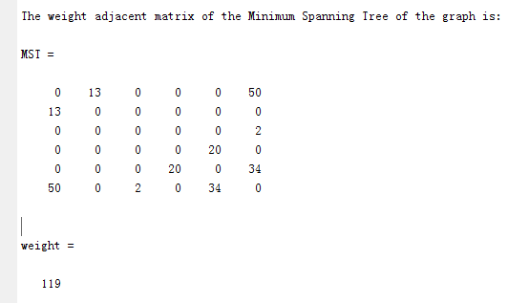
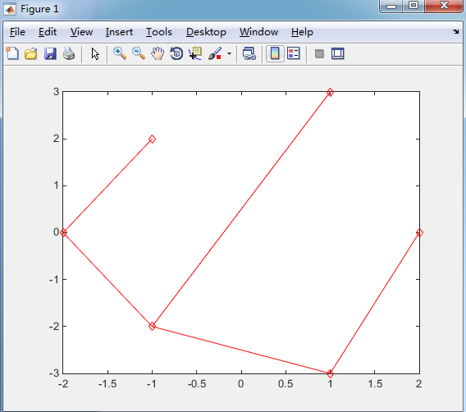
% 6个节点坐标 [-2 0;-1 2;1 4;2 0;1 -4;-1 -2]

