Slide 1

OTECH P-Management
Software

Slide 2
Content
OTECH P-Management Customization summary
Dockerfile
Hosting OTECH P-Management
Challenges

Slide 3

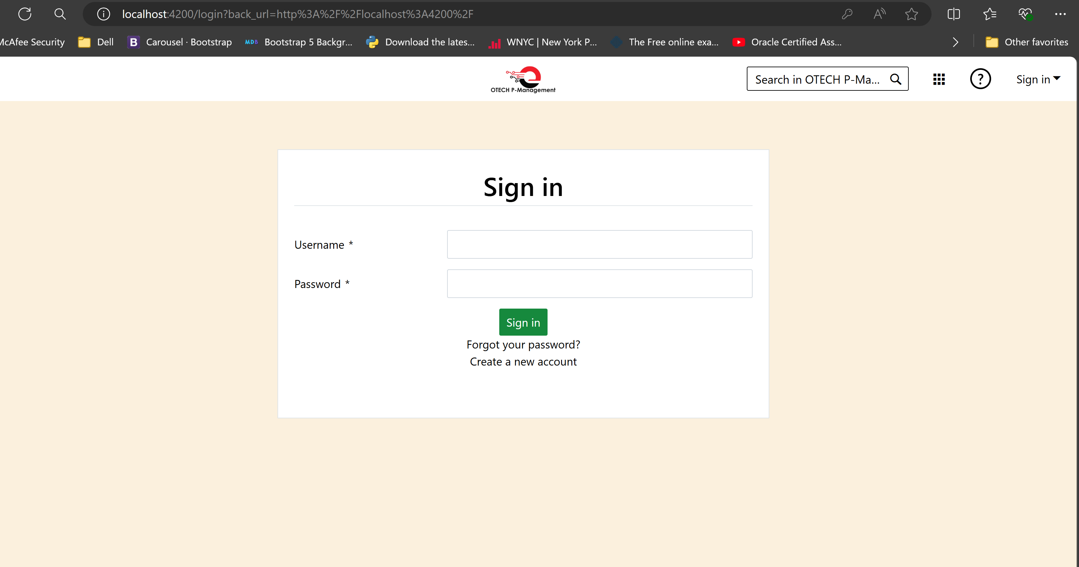
OTECH P-Management
Customization summary
Sign in | OTECH P-Management

Slide 4
OTECH
P-Management
Customization summary
Updated logo to "OTECH P-Management".
Changed favicon icon.
Adjusted header color, font color, and hover color.
Customized search button appearance.
Redesigned login form design.

Slide 5
OTECH P-Management
Customization summary
Updated body background color.
Redesigned side menu.
Replaced instances of "OpenProject" with “OTech P-Management”
Removed unnecessary features like news sections and other.
Created accounts and project and various lists to see the work flow.

Slide 6
Dockerfile
Create Dockerfile:
Open powershell
./openroject/touch Dockerfile
Added necessary instruction in to created Dockerfile
Build docker image:
docker build -t stransform/otech-image:latest
Run the container:
docker run -p 3000:3000 myusername/otech-image:latest
Login to docker hub
docker login
docker push stransform/otech-image:latest

Slide 7
Hosting OTECH P-Management
Requirement for hosting OTECH P-Management
OS:Linux server
CPU:4 VCPU
RAM:8GB
HDD :50GB (can be maximized….)
Login to Linux server
ssh openproject@172.10.10.83
Passwrd:.....
Prepare server environment
sudo apt update
sudo apt upgrade –y
Installed all the requirement to set up and run openproject…

Slide 8
Challenges
Lack of installation steps for ubuntu 22.04
There were no available instructions for installing on the latest ubuntu version ,which caused initial set up difficulties
Learning curve with new environment required additional time to grasp and internalize its working effectively

Slide 9

Thank you
Simon Temesgen
stemesgent@gmail.com

Slide 10
Github
1) Install Git
git –version
2. Create a GitHub Repository
3. Initialize Local Repository
cd /path/to/your/project git init
4. Add Remote Repository
git remote add origin https://github.com/yourusername/your-repository-name.git or
git remote set-url origin git@github.com:STransform/otechproject.git
git push origin dev
5. Add Files to Repository
git add .

Slide 11
Github…
6. Commit Changes
git commit -m "Initial commit“
7. Push to GitHub
Push the committed changes to the GitHub repository:
git push -u origin dev(localbranch)

Slide 12
Github
If u want to switch back to that branch
git checkout dev
Pull Latest Changes
git pull origin dev
You can now continue working on your project, make changes, commit them, and push them as needed
git status

