Slide 1


Plasticine: A flexible buffer management scheme for data center networks
Master Thesis
Vamsi Addanki#
Supervisors: Laurent Vanbever​*, Maria Apostalaki*, Sebastien Tixeuil#
* Eth Zurich # Sorbonne University

Slide 2

Motivation
Internet
  Packet switched network
  No resource reservations
  Best-effort service
  Unpredictable incoming traffic at each hop
  Possible congestion events and packet drops
  Network devices use buffers to reduce packet drops during transient congestion
Bottleneck

Slide 3
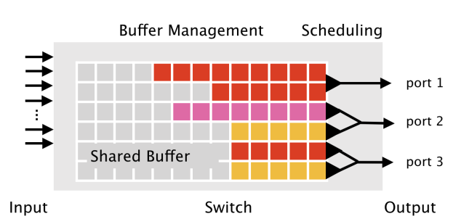
Motivation (Shared Buffer)
Modern devices use shared buffer space among all ports and queues
  Cost effective
  Low hardware complexity
  Requires buffer management algorithm

Slide 4
Motivation (Buffer allocation objectives)
Maximize link utilization
  Certain minimum buffer for a port is required to fully utilize output link
Minimize packet drops

Slide 5
Motivation (Buffer → Link Utilization)
Classical Rule-of-Thumb
  C x RTT (BDP)
Stanford Model
  C x RTT / √N
DCTCP (Data center TCP)
  C x RTT/7 + N
  C = Capacity;
  RTT = round-trip-time;
  N=number of flows

Slide 6
Motivation (Data center Problem-1)
Buffers per port are significantly lower than BDP
  Example : Facebook data center TOR switch
  Capacity : 128 x 100Gbps
  Total Buffer : 64MB
  Buffer per port : 500KB
  BDP ~ 2.5MB
  Required >> Available
static allocation → under utilization of links

Slide 7
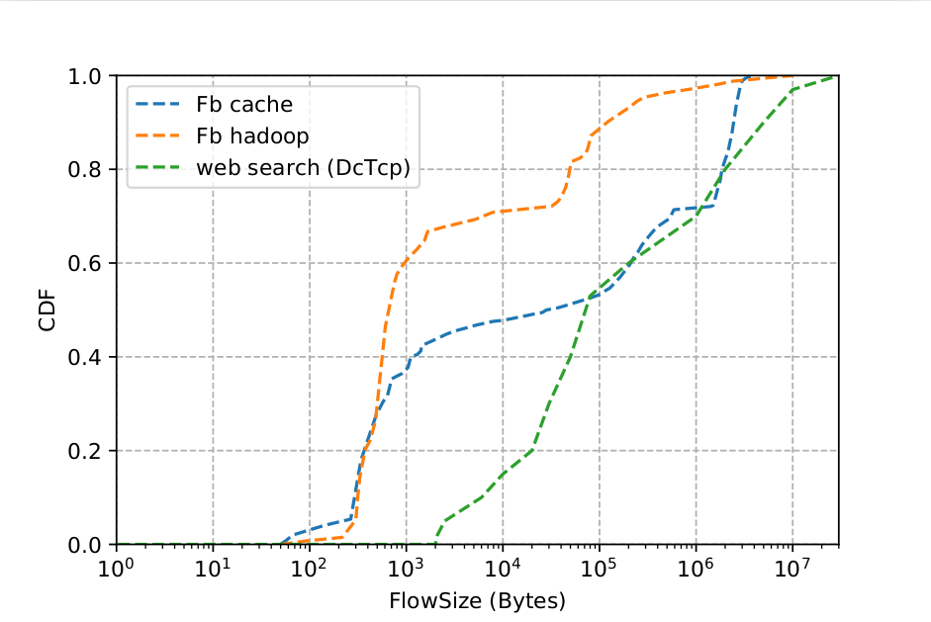
Motivation (Data center Traffic Patterns)
Majority bytes are Long flows (>1MB)
Majority flows are Short Flows (<100KB)

Slide 8
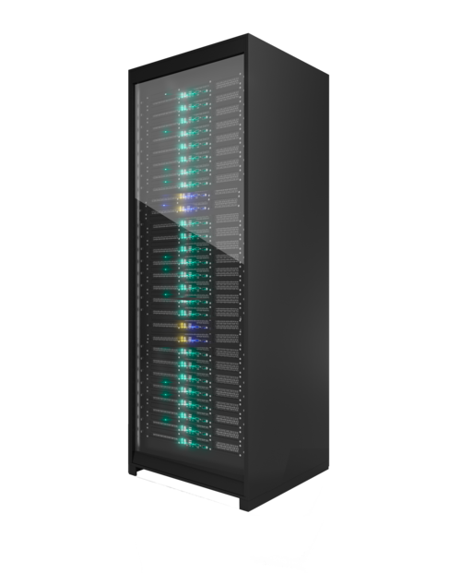
Motivation (Data center Traffic Patterns)
TCP incast scenario → Bursts
High buffer requirement
Short duration of time
Response
File Request
Distributed File system
Bottleneck
Transient Congestion

Slide 9
Motivation (Buffer allocation objectives)
Minimize short flow completion times
Burst absorption

Slide 10
Motivation (Data center Problem-2)
Orthogonal buffer allocation requirements
  Limit allocation → Long/unresponsive flows are greedy
  Maximize allocation → Burst absorption
Oblivious to traffic classes
  Buffer Management
  Congestion control
Differentiating traffic types is necessary

Slide 11
Motivation (Data center Problem-3)
Low priority traffic class across multiple queues can monopolize total buffer
  Buffer(low priority) x num_queues ~ Total buffer
  Leads to low available buffer for bursts and short flows
  Static buffer bounds lead to under-utilization
Dynamic bounds are necessary

Slide 12
Motivation
Our Objectives
  Link utilization
  High burst absorption
  Better flow completion times
In short, maximize the benefit of buffering packets i.e,
Buffer usage → better overall performance

Slide 13
Outline
Background
Plasticine
Evaluation
Conclusion

Slide 14
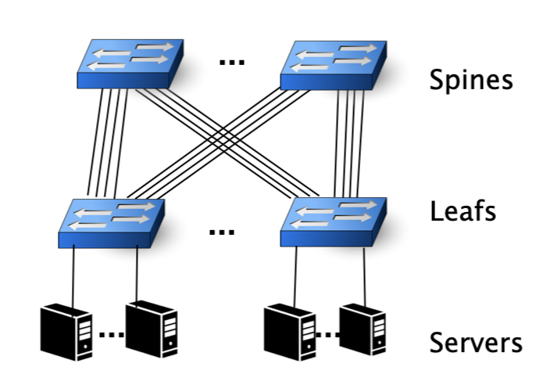
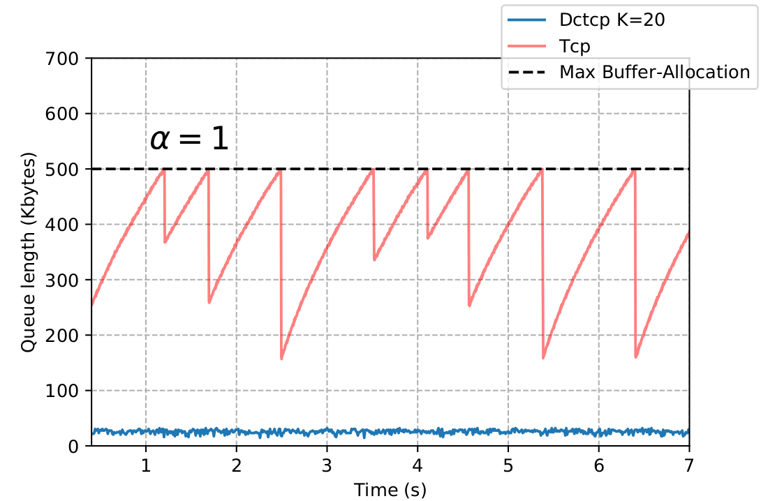
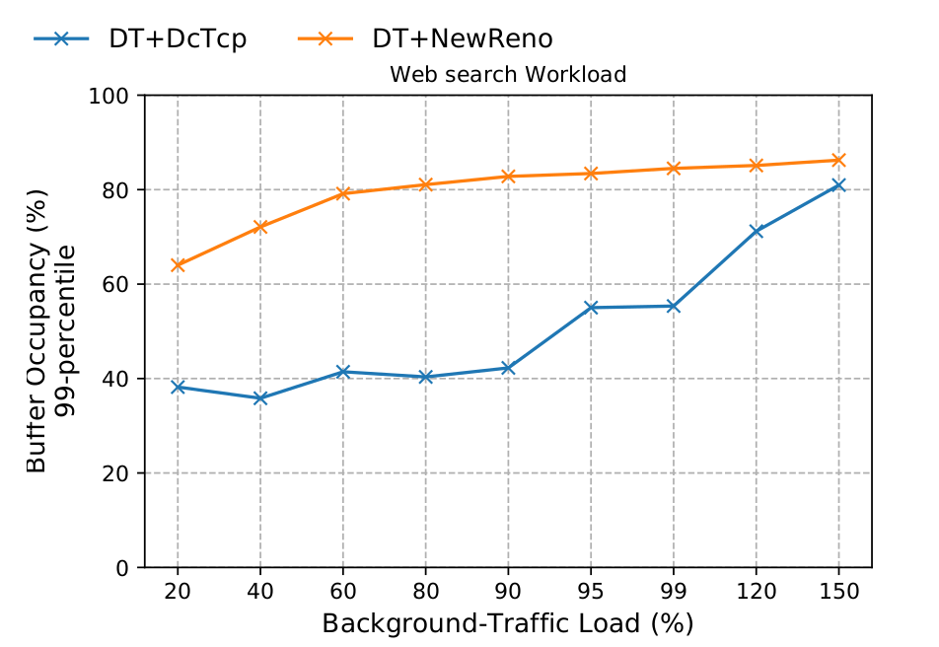
Background (TCP & Variants)
Bottleneck
2 long flows
Leaf spine Data center topology

Slide 15
Background (TCP & Variants)
Observation 1: As the load increases, even DCTCP tends to utilize more buffer, as much as TCP in extreme cases.
Leads in inefficient control of queue lengths when network load increases.
Buffer allocation plays a key role

Slide 16
Background (TCP & Variants)
Observation 2: DCTCP marking threshold (K) is dependent on Capacity.
Leads in inefficient control of queue lengths when multiple queues of same port use buffer simultaneously.
  Dynamically changing marking threshold is not possible at the moment.
  Even so, such a mechanism creates an unstable system
Buffer allocation must consider dequeue rates

Slide 17
Background (Buffer Management)
Dynamic Threshold (DT)
  Widely used state-of-the-art buffer management
  Dynamic buffer allocation
Allocation Scheme: Thresholds per queue
T_{i}^{p} (t) = a . (remainingBuffer)
Threshold
Port i
Queue p
Alpha Parameter

Slide 18
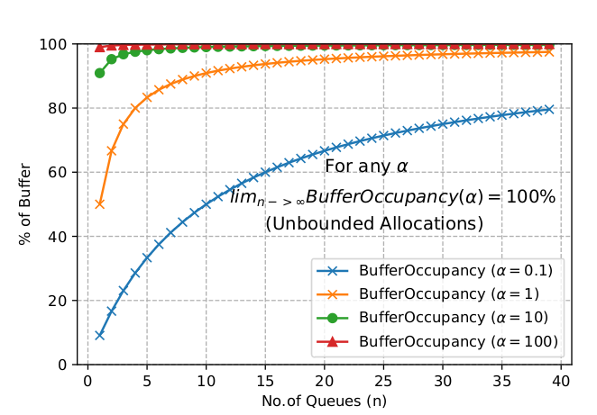
Background (Buffer Management)
DT’s inefficiencies
  Unbounded buffer allocation
  Oblivious to dequeue rate
  Oblivious to traffic types

Slide 19
Plasticine
Allocation Scheme: Thresholds per queue at port i and priority p
T_{i}^{p} (t) = a . (FairShare).(DequeueRate).(remainingBuffer)
(1/N_{p}) (γ_{i}^{p})
N_{p} = number of congested queues of priority p
γ_{i}^{p} = dequeue rate of queue

Slide 20
Plasticine
Key properties
  Aggregate max buffer occupancy of a traffic class is bounded and configurable
  On the fly detection and prioritization of short and bursty flows
  Allocation is based on dequeue rates
A detailed analysis of plasticine buffer allocation scheme, bounds, guarantees are discussed in the report.

Slide 21
Evaluation

Slide 22
Evaluation
Two scenarios
  Single queue per port : All the traffic to an output port share one queue. Packets have no priority tags.
  Multi queue per port : Packets with priority tags + in-network priority queuing.
Traffic
  Background : Websearch workload at load 90%
  Foreground : Query traffic (further details in the report)

Slide 23
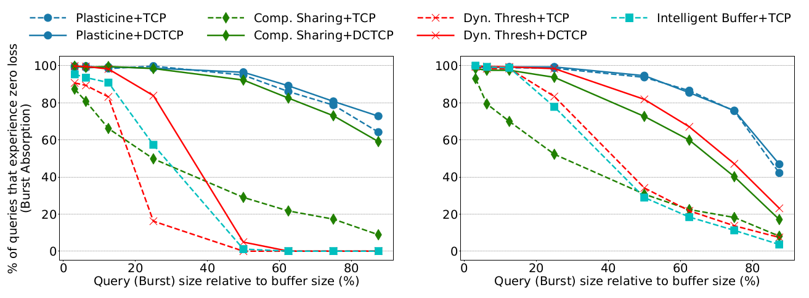
Evaluation
Plasticine
70% gain
30% gain
Plasticine
Dynamic Threshold
Dynamic Threshold
Single queue per port
Multi queue per port

Slide 24
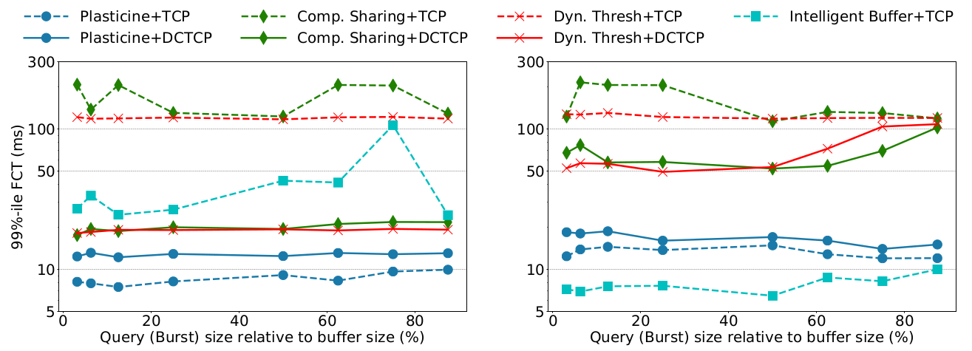
Evaluation
Single queue per port
Multi queue per port

Slide 25
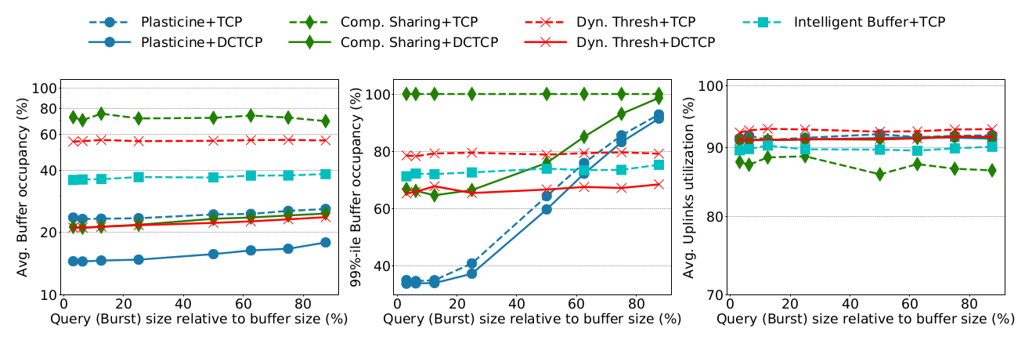
Evaluation

Slide 26
Evaluation (continued...)
Data center traffic with mixed TCP and DCTCP flows (In report)
Data center + WAN traffic (In report)

Slide 27
Conclusion
Fundamental problems in the state-of-the-art buffer management scheme have been identified
Our proposal Plasticine significantly improves burst absorption and flow completion times
  Without loss of throughput
  Without static allocations

Slide 28
Summary of work
Plasticine algorithm formulation
Modeling and analysis
NS3 simulations
  4000+ lines of written code from scratch
Numerous bash scripts
Python
  pandas, numpy for reading data files
  Matplotlib for plots

Slide 29
Thank you
&
Open for questions

Slide 30
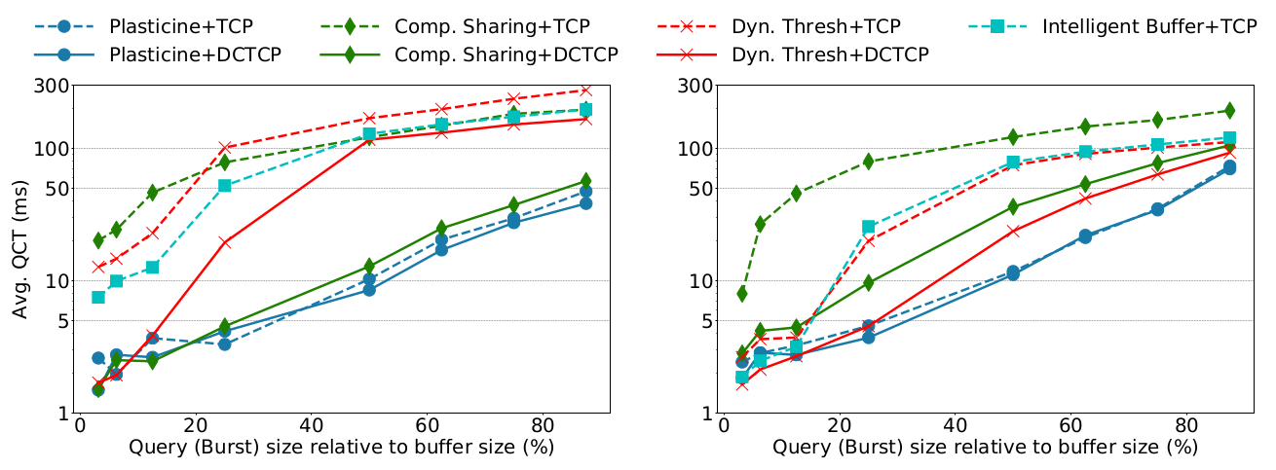
Evaluation
Single queue per port
Multi queue per port

Slide 31
Motivation (Data center Traffic Patterns)
Majority of bytes (traffic volume) are from long flows (>1MB)
  Contribute to link utilization
  Require more buffer space
  Certain tolerance to packet drops
Majority of flows are short flows (<100KB)
  Require low buffer space
  Sensitive to packet drops

Slide 32
Background (TCP & Variants)

Slide 33
Motivation (Analogy)
Shared Road (sq.meters) ↔ Shared Buffer (Bytes)
  Lane 1,2,3 ↔ port 1,2,3
  Car ↔ low priority traffic class “A”
  Bike ↔ low priority traffic class “B”
  Bus ↔ medium priority traffic class “C”
  Ambulance ↔ High priority traffic class “Ha”
  Police ↔ High priority traffic class “Hp”
All share the same resource i.e, road/buffer

Slide 34
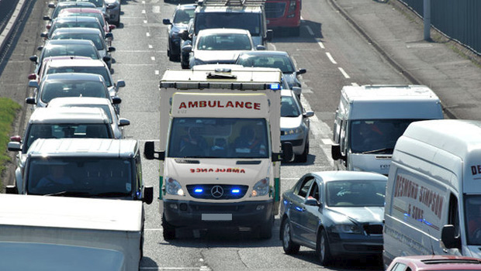
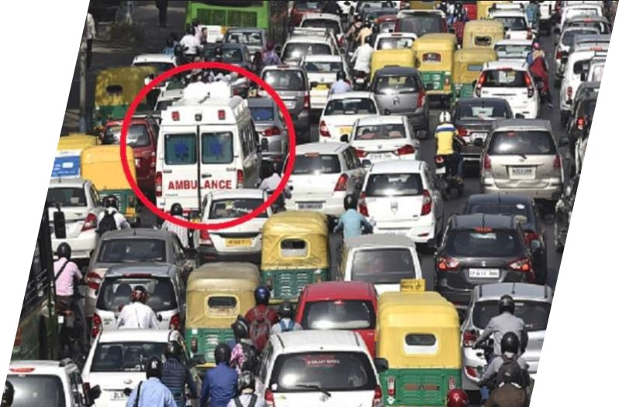
Motivation (Analogy)
Under-utilized road
Congested Road

Slide 35
Motivation
Network traffic is much complex than the analogy

Slide 36
Motivation (Analogy)
Existing cars move aside and make space for ambulance
Ambulance accesses a non-blocking fast lane Prioritized
No separate lane dedicated
Just enough space

