Slide 1
Moving a step forward in the quest for Deterministic Networks (DetNet)
V.Addanki, L. Iannone
Telecom-Paris, Paris (France)

Slide 2
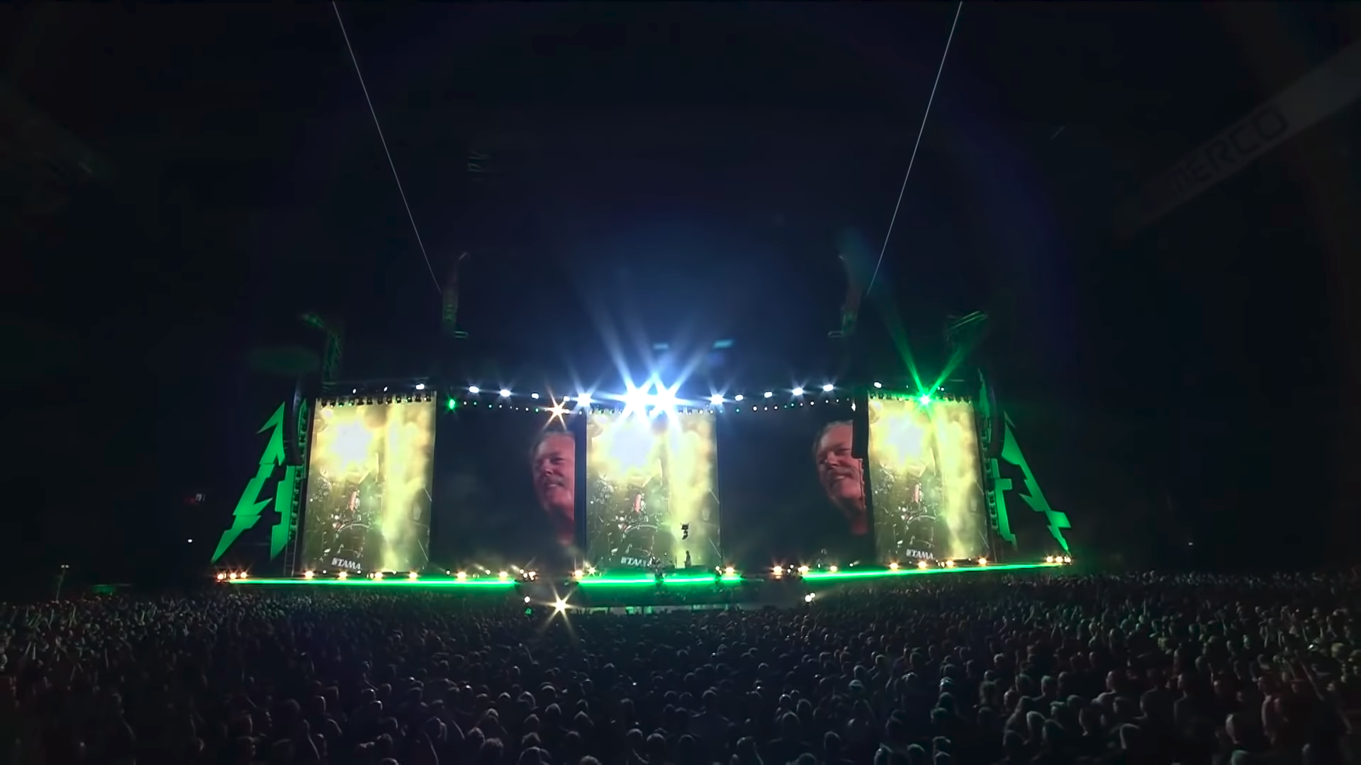
Motivation
Traditional analog audio/video standards use single-purpose point-to-point connections
Digital audio/video standards still use point-to-point interconnects and interfaces
Excessive cable mass
Overuse of resources
  Cost
Yet, problems:
  Latency
  Synchronization
What you see:
James still saying “Hello Paris!”
What you see:
Drummer already started
playing
Screens
Actual Stage
What you hear: “Nothing Else
Matters!”

Slide 3
Motivation
Audio Video Bridging (AVB) [around 2010]
Switched Ethernet networks
Primarily for AV
Requires AVB support on all the devices in the network
  Scope limited to a fully controlled local area network.
Goals:
  Low-latency
  Reliability
  Synchronization
Screens
Actual Stage

Slide 4
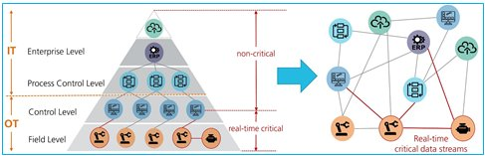
Motivation
AVB emerged into Time Sensitive Networking (TSN IEEE802.1Q WG) [2012]
TSN aims at reliable, deterministic, low-latency data transmission over Ethernet networks
Limited to Link-layer and fully controlled LAN
Use-cases:
  Aerospace
  Automotive
  Industrial control process
  Vehicular control
  Audio/Video streaming
Actual Stage
Image source: https://www.design-reuse.com/articles/46536/an-introduction-to-time-sensitive-networking.html

Slide 5
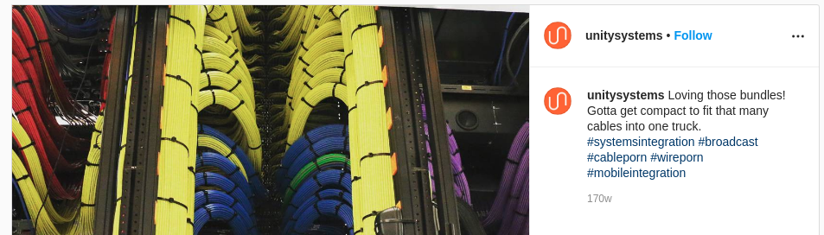
Motivation
ESPN DC2 for SportsCenter and NFL football, an example of successful TSN deployment
  194,000 sq.ft broadcast studio
  Handles 46Tbps throughput with 60,000 simultaneous signals
  7 studios each with layer-2 LANs using TSN standards
    Each independent studio worked well in forwarding audio reliably with deterministic delays
  Due to lack of standards-based routing solution, studios were interconnected using dedicated paths
6
Actual Stage

Slide 6

Motivation
“Layer-3 Interconnecting Layer-2 Islands”
IETF DetNet
Operates at Layer-3
Scalability to large networks
Use-Cases:
  Professional audio/video
  Electrical Utilities
  Building automation systems
  Wireless and industrial applications
  Cellular radio
  Private blockchains for Determinism
Actual Stage

Slide 7
Motivation
Internet standards process [RFC 2026]:
  Technical excellence
  Prior implementation and testing
  Clear, concise, and easily understood documentation
  Openness and fairness
  Timeliness
Implementing, testing & perfecting with LANs is relatively easier than with WANs
  Additionally, DetNet use-cases involve high degree of safety requirements for equipment and humans
Simulation tools help in speeding-up the process of development and standardization
  DeNS: Deterministic Networks Simulator
Simulation tools help in identifying and debugging the problems of existing mechanism in wide range of scenarios
  TAPS: Time Aware PIFO Scheduling

Slide 8
Outline
Background
  TSN standards
  TSN Queuing and Scheduling
  TSN state-of-the-art simulator
DeNS: Deterministic Networks Simulator
TAPS: Time Aware PIFO Scheduling
Results
Conclusion
Actual Stage

Slide 9
Background – TSN Standards
IEEE 802.1 TSN Standards
Flow Concept
[flow classification]
Flow Control
[Queuing and Scheduling]
Flow Synchronization
[Time synchronization]
Flow Management
[Stream Reservation]
Flow Integrity
[Frame replication
and elimination]
Screens
Actual Stage

Slide 10



Background – TSN Queuing & Scheduling
Time Aware Scheduling (TAS)
[IEEE 802.1Qbv]
Switching Fabric
Gate Control List
T1: 00000001
T2: 11111110
7
6
5
4
3
2
1
0
MisbehavingFlows
Gate
Gate
Gate
Gate
Gate
Gate
Gate
Gate
Transmission Selection
Too Late!

Slide 11
Background – TSN Queuing & Scheduling
Cyclic Queuing and Forwarding (CQF)
[IEEE 802.1Qch]
Switching Fabric
Gate Control List
T1: 11111111
T2: 11111111
7
6
5
4
3
2
1
0
Gate
Gate
Gate
Gate
Gate
Gate
Gate
Gate
Transmission Selection

Slide 12
Background – TSN Queuing & Scheduling
Cyclic Queuing and Forwarding (CQF)
[IEEE 802.1Qch]
While CQF brings determinism in queuing delays and in-turn end-to-end latency, it retains the problems of TAS
  added queuing latency at each hop
  impact of mis-behaving flows
Odd Cycle
Cycle-Change
Even Cycle
Out

Slide 13
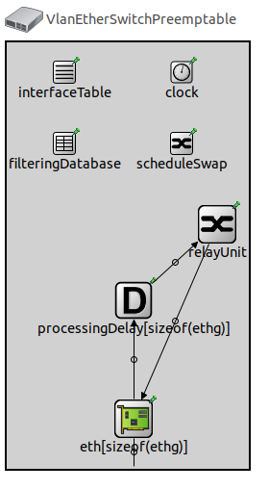
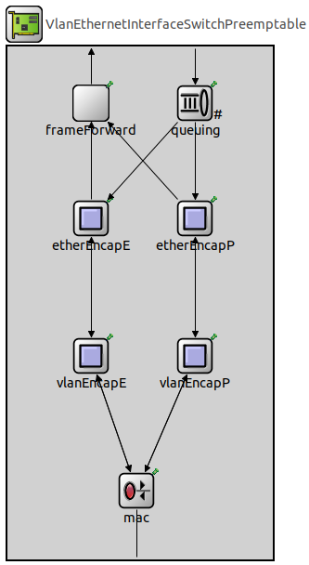
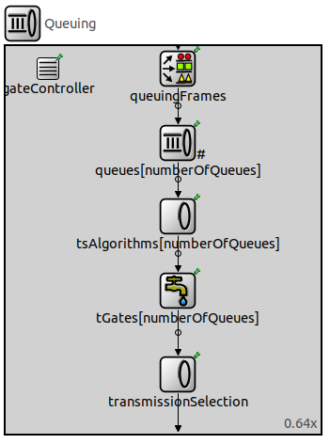
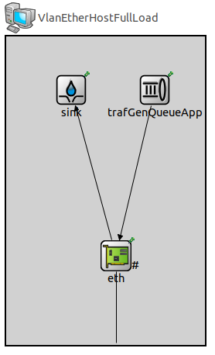
Background – TSN state-of-the-art Simulator
Modules do not support full protocol stack implementation
End-hosts only connects to a CBR traffic generator and a sink
  - No possibility to add TCP hosts for instance
Switch modules only support standard encap/decap and queuing functionalities
No Layer-3 extensions
No router modules

Slide 14
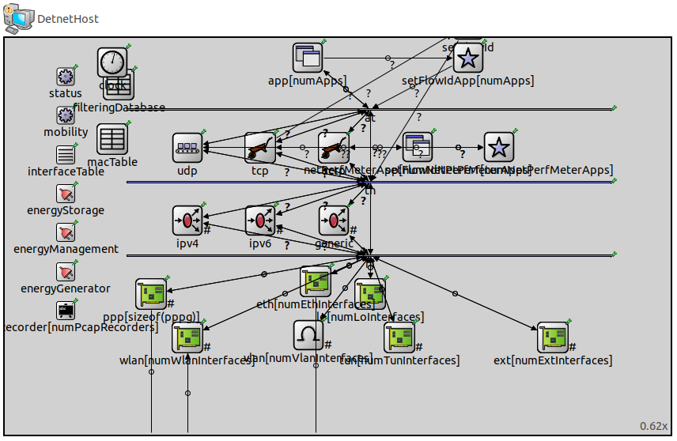
DeNS: Deterministic Networks Simulator

Slide 15
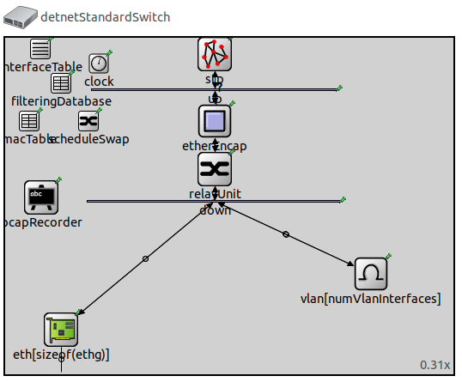
DeNS: Deterministic Networks Simulator

Slide 16
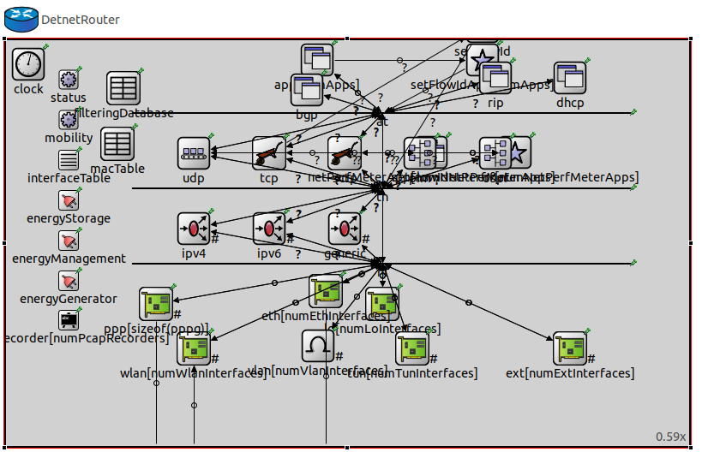
DeNS: Deterministic Networks Simulator

Slide 17
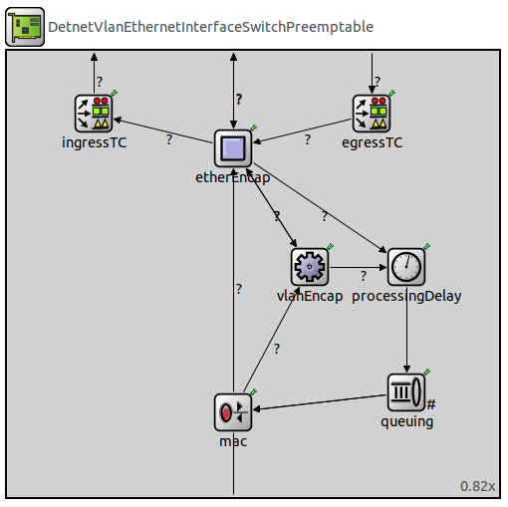
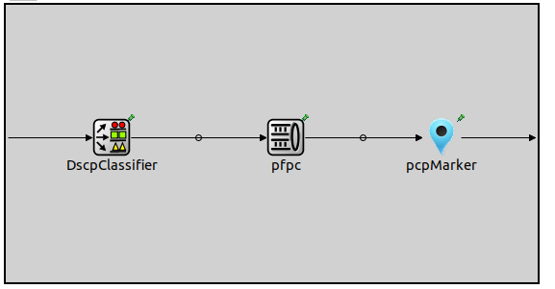
DeNS: Deterministic Networks Simulator

Slide 18
TAPS: Time Aware PIFO Scheduling
Switching Fabric
Gate Control List
T1: 00000001
T2: 11111110
Gate-7 Open?
NO
YES
PIFO
6
5
4
3
2
1
0
7
Gate
Gate
Gate
Gate
Gate
Gate
Gate
Gate
Transmission Selection

Slide 19
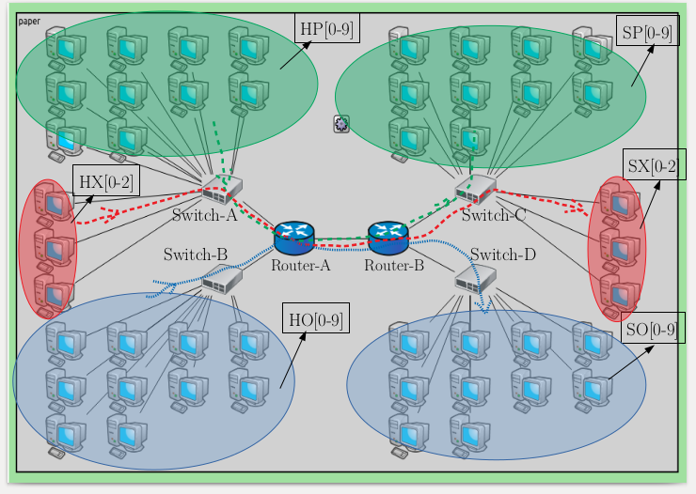
Simulation - Topology
DetNet Hosts
DetNet (or) Misbehaving Hosts
TCP (Best-effort) Hosts

Slide 20
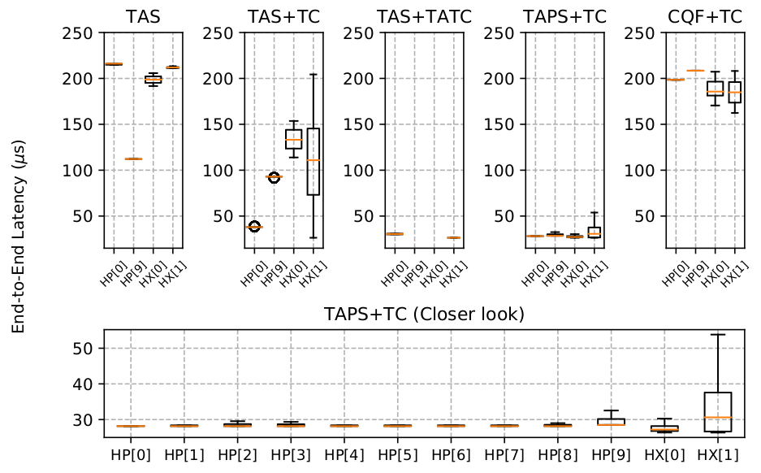
Simulation - Results
Time Aware Scheduling
Time Aware Scheduling
+ Traffic Conditioner
Time Aware Scheduling
+ Traffic Conditioner
(Drop all out-of-slot arrivals)
Time Aware PIFO Scheduling
+ Traffic Conditioner
Closer look
Provides bounded low-latency services to all DetNet flows, both scheduled
and sporadic
  - Even in the presence of mis-behaving flows
Cyclic Queuing and Forwarding
+ Traffic Conditioner

Slide 21
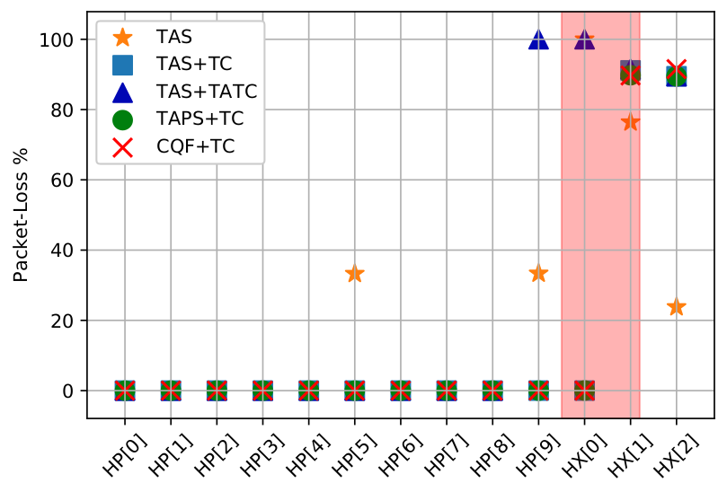
Simulation - Results

Slide 22
Conclusion
DeNS simulator provides full protocol stack features, necessary DetNet and TSN modules
  All the modules of DeNS are compatible with standard modules of INET framework
  Source code is made available online on GitHub
TAPS solution provides bounded low-latency service
  Perhaps it is time to think outside of FIFO queuing for latency critical flows in the context on DetNet

Slide 23
Thank you
&
Open for questions

