Slide 1
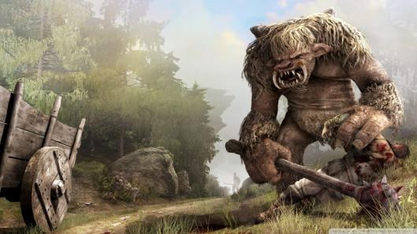
Team “troll”
GAME
“TROLL RUNNER”

Slide 2

team members
Nikola Bogomirov - loderunner
Simeon Tzvetkov - STzvetkov
Zlatimir Mihaylov - mihaylov
Krasimira-An Petrova - kavpetrova
Kristian Ivanov - Kristianc
Biser Sirakov - BiSirakov
Petko Hadjipetkov - petkoH
Blagoy Shokov – Blagoy.Shokov

Slide 3
General rules of the game
After a thorough investigation of the two games that inspired our one (hours and hours spent in “running”, jumping and shooting) we got the main playing concepts. Then we merged them and let our imagination go wild. The final result may cause a mild heart attack to the authors of the original games if they see what we have done with their ideas.
These rules form the overall logic of our program:
The game is a single player one. Adding a second “troll” to share the same keyboard could only lead to real life bloodsheds and even worse: unwanted damage of the input device.
The playing figure is navigated over a two dimensional lane, performing movements in two possible directions.
The objects on the lane are neutral (like clouds) or such that have impact over the “troll’s” behavior and the game as a whole in case of collision (obstacles, pickups)
The player uses space to jump and ESC is used to pause the game.

Slide 4
Requirements fulfilled
Classes and methods
The game’s architecture consists of 10 classes
The code is distributed between over 30 methods
Exceptions
There are implemented 2 user exceptions, which are handled along with several standard ones
External text files serve for two purposes in the application:
Store ASCII graphics for the visualized object
Store (and update) the highest score achieved in the game
GitHub repository: https://github.com/STzvetkov/Troll-runner.git

Slide 5
