Slide 1
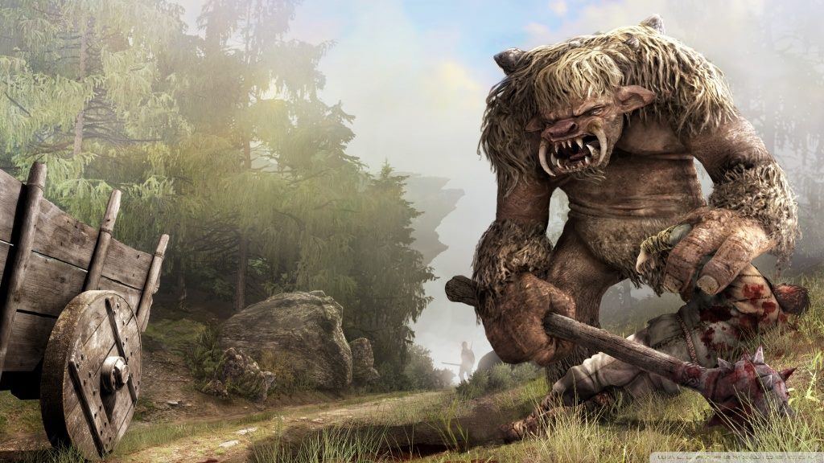
Team “troll”
GAME
“TROLL RUNNER”

Slide 2

team members
Nikola Bogomirov - loderunner
Simeon Tzvetkov - STzvetkov
Zlatimir Mihailov - mihailov
Krasimira-An Petrova - kavpetrova
Kristian Ivanov - Kristianc
Biser Sirakov - BiSirakov
Petko Hadjipetkov - petkoH
Blagoy Shokov – Blagoy.Shokov

Slide 3
https://github.com/STzvetkov/Troll-runner
General rules of the game
After a thorough investigation of the two games that inspired our one (hours and hours spent in “running”, jumping and shooting) we got the main playing concepts. Then we merged them and let our imagination go wild. The final result may cause a mild heart attack to the authors of the original games if they see what we have done with their ideas.
These rules form the overall logic of our program.
The game is a single player one. Adding a second “troll” to share the same keyboard could only lead to real life bloodsheds and even worse: unwanted damage of the input device.
The player uses space to jump and right arrow to increase movement speed. ESC is used for pause.

Slide 4
