Slide 1
Beyond Default Prediction
A Risk-Adjusted Approach to Loan Optimization
Applied Machine Learning Project
Ashish Rajeev Chaudhary
Hazem Ani
Kasem Chaisathitwanit
Prerna Bharti

Slide 2

Problem & Stakeholder
Domain Problem
Primary Stakeholder
Lenders must decide which applicants to approve while balancing profitability and credit access
Traditional models treat lending as approve/deny, ignoring how a loan structure affects outcomes
Our approach goes beyond default prediction to estimate expected financial value across loan profiles
Scope evolved from pure prediction to a risk-adjusted decision framework for actionable recommendations
Mid-size financial institution
Wants to responsibly expand credit access to borrowers with limited histories or lower scores
Needs to protect financial stability while serving underserved populations
Seeks a practical tool to identify loan structures with positive expected value at a given risk tolerance
Loan Optimization — Applied ML
2 / 8

Slide 3

Envisioned Solution
Three-Stage Pipeline
1. Default Probability Model
Train logistic regression and XGBoost on Lending Club data; calibrate probabilities with Platt scaling
2. Expected Profit Framework
Compute Loss Given Default per sub-grade; Calculate expected revenue, loss, and profit for each borrower
3. Loan Size Optimization & Policy Simulation
Simulate a grid of loan amounts; Apply a risk-adjusted objective function to find the profit-maximizing size per borrower
What This Enables
Recommends how much to lend, not just whether to lend, connecting ML predictions to dollar-level decisions
Evaluates policy impact on underserved borrowers (high DTI, limited history) to test whether optimized sizing improves outcomes
Loan Optimization — Applied ML
3 / 8

Slide 4

Data
2.26 M
145
loan_status
Records
Features
Target Variable
Data Overview
Lending Club dataset downloaded from Kaggle, holds historical loan applications with borrowers and loan attributes
Removed columns with >30% missing values and dropped non-predictive / leakage variables (left with 50 variables)
Encoded categorical variables, imputed missing values (median for numeric, mode for categorical), scaled numerical features
Addressed class imbalance using class weights; split into training and test
Engineered 10 new features: 7 financial ratio features (DTI, Income-to-loan, etc.) and 3 profitability metrics (revenue, expected loss, expected profit
Loan Optimization — Applied ML
4 / 8

Slide 5

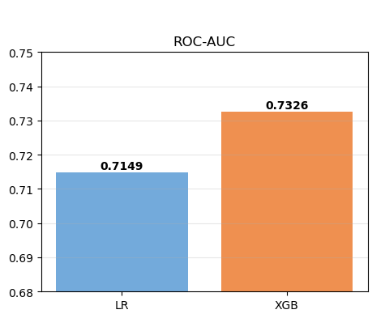
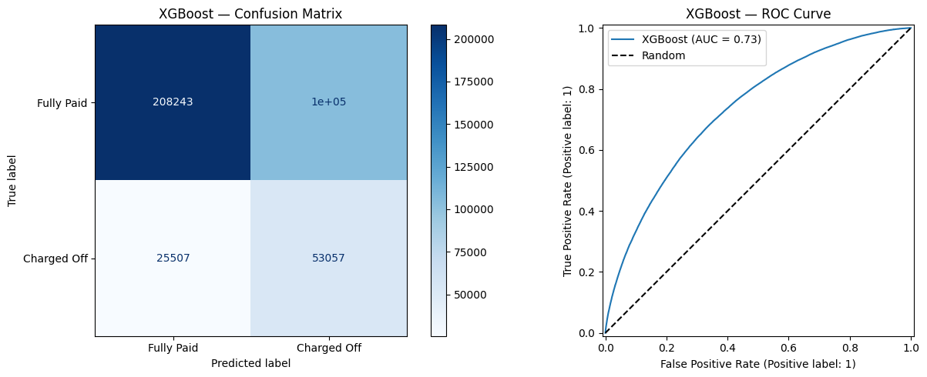
Initial Results
Model Comparison
XGBoost Results
Logistic Regression
XGBoost
Model Accuracy: 67%
Loan Optimization — Applied ML
5 / 8

Slide 6
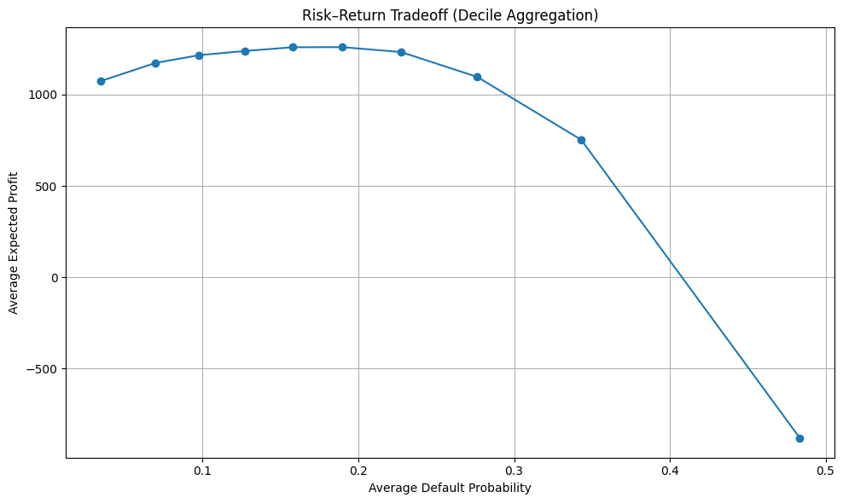
Initial Results (cont.)
Policy Simulation Results
Sweet spot at PD 0.15–0.20 - Average expected profit peaks ~$1,250
Low-risk ≠ most profitable - Borrowers with PD < 0.10 generate lower profit (~$1,080)
Optimal cutoff identified at PD ≈ 0.40 - Loans above this threshold are net-negative on average, providing a data-driven basis for the loan approval policy.
Loan Optimization — Applied ML
6 / 8

Slide 7

Challenges
Class Imbalance
Model Calibration Limits
Data Quality
[Resolved]
[Addressed]
[Ongoing]
Defaults are a minority class in the Lending Club data. Required class weighting and careful metric selection (F1, ROC-AUC) over accuracy to avoid a model that simply predicts non-defaults.
Platt scaling and isotonic regression improved probability alignment but yielded only minor gains in overall model performance. We explored several approaches (randomized hyperparameter tuning, addressing multicollinearity by adjusting feature sets, SMOTE, and removing scaling for XGBoost) but none produced significant improvement Financial framework and policy simulation heavily depends on well-calibrated PDs, so this remains an area to watch.
Lending Club data contains 145 features with many columns having >30% missing values and potential leakage variables. After cleaning, imputation, and feature engineering, model accuracy did not improve significantly. This could suggest that borrower default behavior is inherently difficult to predict from structured application-time data alone.
Loan Optimization — Applied ML
7 / 8

Slide 8

Plan & Goals
Next Steps
Final Deliverable
Train Random Forest with hyperparameter tuning
Apply GridSearch/RandomizedSearch to optimize depth, estimators, and split criteria to extract maximum predictive signal from the current feature set.
Push model accuracy as the final deliverable
Benchmark Random Forest against the current model and the highest achievable accuracy, with performance evaluated on held-out test data
Loan Optimization — Applied ML
8 / 8

Slide 9
Thank you
Questions?

