Slide 1
INFERRA
Infectious Disease Surge Early Warning System
Jayesh Sawarkar
Roshni More
Insha Maniyar
IST 707 Applied Machine Learning | Prof. Joshua Introne | Spring 2025

Slide 2
Problem & Stakeholder
THE TIMING GAP
Primary Stakeholder
Public Health Authorities(CDNA State Health Dept. Surge Officers)
Surges peak 2-4 weeks AFTER they begin
Hospitals overwhelmed before agencies respond
No advance warning before bed overload
Need: 1-2 week advance notice of RSV/influenza
surges to pre-position pediatric antiviral stockpiles
and activate hospital surge protocols before bed
capacity is breached.
FRAGMENTED DATA
Secondary Stakeholder
Epidemiologists & Researchers
COVID in WHO, RSV in NNDSS, NZ in PHF Science
No unified model across diseases or sources
Agencies cannot act on fragmented signals
Validated cross-disease/cross-country ML framework for outbreak forecasting research.
GEOGRAPHIC BLIND SPOT
Indirect Stakeholder
General Public
Surges move: NSW > VIC > QLD > SA (2-8 weeks)
NSW Granger-causes VIC RSV, 4-wk lead (p=0.002)
Signal exists in NNDSS data, completely unused
Timely public advisories, reduced hospital overcrowding, better resource allocation during surges.
Every week of delay = overcrowded hospitals, missed antiviral windows, preventable deaths

Slide 3
Envisioned Solution
Train once on COVID globally. Generalize to any disease, any country, without retraining.
1
2
3
4
5
Train
Features
Models
Test
Deploy
238 countries
WHO COVID
>
16 engineered
from raw counts
>
4 classifiers
+ regression
>
4 holdout
test sets
>
Live Streamlit
dashboard
AUS + NZ fully excluded
Normalized to per 100k
Rt, lags, rolling stats
Z-score, seasonality
LR, RF, GB, XGBoost
SMOTE + RandomizedSearchCV
AUS COVID, AUS RSV
NZ COVID, NZ RSV
Traffic light system
Plain English advisory
Surge Labelling: COVID: Rt > 1.2 for 3+ consecutive weeks | RSV: Z-score > 1.5 for 2+ weeks | Rt = 42% of feature importance | No future data leakage

Slide 4
Data Sources
🌍 WHO COVID-19
🏥 AUS NNDSS (RSV)
240 countries · weekly · Jan 2020 – Jan 2026
~75,840 rows after preprocessing
Normalised to cases-per-100k
Train: 238 countries (AUS + NZ excluded)
RSV · 5 states · fortnightly · 2017–2024
50+ Excel files → clean time series
8 years of RSV history
Test 2: AUS RSV cross-disease evaluation
PHF Science NZ
👥 Population (World Bank)
RSV · weekly · 2022–2025
Custom scraper: NZ_Airborne_Disease_Scraper
6 diseases: RSV · Flu A/B · hMPV · RV · AdV
Test 4: NZ RSV (cross-disease + cross-country)
AUS: 26,473,055 · NZ: 5,223,100
2023 estimates · matched by country name
Removes country-size bias from raw counts
Enables direct AUS ↔ NZ surge comparison

Slide 5
Results — Precision, Recall & Model Comparison
Precision & Recall by Test
Test 1 AUS COVID
Test 2 AUS RSV
Test 3 NZ COVID
Test 4 NZ RSV
1.000
1.000
0.923
0.848
0.971
0.767
0.545
0.868
AUC
F1
AUC
F1
AUC
F1
AUC
F1
1.000
1.000
0.871
0.826
0.911
0.662
0.766
1.000
Prec
Recall
Prec
Recall
Prec
Recall
Prec
Recall
How Reliable Are the Results?
Bootstrap 95% CI — AUS RSV
Which Model Works Best?
AUC = 0.923
CI: [ 0.815 – 0.997 ]
Logistic Regression
BEST cross-disease
AUC 0.923 (RSV)
★ Simpler = more transferable
1,000 bootstrap samples — result is stable, not a lucky split
Random Forest
BEST in-region
AUC 1.000 (COVID)
Tuned ensembles overfit
Ablation — Does Rₜ Matter?
Gradient Boosting
Strong geographic
AUC 0.993 (NZ)
Good country transfer
With Rₜ → AUC = 0.971
Without Rₜ → AUC = 0.968
XGBoost
Regularised
AUC 0.990 (NZ)
Similar to GB
Drop = 0.003 → lags + z-score carry independent signal

Slide 6
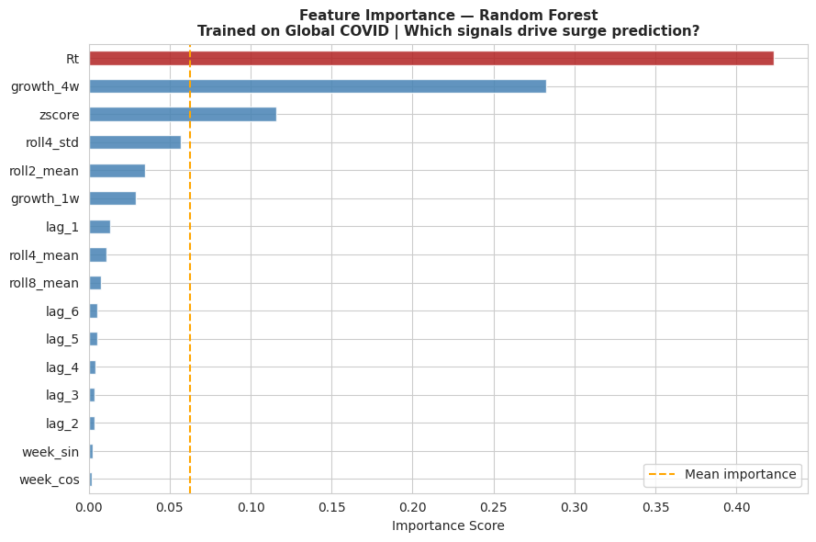
Results — Feature Importance & Geographic Signal
Headline Findings
Universal epidemic patterns → COVID model predicts RSV without retraining
Simpler models (Logistic Regression) outperform complex models cross-disease
Early warning achieved → reliable 1–2 week prediction window (AUC = 0.84)
Strong regional signal → NSW leads VIC by ~4 weeks (Granger p = 0.002)
High precision → ~91% accurate alerts (low false alarms)
Robust validation → zero data leakage (AUS & NZ excluded from training)
Inferra Dashboard

Slide 7
Initial Results - How Early Can We Warn?
Operational Window
✅ 1 week - AUC 0.976
Actionable early warning
🟡 2 weeks - AUC 0.907
Useful
🔴 6+ weeks - AUC ~0.5
Random
Granger: NSW → VIC RSV leads by 4 weeks (p=0.002), structural early warning signal

Slide 8


Challenges
Plan & Goals
EXPLAINED
AUC ≈ 1.0 on AUS COVID
Final Deliverable
Appeared to be overfitting, actually expected autocorrelation at h=0. Horizon analysis reveals the true picture: AUC drops to 0.654 at 4 weeks. AUC@4wk is now our primary metric.
📓 Modeling Notebook
Complete pipeline: train → 4 test sets → horizon → regression → Granger
INVESTIGATED
RSV June 2024 Anomaly
Checkpoint feedback flagged unusual slope in RSV plot. Investigated via state-level NNDSS data, identified as a reporting correction (negative count) in one NNDSS fortnight, not a real epidemiological event. Documented in notebook.
🖥 Live Dashboard
Streamlit app: COVID (238 countries) + RSV (AUS + NZ) + traffic light advisory
ADDRESSED
Cross-Disease F1 = 0
📄 Final Report
Methodology · results · limitations · stakeholder impact
COVID-calibrated probability threshold (0.5) was too high for RSV density. Fixed with threshold recalibration (PR curve optimisation). AUS RSV F1: 0.848. NZ RSV F1: 0.868 at optimised threshold.
CURRENT
NZ RSV Short Baseline
Remaining Work
Report
NZ virology data starts 2022 (post-COVID rebound). 76% of weeks labelled as surge, model sees near-constant surge, AUC = 0.545. AUS RSV (8-year baseline) achieves AUC = 0.923 identically. Solution: extend NZ RSV back to pre-2022.
Future Scope
Simpler Models Generalise Better
CURRENT
Extend to non-respiratory diseases (dengue, measles) to test the limits of cross-disease generalization.
Tuned RF/XGBoost show lower cross-disease AUC than Logistic Regression. Deeper trees overfit COVID patterns, losing transferability to RSV. Key finding: bias-variance tradeoff across domains, LR best for cross-disease.

Slide 9
Thank YOU

