Slide 1

GameObject*(root)
: 부모 -> 자식
포인터로 저장
: 자식 -> 부모
포인터 배열(vector)로 저장
...
GameObject* m_pParent;
nullptr
std::vector<GameObject*> m_pChildren;
※실제 코드는 std::shared_ptr<> 를 이용하여 관리
GameObject*
...
...
GameObject* m_pParent;
GameObject* m_pParent;
std::vector<GameObject*> m_pChildren;
std::vector<GameObject*> m_pChildren;
...
...
...
GameObject* m_pParent;
GameObject* m_pParent;
GameObject* m_pParent;
std::vector<GameObject*> m_pChildren;
std::vector<GameObject*> m_pChildren;
std::vector<GameObject*> m_pChildren;

Slide 2
GameObject
HelicopterObject
HummerObject
TankObject
ApacheObject
GunshipObject
SuperCobraObject
Mi24Object
M26Object

Slide 3
TF(root) = Matrix4x4::Identity()
TW(root) = Matrix4x4::Identity()
root
TW (Frame1) = TF(Frame1) * TW(root)
TW(Frame2) = TF(Frame2) * TW(root)
Frame1
Frame2
TW(Frame3) = TF(Frame3) * TW(Frame1)
= TF(Frame3) * (TF(Frame1) * TW(Root))
…
…
Frame3
Frame4
Frame5
※ m_xmf4x4Transform -> TF
※ m_xmf4x4World -> TW
※ 기본 초기화 상태를 가정하고 나타냄

Slide 4
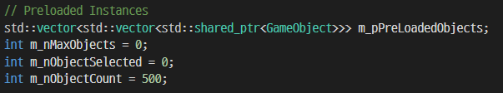
std::vector<std::vector<std::shared_ptr<GameObject>>>
std::vector<std::shared_ptr<GameObject>>
…
m_nMaxObjects
m_nObjectSelected
std::vector<std::shared_ptr<GameObject>>
…
m_nMaxObjects
std::vector<std::shared_ptr<GameObject>>
…
m_nMaxObjects
std::vector<std::shared_ptr<GameObject>>
…
m_nMaxObjects
std::vector<std::shared_ptr<GameObject>>
…
m_nMaxObjects
std::vector<std::shared_ptr<GameObject>>
…
m_nMaxObjects
m_nObjectCount
Update(Animate) & Render
for (auto& pObj : m_pPreLoadedObjects[m_nObjectSelected] | std::views::take(m_nObjectCount))
실제 코드

Slide 5
std::unordered_map<std::string, std::shared_ptr<GameObject>> m_pGameObjects
“Apache”
로딩된 GameObject
“Gunship”
로딩된 GameObject
원본 리턴
GetGameObject()
“SuperCobra”
로딩된 GameObject
“Hummer”
로딩된 GameObject
GameObject::CopyObject()
복사본 리턴
CopyGameObject()
“M26”
로딩된 GameObject
AddGameObject()
※ 함수 파라미터 생략
“Mi24”
로딩된 GameObject

Slide 6
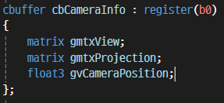
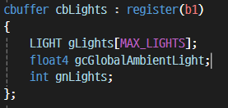

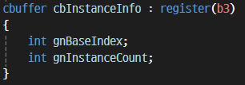
Descriptor Range
Root Signature
NumDescriptors = 2
BaseShaderRegister = 0
Root Parameter[0]
Descriptor Table
Root Parameter[1]
Descriptor Table
Descriptor Range
Descriptor Table
NumDescriptors = 1
BaseShaderRegister = 2
Root Parameter[2]
Root Parameter[3]
Root Constants
INSTANCING_USING_DESCRIPTOR_TABLE 선언
Descriptor Range
NumDescriptors = 1
BaseShaderRegister = 0
Root Parameter[0]
Descriptor Table
Root Parameter[1]
Descriptor Table
Root Parameter[2]
Root Descriptor
Root Parameter[3]
Root Constants
INSTANCING_USING_DESCRIPTOR_TABLE 미선언

Slide 7
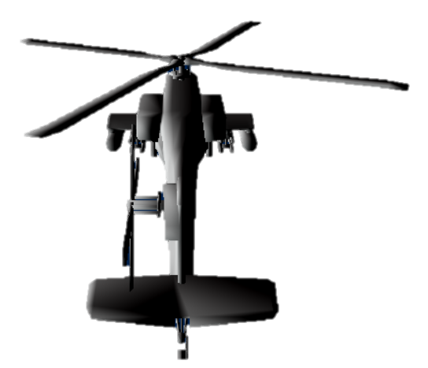
std::unordered_map<INSTANCE_KEY, UINT> m_InstanceIndexMap
MainRotor
AddToRenderMap()
MainRotor
Instance Key
m_nInstanceIndex++
(0으로 가정)
Body
AddToRenderMap()
Body
Instance Key
m_nInstanceIndex++
TailRotor
AddToRenderMap()
TailRotor
Instance Key
m_nInstanceIndex++
[0]
월드
행렬
…
…
std::shared_ptr<GameObject>
[1]
…
[2]
…
std::vector<std::pair<INSTANCE_KEY, std::vector<XMFLOAT4X4>>> m_InstanceDatas

Slide 8
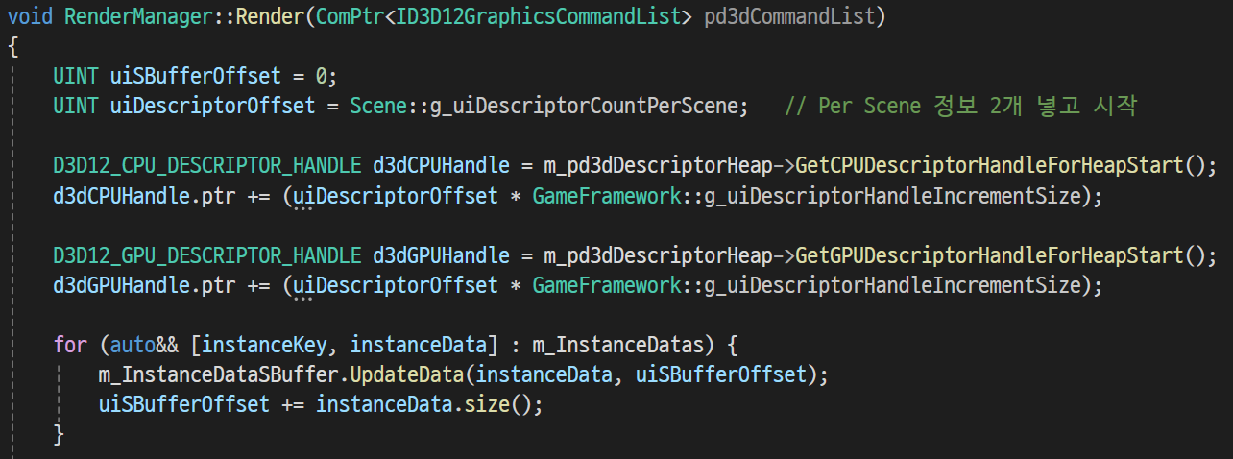
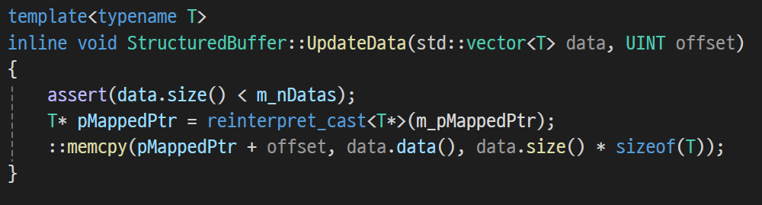

Slide 9
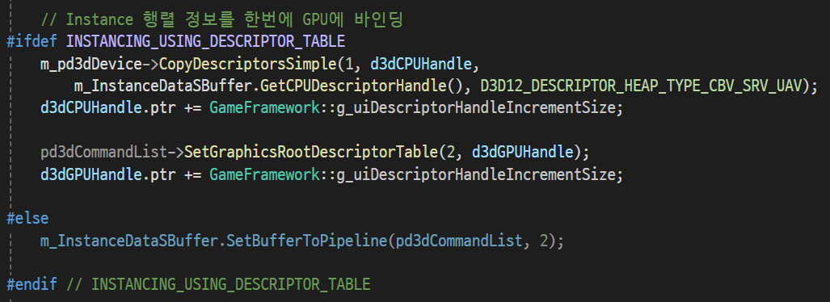
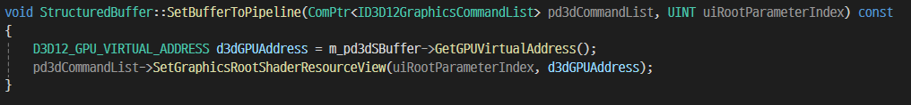

Slide 10
For 루프 전까지 Descriptor Heap
이 구간에 Material 정보(CBV)를 Copy & Set
CBV
CBV
SRV
…

