Slide 1
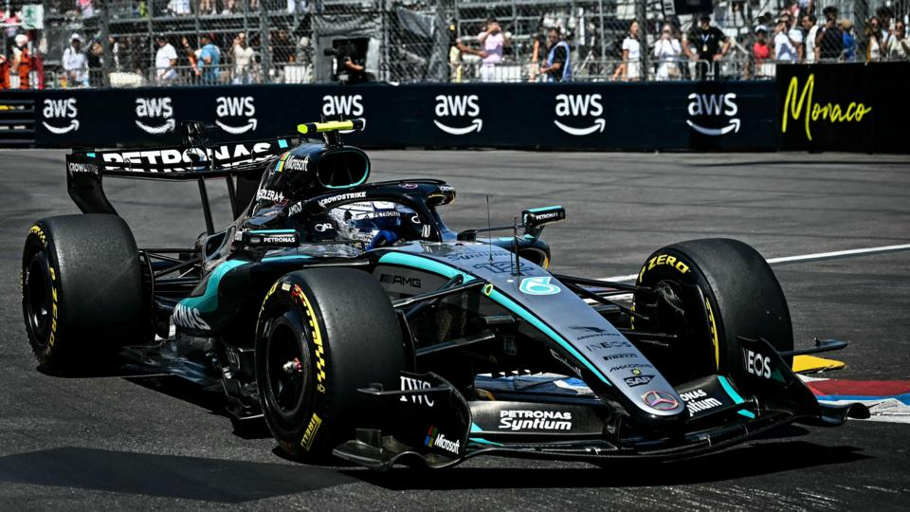
MACHINE LEARNING 2 · SEATTLE UNIVERSITY · SPRING 2026
Group 3 | A. Hemant Kumaar · Jack Lichwa · Prithika K
Formula 1 Pit Stop
Strategy Analysis
Predicting race outcomes and clustering driver behavior from 70 years of historical pit-stop data
5,970
51
4
R² 0.93
driver-race records
features
ML problem types
pit-duration model

Slide 2
BACKGROUND & MOTIVATION
Races are decided by seconds — can data predict them?
▸ The pit stop is the battleground. Speed, timing, and strategy in a 2-second window decide positions.
▸ Teams act on incomplete information. Weather, accidents, and rival moves all shift the optimal call.
▸ Pit data exposes hidden structure. Crew discipline and team quality leave a measurable signature.
PREDICT
How long will a pit stop take?
CLASSIFY
Who finishes on the podium?
Central question: Can we predict pit-stop behavior and race outcomes from historical race data alone?
DISCOVER
Do natural driver tiers exist?
02 / 14

Slide 3
DATASET OVERVIEW
70 years of Formula 1 race & pit-stop history
5,970
51
918
driver-race observations
engineered features
podium finishes (15.4%)
FEATURE CATEGORIES
Race context
Circuit traits
Qualifying
year · round · circuit · country
altitude · latitude · length
grid position · lap time
Pit metrics
Outcomes
Preprocessing
count · min/mean/max duration
final position · top-3 (binary)
PCA imputation · one-hot · scaling
03 / 14

Slide 4
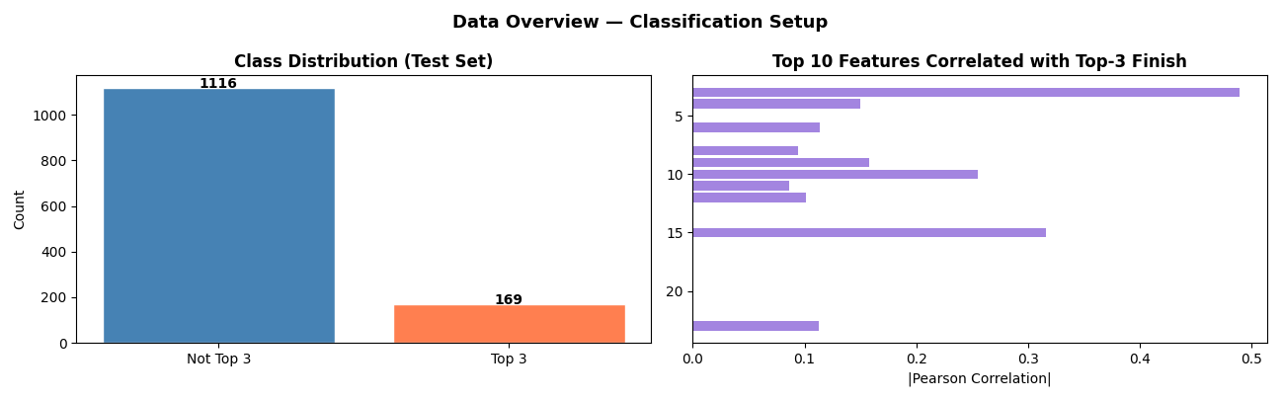
EXPLORATORY DATA ANALYSIS · LAB 1
A heavily imbalanced, multi-collinear dataset
▸ 15.4% positive class. Only 918 of 5,970 results are podiums — accuracy alone misleads.
▸ Pit duration 20–30s. Right-skewed, with a penalty tail beyond 35s.
▸ Correlated predictors. Min/mean/max pit duration move together; grid ≈ qualifying.
▸ Independent axes. Pit metrics are uncorrelated with position variables.
04 / 14

Slide 5
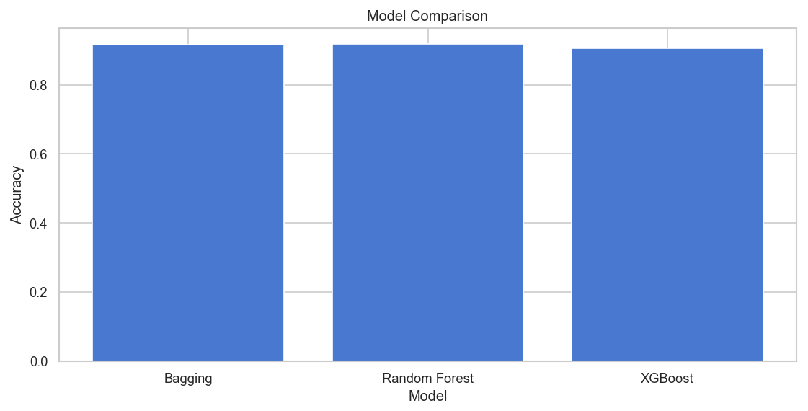
REGRESSION · PREDICTING PIT DURATION · LAB 2
Pit-stop duration is highly predictable
0.93
<1s
R² across every ensemble
average error (MAE 0.73s)
▸ Crew performance is consistent. Error under one second means pit execution is measurable, not random.
▸ Discipline beats circumstance. Team standards dominate over race-specific conditions.
Model | RMSE | MAE | R²
Gradient Boosting | 1.000 | 0.731 | 0.9335
Random Forest | 1.031 | 0.717 | 0.9314
Bagging | 1.099 | 0.731 | 0.9269
XGBoost | 1.263 | 0.794 | 0.9160
05 / 14

Slide 6
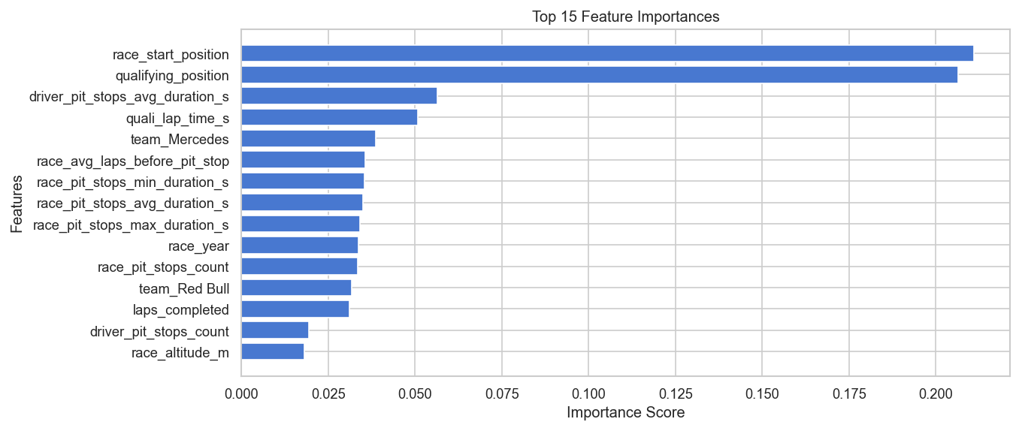
REGRESSION · WHAT DRIVES PIT DURATION · LAB 2
One signal dominates: crew consistency
0.90
importance — minimum pit duration
▸ Fastest stop predicts the average. A crew's best execution nearly determines its mean.
▸ Race context is marginal. Circuit, weather, and dynamics add under 2% of variance.
▸ A team property, not a race one. Fast pit programs hold their edge across every event.
06 / 14

Slide 7
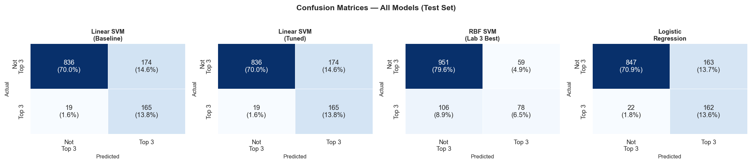
CLASSIFICATION · PREDICTING PODIUMS · LAB 4
Can we predict the top 3? Prioritize F1, not accuracy
Model | Accuracy | Precision | Recall | F1-Score | Assessment
Linear SVM | 91% | 0.72 | 0.68 | 0.63 | Best generalization
Logistic Regression | 91% | 0.72 | 0.66 | 0.64 | Competitive · interpretable
Decision Tree | 90% | 0.70 | 0.69 | 0.70 | Balanced alternative
Random Forest | 90% | 0.83 | 0.49 | — | High precision, low recall
RBF SVM | 86% | 0.57 | 0.42 | 0.49 | Severe overfitting
07 / 14

Slide 8
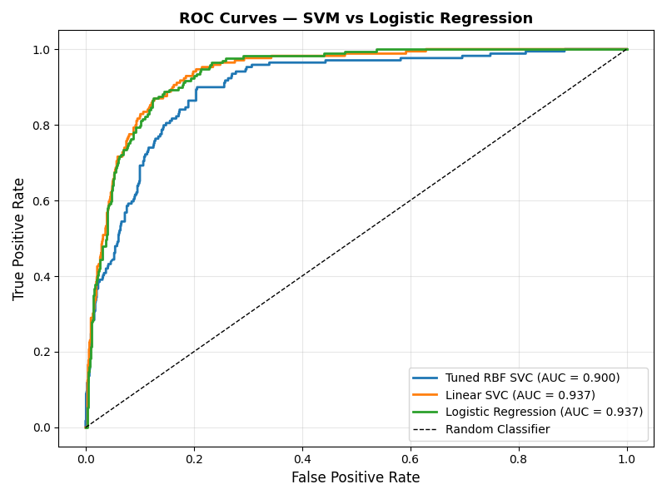
CLASSIFICATION · GENERALIZATION · LAB 4
Why linear wins and the RBF kernel fails
▸ The boundary is linear. Grid (0.21) + qualifying (0.21) nearly determine the podium; pit metrics add ~0.05.
▸ RBF memorizes. Train AUC 1.00 vs test 0.79 — a 0.21 gap hidden by class imbalance.
▸ High accuracy can mislead. 86% barely beats the 84.6% 'always predict no' baseline.
▸ Recall over precision. Catching 2 of 3 real podium drivers matters most for strategy.
Model | Train AUC | Test AUC | Gap
Linear SVM | 0.95 | 0.94 | 0.01
Logistic Reg. | 0.95 | 0.93 | 0.02
RBF SVM | 1.00 | 0.79 | −0.21
08 / 14

Slide 9
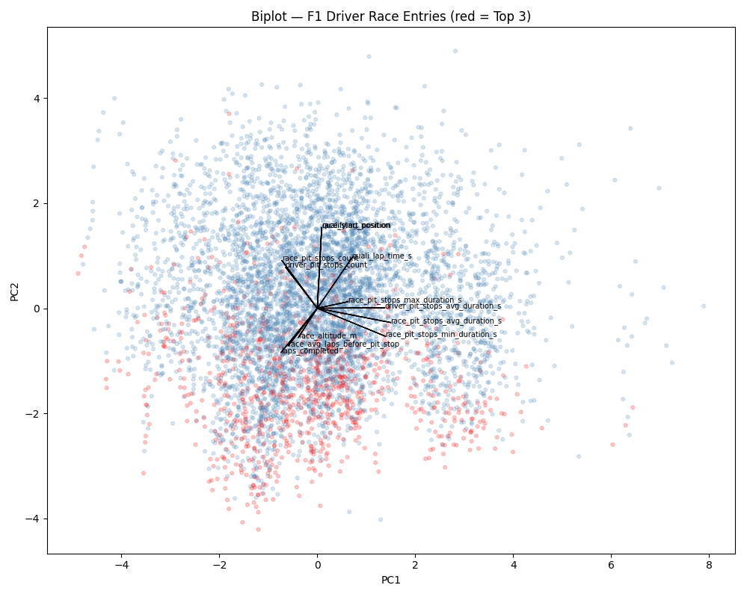
DIMENSIONALITY REDUCTION · PCA · LAB 8
Four independent dimensions, no dominant axis
Component | Represents | Variance | Cumul.
PC1 | Pit duration & crew speed | 25.2% | 25.2%
PC2 | Driver pace & grid | 17.9% | 43.1%
PC3 | Circuit characteristics | 15.5% | 58.6%
PC4 | Pit-strategy aggressiveness | 14.6% | 73.2%
▸ Variance is evenly spread. No single 'primary' axis — four genuinely independent factors.
▸ Pit speed ⊥ grid position. You cannot infer one from the other; keep both feature types.
▸ Elite drivers cluster tight. Low PC1 + low PC2 = fast pits and front grid.
09 / 14

Slide 10
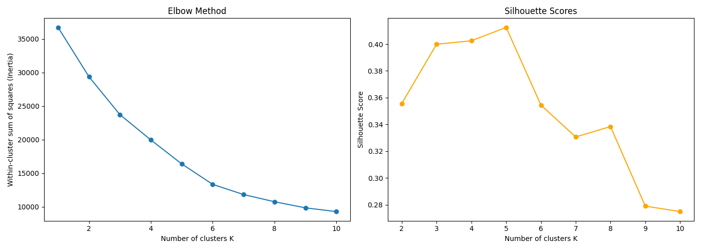
CLUSTERING · CHOOSING K · LAB 9
Do natural driver tiers exist? K-Means says five
K = 5
0.413
2 methods
optimal cluster count
peak silhouette score
K-Means + Hierarchical agree
10 / 14

Slide 11
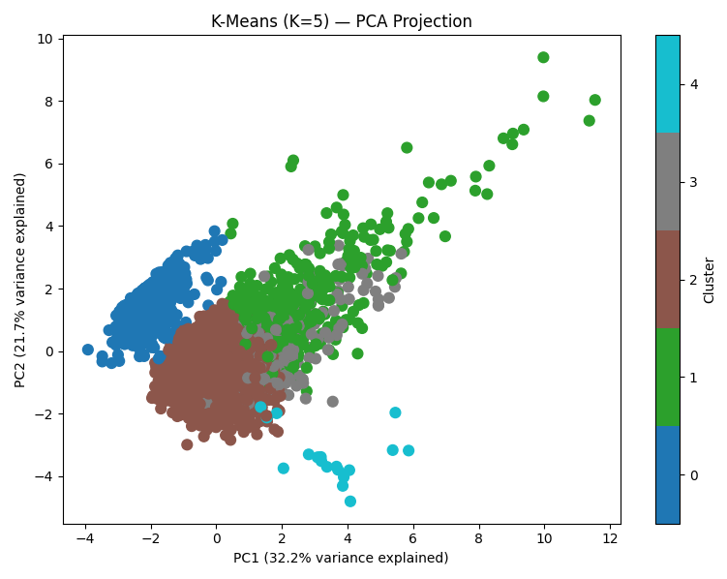
CLUSTERING · FIVE DRIVER TIERS · LAB 9
Elite and DNF are sharp; the midfield is a continuum
Tier | Size | Top-3 | Grid | Agreement
0 · Elite | ~880 | 50%+ | 1–6 | 99–100%
1 · Mid-A | ~2,500 | 10–15% | 7–13 | ~70%
2 · Mid-B | ~2,000 | 5–10% | 13–18 | ~70%
3 · Back-grid | ~500 | <5% | 18–20 | ~75%
4 · DNF | ~18 | 0% | varies | 99–100%
▸ Elite status is reproducible. Clusters 0 & 4 are stable across methods — real, intrinsic groups.
▸ Midfield has no fixed type. Soft boundaries: success is context-dependent, not strategy-defined.
11 / 14

Slide 12
SYNTHESIS
Four findings from four lenses on the same data
01
Pit behavior is measurable
02
Outcomes are grid-determined
Gradient Boosting reaches R² = 0.93. Duration is crew-driven and improvable — not luck.
F1 = 0.63 from grid + qualifying alone. Pit strategy refines, it doesn't decide.
03
Feature space is 4-D
04
Driver tiers are real but fuzzy
PC1–PC4 hold 73% of variance with no dominant axis — the data won't compress.
Elite (880) is stable across methods; the 4,500-strong midfield is continuous.
12 / 14

Slide 13
LIMITATIONS & FUTURE WORK
What the model can't yet see
PRIORITIZED NEXT STEPS
Temporal scope
70 years pool incomparable eras — pit tech went from ~45s to ~2s.
Direction | Impact | Feasibility
Era-stratified modeling | High | High
In-race telemetry | High | Medium
Causal framework | Medium | Medium
Team/driver effects | Medium | Medium
Context-aware midfield | Medium | Medium
No in-race dynamics
Static, pre-race features miss weather, tire wear, and safety cars.
No causal inference
Grid predicts podiums — but a fast car may simply cause both.
Confounded effects
Budget, crew, equipment, and driver skill can't be separated.
13 / 14

Slide 14
CONCLUSION
Grid position is destiny —
pit strategy is refinement.
▸ Pit duration is predictable. R² = 0.93; team consistency dominates over circumstance.
▸ Podiums are partly classifiable. F1 = 0.63–0.70; pre-race position carries most of the signal.
▸ The feature space is efficient. Four PCA components capture 73% of all variance.
▸ Driver tiers are real. Elite teams are tight and reproducible; the midfield is diffuse.
R² 0.93
pit duration model
F1 0.70
top-3 classification
K = 5
driver tiers
4 PCs
capture 73% variance
Data informs strategy — but real-time judgment still wins races.

