Slide 1
Deterrent Effects of DUI Punishment at the 0.08 BAC Threshold: Evidence from a Regression Discontinuity Design
Group 4:
Liliya Dimova, Brenda Hernandez Barragan, Cesar Lagos Davila, Xuanzhi Lu, Tien Nguyen, Zion Yates

Slide 2


High number of alcohol-related incidents in WA
In 2022
13,524 individuals lost their lives in motor vehicle crashes involving at least one alcohol-impaired driver- Result in 32%
3,402 deaths were attributed to alcohol-related incidents

Slide 3

Less strict in penalties compares to Canada
Fines from $350 to $5,000.
License Suspension will be suspended from 90 days to 4 years with potential jail time.
The conviction remains on a driving record for 7 years.
Fines from $350 to $5,000.
A one-year license suspension for first-time offenders to 120 days in prison.
Potential permanent license revocation for repeat offenders
Similarity: The legal Blood Alcohol Concentration (BAC) limit for adults is set at 0.08%

Slide 4
Question to discuss
Does the threat of these specific consequences actually prevent a driver from reoffending?
Should Washington consider lowering the 0.08% BAC threshold to increase public safety?

Slide 5
Survey Background
Traffic stop observations was conducted in Washington State from 1999
BAC 1 and BAC2: with the smallest value is used to determine.
Accident indicators
214,558 observations.
Demographic variables: sex, race, and age
Recidivism outcomes- a binary variable indicating whether the driver committed another DUI offense after the initial stop.

Slide 6
Regression discontinuity design validation
Purpose: To estimate the effect of harsher DUI punishment on future recidivism
Why this model?
This method is appropriate because Washington State applies stricter punishment once a driver’s blood alcohol concentration (BAC) reaches the legal cutoff of 0.08
punishment changes sharply at this threshold, drivers just below and just above the cutoff can be compared to estimate the causal effect of punishment on future DUI behavior.
Assumption: drivers cannot precisely manipulate their BAC around the legal threshold. Drivers near the cutoff should be very similar in all respects except for the punishment they receive.
RDD model validation: A balance test was performed to validate that the application of the punishment is the only variable that jumps at the cutoff of 0.08 BAC
None of the variables were significant. This demonstrates that none of these variables differ at the cutoff, providing validity to our model.
 | Accident | Male | White
Constant | 0.0761*** | 0.7914*** | 0.8494***
Punishment | -0.0037 | 0.0057 | 0.0021
BAC Centered | -1.545*** | 0.2097 | 0.1850
Punishment × BAC | 2.674*** | -0.3119** | -0.0101
Observations | 214,558 | 214,558 | 214,558

Slide 7
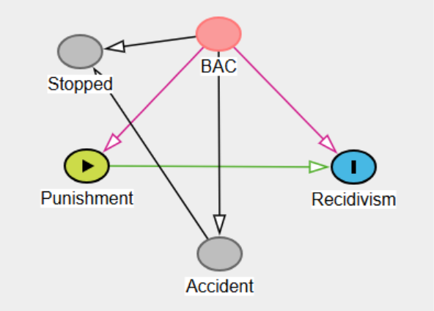
Introduction to RDD Components
Running Variable: We construct the running variable by taking the minimum of bac1 and bac2 for each observation. We then center this variable at the legal threshold of 0.08, creating bac_centered.
Treatment assignment: a binary variable indicating whether the BAC value crosses the legal threshold. If BAC ≥ 0.08, the variable takes the value 1, indicating that the stricter DUI punishment is triggered.
Bandwidth and Bin Size:
A ±0.05 window around the cutoff was selected to focus on observations that are most comparable to the legal threshold.
Bin size of 0.001 was used, which generated a smoother distribution.
Equation: Recidivism = β0 + β1 (Punishment) + β2 (BAC centered) + β3 (Acc) + β4 (Punishment × BAC centered)

Slide 8
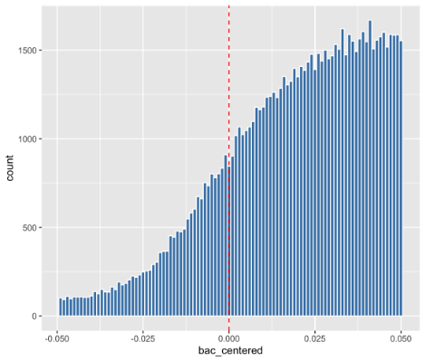
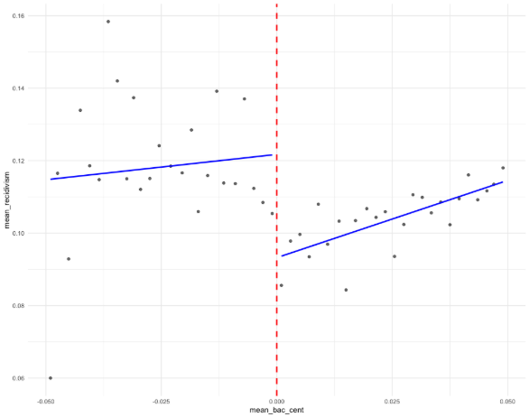
Graphical Evidence
The distribution of BAC values around the legal cutoff at 0.08.
The vertical dashed red line marks the threshold where stricter punishment begins
→This suggests that drivers are not manipulating their BAC levels to avoid crossing the legal limit
The relationship between BAC levels and the probability of recidivism
The vertical dashed line marks the legal cutoff at BAC = 0.08.
→A visible drop in recidivism occurs just after the cutoff, suggesting that stricter punishment may reduce the probability of future DUI offenses.

Slide 9
Regression Model Output
Variable | Estimate | Std. Error | t-value | Pr(>|t|) | Significance
(Intercept) | 0.115926 | 0.002894 | 40.062676 | < 2.2e-16 | ***
Punishment (Treatment) | -0.020213 | 0.003190 | -6.337357 | 2.3420e-10 | ***
BAC (Centered at 0.08) | -0.034321 | 0.083885 | -0.409140 | 6.8244e-01
Accident | -0.009051 | 0.001982 | -4.566740 | 4.9564e-06 | ***
Interaction (Punishment × BAC) | 0.369573 | 0.085524 | 4.321265 | 1.5521e-05 | ***
Based on the intercept: 11.96% chance of committing another DUI offense in the future.
The coefficient for Punishment tells 2.02 percentage points less likely to commit another DUI in the future →the punishment at the legal threshold may discourage repeated drunk driving behavior.
The coefficient for bac_centered (-0.034321) shows that as drivers approach the cutoff, their probability for recidivism slightly decreases. An explanation for this might be that drivers that were close to getting the treatment were now aware of the harshness of the punishment, making them hesitant to drive in the same conditions in the future.
The interaction term (Punishment × bac_centered = 0.369573) shows that the relationship between BAC and recidivism changes once the punishment threshold is crossed. In other words, the slope of recidivism with respect to BAC is different for drivers above the legal limit compared to those below it.
The results are statistically significant since the p-value for the punishment coefficient is extremely small. Overall, the results suggest that the 0.08 BAC cutoff has a deterrent effect, meaning that drivers who receive the stricter punishment at the threshold are somewhat less likely to commit another DUI in the future.

Slide 10
Conclusion and Policy Implications
0.08 threshold has a positive impact on drivers as because it successfully discourages them to offend the regulation in future driving, which is also very much aligned to general common sense and our own assumption before carrying out the study.
The estimated coefficient on the treatment variable is -0.020213 and statistically significant → a negative coefficient shows a discouraging effect of the current WA DUI policy.
DUI penalties reduces the possibility of future recidivism by approximately 2.02 percentage points
Compared to the baseline recidivism rate (11.96%), it shows a successful reduction of around 17.4%, which suggests that the current 0.08 BAC threshold can mitigate future violations while driving on the road.
The estimated deterrent effect of the 0.08 BAC threshold, the results of this study suggest that DUI enforcement can successfully discourage driving violations in the future. Drivers who receive DUI penalties show a weaker likelihood to commit sequential offenses, suggesting that legal obligations may mitigate risky driving behavior.
Maintaining an effectively high BAC threshold can successfully reduce repeated violations in the future
If residents in Washington State ever yearned for a higher threshold and stricter policy implementation, our current findings offer some supportive evidence in doing so to bring more safety on the road.

Slide 11
THANK YOU
Group 4

