Slide 1
Guitar effects pedal (analogue)
By: Sajjad Ullah
Supervisor: Kevin Chubb
DTO21A

Slide 2
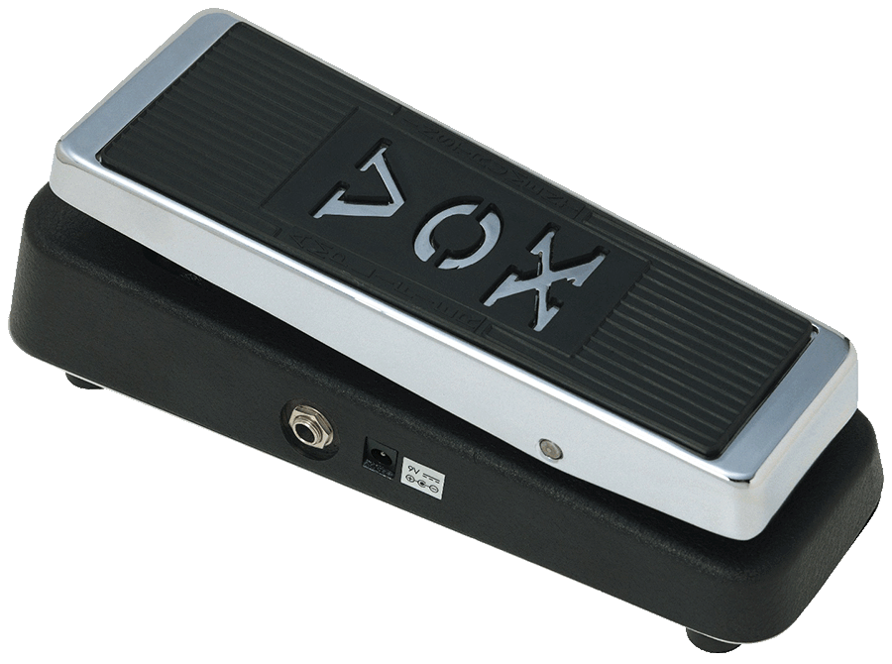
Introduction
Researching pedal effects
Identify the analogue processing methods
Investigating types of designs
Verification and validation testing
Vox V847 Pedal

Slide 3
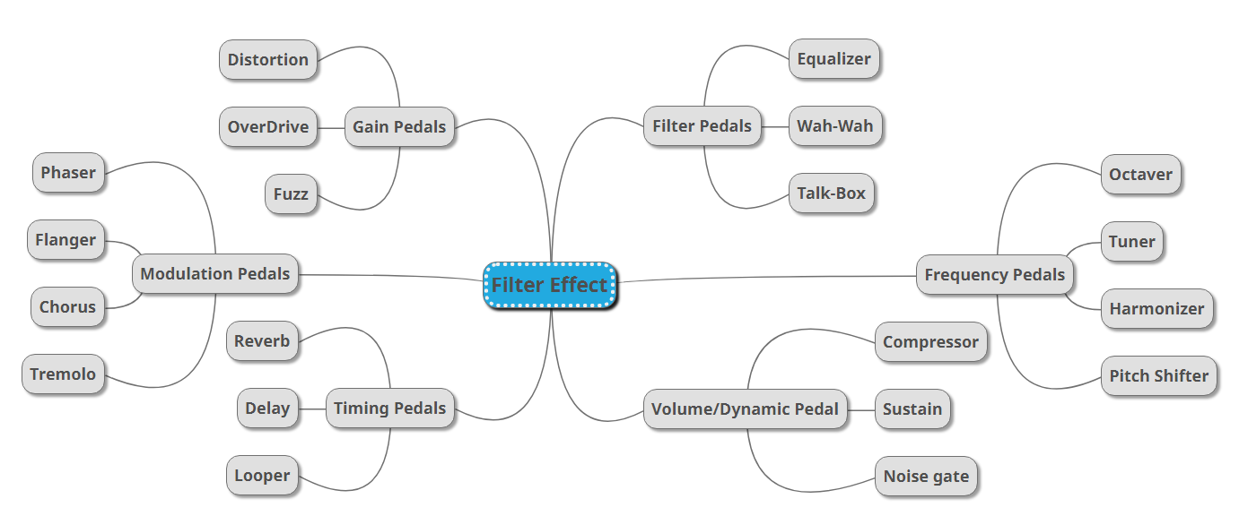
Breakdown of Pedal Effects

Slide 4
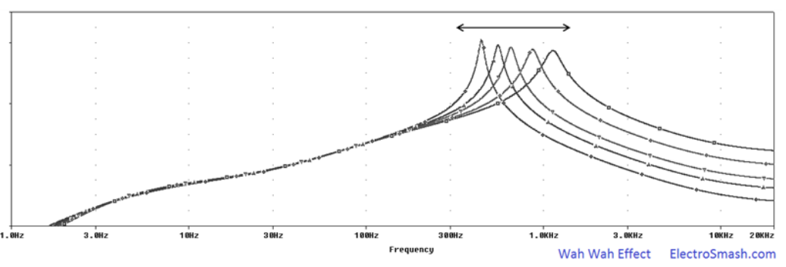
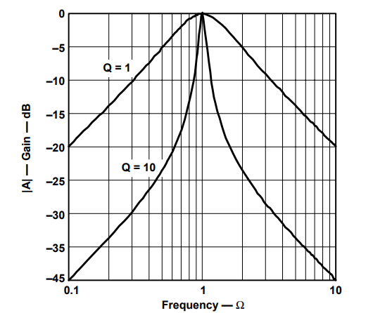

The Wah-Wah Effect
Frequency ‘sweeping’
Quality factor Q
Q $=\frac{fmid}{Bandwidth }$

Slide 5
Bandpass Filter
Option 1: Passive filter design
Option 2: Active filter design

Slide 6

Option 1: Passive Filter Design
Cascading High & low pass to form Bandpass
Two concerns:
2 resistors must change in unison
Loading effect.
Test No. | R_{load} (ohms) | Voltage without buffering Op-amp | Voltage with buffering Op-amp
1 | 1 | 0.009998 | 5
2 | 100 | 0.8333 | 5
3 | 10,000 | 4.762 | 5
4 | 100,000 | 4.975 | 5
5 | 1,000,000 | 4.998 | 5
$$HighPass cutoff: F_{Low}=\frac{1}{2πR1C1} , LowPass cutoff: F_{High}=\frac{1}{2πR2C2}$$

Slide 7

Option 2: Active Filter Design
To provide sweep: 3 resistors must change in unison.
R
--
$$Sallen−Key Bandpass mid frequency: f_{m}=\frac{1}{2πRC}$$

Slide 8
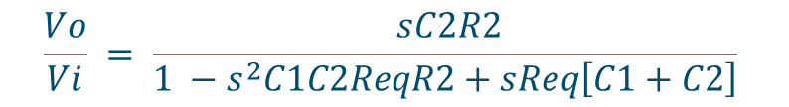
Multiple feedback configuration
Ideal because of the ability to use one component to sweep the frequency
R1& R3 prevent a squared increase in resonate frequency gain.
$$\frac{Vo}{Vi} = \frac{ sC2R2}{1 −s^{2}C1C2ReqR2+sReq\left[C1+C2\right]}$$
Req
$$\text{Using} \text{Req}\text{, }\text{re}\text{sonance} \text{gain} \text{magnitude}\text{: }\text{|}\text{H}\text{0}\text{BP}\text{| = 2}\text{Q}\text{2}$$
$$\text{Using} \text{R}\text{1\&}\text{R}\text{2, }\text{re}\text{sonance} \text{gain} \text{magnitude}\text{: }\text{|}\text{H}\text{0}\text{BP}\text{| }\text{<}\text{ 2}\text{Q}\text{2}$$

Slide 9
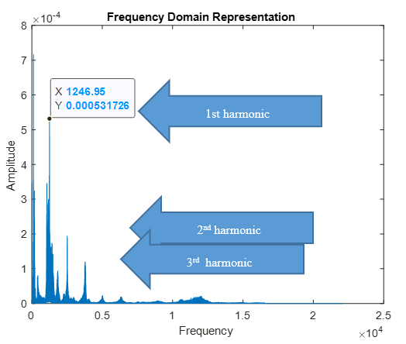
Requirements Analysis
Using MATLAB
Recorded harmonic data
 | Harmonic in Hz
High frequency note | 1st | 2nd | 3rd
highv1 | 1041 | 2413 | 3730
highv2 | 1246 | 2507 | 3775
highv4 | 1065 | 2506 | 3767
highv5 | 1061 | 2505 | 3773
high_cleanv1 | 1241 | 2487 | 3743
average | 1130.8 | 2483.6 | 3757.6
Low frequency note | 1st | 2nd | 3rd
lowv1 | 257 | 515 | 777
lowv2 | 257 | 516 | 776
lowv3 | 257 | 516 | 776
lowv4 | 257 | 515 | 776
low_cleanv1 | 256 | 512 | 773
average | 256.8 | 514.8 | 775.6

Slide 10
System Design
Range 200Hz – 2k Hz.
Q factor set to 10.
Gain at resonant frequency is set to 0 dB.
For 200 Hz, R3 = 2.1k Ω.
For 2k Hz, R3 = 21 Ω.

Slide 11
Simulation verification
Frequency Sweep
Simulation of frequency response

Slide 12
MATLAB verification
Check the derivation of transfer function.
Does it agree with Pspice simulation of (1.02k Hz & 1dB)

Slide 13
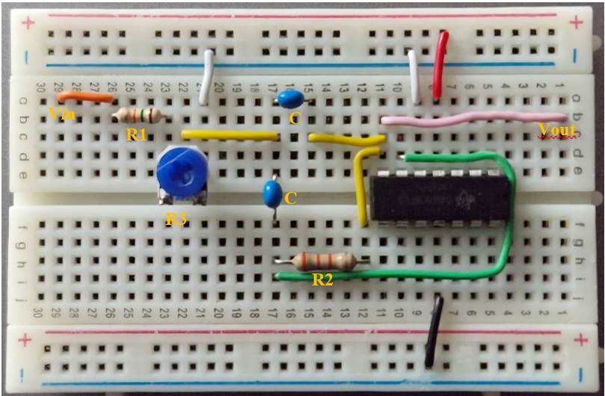
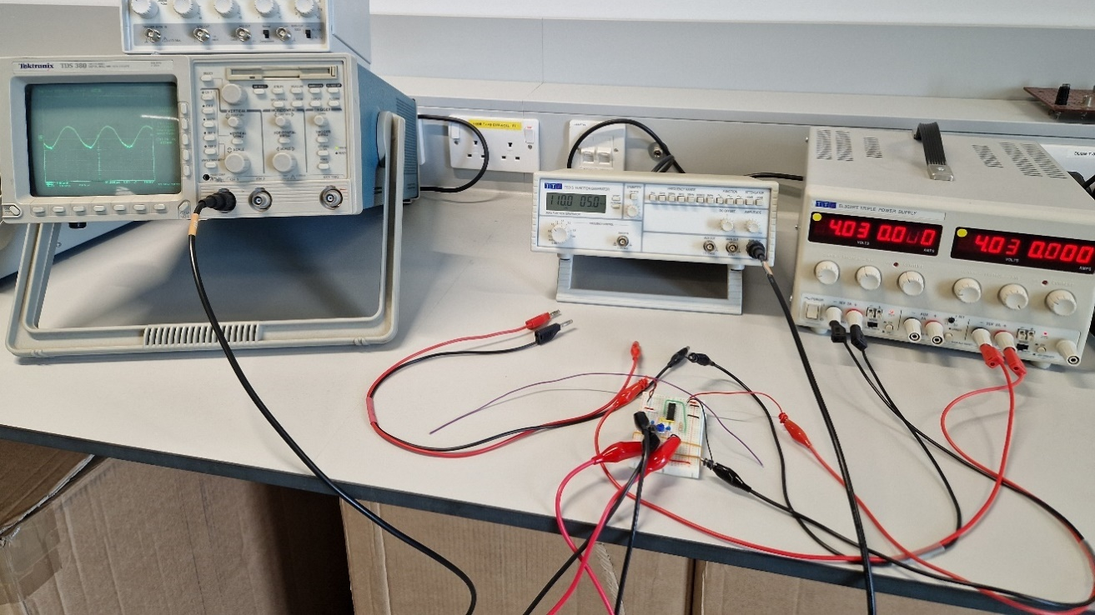
Validation Testing

Slide 14

Bode magnitude plot from testing
R3 was set to 150 Ω.
Calculation of expected resonant frequency (fm).
Expected fm = 719 Hz
11% error between expected and real value.

Slide 15
More accurate prediction of Fm
Ideal components
Used measured resistance values
However ideal capacitor values of 100 nF were used.
Measured values: C1 = 95nF & C2 = 96.4nF
Expected fm becomes = 751 Hz instead of 719 Hz.
System actually had 6.5% error

Slide 16
The End

Slide 17
Data Collected
Data of magnitude and phase
Q factor & BW across the frequency range
 | Measurements |  |  | Calculated
Frequency (Hz) | Vin (mv) | Vout (mv) | Time delay, Td (ms) | phase (θ) | 20log(Vout/Vin) (dB)
216 | 624 | 30 | 4.6 | 358 | -26.4
300 | 688 | 46 | 3.3 | 356 | -23.5
350 | 488 | 40 | 2.8 | 353 | -21.7
400 | 488 | 48.8 | 2.5 | 360 | -20.0
500 | 488 | 73 | 1.46 | 263 | -16.5
600 | 488 | 122 | 1.24 | 268 | -12.0
700 | 488 | 288 | 1.02 | 257 | -4.6
800 | 488 | 508 | 0.6 | 173 | 0.3
900 | 488 | 264 | 0.34 | 110 | -5.3
950 | 488 | 184 | 0.32 | 109 | -8.5
1000 | 488 | 152 | 0.3 | 108 | -10.1
1050 | 488 | 128 | 0.26 | 98 | -11.6
1100 | 488 | 112 | 0.26 | 103 | -12.8
1200 | 488 | 88 | 0.24 | 104 | -14.9
1300 | 488 | 72 | 0.22 | 103 | -16.6
1400 | 488 | 62 | 0.19 | 96 | -17.9
1500 | 488 | 56 | 0.18 | 97 | -18.8
1600 | 488 | 50 | 0.17 | 98 | -19.8
1700 | 488 | 46 | 0.16 | 98 | -20.5
1800 | 488 | 42 | 0.15 | 97 | -21.3
1900 | 488 | 38 | 0.14 | 96 | -22.2
2000 | 488 | 36 | 0.13 | 94 | -22.6
Freq (Hz) | R3 | Q | BW (Hz)
200 | 2188.53 | 1.95 | 563.88
300 | 972.68 | 2.82 | 390.44
400 | 547.13 | 3.70 | 296.95
500 | 350.17 | 4.60 | 239.13
600 | 243.17 | 5.50 | 200.00
700 | 178.66 | 6.40 | 171.81
800 | 136.78 | 7.31 | 150.55
900 | 108.08 | 8.21 | 133.95
1000 | 87.54 | 9.12 | 120.64
1100 | 72.35 | 10.02 | 109.73
1200 | 60.79 | 10.93 | 100.63
1300 | 51.80 | 11.84 | 92.91
1400 | 44.66 | 12.75 | 86.30
1500 | 38.91 | 13.65 | 80.56
1600 | 34.20 | 14.56 | 75.54
1700 | 30.29 | 15.47 | 71.10
1800 | 27.02 | 16.38 | 67.16
1900 | 24.25 | 17.29 | 63.63
2000 | 21.89 | 18.19 | 60.46

Slide 18
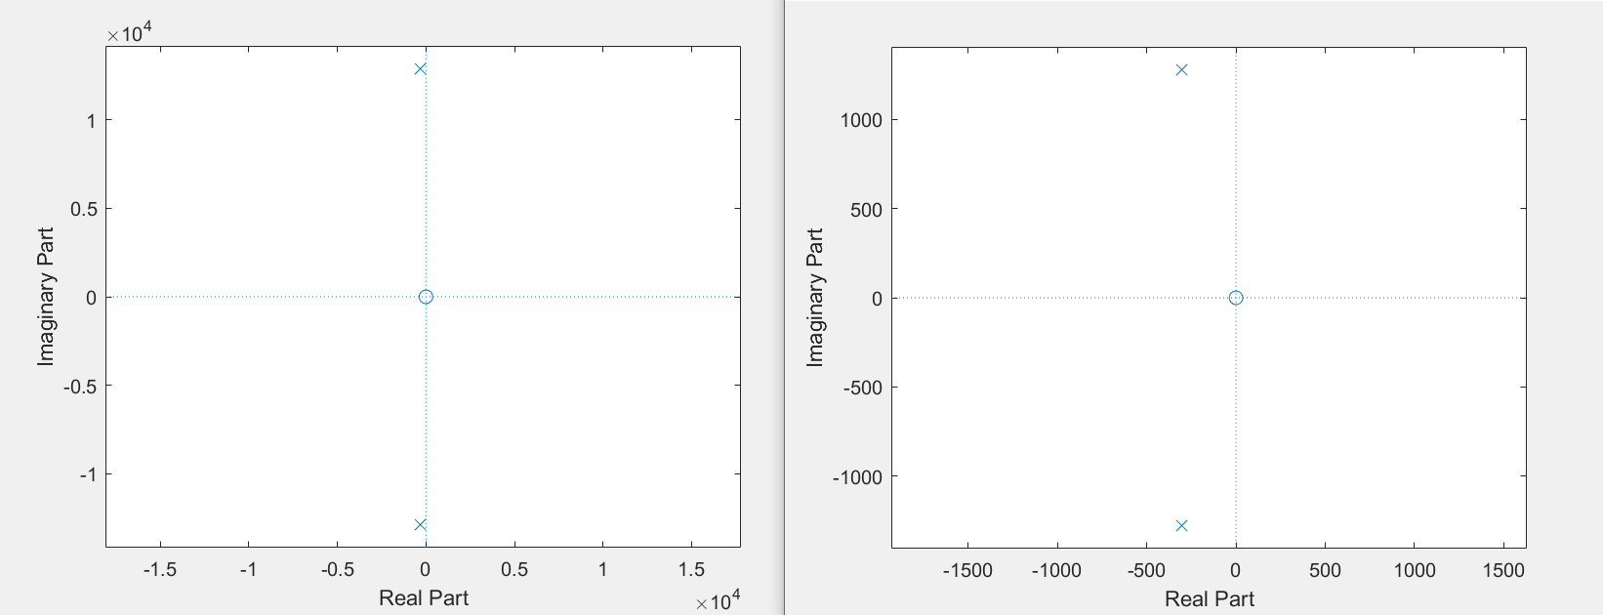
S-plane across frequency range
20 ohms – 2k Hz
2K ohms – 200 Hz

Slide 19
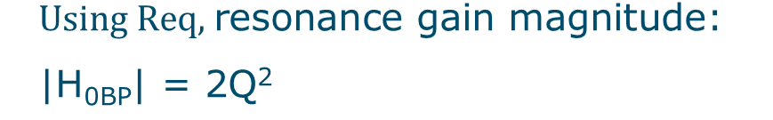
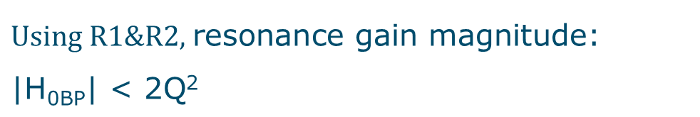
$$\text{Using} \text{R}\text{1\&}\text{R}\text{2, }\text{re}\text{sonance} \text{gain} \text{magnitude}\text{: }\text{|}\text{H}\text{0}\text{BP}\text{| }\text{<}\text{ 2}\text{Q}\text{2}$$
$$\text{Using} \text{Req}\text{, }\text{re}\text{sonance} \text{gain} \text{magnitude}\text{: }\text{|}\text{H}\text{0}\text{BP}\text{| = 2}\text{Q}\text{2}$$

Slide 20
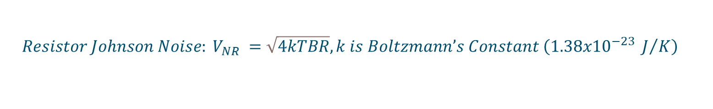
Factors at play
Parasitic capacitance
Op-amp idealizations eg offset voltage between the input terminals are zero
Resistor Noise
$$Resistor {Johnson Noise: V}_{NR} =\sqrt{4kTBR}, k is Boltzmann’s Constant \left(1.38x{10}^{−23} J/K\right)$$

Slide 21
Filter Implementation
Using LM324 Quad chip
Red & Black are for +/- Power supply
White colour wire is used for ground terminal

Slide 22
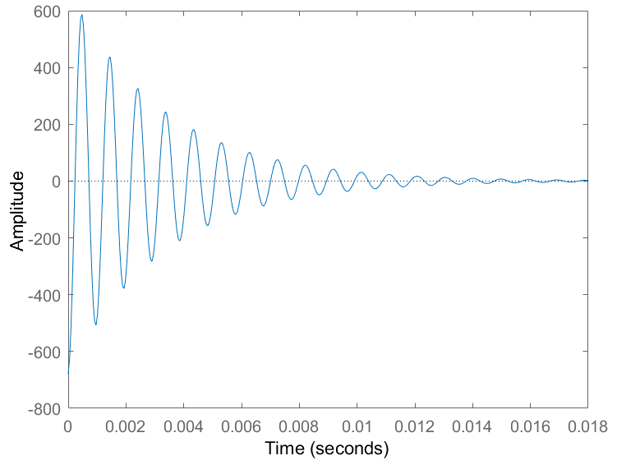
Filter Stability
Impulse Response
S-plane plot of Laplace transform roots

Slide 23
Op-amp Consideration: slew rate
Ensures the amplifier can provide an output that is an accurate representation of the input.
Units of volts per microsecond (V/μs).
Can cause the output waveform to be distorted if the maximum rate of change is exceeded.
slew rate of the LM324 is 0.3 V/μs, (gives max freq 95k Hz).

Slide 24
Investigating Feasibility of Passive filter
Voltage Divider without op-amp
Voltage Divider with op-amp
Test No. | R_{load} (ohms) | Voltage without buffering Op-amp | Voltage with buffering Op-amp
1 | 1 | 0.009998 | 5
2 | 100 | 0.8333 | 5
3 | 10,000 | 4.762 | 5
4 | 100,000 | 4.975 | 5
5 | 1,000,000 | 4.998 | 5
Circuit should provide 5v to any load.
The op-amp LM324 has input impedance of 1G Ω.

