Slide 1


A Comparative Analysis of Resources across Cloud Platform and Bounded Infrastructure.

Slide 2
Mentor
Mr.Vivek M, Assistant Professor
Department of Artificial Intelligenceand Data Science,
Jansons Institute of Technology Coimbatore, India
mvivekcse@gmail.com
Authors
Mr. Santhosh P
B.Tech Artificial Intelligence and Data Science
Jansons Institute of Technology
Coimbatore, India
santhoshtupr@gmail.com
Mr.Sri Murugan G
B.Tech Artificial Intelligence and Data Science
Jansons Institute of Technology
Coimbatore, India
srimurugan27042003@gmail.com
Mr.Subash P
B.Tech Artificial Intelligence and Data Science
Jansons Institute of Technology
Coimbatore, India
subashpalvel.ai@gmail.com
Ms.Vidavaluru Divyanjali
B.Tech Artificial Intelligence and Data Science
Jansons Institute of Technology
Coimbatore, India
vidavalurudivyanjali@gmail.com

Slide 3

Abstract
This literature review compared Cloud-based development platforms like Intel OneAPI DevCloud and Google Colab with bounded infrastructures, based on performance, ease of use, accessibility, cost savings, and integration with other services.
Cloud-based platforms offer significant advantages over traditional local machines in all these parameters.
With increasing demand for high-performance computing in emerging technologies like AI, IoT, and Neural Networks, cloud-based development platforms are expected to play a crucial role.

Slide 4
Introduction
Cloud-based development platforms have transformed the field of software development.
Intel OneAPI DevCloud and Google Colab are popular platforms for machine learning and AI applications.
Both platforms offer significant performance gains, ease of use, accessibility, cost savings, and integration with other services.
Cloud-based platforms provide powerful hardware resources without the need for expensive local hardware or software.
Intel OneAPI DevCloud has gained popularity among developers who require access to Intel hardware accelerators, while Google Colab is popular for its collaborative features and free access to a GPU.

Slide 5
Ease Of Use
Ease of use is an important factor to consider when choosing a platform for software development or machine learning tasks.
Google Colab has a web-based interface and integration with other Google services, making it the most accessible option for beginners.
Intel OneAPI DevCloud requires some knowledge of the command line interface, but provides a wide range of tools and resources for more experienced users.
A bounded infrastructure can be customized to suit specific requirements, but the setup and maintenance can be time-consuming and require technical expertise.

Slide 6
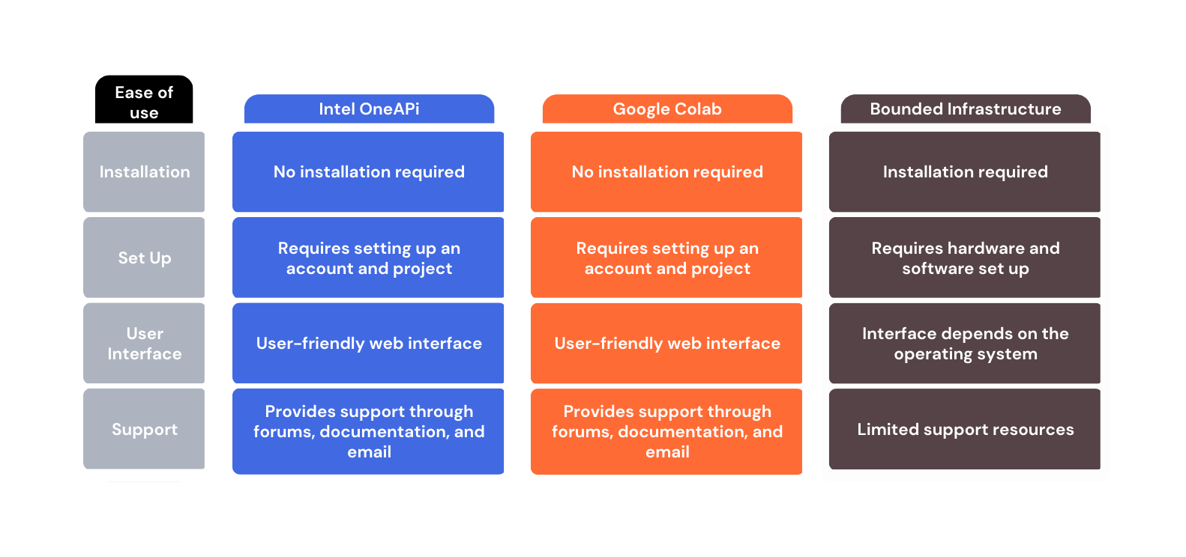

Slide 7
Performance
Performance is key when choosing a platform for software development or machine learning tasks.
Intel OneAPI DevCloud provides high-performance computing capabilities with access to multiple high-performance processors and accelerators.
Google Colab provides a more limited set of resources with access to a single GPU and limited access to TPUs.
A bounded infrastructure's performance depends on its hardware, and it can be expensive to purchase and maintain.
The performance of a platform can also be affected by the type of workload being executed, as some tasks may be more CPU or GPU intensive than others.
The performance of a platform can also depend on the availability and accessibility of specialized hardware such as FPGAs and TPUs.

Slide 8
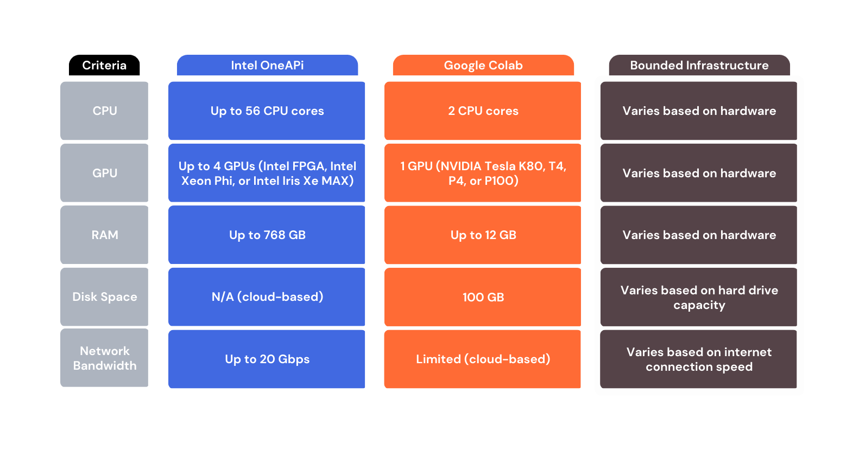

Slide 9
Accessibility
Accessibility is important when choosing a platform for software development or machine learning.
Intel OneAPI DevCloud offers a wide range of hardware and software resources, available worldwide with straightforward access and technical support.
Google Colab provides a web-based interface accessible from any device with an internet connection and no installation or setup required.
Bounded infrastructure's accessibility depends on the operating system and software installed, specialized hardware and software may limit accessibility.
Intel OneAPI DevCloud and Google Colab offer significant advantages over bounded infrastructure in terms of accessibility, with access to a wide range of resources and remote accessibility.

Slide 10
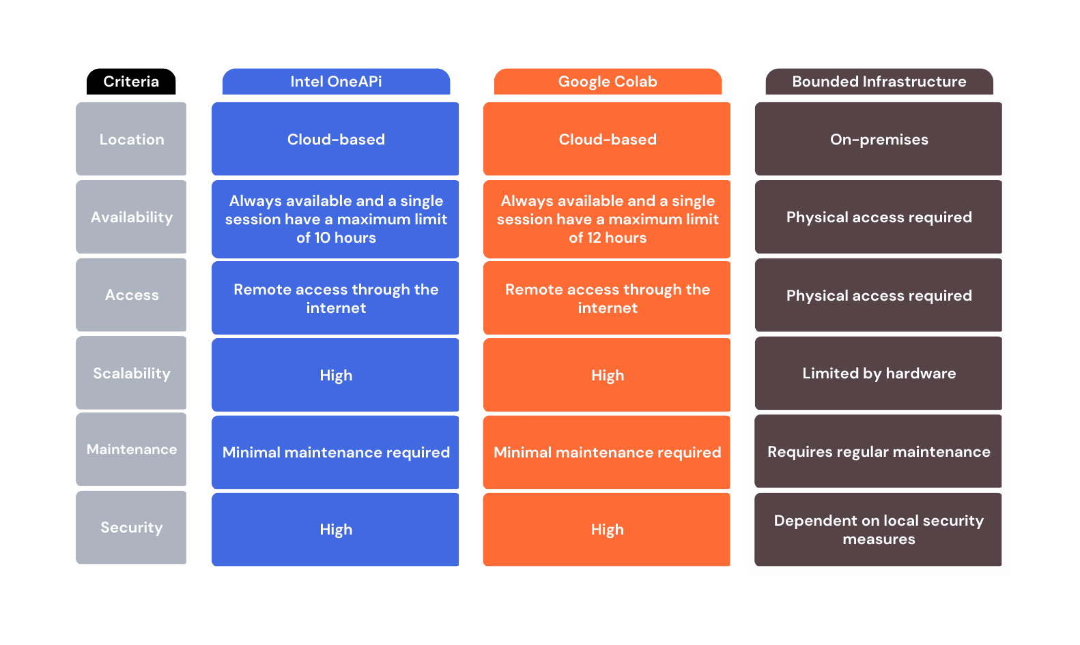

Slide 11
Cost Savings
Cost savings are important when choosing a development platform
Intel OneAPI DevCloud and Google Colab are cloud-based and offer significant cost savings compared to bounded infrastructure
DevCloud is free, reducing hardware, software, and maintenance costs
Colab offers pre-installed software and libraries, saving time and effort in setting up a development environment
Cloud-based platforms eliminate the need to purchase and maintain high-end hardware, offer a pay-as-you-go model, and access to hardware accelerators
Sharing resources with others can significantly reduce overall costs
Cloud-based platforms are scalable and can help reduce energy costs
These platforms can offer significant cost savings for software development and machine learning tasks

Slide 12
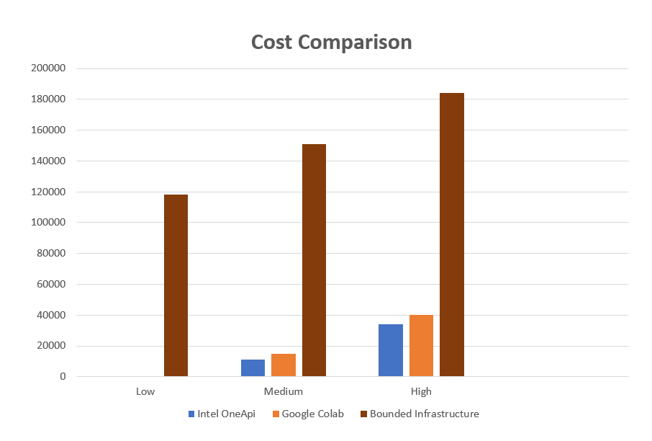

Slide 13
Integration
What are the benefits of integrating cloud-based development platforms with other services?
Data storage and management: Users can store and manage their data securely in the cloud and access it from anywhere.
Collaboration: Integrating with collaboration tools allows developers to share code, collaborate in real-time, and improve productivity.
Deployment and hosting: Integrating with cloud-based hosting services makes it easier to deploy and host applications in the cloud.
Monitoring and analytics: Users can monitor and analyze the performance of their applications to identify and address issues.
Machine learning and AI: Integrating with machine learning and AI tools and services provides access to pre-built models and algorithms for developing advanced applications.

Slide 14
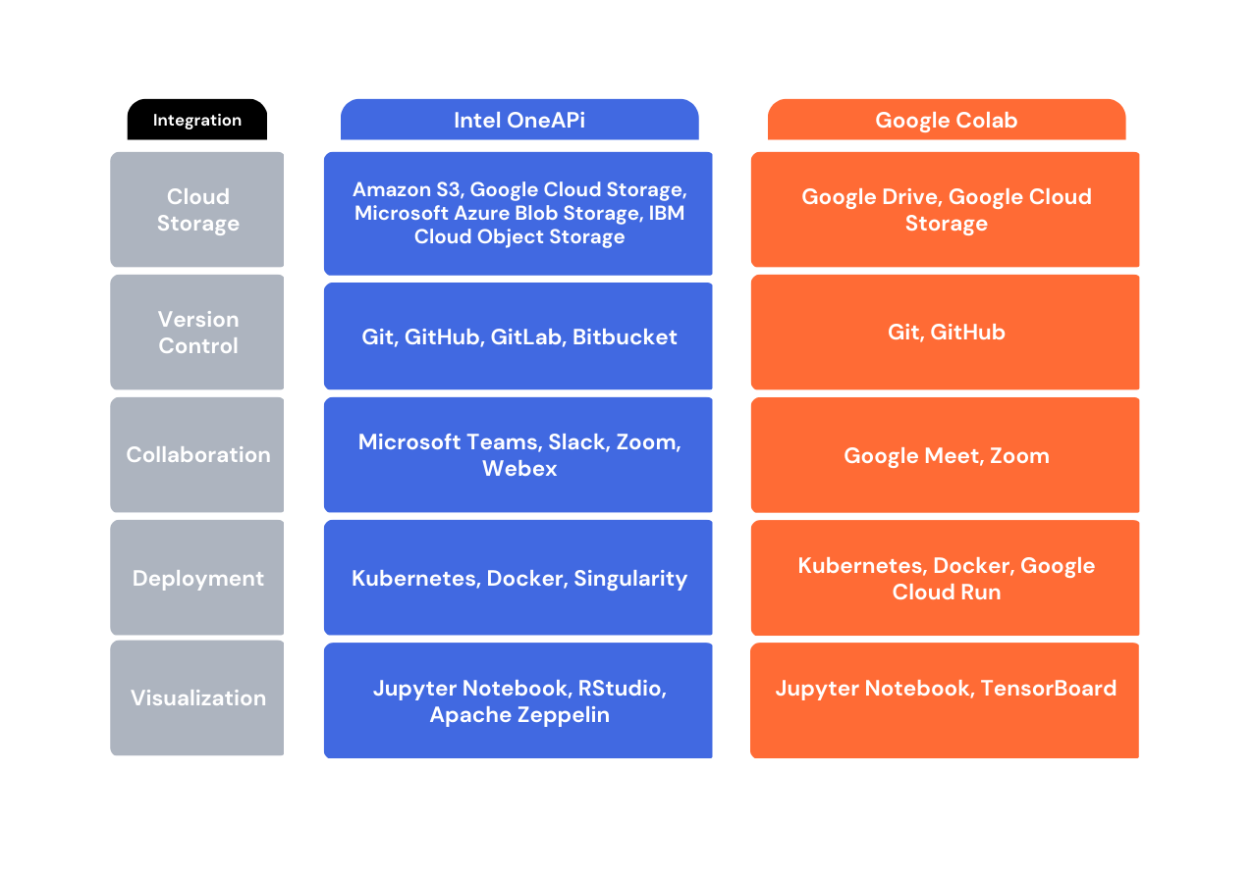

Slide 15
A Student's Asset
Cloud-based development platforms have made it easier for educators to teach machine learning and artificial intelligence concepts to students.
Students don't need to worry about setting up their own development environments, which saves time and reduces distractions.
Cloud-based platforms facilitate collaboration among students and educators, fostering a community of learners and promoting knowledge sharing.
These platforms have made machine learning and artificial intelligence more accessible to students from diverse backgrounds.

Slide 16
Future Scope
Cloud-based development platforms like Intel OneAPI DevCloud and Google Colab have made machine learning and artificial intelligence more accessible to students and data scientists. These platforms are expected to play a significant role in the development of applications and services, including edge computing and data science. As more developers embrace these platforms, demand for user-friendly interfaces and comprehensive documentation will continue to grow. Additionally, these platforms are expected to integrate with other services and play a critical role in the development of emerging technologies like AI and IoT. Platform providers will need to continue investing in security features and compliance standards to maintain the trust of their users.

Slide 17
Conclusion
Once upon a time, researchers and developers struggled with the challenges of specialized knowledge and expensive hardware in the fields of machine learning and artificial intelligence. But then, cloud-based development platforms like Intel OneAPI DevCloud and Google Colab emerged, providing accessibility, cost savings, and high-performance computing resources from anywhere. These platforms are game-changers, integrating with other popular tools and services and allowing collaboration and easy management of work. With the future promising an even more user-friendly experience, comprehensive documentation, and better security features, the world of emerging technologies like AI and IoT is ripe for growth, and cloud-based development platforms are leading the way.

Slide 18


