Slide 1
Parallel Computation of Reducts
-Robert Susmaga

Slide 2
Sequential Implementation
Reduct generation algorithm based on the discernibility matrix.
The result of the algorithm is the set of all exact reducts.

Slide 3
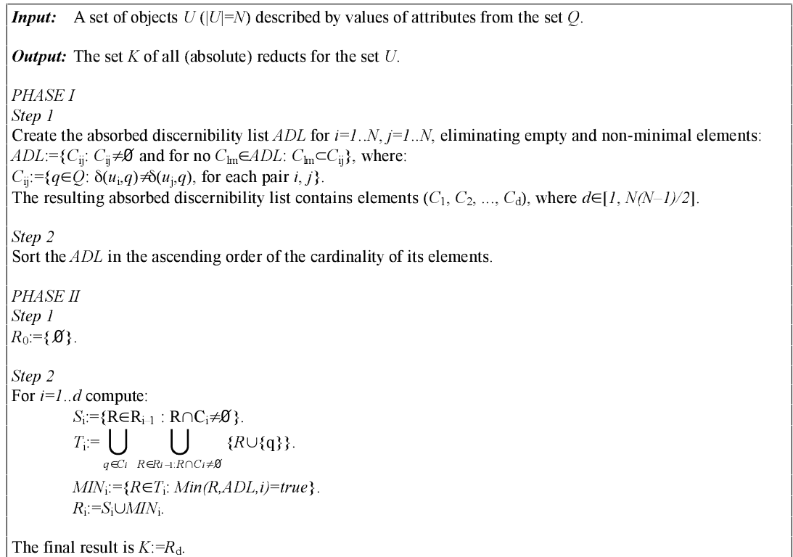
Susmaga Algorithm

Slide 4
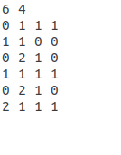
Susmaga Algorithm
Input:

Slide 5
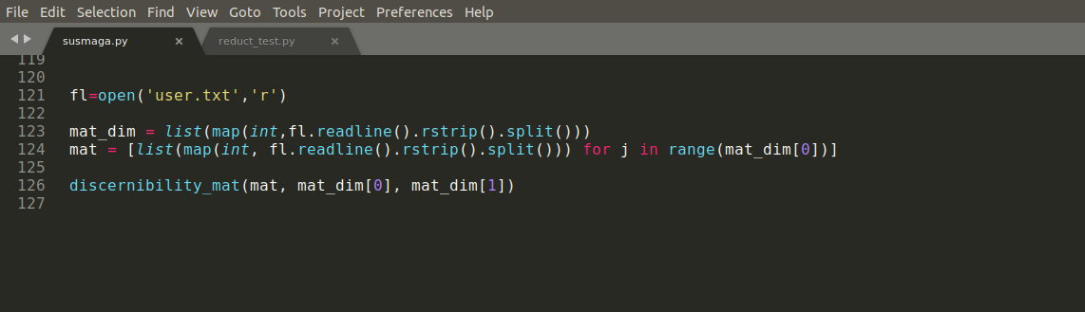
Susmaga Algorithm
Read input from user.txt file

Slide 6
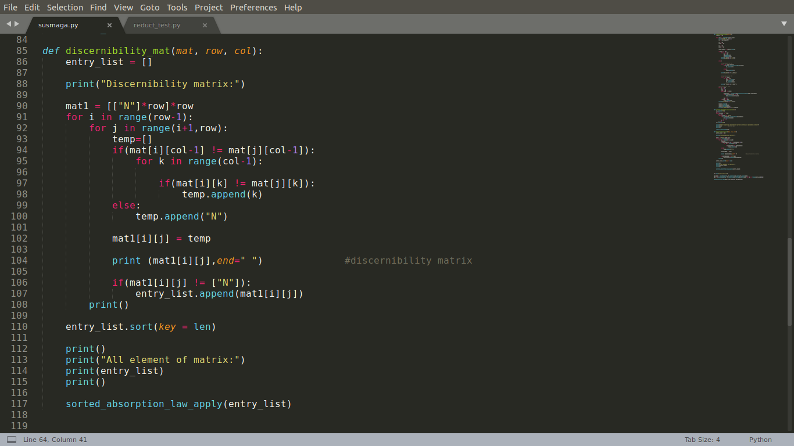
Constructing Discernibility Matrix

Slide 7
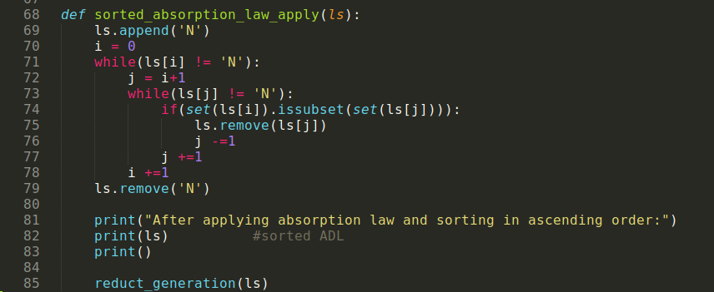
Applying Absorption Law
a^(a v b) = a v (a^b) = a

Slide 8
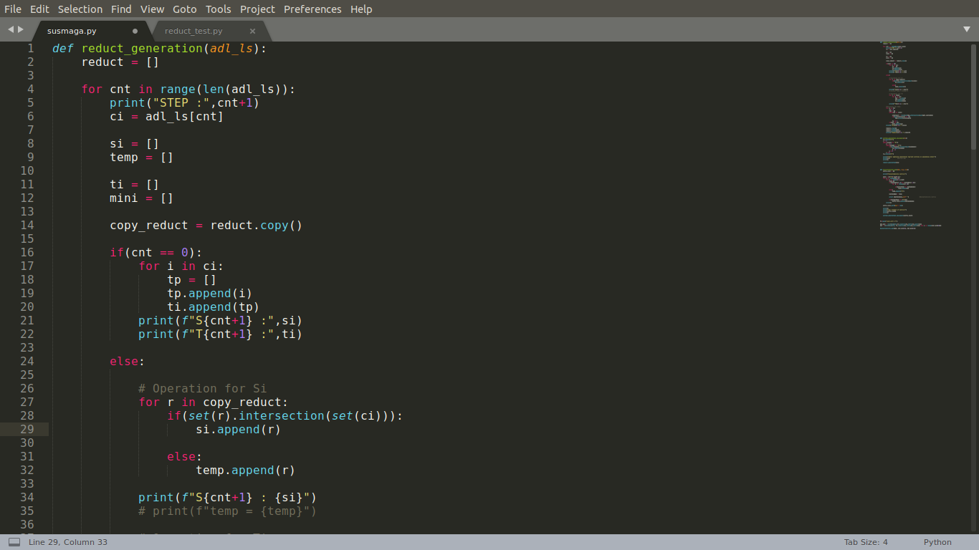
Computing Si

Slide 9
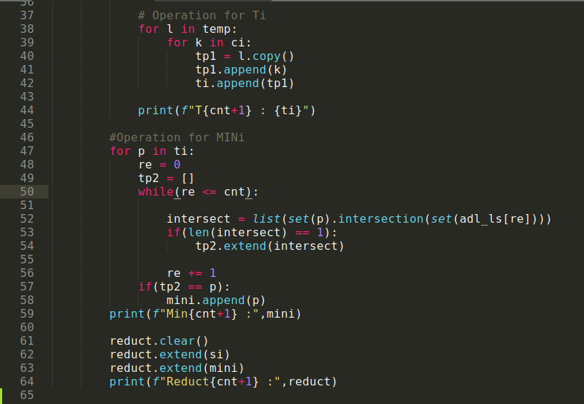
Computation of Ti, MINi, Ri

Slide 10
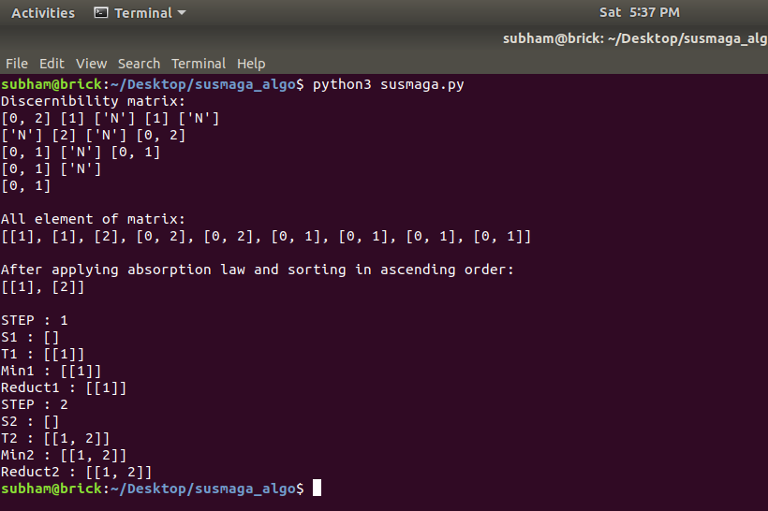
Output of Susmaga Algorithm

Slide 11


