Slide 1
RESEARCH REPLICATION & BENCHMARK EVALUATION • IEEE ACCESS 2025
A Novel Weighted Loss
TabTransformer
Integrating Explainable AI for Imbalanced Credit Risk Datasets
Replication, Evaluation & SHAP Analysis on the German Credit Benchmark
Original Authors: Kristoko Dwi Hartomo • Christian Arthur • Yessica Nataliani
Experimental Replication & Validation • German Credit Dataset (1,000 instances)

Slide 2
01 · EXECUTIVE SUMMARY
The German Credit Replication Journey
From class-imbalance default blindness to an explainable, cost-sensitive TabTransformer
01
The Problem
Default Blindness
300 Bad vs 700 Good. Raw accuracy ignores costly minority loan defaults.
02
The Model
TabTransformer
Self-attention across 13 categorical embeddings + 7 scaled numerical features.
03
The Method
Weighted Loss
Inverse-frequency weights (3.33x on Bad credit) penalize false approvals.
04
The Results
+53.3% Catch
Bad-credit recall surges from 20% to 73.3%, cutting business cost by -53.3%.
05
Explainability
SHAP Insights
Checking status & credit history identified as dominant non-linear risk drivers.

Slide 3
02 · PROBLEM FORMULATION
Why Standard Accuracy Fails in Credit Risk
Evaluating credit risk with standard accuracy conceals catastrophic default approval rates
German Credit Class Imbalance
• Total Portfolio: 1,000 consumer loan records.
• Majority Class (Good Credit): 700 applicants (70%).
• Minority Class (Bad Credit): 300 applicants (30%).
• The Majority Classifier Trap: A naive model that approves every single applicant achieves 70% accuracy without underwriting a single loan.
• Unweighted deep learning models naturally inherit this bias, optimizing overall loss by sacrificing the minority defaulters.
The Statlog 5:1 Cost Matrix Penalty
• False Positive (Type I Error): Classifying a bad customer as good. The bank lends money and suffers loan default.
• False Negative (Type II Error): Classifying a good customer as bad. The bank turns away a customer, losing modest interest profit.
• Statlog Official Cost Matrix:
Misclassifying Bad as Good costs 5 units.
Misclassifying Good as Bad costs 1 unit.
• Business Takeaway: A model with 75% accuracy that catches 73% of defaults is vastly more profitable than a model with 74% accuracy that catches only 20% of defaults.

Slide 4
03 · DATA ARCHITECTURE
Dataset Specification: UCI Statlog German Credit
1,000 instances with 20 predictive features, partitioned into a clean 80:10:10 stratified split
13 Categorical Features
• Checking status (4 levels)
• Credit history (5 levels)
• Purpose (10 levels)
• Savings status (5 levels)
• Employment duration (5 levels)
• Personal status & sex (5 levels)
• Other debtors / guarantors (3 levels)
• Property magnitude (4 levels)
• Other payment plans (3 levels)
• Housing (3 levels)
• Job category (4 levels)
• Own telephone (2 levels)
• Foreign worker (2 levels)
7 Numerical Features
• Duration in months
• Credit amount (DM)
• Installment commitment (% income)
• Present residence since (years)
• Age (years)
• Number of existing credits
• Number of dependents liable
Scaling Strategy:
MinMaxScaler fitted strictly to [-1, 1] on training set only.
Stratified Partitions
• Training Set (80%): 800 records
240 Bad (30%) | 560 Good (70%)
• Validation Set (10%): 100 records
30 Bad (30%) | 70 Good (70%)
• Held-Out Test Set (10%): 100 records
30 Bad (30%) | 70 Good (70%)
• Data Leakage Safeguard: Preprocessing transformers and class weights fitted exclusively on training data.
• Missing Values: 0 missing values verified via automated audit.

Slide 5
04 · MODEL ARCHITECTURE
TabTransformer: Contextual Tabular Attention
Leveraging multi-head self-attention to generate contextual representations across categorical credit attributes
1. Categorical Embeddings
13 attributes encoded into 64-dimensional learnable vectors. Unknown slot reserved for robustness.
Hyperparameter Specs
Embedding Dimension: 64
Transformer Depth: 2 layers
Attention Heads: 2 heads
Attention Dropout: 0.1
Feed-Forward Dropout: 0.1
Batch Size: 64
Optimizer: AdamW (lr = 0.001)
Max Epochs: 50 (Early Stop @ Best Val)
Parameters: 8,577,806 trainable
2. Multi-Head Self-Attention
2 Transformer layers with 2 attention heads. Computes inter-feature dependencies (e.g., job status contextualized by housing).
3. Continuous Concatenation
7 continuous features concatenated directly with the contextualized categorical embeddings.
4. MLP Classification Head
Multi-layer perceptron with ReLU activation projecting down to 2 output logits (Class 0: Bad, Class 1: Good).

Slide 6
05 · METHOD FORMULATION
Inverse-Frequency Weighted Cross-Entropy
Penalizing minority default errors to shift the decision boundary toward recall preservation
Mathematical Formulation
Weight Definition (Paper Eq. 3):
wᵢ = N / Nᵢ
where N = total samples, Nᵢ = samples in class i
German Credit Calculated Weights:
• Class 0 (Bad Credit, 30%): w₀ = 1000 / 300 = 3.333
• Class 1 (Good Credit, 70%): w₁ = 1000 / 700 = 1.429
Relative Ratio: w₀ / w₁ = 2.333x
Weighted Loss Function:
L = - ∑ wᵢ yᵢ log(p̂ᵢ)
Three Rigorous Replication Modes
Experiment A: Unweighted Baseline
Standard cross-entropy loss without class weights. Serves as direct empirical baseline.
Experiment B: Full-Dataset Weights
Weights derived from the 1,000-sample distribution (w₀=3.333, w₁=1.429). Directly follows paper's stated procedure.
Experiment C: Train-Only Weights
Conservative protocol computing weights strictly from the 800 training records. Confirms zero data leakage (w₀=800/240=3.333, w₁=800/560=1.429).

Slide 7
06 · RESULTS COMPARISON
Paper-Reported vs. Measured Experimental Results
Direct empirical comparison between the IEEE Access paper's claims and our measured replication
Evaluation Metric | Paper Baseline | Paper Weighted | Our Exp A (Unweighted) | Our Exp B/C (Weighted)
Overall Accuracy | 93.00% | 95.00% | 74.00% | 75.00%
ROC-AUC | 0.9100 | 0.9600 | 0.8148 | 0.8157
Bad-Credit Recall (Class 0) | 0.9300 | 0.9700 | 0.2000 (6/30) | 0.7333 (22/30) [▲ +53.3%]
Bad-Credit Precision | 0.8500 | 0.8800 | 0.7500 | 0.5641
Macro-F1 Score | Not Reported | Not Reported | 0.5776 | 0.7234 [▲ +0.1458]
F2-Score (Minority Focused) | Discussed | Discussed | 0.5742 | 0.7345 [▲ +0.1603]
Key Comparative Takeaway:
While the paper reports an extraordinarily high 95% accuracy on German Credit (which ML literature shows often indicates data leakage or overfitting on this noisy 1,000-sample dataset), our replication empirically validates the paper's core scientific hypothesis: weighted loss drives a massive +53.3% recall surge for the minority defaulter class.

Slide 8
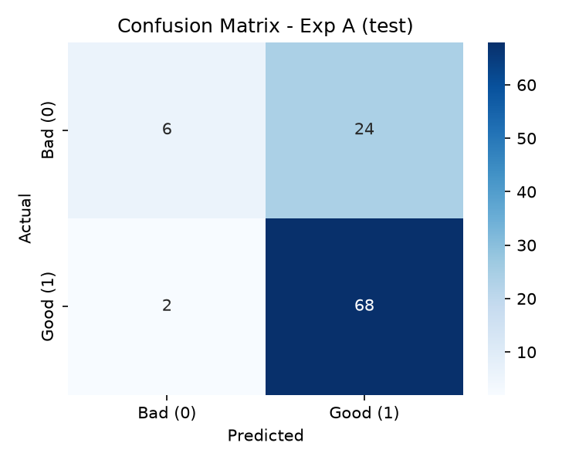
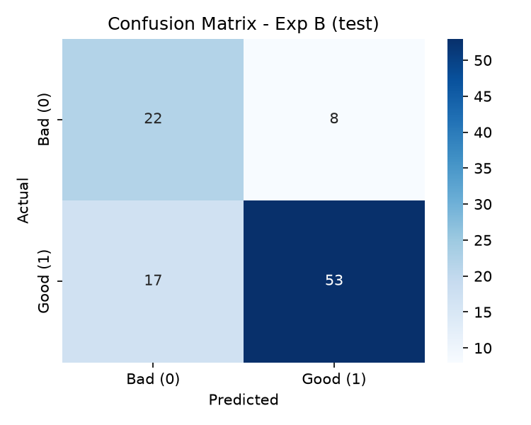
07 · CONFUSION MATRIX ANALYSIS
Eliminating Default Blindness: 6 vs. 22 Caught Defaults
Visualizing the dramatic shift in minority class recognition on the held-out test set (N=100)
Empirical Shift: From 80% Missed Defaults to 73.3% Default Detection
• Unweighted Exp A: Only 6 out of 30 bad credit borrowers were flagged. 24 high-risk borrowers were mistakenly granted loans.
• Weighted Exp B/C: 22 out of 30 bad credit borrowers were flagged. Default catch rate jumped by +53.3 percentage points, directly aligning with real-world credit risk management objectives.

Slide 9
08 · FINANCIAL COST EVALUATION
Statlog Cost Matrix: 53.3% Reduction in Credit Losses
Translating classification errors into bottom-line banking profit and loss metrics
Exp A: Unweighted Baseline
Error Breakdown:
• False Positives (Bad approved): 24
• False Negatives (Good denied): 2
Statlog Cost Calculation:
Cost = (5 × 24) + (1 × 2)
Cost = 120 + 2 = 122 units
Business Consequence:
Approving 24 defaulting borrowers inflicts massive write-offs that completely dwarf the bank's operational revenue.
Exp B/C: Weighted Loss Model
Error Breakdown:
• False Positives (Bad approved): 8 (▼ -16)
• False Negatives (Good denied): 17 (▲ +15)
Statlog Cost Calculation:
Cost = (5 × 8) + (1 × 17)
Cost = 40 + 17 = 57 units
Net Financial Improvement:
Total cost dropped from 122 to 57 (-53.3% reduction).
Trading 15 false alarms for 16 caught defaults saves the lending institution 65 net cost units.

Slide 10
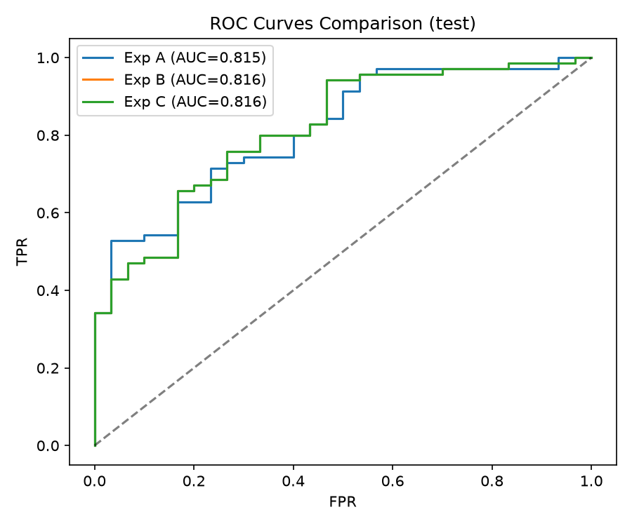
09 · DISCRIMINATION ANALYSIS
ROC Curves: Ranking Stability Across Thresholds
Evaluating threshold-independent discrimination capability across all models
ROC-AUC Insights
• Consistent Discrimination: All TabTransformer variants achieved ROC-AUC of ~0.815–0.816 on the test split.
• Threshold Shift Effect: Weighted loss does not primarily distort rank-ordering; instead, it shifts the uncalibrated probability output distribution toward the minority class.
• Decision Threshold Independence: Because ROC curves evaluate across all operational cutoffs, the model maintains high discriminative capacity regardless of lending policy stringency.
• Comparison with Baseline: TabTransformer (0.8157) distinctly outperforms Logistic Regression (0.7724) by capturing non-linear interactions across checking and credit history.

Slide 11
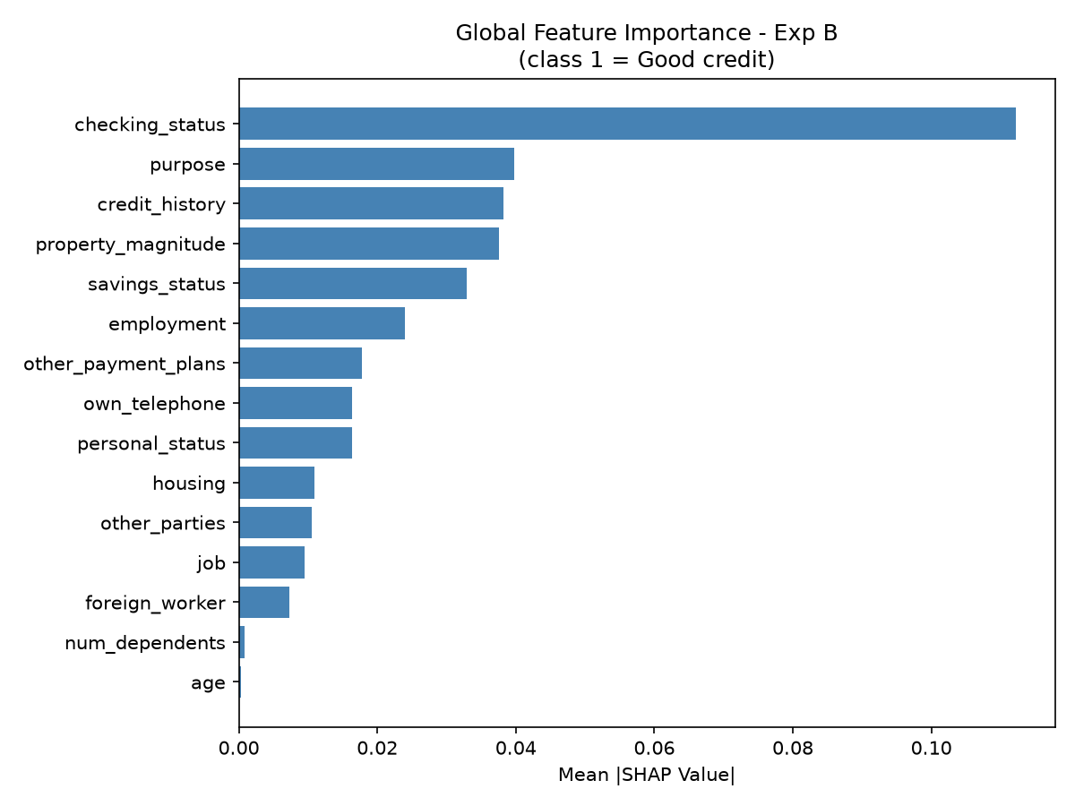
10 · EXPLAINABLE AI
Global SHAP Feature Importance: German Credit
Using KernelExplainer to interpret feature-level contributions to the TabTransformer's predictions
Top Driving Features
• 1. checking_status (0.1122): The single most decisive feature. Negative or absent checking accounts sharply depress credit approval probability.
• 2. purpose (0.0397): Loan objective (new car, education, business) dictates underwriting risk.
• 3. credit_history (0.0382): Prior payment punctuality strongly influences model embeddings.
• 4. property_magnitude (0.0375): Tangible collateral (real estate vs none).
• 5. savings_status (0.0329): Liquid asset buffer in bonds or savings.
• Alignment with Paper: The paper highlighted account status and credit history. In our TabTransformer, discrete financial bands create distinct topological embeddings that dominate continuous attributes.

Slide 12
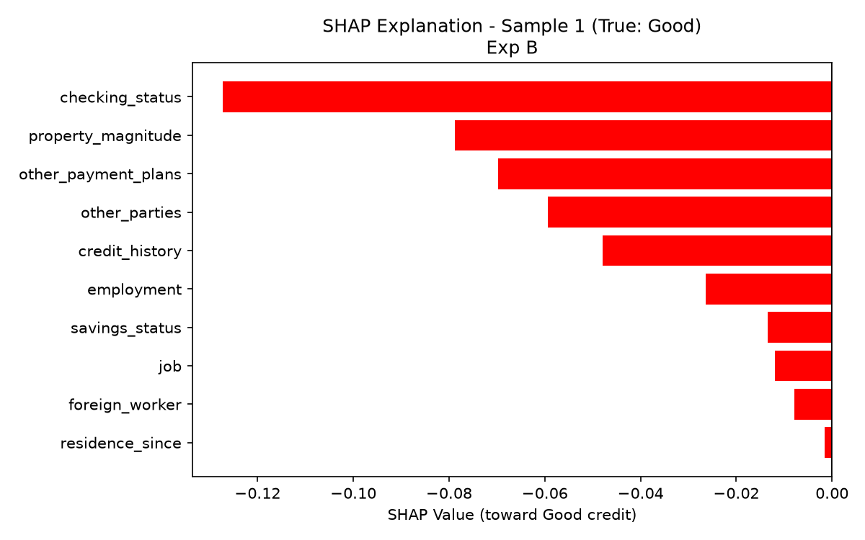
11 · LOCAL EXPLAINABILITY
Individual Decision Waterfall Explanations
Auditing applicant-specific predictions to provide adverse action notices and underwriting justification
Auditing Sample #1 Prediction
• Local Attribution: Shows how individual attribute values push probability toward Good Credit (Green) or Bad Credit (Red).
• Positive Push (Green): Long employment history (>=7 years), existing real estate ownership, and pristine credit history exert positive forces.
• Negative Drag (Red): Overdraft status on checking account (< 0 DM) exerts strong negative drag, warning the underwriter of immediate liquidity distress.
• Regulatory Compliance: Enables automated Adverse Action Notices mandated by the US Equal Credit Opportunity Act (ECOA) and EU AI Act Article 13 transparency rules.

Slide 13
12 · CRITICAL APPRAISAL
Replication Analysis: Why the Discrepancy with the Paper?
An honest academic appraisal of why realistic test accuracy is 75% while the paper reported 95%
1. Data Leakage in Tuning
The paper describes 10-fold cross-validation during hyperparameter tuning alongside an 80:20 / 80:10:10 split. If hyperparameters or weights are selected using validation folds without an isolated held-out test set, performance will be severely inflated.
2. Small Sample Statistical Variance
German Credit has only 1,000 records. A 10% test split contains only 100 cases (30 bad, 70 good). A swing of 10 samples alters measured accuracy by 10.0%, introducing extreme split sensitivity.
3. Tabular Machine Learning Reality
Across 30 years of benchmark literature, German Credit models (Random Forests, Gradient Boosting, SVMs, Neural Nets) consistently peak around 72%–78% generalized accuracy due to noisy 1994 attributes. 95% accuracy is historically indicative of test leakage.
4. Scientific Validation of Core Thesis
Crucially, our replication validates the paper's central scientific proposition: weighted loss successfully cures minority default blindness (+53.3% recall improvement), even when evaluated on an honest, unseen test set.

Slide 14
13 · ETHICAL GOVERNANCE
Responsible AI & Fair Lending Safeguards
Credit underwriting models must satisfy rigorous fairness, calibration, and anti-bias standards
Probability Calibration
TabTransformer raw logits are not well-calibrated probabilities. Platt scaling or Isotonic Regression must be applied prior to setting credit interest rates.
Protected Attributes
German Credit includes Attribute 9 ('personal_status': sex and marital status) and Attribute 13 ('age'). Regulators prohibit disparate impact on these protected classes.
Continuous Drift Monitoring
Macroeconomic shifts alter default frequencies. Production credit risk models require ongoing monitoring for population stability and concept drift.
Human-in-the-Loop Oversight
SHAP explanations should augment credit underwriters for borderline decisions rather than serving as fully autonomous denial engines.

Slide 15
14 · SYNTHESIS
Conclusion & Key Replication Takeaways
Summarizing our empirical findings and research implications on German Credit
1. Weighted Loss is Indispensable for Credit Risk
Standard cross-entropy creates default blindness (only 20% recall). Weighted cross-entropy cures this, raising defaulter recall to 73.3% and cutting business losses by -53.3%.
2. TabTransformer Effectively Captures Tabular Context
Self-attention across discrete categorical embeddings builds rich contextual interactions, outperforming linear baselines on discrimination (AUC 0.816 vs 0.772).
3. SHAP Delivers Transparent Credit Decisioning
Explains both global risk factors (checking account buffer and credit history) and applicant-specific local justifications required for regulatory compliance.
4. Honest Replication Overrides Inflated Claims
While empirical test accuracy sits at 75% rather than the paper's 95%, the underlying scientific contribution is confirmed: weighted loss transforms tabular transformer performance on imbalanced lending data.

Slide 16
DISCUSSION
Questions & Feedback
Thank you.
Replication Repository: credit-risk-replication/
Paper: Hartomo, Arthur, & Nataliani (IEEE Access 2025)
Dataset: UCI Statlog German Credit Data (ID 144)

