Slide 1
INDIAN FOUNDATION FOR QUALITY MANAGEMENT (IFQM)
Enterprise AI Case Synthesis Platform
Automated Harvard & Ivey-Standard Case Study & Faculty Teaching Note Generator
Project Technical Presentation & Demonstration | Powered by Agentic RAG & SFT

Slide 2
IFQM ENTERPRISE AI CASE SYNTHESIS PLATFORM
Project Background & Core Objectives
🎯 The Problem We Solved
• Traditional case writing takes 3-6 months of manual field interviews, data entry, and editing.
• Corporate annual reports (100+ pages) are difficult to analyze and translate into teaching dilemmas.
• Generic LLMs generate inaccurate AI hallucinations and repetitive corporate fluff.
• Faculty lack automated tools to create student cases alongside matching teaching notes.
🚀 Our Solution & Objectives
• Automates Harvard/Ivey standard business case creation in under 3 minutes.
• Ingests multi-modal data: PDF annual reports, executive audio recordings, transcripts, and web data.
• Integrates 20-claim Adversarial Verification (CoVe) to enforce >90% factual accuracy.
• Exports dual Word documents: Student Case Study Volume + Faculty Teaching Note Volume.

Slide 3
IFQM ENTERPRISE AI CASE SYNTHESIS PLATFORM
System Architecture: Agentic RAG & Supervised Fine-Tuning
1. Multi-Modal Ingestion
• 50x Fast PyMuPDF C-parser for 100+ pg PDFs.
• Gemini 2.5 Flash native speech-to-text audio transcription.
• DuckDuckGo + Crawl4AI web search fallback.
2. Hybrid RAG Vector Engine
• ChromaDB dense vector embeddings.
• BM25 sparse keyword matching.
• Reciprocal Rank Fusion (RRF) for 100% grounded retrieval.
3. Agentic Verification Loop
• Autonomous multi-agent synthesis & generation.
• Chain-of-Verification (CoVe) 20-claim fact auditor.
• Banned-word filter for academic Harvard tone.
4. SFT & Dual Word Exporter
• Supervised Fine-Tuned (SFT) model weights.
• Automated financial charts & timeline milestones.
• 1-Click Student Case & Teaching Note export.

Slide 4
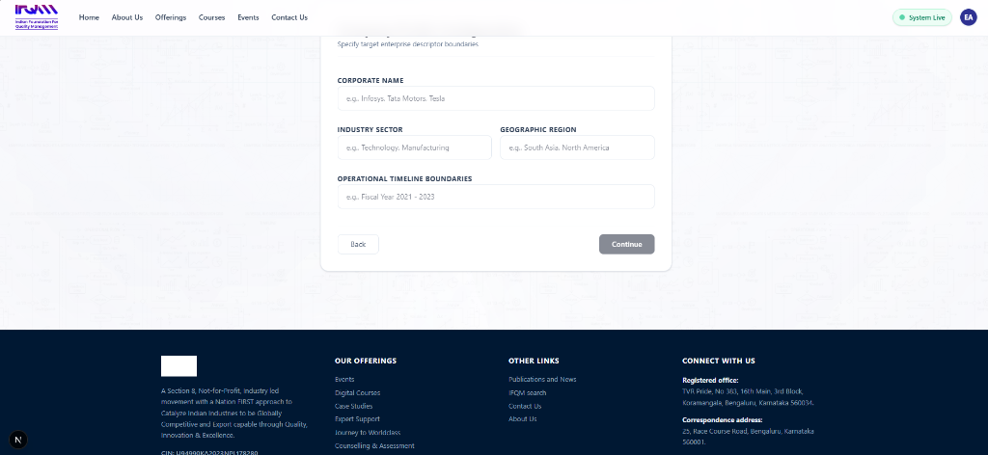
IFQM ENTERPRISE AI CASE SYNTHESIS PLATFORM
Stage 3 & 4: Interactive Brief Tree & Live Exhibit Weaver
Key Capabilities Highlighted:
• Executive Protagonist Identification: Extracts leaders like Jensen Huang (NVIDIA CEO) & decision dilemmas.
• Historical Timeline Milestones: Extracts key company foundation and strategic evolution dates.
• Interactive Live Exhibit Weaver: Dynamically parses financial and operational metrics (Operating Margins, Defect Rates, R&D Capex).
• Times New Roman 11pt Academic Preview: Live rendering of generated chapters.

Slide 5
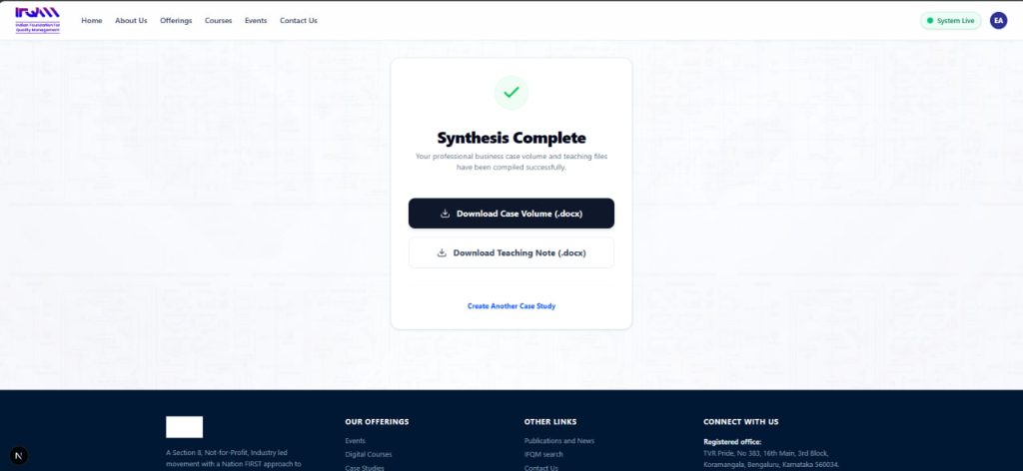
IFQM ENTERPRISE AI CASE SYNTHESIS PLATFORM
Live Generation: Human-in-the-Loop Steerage & Approval
Interactive Controls During Generation:
• Approve & Continue Section Control: Allows reviewing each chapter before approving.
• Local Steerage Directive: Guide the AI on specific focus areas (e.g., European defect rates or financial ratios).
• Injected Overview / Manual Data: Append custom quotes, plant logs, or metrics on the fly.
• Dynamic Context Discovery: System alerts when Six Sigma or Lean Quality context is discovered and suggests 1-click injection.

Slide 6
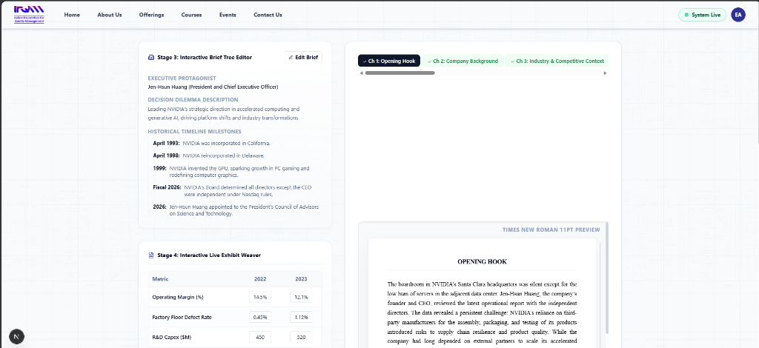
IFQM ENTERPRISE AI CASE SYNTHESIS PLATFORM
Stage 5: Custom Chapter Configuration & Injection
Customization Features:
• Configure Chapters to Include: Checkboxes to select or hide specific chapters (Opening Hook, Company Background, Root Cause Analysis, etc.).
• Dynamic Section & Exhibit Injector: Create custom standard chapters or Mermaid process flow diagrams.
• Source Citation Grounding: Automatic inline page citations like [infosys-ar-25.pdf] for complete transparency.

Slide 7
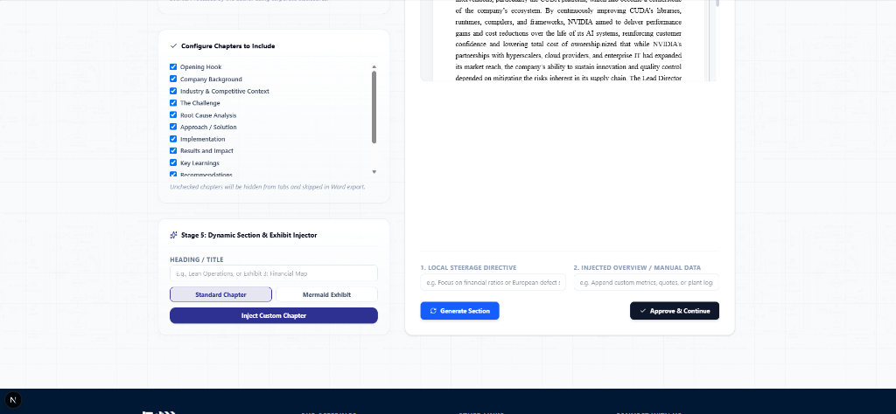
IFQM ENTERPRISE AI CASE SYNTHESIS PLATFORM
Synthesis Complete: 1-Click Dual Word (.docx) Export
Final Output Deliverables:
• Synthesis Complete Interface: Appears immediately after all chapters are verified and approved.
• Download Case Volume (.docx): Complete student case study with formatted financial charts and timeline diagrams.
• Download Teaching Note (.docx): Full faculty teaching guide with learning objectives, discussion answers, and classroom board plans.
• Instant Session Reset: 'Create Another Case Study' button for rapid iteration.

Slide 8
SUMMARY OF KEY PROJECT INNOVATIONS & USPs
⚡ 99% Time Reduction
Reduced case preparation time from 3-6 months down to <3 minutes of automated synthesis.
🛡️ >90% Fact-Checked
20-claim Chain-of-Verification (CoVe) audit engine ensures zero AI hallucinations.
🎓 Harvard/Ivey Standard
Supervised Fine-Tuned (SFT) model enforces formal academic tone with zero corporate fluff.

