Slide 1
AI -Powered Resume Evaluator
Team Members:
Sunil Kumar A Vijay Kumar T Dinesh K JyothiSwaroop S Subramanian K

Slide 2
Business Challenge
Resume Building & Evaluation
By providing an automated Resume Generator and Resume Evaluator, you enable candidates to quickly craft professional, personalized resumes.
The Evaluator analyzes resumes against job descriptions to ensure better matchmaking, helping candidates improve their chances of landing interviews.

Slide 3
Our Solution
Generate Resume : Generate a tailored resume by inputting key details such as personal information, skills, experience, and education, ensuring a customized document for job applications.
Enhances ATS Compatibility: Ensures resumes are optimized for Applicant Tracking Systems (ATS), which is crucial for passing automated filters.
AI Evaluation Model : Develop an AI model to analyze resumes based on job roles, keywords, and structure.
Feedback for User : Display resume scores, feedback, and the potential ATS scan results in a clean, easy-to-understand interface.
Profile Matching : This process can be built into a resume evaluator system, allowing job seekers to enhance their resumes and improve their chances of getting noticed by recruiters.

Slide 4
Project Flow
USER
HomePage
Login
Register
Dashboard
Dashboard
Resume Generator
Resume Evaluator
Job description
Fields
Generated Resume
Upload Resume
Resume Analysis
Job Description
Profile matching Resume

Slide 5
Architecture Diagram
Token generated
Authentication API
Https cookies
SupaBase (postgresql)
Login/Register
POST request
GET
Front End
NextJs
Gemini-AI-1.5-flash
Resume scores & optimizations
SupaBase Storage
POST
Resume API
text extraction
GET
/GET/
Ai API
GET
External API

Slide 6
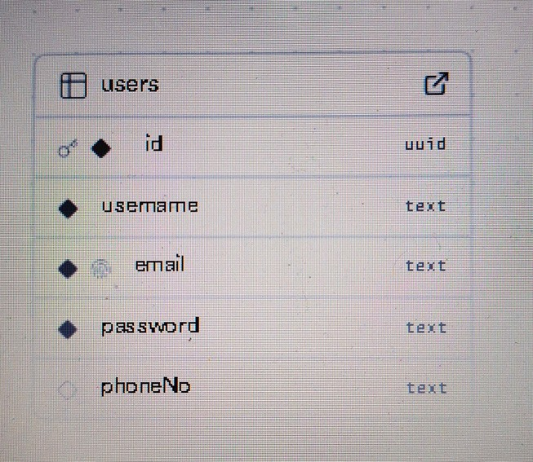
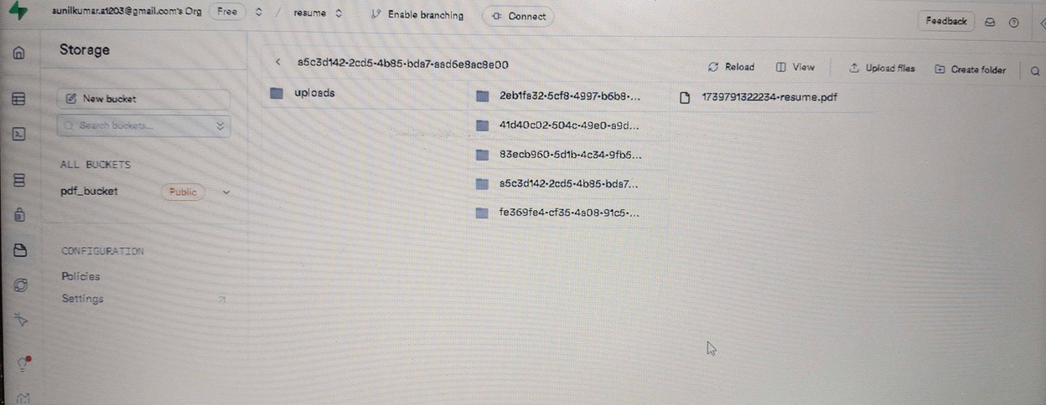
Database Diagram
Register Form Upload Resume
Register : Data will stored in the supabase storage.
Upload Resume : It stored in the bucket(pdf format) in supabase storage.

Slide 7

Phases
Phase 1: Initial Development
User Registration & Dashboard: Implement user sign-up/login via Supabase and create a user dashboard with core modules (Generate, Analyze, Evaluate Resume).
File Storage & Resume Generation: Integrate Supastorage for file upload and develop resume generation, analysis, and evaluation based on JD.
Phase 2: Enhancement & Optimization
User Profiles & Progress Tracking: Allow users to save generated resumes, track progress, and view analysis
UI Refinements: Improve the user interface with interactive elements for better UX and enhanced resume templates.
Phase 3 : Deployment
Prepare for scaling and deploying to cloud infrasture.

Slide 8





Technologies and Tools Used

Slide 9
Benefits of Resume Generator & Evaluator
The Resume Generator and Evaluator address key points in the resume creation process by saving time, offering personalized support, and ensuring better alignment with job descriptions.
This solution directly improves candidates’ chances of landing interviews, driving more successful job placements.

Slide 10
Conclusion:
User Experience Matters: The project taught me the importance of user- friendly design to ensure the tool is accessible for job seekers at all levels.
AI’s Role in Resume Evaluation: Can AI truly match the human context in evaluating resumes? We're exploring how AI can be more context-aware.
Data Accuracy is Key: Ensuring accurate parsing and evaluation of resumes was challenging but crucial for providing useful feedback.
Job Portal Integration: Next, I plan to integrate the system with job portals like LinkedIn for seamless resume application and feedback.

