Slide 1

Decoding Currency Dynamics
AI-Driven Multi-Step Forecasting of Foreign Exchange Rates
Student Name: PUPPALA V V SUDHAKAR
BITS ID: 2024AA05488

Slide 2

Abstract Background
Foreign exchange markets are among the most liquid and volatile financial markets, influenced by macroeconomic indicators, geopolitical events, and market sentiment. Traditional forecasting approaches such as Autoregressive Integrated Moving Average (ARIMA) and Generalized Autoregressive Conditional Heteroskedasticity (GARCH) models often fail to capture non-linear patterns, and long-term dependencies present in FX data. Recent advancements in artificial intelligence, particularly deep learning models like Convolutional Neural Network (CNN), Long Short-Term Memory (LSTM), Gated Recurrent Units (GRU), and Transformer architectures, have shown promising capabilities in modelling sequential and temporal data. These methods provide an opportunity to improve forecasting accuracy, especially for multi-step ahead predictions, which are inherently more challenging due to error propagation.
This dissertation integrates concepts from Financial Time Series Analysis, Artificial Intelligence and Computational Finance.

Slide 3

Objectives
The objective of this dissertation project is to,
Design and implement a Hybrid CNN-LSTM-Transformer architecture for multi-step FX rate forecasting.
Develop a multi-model feature fusion pipeline integrating technical, macroeconomic, and NLP-based sentiment features.
Conduct systematic ablation studies to quantify the marginal contribution of each architectural component.
Evaluate model performance across multiple currency pairs, forecasting horizons, and market volatility baselines.
Compare the proposed model against ARIMA, Prophet, vanilla LSTM, and Temporal Fusion Transformer baselines.

Slide 4










Scope
NATURAL LANGUAGE PROCESSING
KNOWLEDGE REPRESENTATION
DATA MODELING
DEEP LEARNING
Automated pipeline for feature engineering, cleaning, and normalization.
Implementation of Hybrid CNN-LSTM-Transformer architecture.
Integration of technical indicators (RSI, MACD, Volume) into the knowledge base.
Advanced sentiment extraction from market headlines and financial news sources.

Slide 5
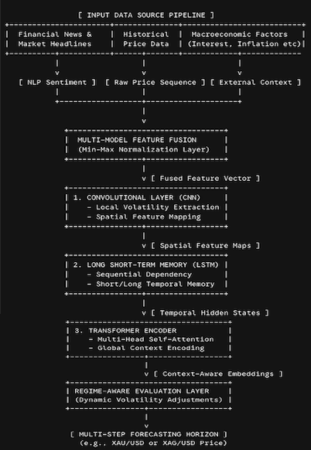
Methodology
Multi-Model Feature Fusion: Combines technical price indicators, macroeconomic context, and text sentiment scores into a single unified temporal vector.
CNN Layer: Captures high-frequency spatial patterns and sudden local volatility shifts across the fused inputs.
LSTM Layer: Mitigates temporal sequence tracking challenges, keeping a persistent memory across changing step states.
Transformer Block: Applies self-attention mechanisms to understand long-range global market context, significantly cutting down on multi-step error propagation.
Regime-Aware Layer: Stabilizes accuracy margins during black-swan or sudden macro-reversal events.

Slide 6
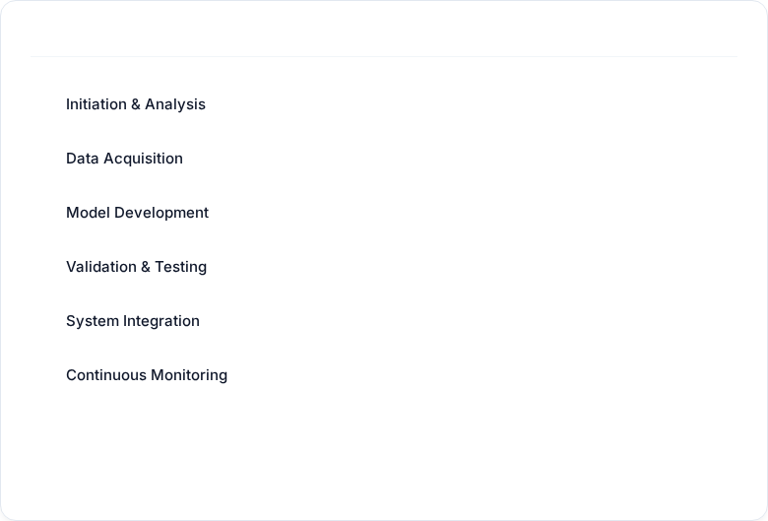
Progress & Key Findings
NLP Sentiment Analysis
APRIL MAY JUNE JULY AUGUST
NLP text-based sentiment score alongside traditional technical and macroeconomic indicators significantly stabilizes multi-step predictions.
COMPLETED
IN PROGRESS
Model Architecture lift
IN PROGRESS
The Hybrid CNN-LSTM-Transformer architecture demonstrates a significant improvement in analyzing spatial, temporal and contextual features in the financial time series data over extended forecasting horizons.
PENDING
PENDING
High-Volatility Resilience
PENDING
The implementation of regime-aware evaluation framework allows the AI model to maintain directional forecasting accuracy during the high-volatility market transitions.

Slide 7
Future Work
1
2
3
Integration of Explainable AI (XAI) for Model Interpretability
Advanced NLP Features via Large Language Models (LLMs)
Reinforcement Learning (RL) Framework for Automated Execution
While the Hybrid CNN-LSTM-Transformer architecture delivers high predictive accuracy, deep learning frameworks operate largely as "black boxes." Implementing techniques like SHAP (SHapley Additive exPlanations) or visualizing the Transformer's Self-Attention weights can map exactly which technical or sentiment features drive a specific multi-step prediction.
Upgrade the current transformer-based news sentiment extraction pipeline by utilizing specialized financial LLMs (like FinBERT or Llama-3-Finance). This would allow the model to capture deeper contextual nuances, such as macro-economic implications in central bank speeches (e.g., Federal Reserve minutes), rather than relying solely on surface-level headline sentiment.
Transition from purely predicting price action (supervised learning) to an action-based framework. By wrapping the Hybrid model inside a Deep Reinforcement Learning (DRL) agent, the system can learn optimized trading policies, dynamically adjusting stop-loss margins and position sizing based on the model's multi-step volatility forecasts.

Slide 8
THANK YOU

