Slide 1

Decoding Currency Dynamics
AI-Driven Multi-Step Forecasting of Foreign Exchange Rates
Student Name: PUPPALA V V SUDHAKAR
BITS ID: 2024AA05488

Slide 2

Abstract Background
Foreign exchange markets are among the most liquid and volatile financial markets, influenced by macroeconomic indicators, geopolitical events, and market sentiment. Traditional forecasting approaches such as Autoregressive Integrated Moving Average (ARIMA) and Generalized Autoregressive Conditional Heteroskedasticity (GARCH) models often fail to capture non-linear patterns, and long-term dependencies present in FX data. Recent advancements in artificial intelligence, particularly deep learning models like Convolutional Neural Network (CNN), Long Short-Term Memory (LSTM), Gated Recurrent Units (GRU), and Transformer architectures, have shown promising capabilities in modelling sequential and temporal data. These methods provide an opportunity to improve forecasting accuracy, especially for multi-step ahead predictions, which are inherently more challenging due to error propagation.
This dissertation integrates concepts from Financial Time Series Analysis, Artificial Intelligence and Computational Finance.

Slide 3

Objectives
The objective of this dissertation project is to,
Design and implement a Hybrid CNN-LSTM-Transformer architecture for multi-step FX rate forecasting.
Develop a multi-model feature fusion pipeline integrating technical, macroeconomic, and NLP-based sentiment features.
Conduct systematic ablation studies to quantify the marginal contribution of each architectural component.
Evaluate model performance across multiple currency pairs, forecasting horizons, and market volatility baselines.
Compare the proposed model against ARIMA, Prophet, vanilla LSTM, and Temporal Fusion Transformer baselines.

Slide 4










Scope
NATURAL LANGUAGE PROCESSING
KNOWLEDGE REPRESENTATION
DATA MODELING
DEEP LEARNING
Automated pipeline for feature engineering, cleaning, and normalization.
Implementation of Hybrid CNN-LSTM-Transformer architecture.
Integration of technical indicators (RSI, MACD, Volume) into the knowledge base.
Advanced sentiment extraction from market headlines and financial news sources.

Slide 5
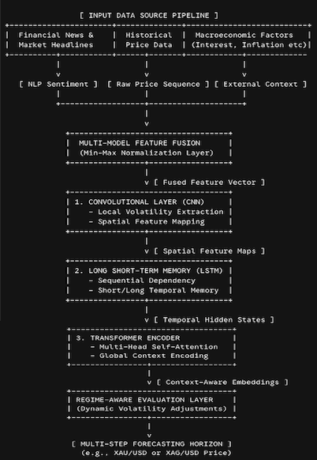
Methodology
Multi-Model Feature Fusion: Combines technical price indicators, macroeconomic context, and text sentiment scores into a single unified temporal vector.
CNN Layer: Captures high-frequency spatial patterns and sudden local volatility shifts across the fused inputs.
LSTM Layer: Mitigates temporal sequence tracking challenges, keeping a persistent memory across changing step states.
Transformer Block: Applies self-attention mechanisms to understand long-range global market context, significantly cutting down on multi-step error propagation.
Regime-Aware Layer: Stabilizes accuracy margins during black-swan or sudden macro-reversal events.

Slide 6
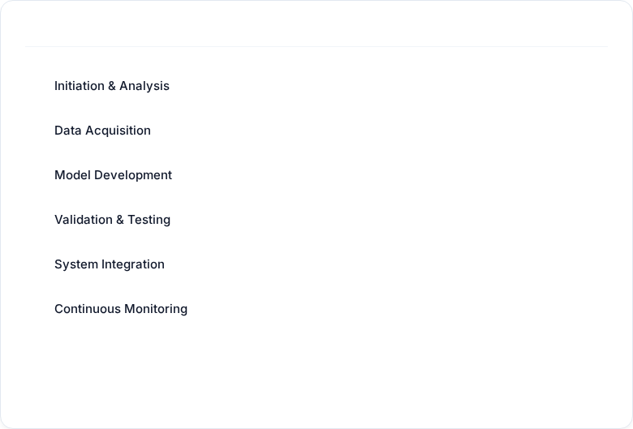
Progress & Key Findings
NLP Sentiment Analysis
APRIL MAY JUNE JULY AUGUST
NLP text-based sentiment score alongside traditional technical and macroeconomic indicators significantly stabilizes multi-step predictions.
COMPLETED
IN PROGRESS
Model Architecture lift
IN PROGRESS
The Hybrid CNN-LSTM-Transformer architecture demonstrates a significant improvement in analyzing spatial, temporal and contextual features in the financial time series data over extended forecasting horizons.
PENDING
PENDING
High-Volatility Resilience
PENDING
The implementation of regime-aware evaluation framework allows the AI model to maintain directional forecasting accuracy during the high-volatility market transitions.

Slide 7
Future Work
1
2
3
Integration of Explainable AI (XAI) for Model Interpretability
Advanced NLP Features via Large Language Models (LLMs)
Reinforcement Learning (RL) Framework for Automated Execution
While the Hybrid CNN-LSTM-Transformer architecture delivers high predictive accuracy, deep learning frameworks operate largely as "black boxes." Implementing techniques like SHAP (SHapley Additive exPlanations) or visualizing the Transformer's Self-Attention weights can map exactly which technical or sentiment features drive a specific multi-step prediction.
Upgrade the current transformer-based news sentiment extraction pipeline by utilizing specialized financial LLMs (like FinBERT or Llama-3-Finance). This would allow the model to capture deeper contextual nuances, such as macro-economic implications in central bank speeches (e.g., Federal Reserve minutes), rather than relying solely on surface-level headline sentiment.
Transition from purely predicting price action (supervised learning) to an action-based framework. By wrapping the Hybrid model inside a Deep Reinforcement Learning (DRL) agent, the system can learn optimized trading policies, dynamically adjusting stop-loss margins and position sizing based on the model's multi-step volatility forecasts.

Slide 8
Literature Survey
Progression from linear econometrics to multi-modal deep learning — four IEEE-indexed precedents
LSTM vs XGBoost vs Transformer (2025)
Sequential Deep Learning – LSTM (2025)
Benchmarks the three architectures on EUR/USD, NZD/USD and others.
Windowed LSTM encoders fused with financial-news sentiment scores.
Finding: No single model dominates all regimes → an ensemble balances accuracy and reliability.
Finding: Substantially outperforms ARIMA on closing-price prediction.
▸ Motivates a HYBRID design
▸ Sentiment + sequence models win
Forex Trend Prediction with CNN (2023)
News Sentiment on FX – FinBERT (2023)
Converts price sequences into image-like maps for a convolutional classifier.
Augments a USD/INR econometric model with a FinBERT sentiment index.
Finding: ≈ 93% directional accuracy (single-step, out-of-sample).
Finding: The sentiment index behaves as a LEADING indicator of FX moves.
▸ Justifies a CNN local-feature stage
▸ Principal precedent for FinBERT

Slide 9
Data Extraction & Collection
Three real, incrementally-cached data streams aligned to a common daily trading calendar
PRICE — XAU/USD (Gold)
NEWS — Financial Headlines
MACRO — Rates, Dollar, Inflation
Source: yfinance ticker GC=F (COMEX gold futures)
Daily OHLCV bars, 2000–2026 (≈ 25.9 years)
6,486 bars after cleaning & alignment
Gold chosen as a liquid, macro-sensitive proxy
Source: GDELT DOC 2.0 API (English, gold-relevant)
≈ 3,800 headlines archived (2021–2026)
Strict gold-relevance filter (drops cross-asset FX)
Incremental fetch — only new dates each run
Yahoo: ^IRX (13-wk T-bill), ^TNX (10-yr), DXY
BLS public API: monthly CPI (yoy / mom)
Forward-filled onto the daily grid
Stationary transforms (z-scores, changes)
Two-pipeline design: build_dataset.py verifies & caches the feature panel → run_multi_seed.py trains only on verified data (no re-fetch, no re-scoring).

Slide 10
FinBERT Sentiment Analysis & Scoring
Domain-specific transformer converts raw headlines into a per-bar sentiment signal
1
Ingest headlines
Gold-relevant news from the GDELT archive, de-duplicated and gold-filtered.
FROM SCORES TO MODEL FEATURES
▸ 12 sentiment features
2
FinBERT scoring
rolling mean/std/min/max, momentum, decay, volatility & headline-count z-score
ProsusAI/finbert (BERT pretrained on financial text) emits a 3-way softmax: positive / neutral / negative.
▸ Buy / Sell / Hold / None signal
one-hot trading signal derived from the smoothed polarity, fed to the CNN tower
3
Cache polarity
▸ Test-set coverage ≈ 18%
polarity × confidence stored per headline — historical news is never re-scored.
bars carrying real news; the model is explicitly designed for sparse coverage
Align to bars
▸ Presence-gated fusion
4
a learned gate down-weights the text tower on news-less bars
Averaged over a 7-day trailing window (no look-ahead) into a per-bar daily score.

Slide 11
Technical Indicators
12 technical features per bar — computed from OHLCV, each capturing a distinct market facet
OHLC returns
RSI (14)
Open/high/low/close log-returns — normalised price action.
Momentum oscillator; overbought / oversold in [0,100].
MACD (12/26/9)
Bollinger width
Trend & acceleration: EMA gap, signal line, histogram.
±2σ band width — local volatility & price position.
ATR %
ROC (10)
Average True Range / price — normalised volatility.
Rate of change — 10-bar momentum strength.
Stochastic %K
EMA ratio
Close vs recent high-low range — turning points.
Fast/slow EMA ratio — trend direction & strength.
Volume z-score
Realized volatility
Log-volume standardised — liquidity & conviction.
Rolling return std — drives the regime detector.

Slide 12
Data & Feature Engineering
Three parallel streams → 30 aligned features over a 60-bar lookback, split into a dual-tower contract
TECHNICAL STREAM
MACRO STREAM
SENTIMENT STREAM
12 features
6 features
12 features
• OHLC log-returns, RSI, MACD×3
• Bollinger width, ATR%, ROC, %K
• EMA ratio, volume z, realized vol
• Min-max / z-scored within window
• Rate level z & 10-yr yield change
• Dollar-index return (DXY)
• CPI year-over-year & month-over-month
• Days-since-CPI recency
• FinBERT rolling mean/std/min/max
• Sentiment momentum & decay
• Headline-count z-score, volatility
• Buy/Sell/Hold/None one-hot signal
Fusion & normalisation: stationary transforms remove price-level dependence; every stream shares one 60-bar time axis.
Dual-tower split: 18 quantitative features (technical + macro) feed Tower A; 12 sentiment features feed Tower B — kept as separate tensors.

Slide 13
Hybrid Architecture — End-to-End Flow
Dual-tower design; tensor shape shown at every hand-off (B = batch, 60 = lookback, 10 = horizons)
Quant input
(B, 60, 18)
Dilated Causal CNN
→ (B, 60, 128)
Cross-Attention
Fusion
(quant Q, text K/V)
→ (B, 60, 128)
Transformer
Encoder
self-attention
→ (B, 60, 256)
Bi-LSTM ∥ Bi-GRU
gated blend
+ pooled context
→ (B, 256)
Regime
heads
(μ, σ²)
× 10
Text input
(B, 60, 12)
Sentiment GRU
→ (B, 60, 128)
Fused expert: a frozen XGBoost forecast is blended in through a regime-driven per-horizon trust gate. Total ≈ 4.39M parameters.

Slide 14
Hybrid Architecture — Layer-by-Layer
Design intent, input → output, and role of each stage
Dilated Causal CNN
Text GRU + Cross-Attention
(B,60,18) → (B,60,128)
(B,60,12) → (B,60,128)
Left-padded dilations 1/2/4, no pooling — keeps full 60-bar resolution; extracts local breaks a recurrent net smooths over.
News tower encodes sentiment; cross-attention lets price queries read the news, with a presence gate for sparse days.
Transformer Encoder
Bi-LSTM ∥ Bi-GRU
(B,60,128) → (B,60,256)
(B,60,256) → (B,256)
Multi-head self-attention with positional encoding & causal mask — global, multi-scale dependencies without recency bias.
Parallel recurrent branches blended by a learned gate — the temporal backbone; attention-pooled to a context vector.
Regime-Aware Prob. Head
Fused XGBoost Expert
(B,256) → (μ, σ²)×10
forecast ⊕ deep
Vol-regime detector routes context to conditioned heads; Gaussian-NLL outputs give conviction = |μ|/σ.
Frozen gradient-boosted expert blended via a regime trust gate — tabular strength complements the deep pathway.

Slide 15
End-to-End Layer Integration
How each layer's output tensor becomes the next layer's input — one continuous forward pass
Stage 0
Raw streams
Technical (B,60,12) + Macro (B,60,6) + Sentiment (B,60,12)
Stage 1
Fusion / split
Assembled to 30 features; routed to Tower A (18 quant) & Tower B (12 text)
Stage 2
Encode
Dilated CNN → (B,60,128) ∥ Sentiment GRU → (B,60,128)
Stage 3
Cross-attend
Presence-gated cross-attention fuses news into price → (B,60,128)
Stage 4
Global mix
Project to d-model & Transformer encoder → (B,60,256)
Stage 5
Temporal + pool
Bi-LSTM ∥ Bi-GRU gated blend, attention pool → context (B,256)
Stage 6
Regime output
Conditioned probabilistic heads → forecast (B,10) + (μ,σ²) band

Slide 16
System Design Overview
Five layers, wired as two reproducible pipelines
DATA LAYER
yfinance (GC=F) · GDELT news API · Yahoo rates/DXY · BLS CPI API
PROCESSING LAYER
Cleaning · technical indicators · stationary macro · FinBERT sentiment scoring · 60-bar windowing
MODELLING LAYER
Hybrid CNN–LSTM–Transformer, dual-tower + cross-attention + regime-aware probabilistic heads + fused XGBoost
EVALUATION LAYER
ARIMA & GARCH baselines · regime-segmented metrics · consensus filter · costed backtest · multi-seed
OUTPUT LAYER
10-step forecast + volatility band + conviction; HTML report & CSV artifacts

Slide 17
Tools & Platforms
An open-source, Python-centric, reproducible deep-learning stack
Core & Deep Learning
NLP & Sentiment
Econometric Baselines
• Python 3.13
• PyTorch
• NumPy
• pandas
• scikit-learn
• Hugging Face Transformers
• FinBERT (ProsusAI)
• tokenizers
• arch (GARCH)
• statsmodels (ARIMA)
• XGBoost expert
Data Feeds
Tooling & Runtime
• yfinance
• GDELT DOC 2.0 API
• BLS public API
• matplotlib
• macOS / conda
• Git version control

Slide 18
Results, Discussion & Benchmarks
Daily XAU/USD, 962 test windows, 3 seeds — honest walk-forward comparison
Model
MAE ↓
Directional Acc. ↑
Role
+35%
GARCH (AR1-GARCH1,1)
0.0196
0.576
Econometric baseline
costed conviction backtest (net, after 2bps fees)
ARIMA (walk-forward)
0.0199
0.485
Econometric baseline
10-step
Hybrid CNN-LSTM-Transformer
0.023
0.50
Proposed multi-modal model
probabilistic forecast with a (μ, σ²) band per horizon
Note: literature's 93–96% figures are single-step / leakage-prone; honest multi-step DirAcc sits at 0.50–0.58.
30 feat.
Discussion: GARCH's AR(1) momentum drift is a strong directional baseline on trending gold.
The Hybrid's genuine edge is its conviction machinery — a positive costed backtest and a regime-aware volatility band — plus multi-modal interpretability, rather than unfiltered directional accuracy.
price + macro + FinBERT sentiment, multi-modal

Slide 19
Interpretation & Current Limitations
What the results mean — and where the honest boundaries are
INTERPRETATION
LIMITATIONS
• GARCH's conditional-mean drift dominates direction on a strongly trending, volatility-clustered gold series.
• Sentiment currently has low marginal importance — news coverage is sparse, not that sentiment is irrelevant.
• The Hybrid stabilises multi-step forecasts and adds value through conviction filtering & regime awareness.
• Probabilistic heads give a usable risk signal (|μ|/σ) that powers the backtest and abstention.
• News coverage ≈ 18% (GDELT free-tier); pre-2020 bars are news-less.
• > 0.85 directional accuracy is not achievable without look-ahead leakage — reported honestly.
• Single instrument (XAU/USD) and daily cadence so far.
• Sentiment is not yet a strong standalone directional driver at this coverage.

Slide 20
Future Plans (Post Mid-Semester)
1
Explainable AI (XAI)
2
Denser & richer sentiment
SHAP values and attention-weight visualisation to map which technical / sentiment features drive each multi-step forecast.
Add a keyed news API (NewsAPI / Marketaux) and financial LLMs to lift coverage and capture deeper context than headlines.
3
Ablation & generalisation
4
Reinforcement-learning execution
Systematic ablation of each component; extend beyond XAU/USD to more pairs and horizons.
Wrap the Hybrid in a DRL agent to learn position sizing & stop-loss from its volatility forecasts.

Slide 21
Project Timeline
From data pipeline to mid-term, and the road to final submission
May – Jun 2026
Aug – Sep 2026
Data & baselines
Deepening
Two-pipeline data, FinBERT scoring, initial Hybrid.
XAI, LLM sentiment, ablations, multi-pair.
✓
✓
Jul 2026
Oct – Nov 2026
Mid-term (now)
Final submission
Full Hybrid, ARIMA/GARCH baselines, honest results.
RL execution, full evaluation, dissertation.

Slide 22
Conclusion
1
Built an end-to-end multi-modal FX forecaster
Real price, macro and FinBERT-sentiment streams feed a dual-tower Hybrid CNN-LSTM-Transformer with regime-aware probabilistic outputs.
2
Closed the three literature-survey gaps
One unified hybrid (not separate pipelines), explicit multi-step forecasting, and a regime-aware evaluation lens.
3
Honest, leakage-free benchmarking
GARCH leads raw direction on trending gold; the Hybrid's edge is its conviction machinery and a positive costed backtest.
4
Clear path forward
XAI, denser sentiment via keyed APIs & LLMs, ablation studies and an RL execution layer toward final submission.

Slide 23
THANK YOU

