Slide 1

iPRIMED Education Solutions Private Limited
FINAL PROJECT
“HOTEL ROOM BOOKING APPLICATION”
Submitted by
(Team 05) SUDHANVA. K S
LIKHITHA.M
KARTHIK.S
PARIKSHITH.D
SANKET THORAT
FROM
HARMAN C++ BATCH 06

Slide 2
ABSTRACT
Our project’s goal is to use codeblocks to create application for building a “Hotel room booking application System.” The goal of this project is to complete the formalities and operations in the HOTEL ROOM BOOKING APPLICATION. In its process, this project works with client information and hotel maintenance.

Slide 3

INTRODUCTION:
Hotel room booking applications is in charge of the hotel’s information and booking system in its entirety. The goal of this application was to cover all procedures that take place in residential hotels.
This online booking engine that enables guests to make secure online reservations through hotel websites while also assisting hotels in accepting bookings and collecting payments online.

Slide 4
Features of project
1.Manage Rooms Module – We can manage how many rooms are available or booked in this module.
2.Check in Rooms Module – In this module, We can track the activity of the guests to check in the room.
3.Check out Rooms Module – We can track the activity of the guests to check out the room in this module.
4.Search Customer Module – We may use this to look up any customer
or guest to see whether they are still available at the hotel.
5.Available Rooms Module – We will be able to book all of the available rooms.

Slide 5
Project Details and Technology
PROJECT DETAILS
Project Name:
Hotel room booking application Project using C++ and MySQL Database
Project Platform:
C++ console
Programming Language Used:
C++ Programming Language
IDE Tool:
codeblocks
Project Type:
Console Application
Database:
MySQL

Slide 6
Background of the project
“Hotel room booking application” is an online console application where users can access and check for available rooms, manage room, search customers, and check- in and check-out rooms.
It is a 24/7 available portal where user can get all the available services.
The guest’s personal details such as first Name, last name, address and Duration of visit (number of days) and phone number are entered during booking made. Users can perform room booking activities anytime and anywhere by accessing it via Internet.
Customers can choose from a wide range of varieties as far as rooms are concerned like Deluxe/ Non deluxe suite/presidential suite, AC/Non-AC, Single/ Double comfort Based on the above criteria the rent per day will be decided.

Slide 7
Proposed system
Hotel room Booking System Proposal
This suggested system is concerned with the creation of a computerized database system to manage bookings for available rooms at different classes of luxury and details are stored so we can access required details of customers easily. This will replace the current manual system, which requires the users to be present at the time of booking through a manual process.
How does this room booking application work?
An online room booking application integrates processes for secure online reservations made through it. The booking engine will show your rates and availability in real time, and guests will be able to choose their dates and complete the reservation.

Slide 8
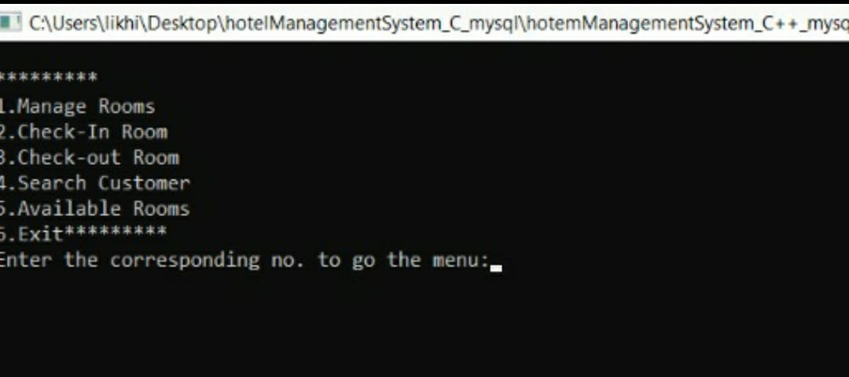
Functionalities of application:
·MAIN MENU
When you start the project from any compiler or by double-clicking the executable.exe file, you’ll see the image shown below is main screen window. In the image below, which is for system’s key features, which is that you can choose whether you want to manage rooms, check-in and check-out rooms, search customers, and available rooms.

Slide 9
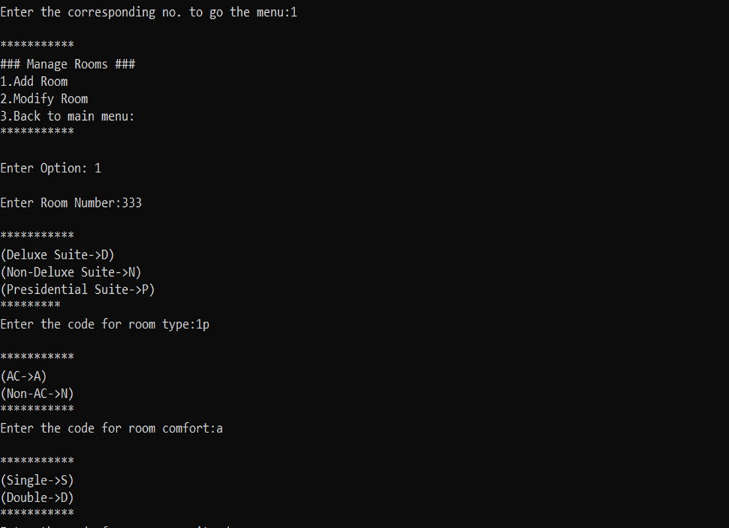
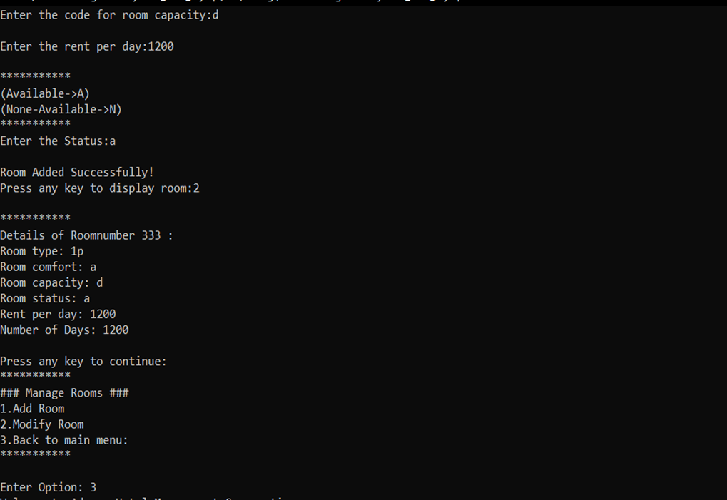
·SELECTING A SERVICE NEEDED
1.Manage Rooms – We can manage how many rooms are available or booked in this module and we have an option of modifying rooms as our requirements.

Slide 10
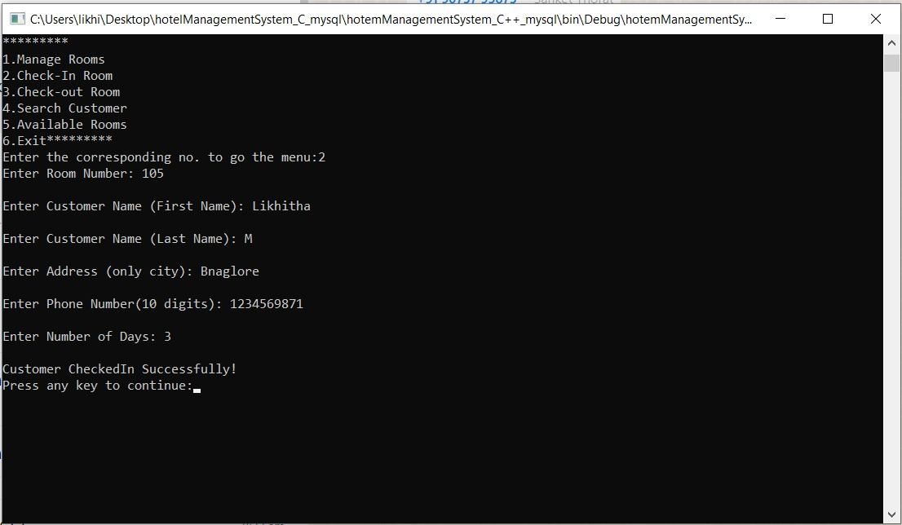
2.Check in Rooms – In this module, we can track the activity of the guests to check in the room.

Slide 11
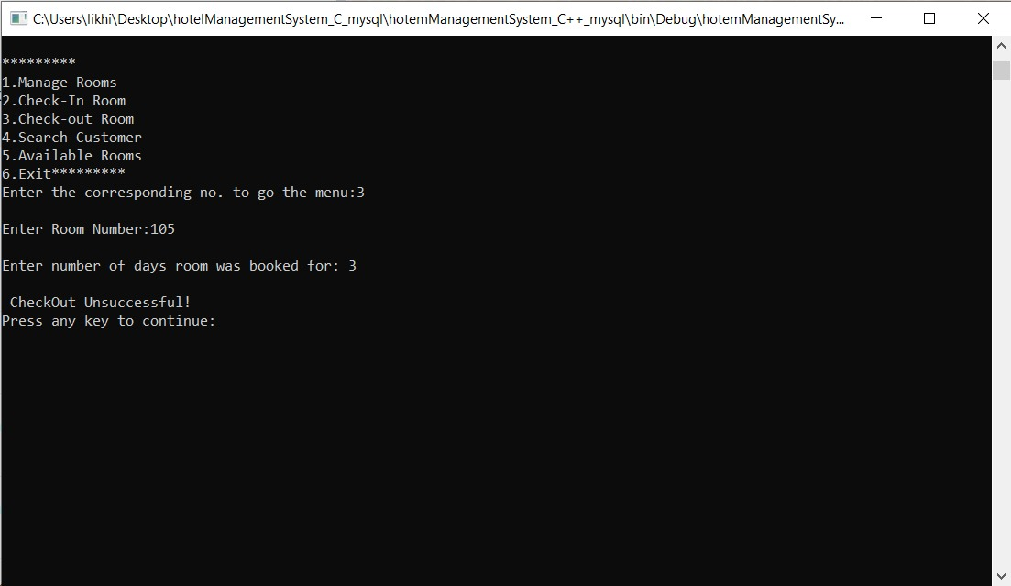
Check out Rooms – We can track the activity of the guests to check out the room in this module.

Slide 12
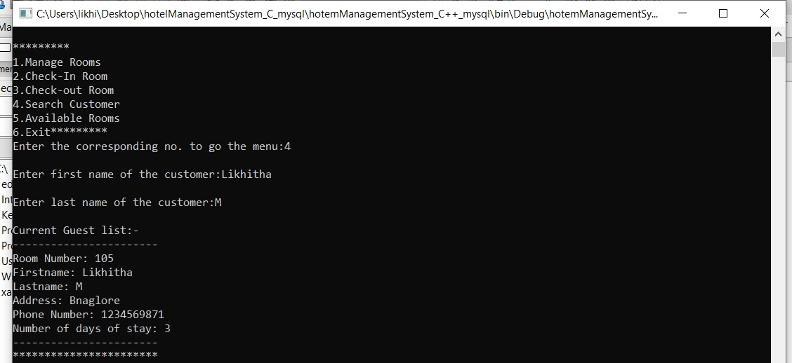
4.Search Customer Module – We may use this to look up any customer or guest to see whether they are still available at the hotel.

Slide 13
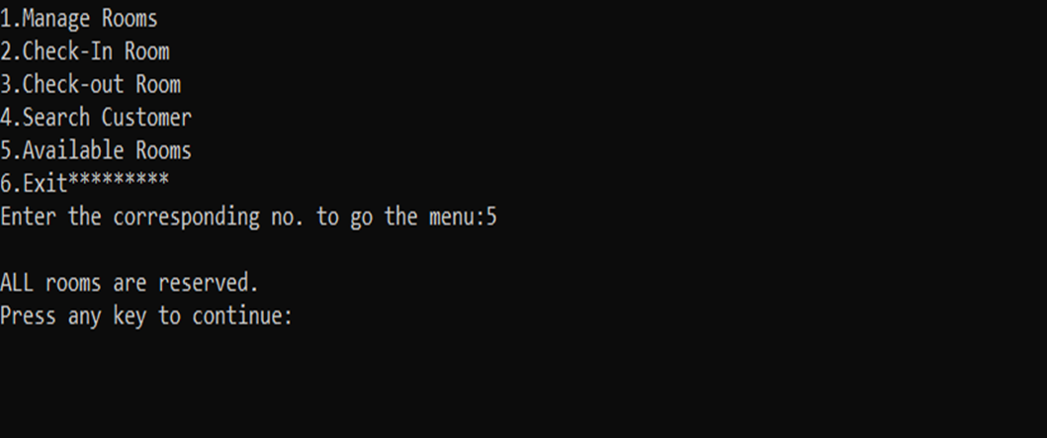
5.Available Rooms– We will be able to book all of the available rooms

Slide 14
Goals of the project:
To develop an easy user console interface
Application is accessible 24/7 whenever and wherever we needed.
Customers/ users data and information is secured
Facilitate smooth distribution of rooms to customers.
Hassle free management of data.
Facilitate admins to search specific customers.
Quick check in and check out options

Slide 15
Problems statement
The Project Hotel Room Booking is a console-based application that allows the hotel administrator to handle all hotel activities online. Interactive console and the ability to manage various hotel bookings and rooms make this system very flexible and convenient.
This application gives the hotel administrator the power and flexibility to manage the entire system from a single online system. Robust Database makes the data more organized and secured.

Slide 16
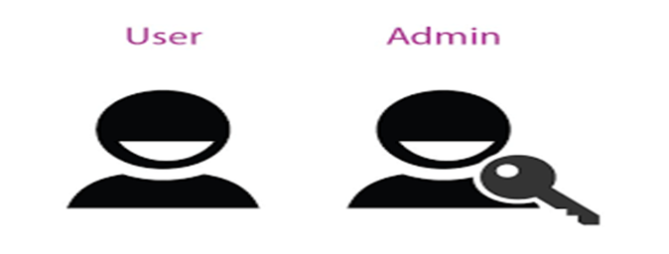
Users of the project
Customers/users to book a room as per there requirements.
Administrator for managing the applications, rooms, and personal details of users to be secured.

Slide 17
Requirements
Hardware Requirements:
2 GHz processor, 2 GB RAM or more (system memory)
20 GB of hard-drive space or more
VGA capable of 1024×768 screen resolution
Necessary computer peripherals such as keyboards etc.
Internet Connectivity (Wired/ Wireless)
Software Requirements:
Windows/ Linux Based OS/ Mac OS/ Any OS capable of running c++
MySQL database
Xampp server

Slide 18
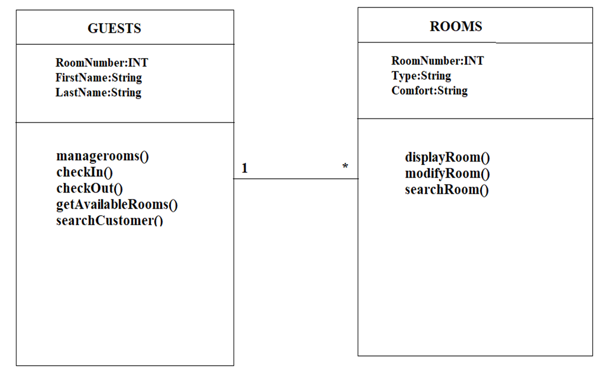
UML Diagram

Slide 19
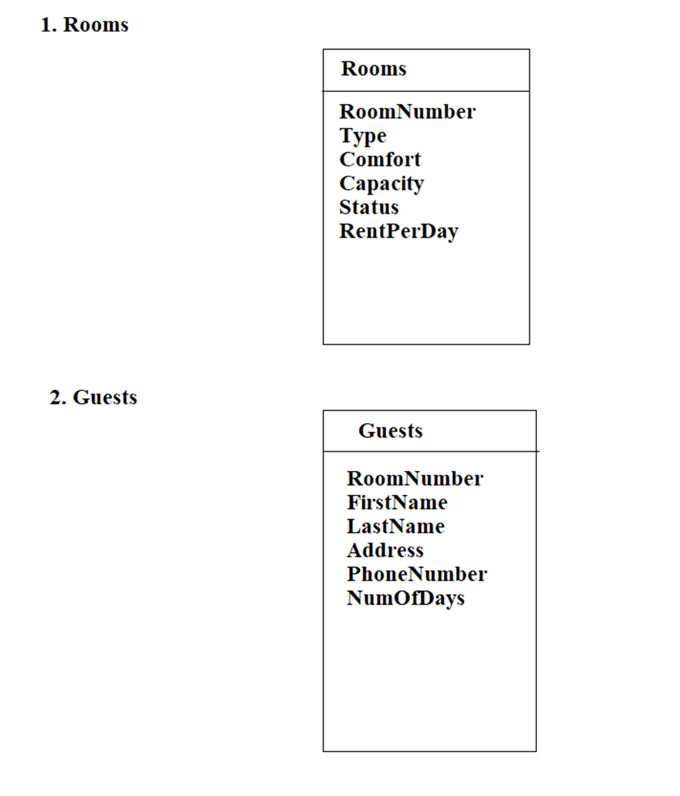
Database design

Slide 20
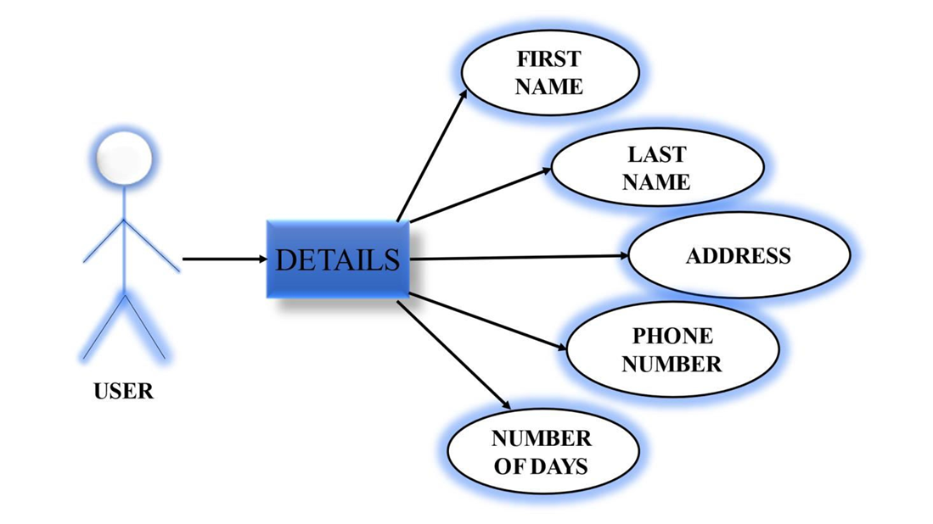
·User-case diagram

Slide 21
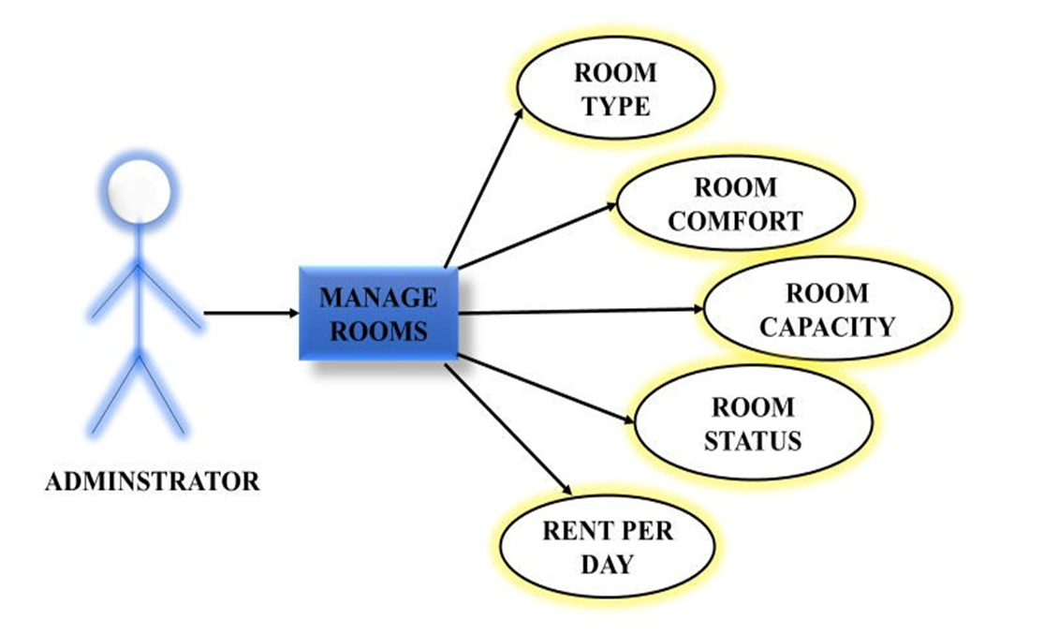
·Admin-case diagram

Slide 22
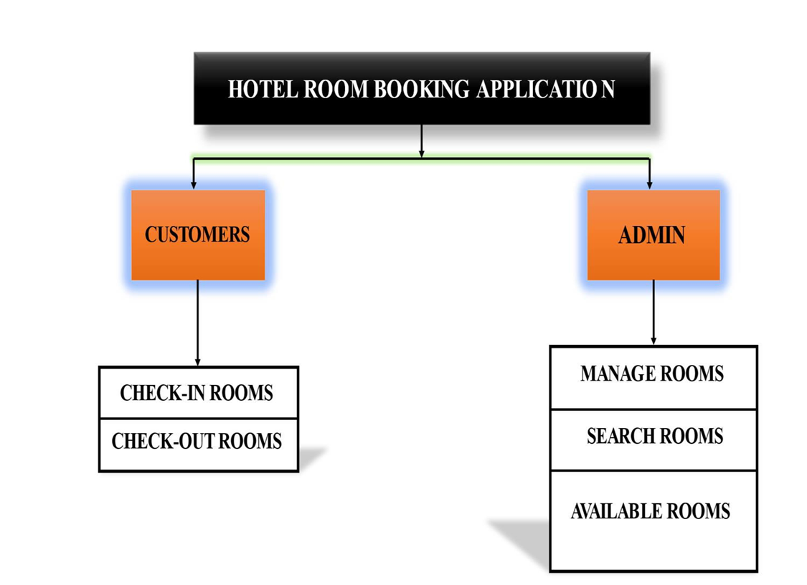
Architecture diagram

Slide 23
System Testing:
·Testing is the process of exercising software with the intent of finding and correcting errors.
·System testing is required for any applications because it gives assurance about the execution and performance.
·System Testing is carried out on the whole system in the context of either system requirement specifications or functional requirement specifications or in the context of both.

Slide 24
Conclusion
While developing this project we have learnt a lot about hotel room booking.
The online hotel room booking application was developed to replace the manual process of booking for a hotel room or any other facility of the hotel.
The old system does not serve the customers in a better way, rather it makes customer data vulnerable.
The new system keeps proper records of customers for emergency and security purposes.
We have learnt how to make a system user friendly.
We also realized the importance of maintaining a minimal margin for errors.
During the development process we studied carefully and understood the criteria of implementation process.

