Slide 1
NAME : SUDHIR KUMAR A
REGISTER NUMBER : 211521243157
DEPARTMENT : ARTIFICIAL INTELLIGENCE AND DATA SCIENCE
3/21/2024 Annual Review

Slide 2
PROJECT TITLE
GENERATE HANDWRITTEN LETTERS USING GAN
3/21/2024 Annual Review

Slide 3


AGENDA
Problem Statement
Project Overview
End Users
Our Solution and Proposition
Key Features
Modelling Approach
Result
Conclusion
3/21/2024 Annual Review

Slide 4

PROBLEM STATEMENT
This project aims to develop a Generative Adversarial Network (GAN) model to generate clear letters resembling handwritten characters, using the MNIST dataset primarily composed of digits.
Objectives include training the GAN, enhancing letter clarity, evaluating performance visually and quantitatively, and proposing improvement strategies
3/21/2024 Annual Review

Slide 5

PROJECT OVERVIEW
.
This project focuses on leveraging Generative Adversarial Networks (GANs) to generate clear and distinct letters resembling handwritten characters.
With a primary emphasis on utilizing the MNIST dataset, traditionally focused on digits, the objective is to expand its applicability to letter generation.
Using Python and libraries such as TensorFlow or Keras the project will develop a GAN model capable of producing high-quality letter images.
Overall, this project aims to contribute to the advancement of GAN-based image generation techniques and their applications in handwritten character recognition.
3/21/2024 Annual Review

Slide 6

WHO ARE THE END USERS?
Content Creators
Data Scientists
Entertainment Industry
Security and Forensics
Educational Institutions
E-commerce and Advertising
Social Media Platforms
3/21/2024 Annual Review

Slide 7

YOUR SOLUTION AND ITS VALUE PROPOSITION
Our solution involves developing a Generative Adversarial Network (GAN) model trained on the MNIST dataset to generate clear and distinct letters resembling handwritten characters.
Through careful design of the model architecture, optimization of training parameters, and exploration of advanced techniques, we aim to create a GAN model capable of producing high-quality letter images.
High-Quality Letter Generation: Our solution provides a method for generating visually clear and distinct letters, leveraging the power of GANs and the extensive MNIST dataset.
Improved Handwriting Recognition: By generating clear and distinct letters, our solution contributes to the advancement of handwriting recognition technologies.
3/21/2024 Annual Review

Slide 8

THE WOW IN YOUR SOLUTION
High-Quality Realism: Our solution doesn't just generate letters; it crafts them with astonishing realism, mimicking the intricacies of handwritten characters with remarkable fidelity.
Enhanced Performance: By harnessing the power of Generative Adversarial Networks (GANs), our solution pushes the boundaries of traditional OCR and document processing systems.
Empowering Education: Our solution doesn't just deliver results; it empowers learners to delve deeper into the fascinating world of AI and computer vision.
Driving Innovation: Beyond its immediate applications, our solution serves as a catalyst for innovation and exploration in the field of image generation.
3/21/2024 Annual Review

Slide 9
MODELLING
Data Preparation : We start by preparing the MNIST dataset, which contains grayscale images of handwritten digits ranging from A to Z.
Generator Network : Our generator network takes random noise as input and aims to generate realistic images of letters.
Discriminator Network : The discriminator network evaluates the realism of generated images by distinguishing between real MNIST digits and fake images produced by the generator.
Training Procedure : We train the GAN in a adversarial manner, where the generator and discriminator networks compete against each other to improve their performance.
Evaluation and Optimization :Throughout training, we monitor the quality of generated images using both visual inspection and quantitative evaluation metrics.
3/21/2024 Annual Review

Slide 10
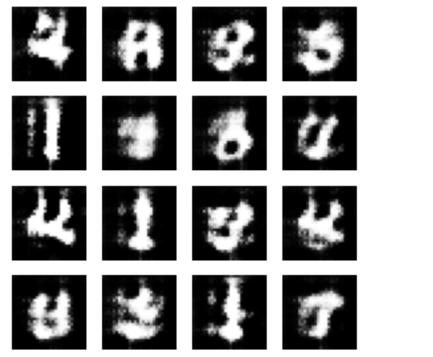
RESULTS
The trained GAN model should produce high-quality, diverse letters resembling handwritten characters. Users can visually inspect the generated letters for authenticity, clarity, and legibility. Quantitative evaluation metrics like FID and IS can objectively assess image quality and diversity. Successful generation enables applications such as handwriting recognition and document processing.
Demo Link
3/21/2024 Annual Review

