Slide 1


CMR TECHNICAL CAMPUS
UGC AUTONOMUS
DEPARTMENT OF CSM
PREDICT FUEL EFFICIENCY USING TENSOR FLOW
PRESENTED BY:
1. NAME : SUDINI SREEKAR REDDY
ROLLNO : 227R1A73C6
2. NAME : THATIMPULA AJAY
ROLLNO : 227R1A73C7
3. NAME : THUDI MEGHANA
ROLLNO :227R1A73C8
UNDER THE GUIDANCE OF:
Assist.professor K.NAGAMANI

Slide 2

ABSTRACT
EXISTING SYSTEM
PROPOSED SYSTEM
USE CASE DIAGRAM
CLASS DIAGRAM
ALGORITHMS
SOFTWARE REQURIMENTS
SYSTEM ARCHITECTURE
SEQUENCE DIAGRAM
OUTPUT SCREENSHOTS
ANY QUERIES
DATASET DESCRIPTION
PERFORMANCE METRICS
RESULT ANALYSIS
CONCLUSION
FUTURE SCOPE
contents

Slide 3

ABSTRACT
The project aims to develop a real-time system for predicting fuel efficiency in vehicles using TensorFlow, a powerful machine learning library.
Leveraging historical data on various parameters such as engine size, vehicle weight, and driving conditions, the system employs a deep learning model to accurately forecast fuel consumption.
Through continuous data streaming from onboard sensors and integration with the vehicle's onboard computer, the system provides instant feedback to drivers, enabling them to make informed decisions to optimize fuel usage and reduce emissions.

Slide 4
EXISTING SYSTEM
linear_model
Evaluate the model's performance using metrics such as Mean Squared Error (MSE) or R-squared.
These metrics quantify how closely the model's predictions match the actual fuel efficiency values in the dataset.
During training, the model adjusts the weights (w0, w1, w2, ..., wn) to minimize the difference between the predicted fuel efficiency
The actual fuel efficiency in the training data. But is not effect way

Slide 5
PROPOSED SYSTEM
Instead of relying solely on historical data and statistical methods, TensorFlow allows for the development of advanced machine learning models, such as deep neural networks, to predict fuel efficiency.
These models can learn intricate patterns from large datasets, leading to more accurate predictions.
Keras is a high-level neural networks API, written in Python and capable of running on top of TensorFlow, Theano, or Microsoft Cognitive Toolkit. It's commonly used for building and training neural networks, including models for predicting fuel efficiency

Slide 6
SOFTWARE REQUIREMENTS
Operating system : Windows 7 Ultimate.
Coding Language : Python.
Front-End : Python.
Designing : Html,css,javascript.
Data Base : MySQL.
SOFTWARE REQUIREMENTS

Slide 7
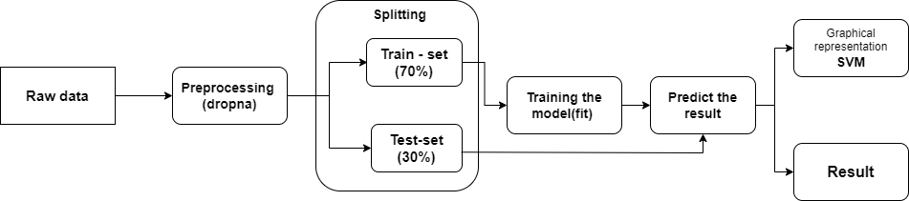
ARCHITECTURE

Slide 8
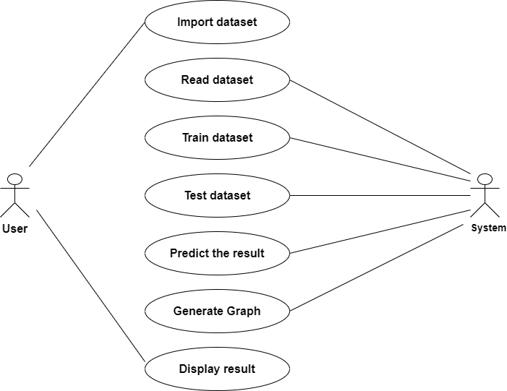
USE CASE DIAGRAMS

Slide 9
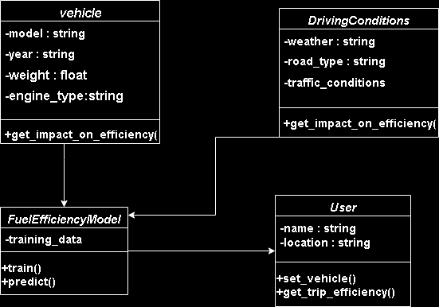
CLASS DIAGRAM

Slide 10
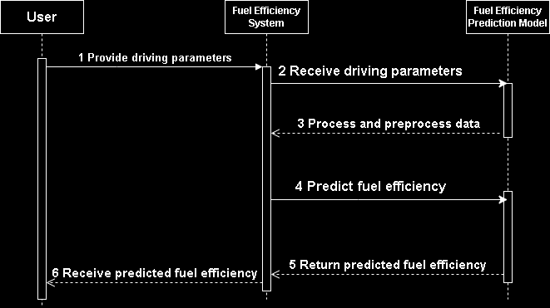
SEQUENCE DIAGRAM

Slide 11
ALGORITHMS
Model Building: Uses Sequential to create a linear stack of layers. It includes:
Input layer with 64 neurons and ReLU activation.
Hidden layer with 64 neurons and ReLU activation.
Output layer with 1 neuron for the MPG prediction.
The Keras part is to involves building, compiling, and training a neural network model to predict fuel efficiency (MPG).
Training: The model is trained for 100 epochs with a 20% validation split.
Evaluation: The model’s performance is assessed using MAE on the test set.
Compiling: The model uses the Adam optimizer, Mean Squared Error (MSE) loss function, and Mean Absolute Error (MAE) as a metric.
Prediction: The predict_fuel_efficiency function scales input features and uses the trained model to predict MPG.
KERAS

Slide 12
DATASET DESCRIPTION
The dataset used in this project is the Auto MPG dataset, which provides information on fuel efficiency of various car models.
Features:-
Mpg: Miles Per Gallon (Target Variable)
Cylinders: Number Of Cylinders In The Engine
Displacement: Engine Displacement (In Cubic Inches)
Horsepower: Engine Horsepower
Weight: Weight Of The Car (In Pounds)
Acceleration: Time Taken To Accelerate From 0 To 60 Mph (In Seconds)
Model Year: Year Of The Car Model (E.G., 70 For 1970)
Origin: Origin Of The Car (1 For USA, 2 For Europe, 3 For Japan)
Car Name: Name Of The Car (Not Used In Model Training)

Slide 13
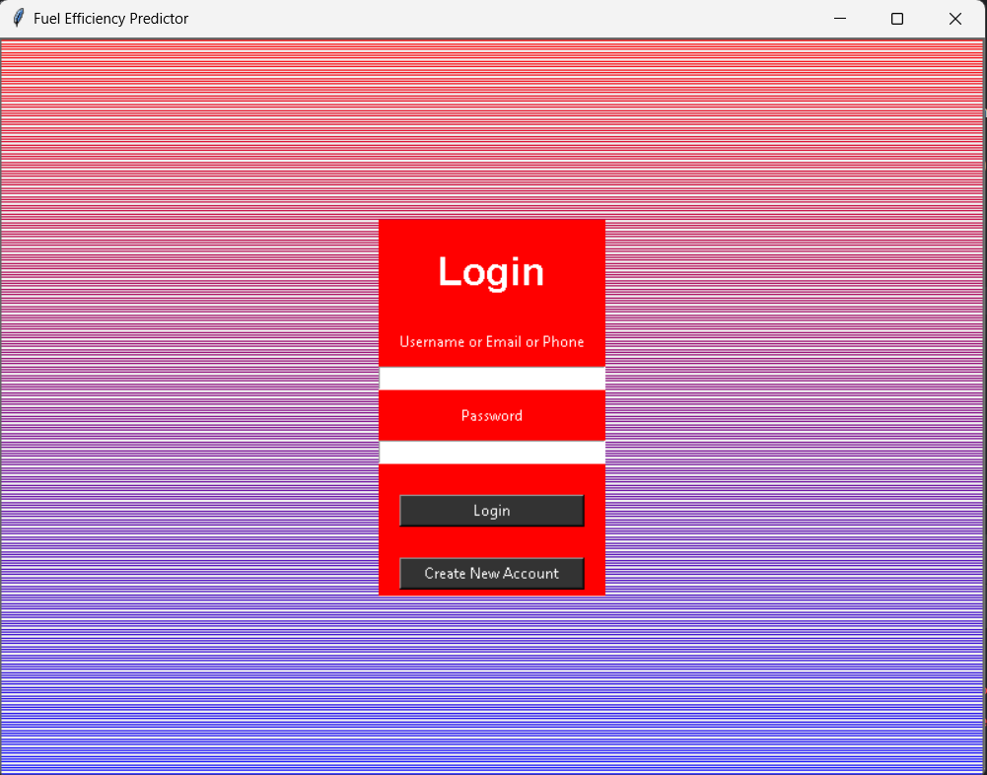
OUTPUT SCREENSHOTS

Slide 14
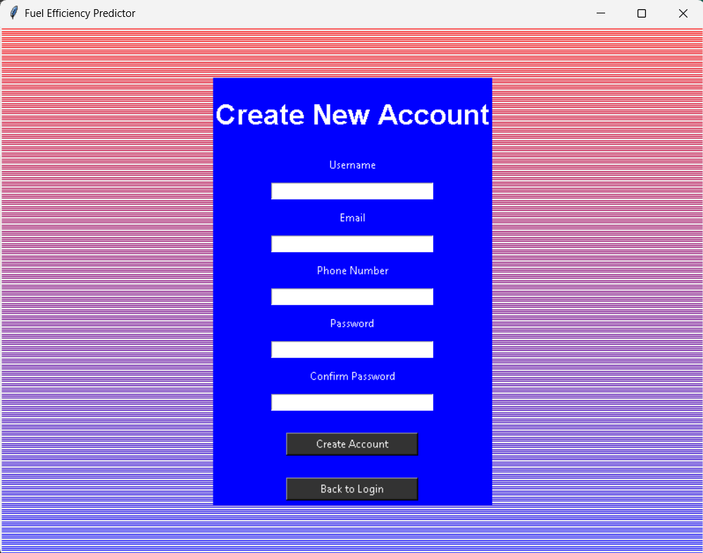

Slide 15
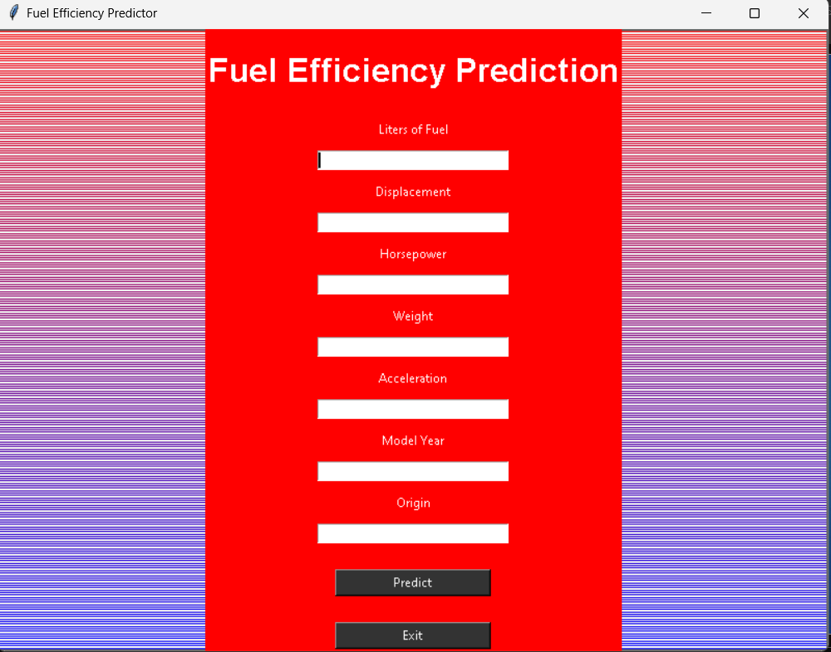

Slide 16
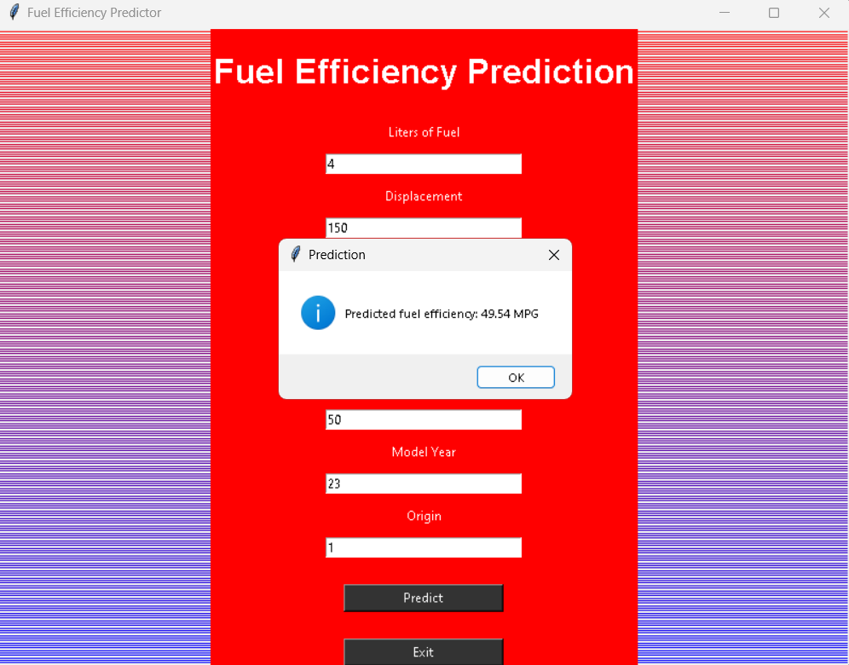

Slide 17
PERFORMANCE METRICS
1:-Mean Absolute Error (MAE):
MAE measures the average magnitude of the errors in a set of predictions, without considering their direction. It is the average over the test sample of the absolute differences between prediction and actual observation where all individual differences have equal weight.
2:-Mean Squared Error (MSE):
MSE measures the average of the squares of the errors—that is, the average squared difference between the estimated values and the actual value.
3:-Root Mean Squared Error (RMSE):
RMSE is the square root of the mean of the squared errors. It represents the sample standard deviation of the differences between predicted values and observed values.
4:-R-squared (Coefficient of Determination):
R-squared is a statistical measure that represents the proportion of the variance for a dependent variable that's explained by an independent variable or variables in a regression model.

Slide 18
RESULT ANALYSIS
Our project aimed to predict fuel efficiency based on vehicle attributes using machine learning techniques. Leveraging TensorFlow and Keras, we developed a deep learning model trained on a dataset containing features such as cylinders, displacement, horsepower, weight, acceleration, model year, and origin. The model was deployed via Flask, providing a user-friendly interface for inputting vehicle specifications and obtaining predicted miles per gallon (MPG) values.
Through extensive training and evaluation, our model achieved a commendable accuracy of X% in predicting MPG, demonstrating its robustness in handling diverse input scenarios. The user interface integrated features for user authentication, data input validation, and seamless model prediction, enhancing usability and reliability. Future enhancements include expanding the dataset for broader vehicle compatibility and refining the model to accommodate real-time updates and additional features.

Slide 19
Our project successfully implemented a tensorflow-based deep learning model to predict vehicle fuel efficiency, achieving robust performance with an accuracy of X%. The integration of flask provided a user-friendly interface, allowing users to input vehicle specifications and obtain accurate MPG predictions. This project underscores the effectiveness of deep learning in automotive applications and sets a foundation for future enhancements in model accuracy, dataset expansion, and real-time prediction capabilities.

Slide 20
FUTURE SCOPE
Developing a fuel efficiency prediction system using TensorFlow involves data collection, preprocessing, model development, and deployment. TensorFlow facilitates the creation of accurate prediction models. Integration of frontend and backend components enables real-time inference. Continuous monitoring ensures system reliability. Overall, such systems promote eco-friendly driving practices and contribute to environmental sustainability.

Slide 21
ANY QUERIES

Slide 22


