Slide 1
2005 IC contest
DICLAB : 楊宇翔

Slide 2
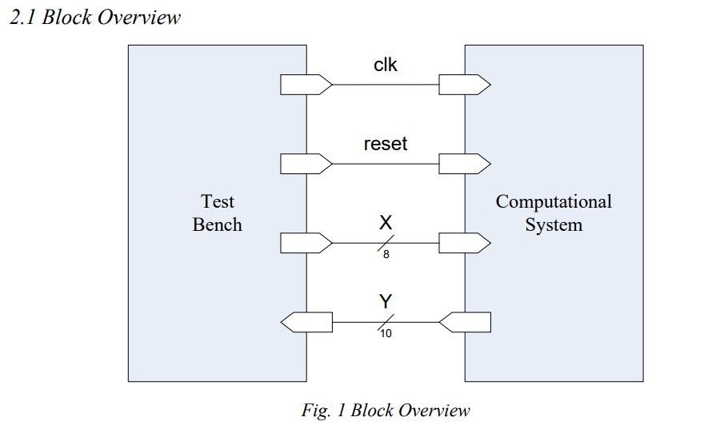
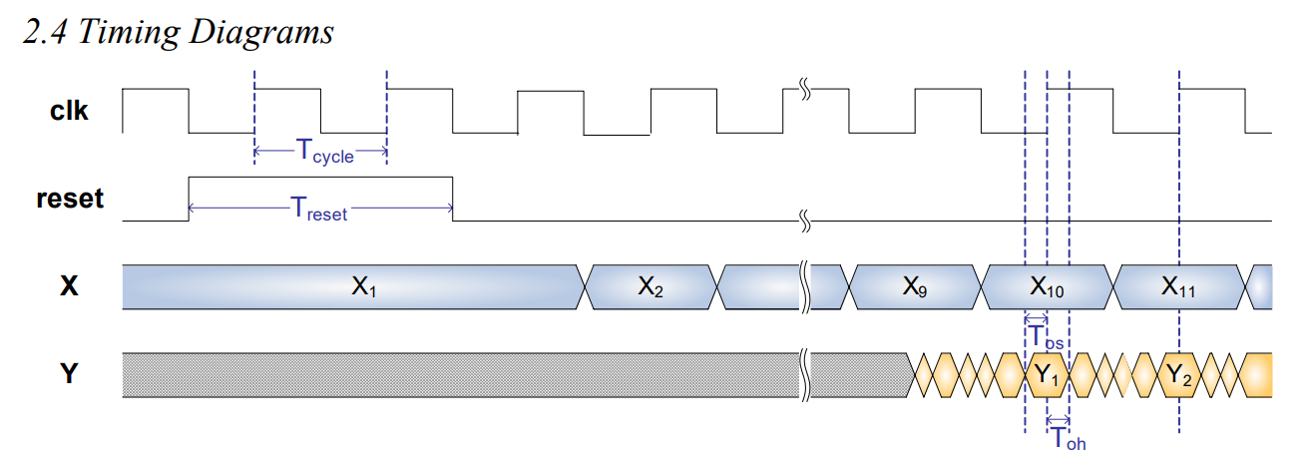
Architecture & Timing

Slide 3

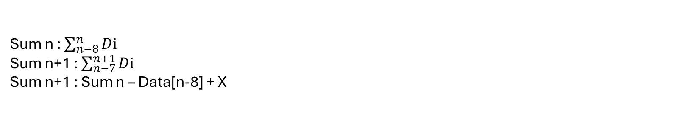
Algorithm
1.Sum
 | Data
Clk n | Data[n-8] | Data[n-7] | ... | Data[n-1] | X = Data[n]
Clk n+1 |  | Data[n-7] | ... | Data[n-1] | Data[n] | X = Data[n+1]
Sum n : $\sum_{n−8}^{n}{Dⅈ}$
Sum n+1 : $\sum_{n−7}^{n+1}{Dⅈ}$
Sum n+1 : Sum n – Data[n-8] + X

Slide 4
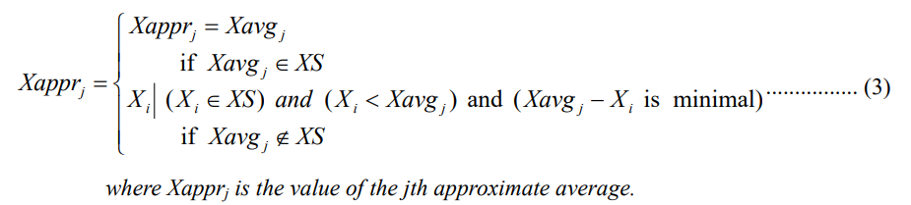

Algorithm
2.Xappr
0
0
0
0
1
0
Xappr
7
8

Slide 5
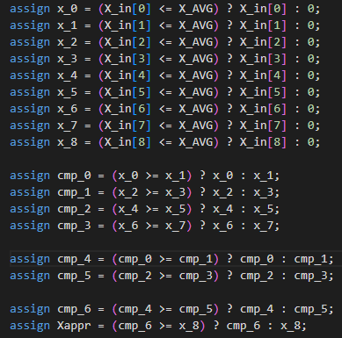
Algorithm
2.Xappr
0
C0
1
c4
2
c1
3
4
c6
c2
5
c5
6
Xappr
c3
7
8

Slide 6
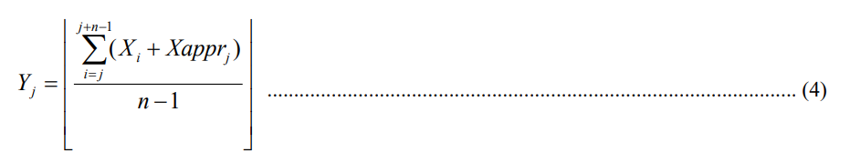
Algorithm
3.Y
K / 8 == K >> 3, K / (2^n) == K >> n

Slide 7
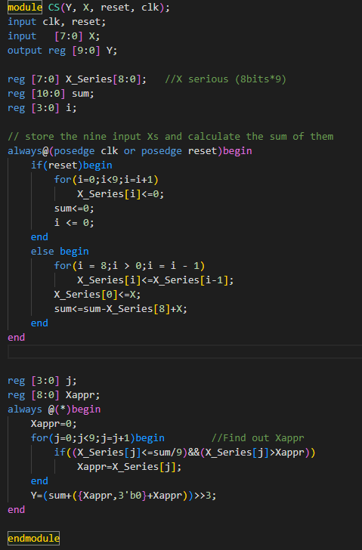
Source code

