Slide 1
MPCT
(Multi-Purpose Cap for Tourism)

Slide 2
MPCT is a device to solve the problems of Pilgrims. This will be light weight device with umbrella like characteristics.and other features installed in it.
Branch : CSE
Group : LM2
Roll Numbers :
1710991804
1710991814
1710991822
Supervisor:
Mrs Charu khosla
Co-supervisor:
Mr. Arun

Slide 3
MPCT for tourism is a device to solve the problem of Pilgrims. This will be a light weight device with umbrella like characteristics and other features installed in it.
Problem Statement

Slide 4
NEED STATEMENT
Pilgrimage is a multibillion dollar industry as it is attended by millions of pilgrims and gives job to lakhs of people. There are hardships of travel during long walk ways to the places of worship while performing religious rituals. If it rains, the matter becomes worse.
EPICS-ASCUP

Slide 5
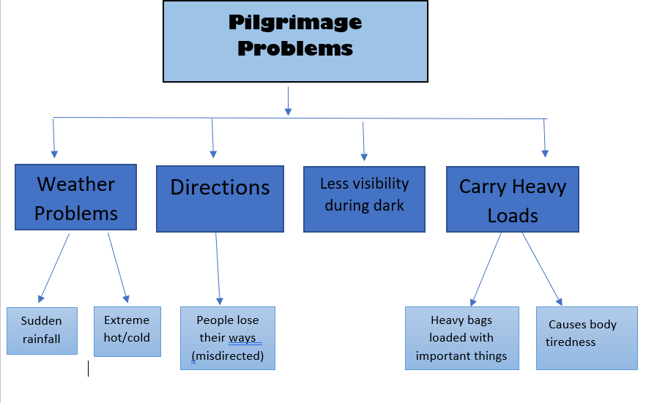
Pilgrimage Problems

Slide 6
METHODOLOGY OPTED
PilgriMage problems
HCD
Stakeholder interview
Internet Support
Mpct
EPICS-ASCUP

Slide 7
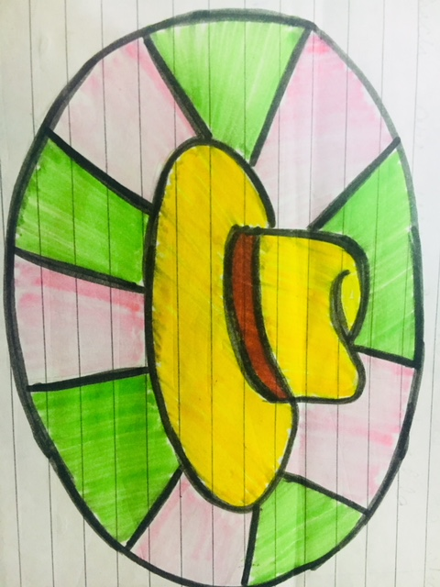

Conceptual Design
EPICS-ASCUP

Slide 8
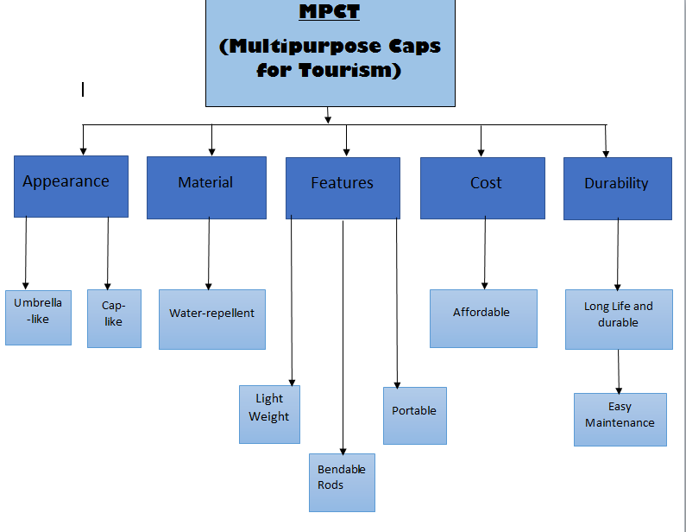
Functional Decomposition
Functional Decomposition
EPICS-ASCUP

Slide 9
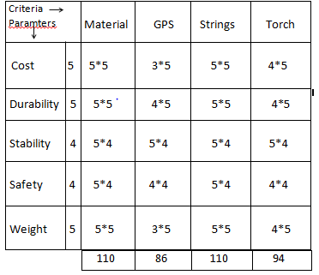
Decision Matrix
EPICS-ASCUP

Slide 10
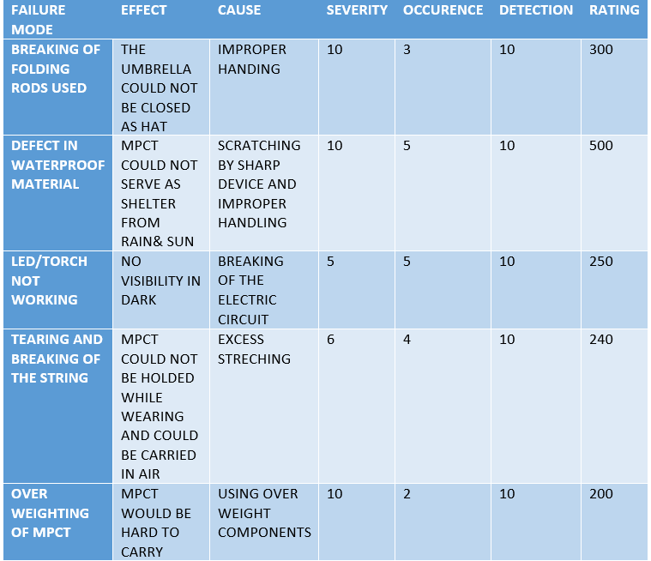
DFMEA MODEL
Lets List the Failures!
EPICS-ASCUP

Slide 11
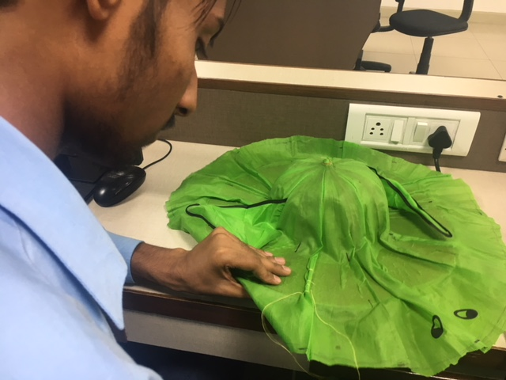
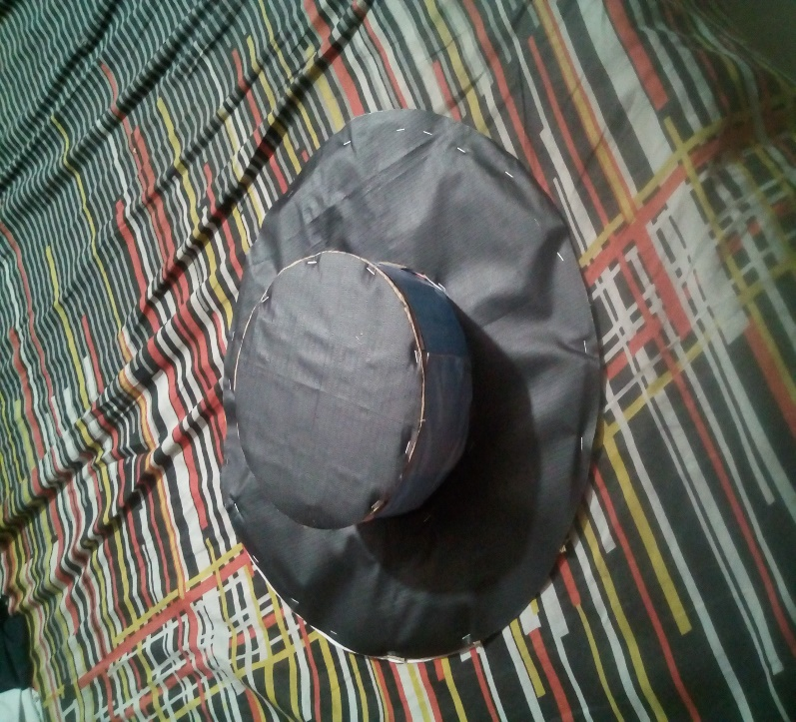
MPCT in MAKING….
Failiure Modes

Slide 12
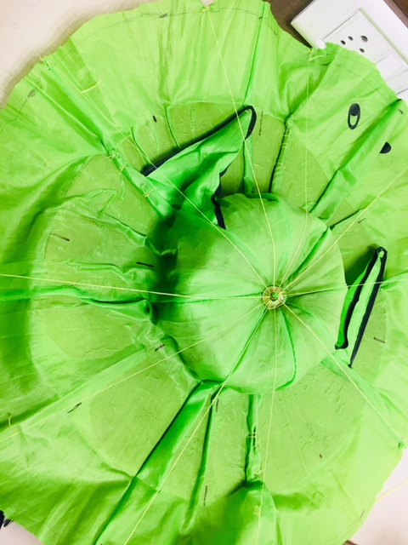
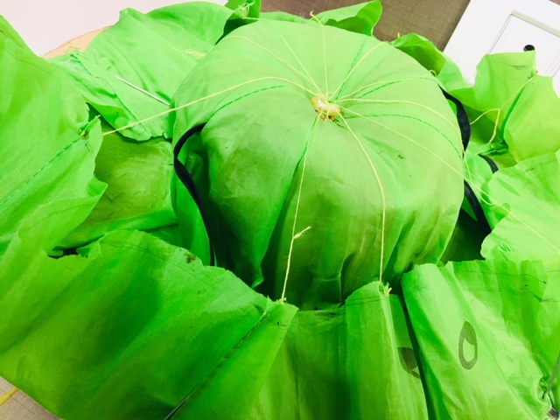
Prototype
EPICS-ASCUP

Slide 13



Slide 14
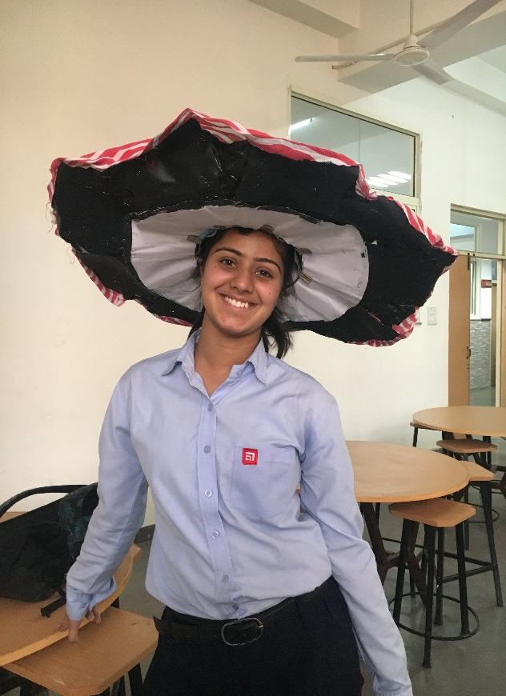
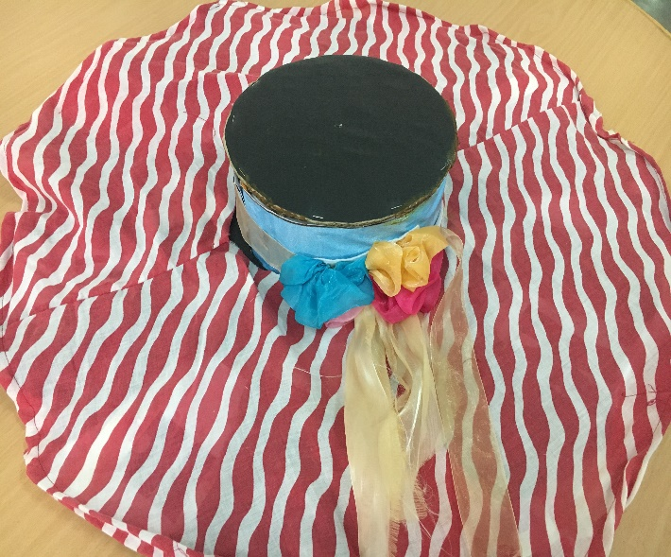
EPICS-ASCUP

Slide 15
Questions??

Slide 16
Thank you ☺

