Slide 1
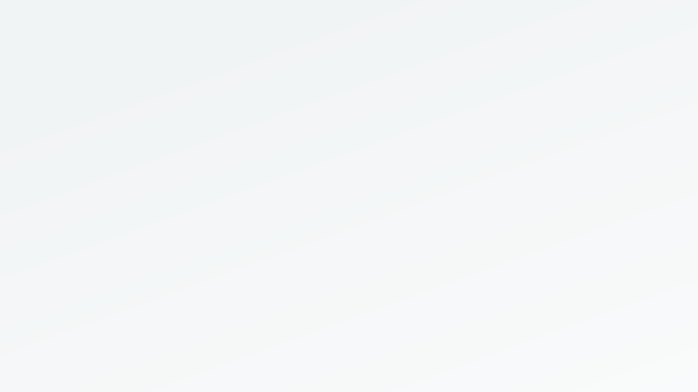
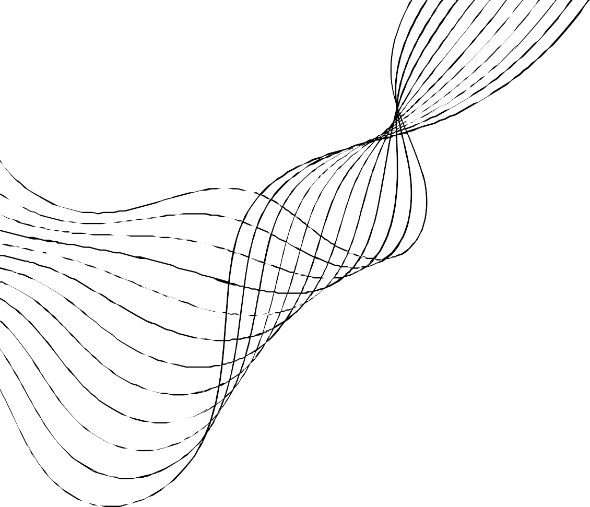
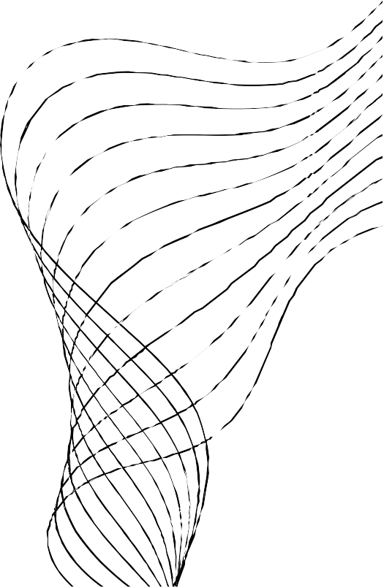
ANALYZING LARGE- SCALE TRANSACTIONAL DATA: A DISTRIBUTED FP- GROWTH IMPLEMENTATION ON
SPARK

Slide 2
GROUP MEMBERS
Bharath L Gnanesh A R Gopal Madhan S Suhaas
(22bds013) (22bds023) (22bds025) (22bds036) (22bds056)

Slide 3
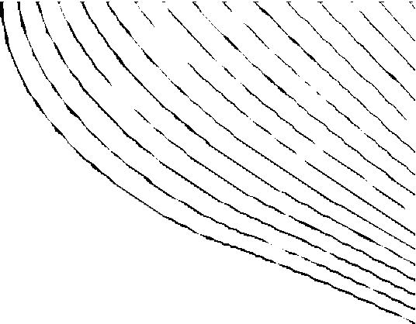
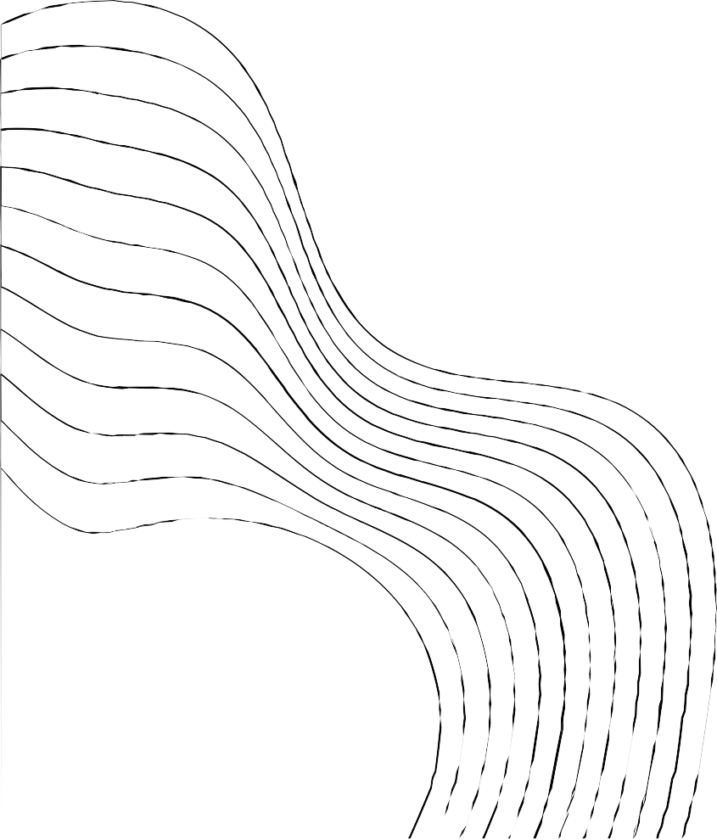
CONTENT
01
02
03
04
05
HADOOP
SPARK
FP ALGORITHM
CODE RUN
ANALYSIS

Slide 4
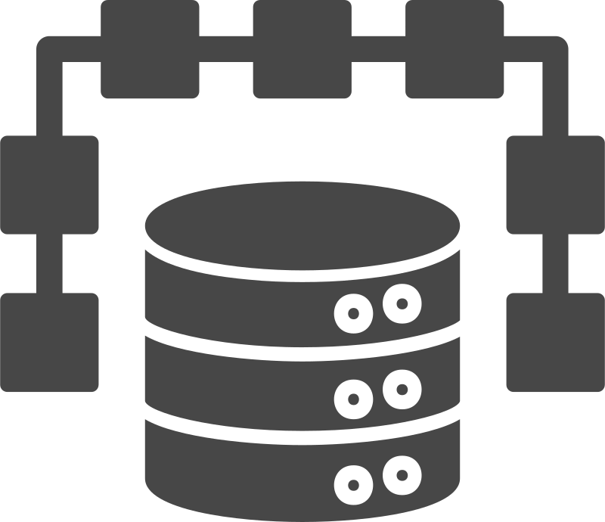
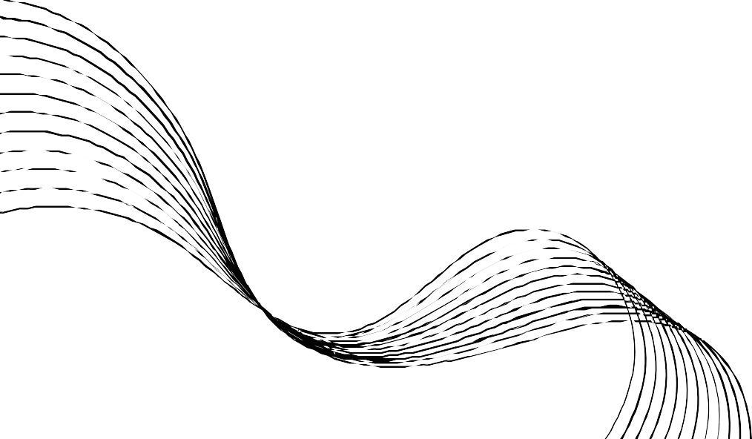
HADOOP
What is Hadoop?
Hadoop is an open-source framework used for storing and processing large volumes of data in a distributed computing environment. It's designed to handle massive datasets across clusters of commodity hardware.

Slide 5
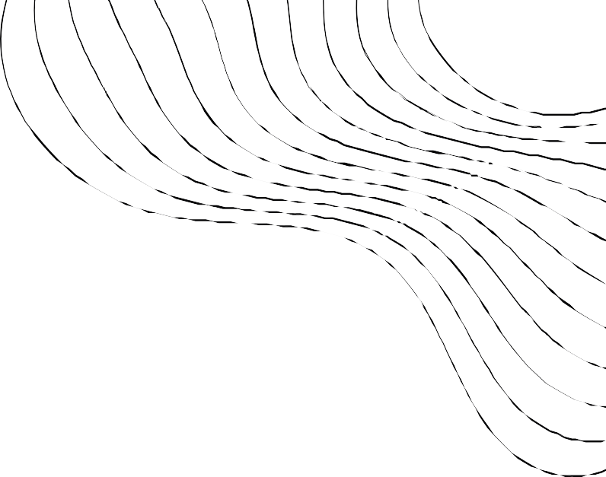
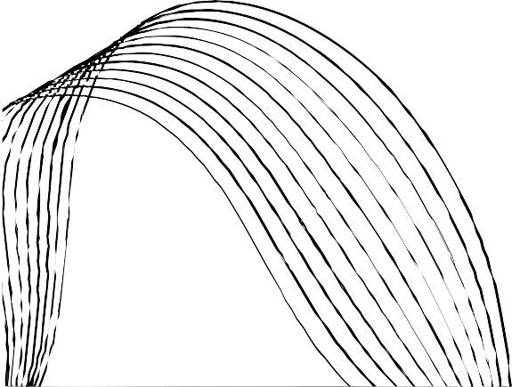
Key Components:
Hadoop Distributed File System (HDFS): A distributed file system that stores data across multiple machines.
MapReduce: A programming model for processing and generating large datasets in parallel.
YARN (Yet Another Resource Negotiator): Resource management layer responsible for managing computing resources in the Hadoop ecosystem.
Hadoop Common: Contains libraries and utilities needed by other Hadoop modules.

Slide 6
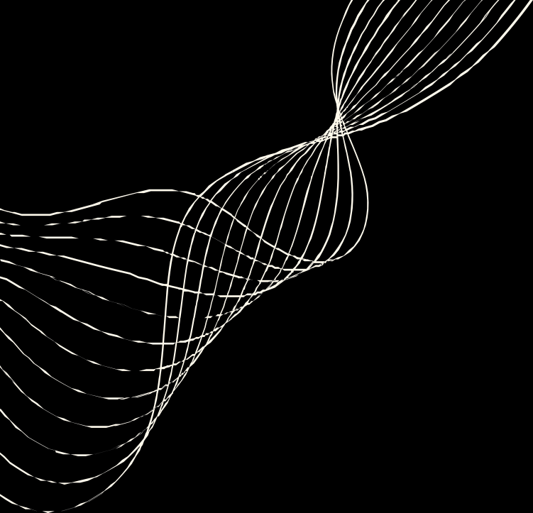
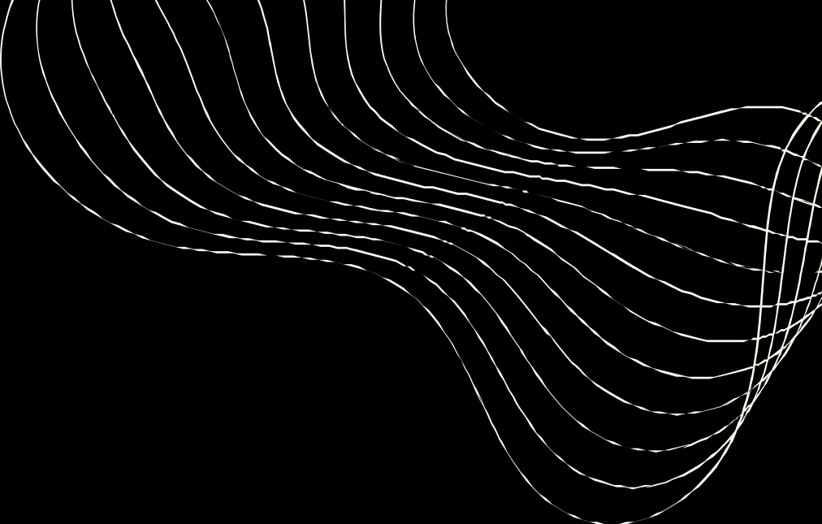
SPARK
Open-source, in-memory application framework.
Provides parallel & distributed processing, scalability & fault tolerance.
Keeps as much of the data required in-memory & avoids disk I/O.
Follows a master/slave architecture with two main daemons and a cluster manager (Master Daemon & Worker Daemon)
Apache Spark is a distributed computing framework that provides in-memory data processing and processing of batch, streaming, and machine learning workloads. It can be used with various data sources such as HDFS, HBase, Cassandra, and Amazon S3 and supports multiple programming languages including Java, Scala, and Python.

Slide 7


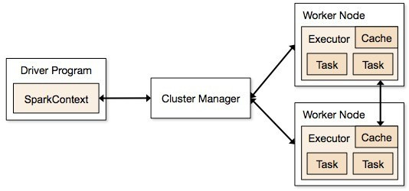
MASTER & WORKER DAEMON
Spark consists of the driver program & the executor program.
Executor program works on worker nodes.
Spark distributes RDDs among executors.
Communication among the driver & the executor.
Spark as an organization :-
Executive management as driver code.
Junior employees as executors.
Worker nodes correspond to the office space that the employees oссиру.

Slide 8
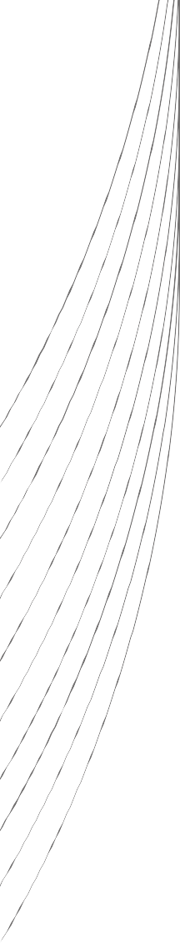
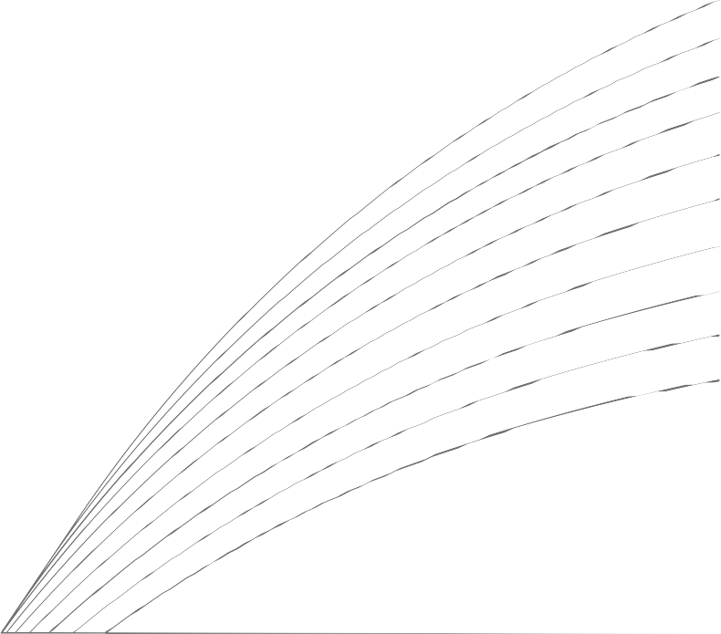
RDD'S
Spark's primary data abstraction.
Collection of fault tolerant & immutable elements
partitioned across the cluster's nodes. • Spark create a DAG when creating an RDD.
Vertices represent the RDD's & the edges represent the transformations or actions.
The DAG scheduler applies the graphical structure to run the tasks that use the RDD to perform transformational processes.
DAG helps enable fault tolerance. When a node goes down, Spark replicates the DAG & restores the node

Slide 9
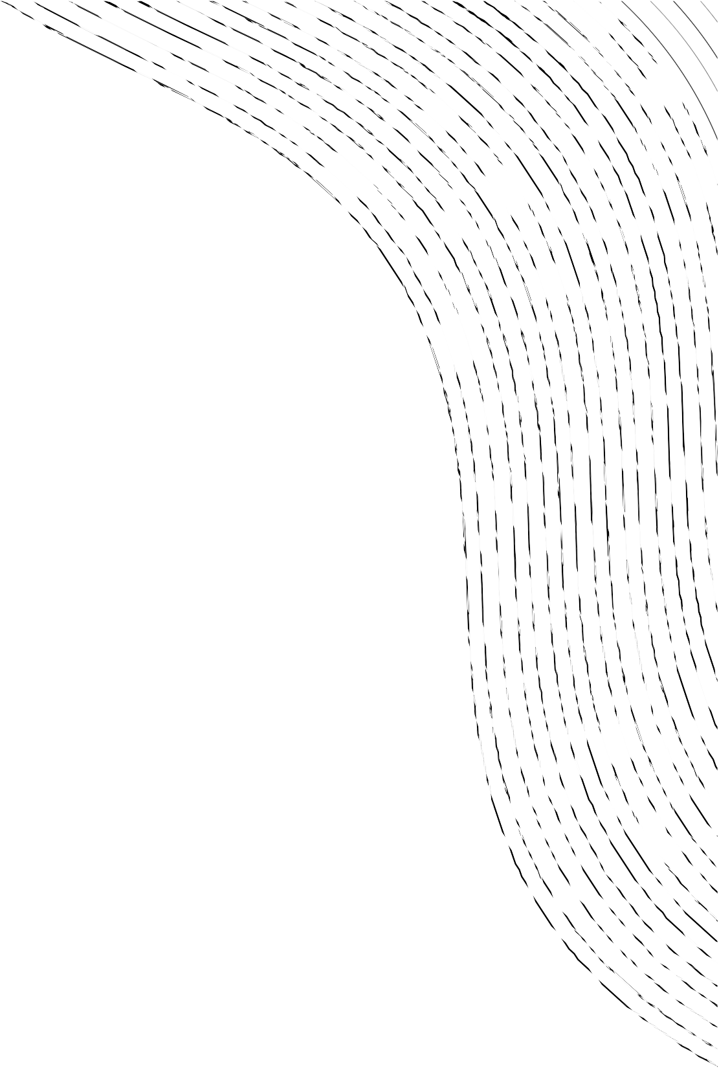
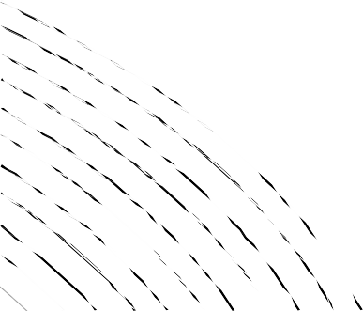
FP - GROWTH ALGORITHM
“FP” stands for Frequent Pattern in a Dataset of transactions
calculate item frequencies and identify frequent items,
a suffix tree (FP-tree) structure to encode transactions, and
frequent itemsets can be extracted from the FP-tree.

Slide 10
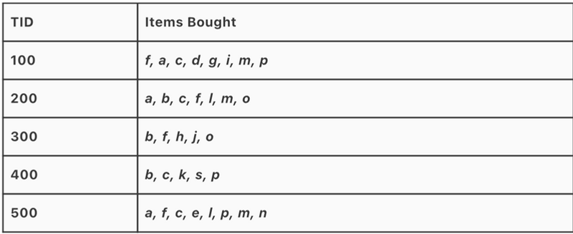
Frequency of each item

Slide 11
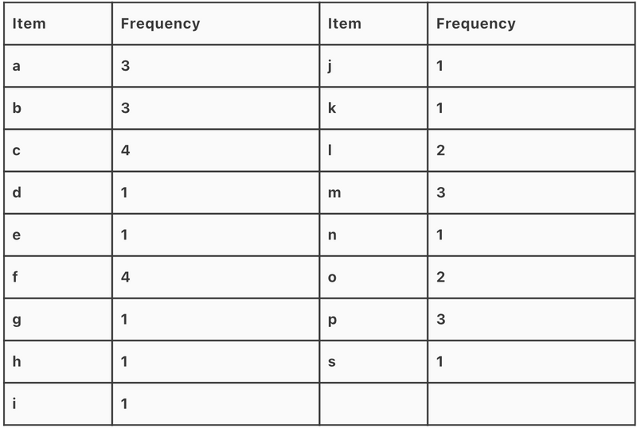
Frequency of each item

Slide 12
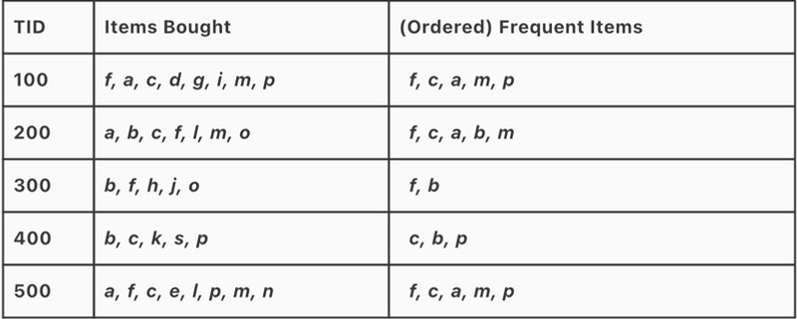
Frequent Pattern set L = { (f:4), (c:4), (a:3), (b:3), (m:3), (p:3) }
Ordered Item set

Slide 13
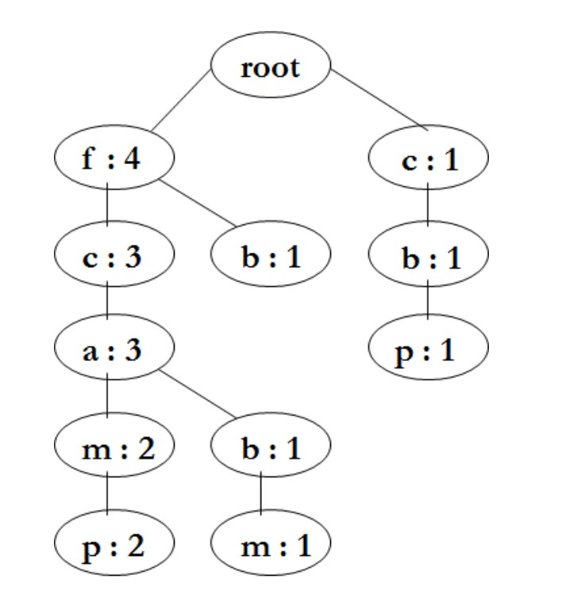
Frequent Pattern Tree

Slide 14
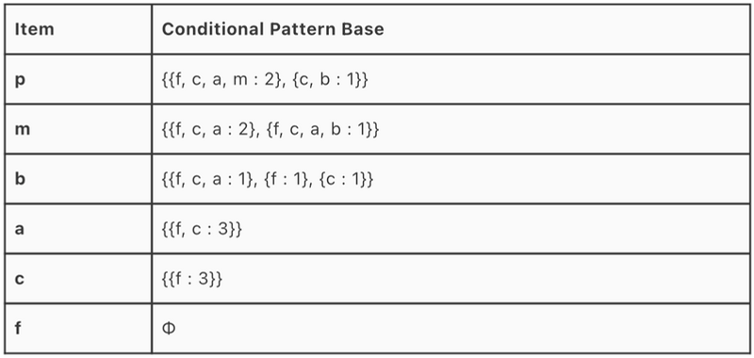
Conditional Pattern Base

Slide 15
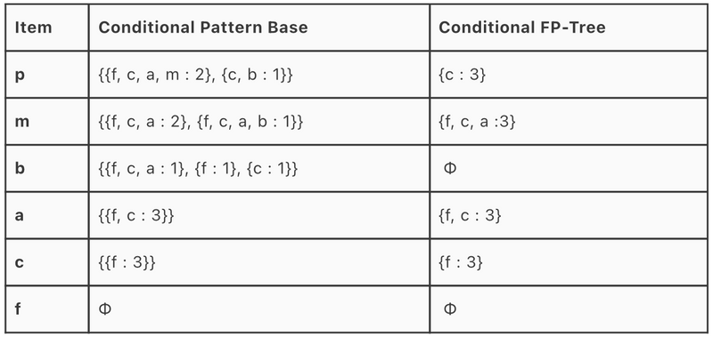
Conditional Frequent Pattern - Tree

Slide 16
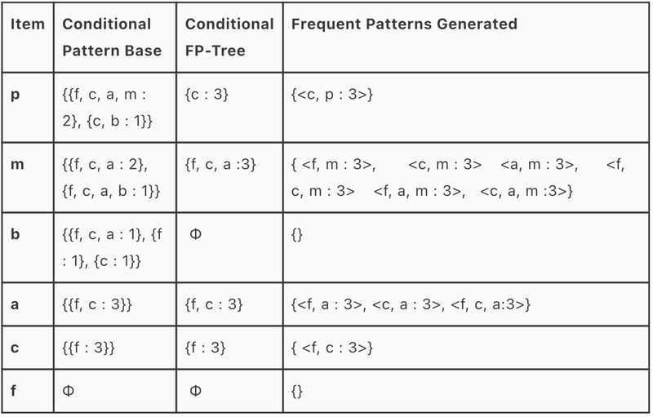
Frequent Patterns Generated

Slide 17

CODE IMPLEMENTATION

Slide 18
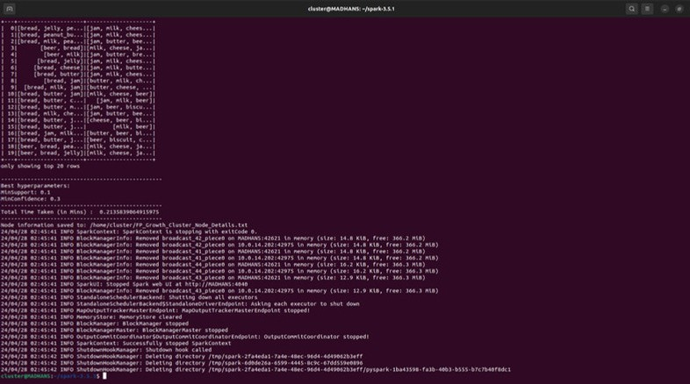
* 1 Node

Slide 19
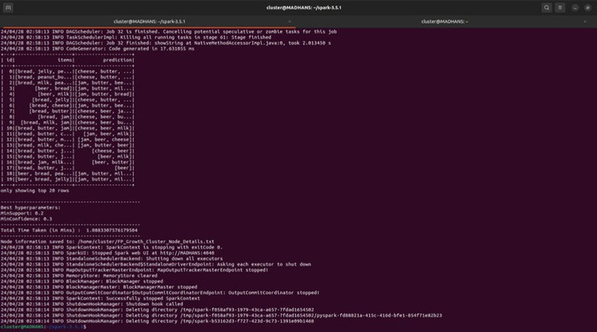
* 3 Nodes

Slide 20
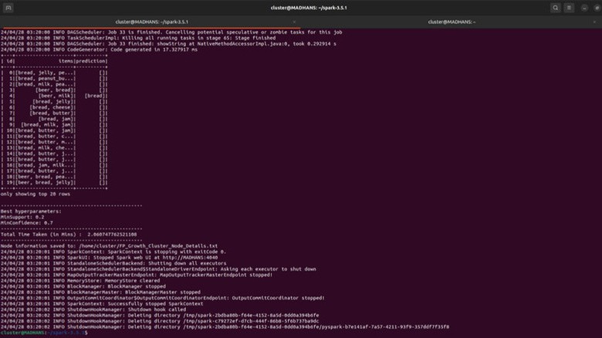
* 5 Nodes

Slide 21

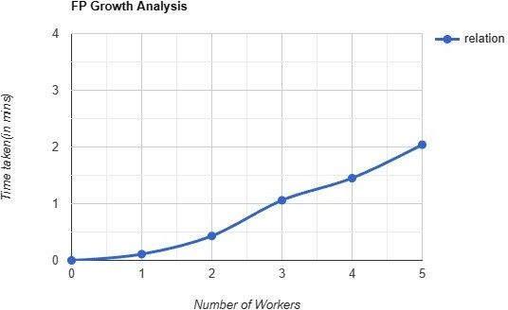
ANALYSIS
The analysis of our project revealed an unexpected trend: as the number of nodes increased, the execution time of the FP-Growth algorithm also increased instead of decreasing.

Slide 22

REASON ?

Slide 23
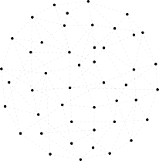
NETWORK OVERHEAD
Network overhead refers to the additional time, resources, and bandwidth consumed by communication between nodes in a distributed system.
This overhead can manifest in several ways:
Serialization and Deserialization
Network Latency
Data Shuffling
Protocol Overhead

Slide 24
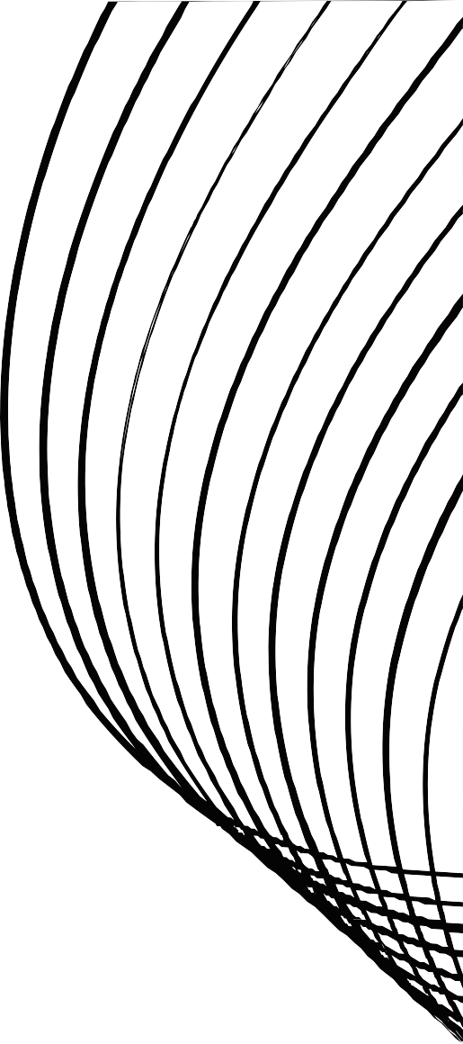

UNDER THE GUIDANCE OF
Dr.Animesh Chaturvedi, Associate Professor Dept. of DSAI , IIIT Dharwad.

Slide 25


