Slide 1

파워포인트 템플릿 및
폰트 출처:
http://www.free-powerpoint-templates-design.com
Welcome!! Sweet Delivery
조원 : 심수현 한승현 최민희 권영준

Slide 2
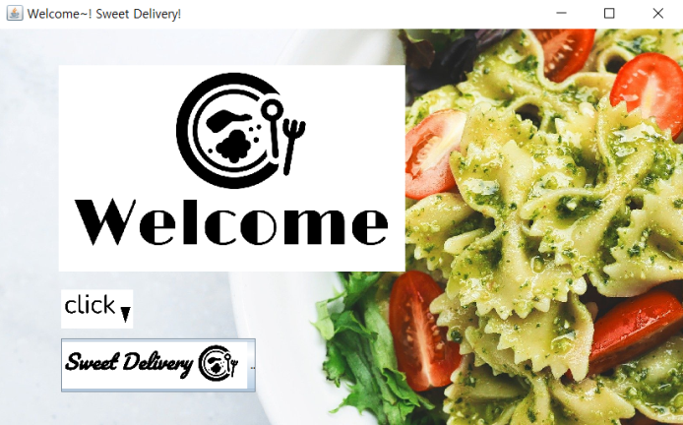
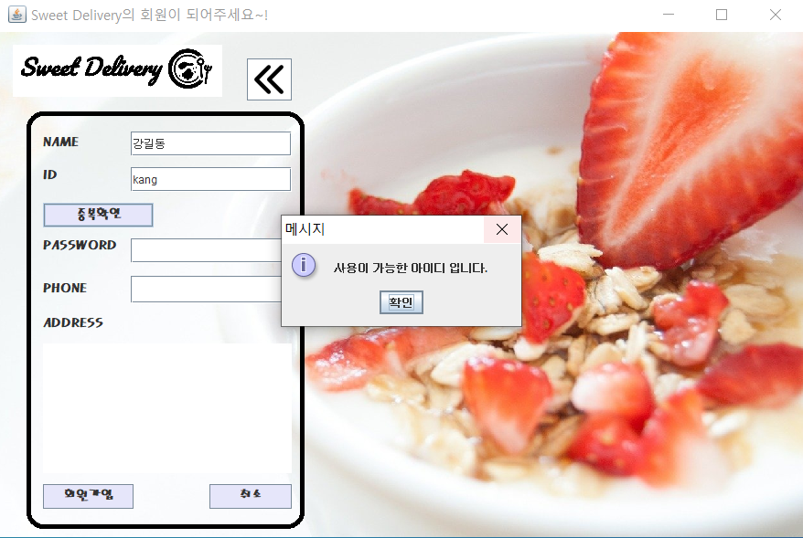
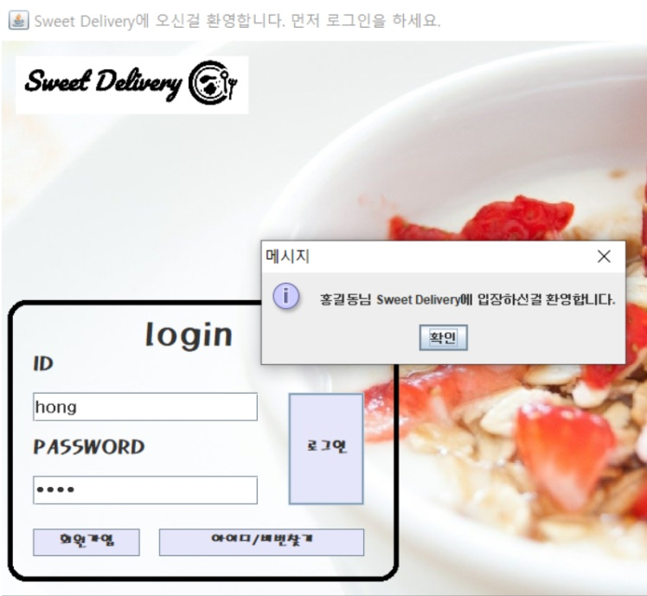
뒤로가기 버튼 : www.flaticon.com
로고: https://www.squarespace.com/logo/#N4IghgrgLgFgpgExALigJwnAvkA
로고
https://www.squarespace.com/logo/#N4IghgrgLgFgpgExALigJwnAvkA
모든 배경:
https://pixabay.com/

Slide 3
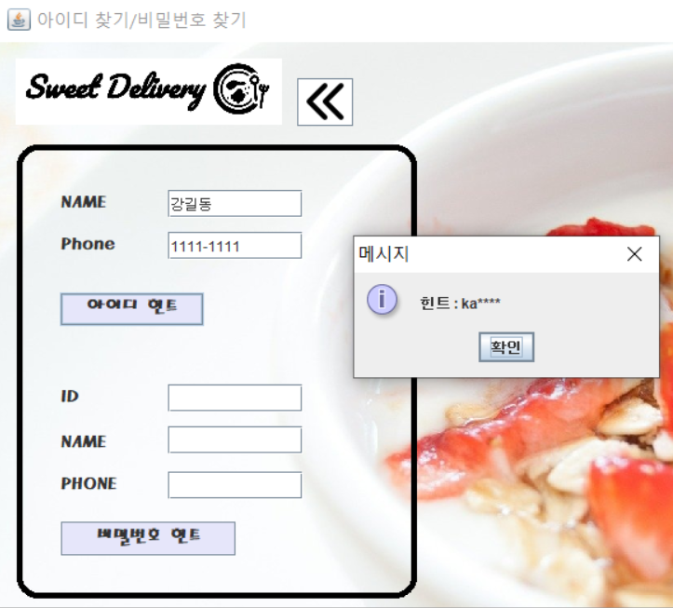

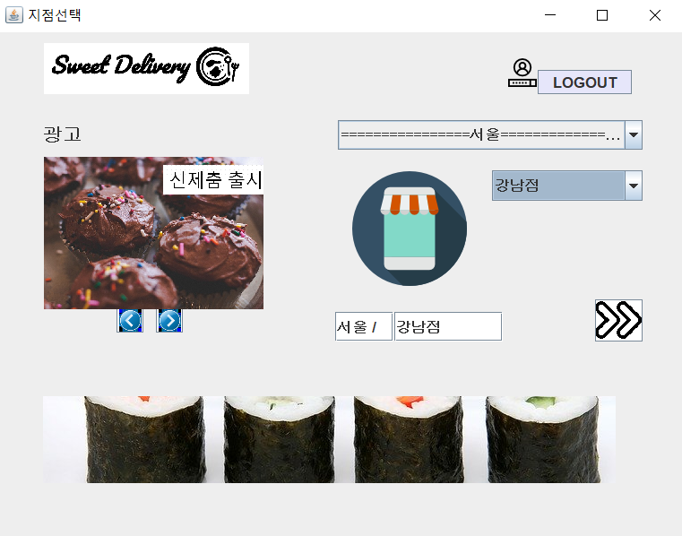
www.flaticon.com
사진출처:https://pixabay.com/
https://pixabay.com/

Slide 4
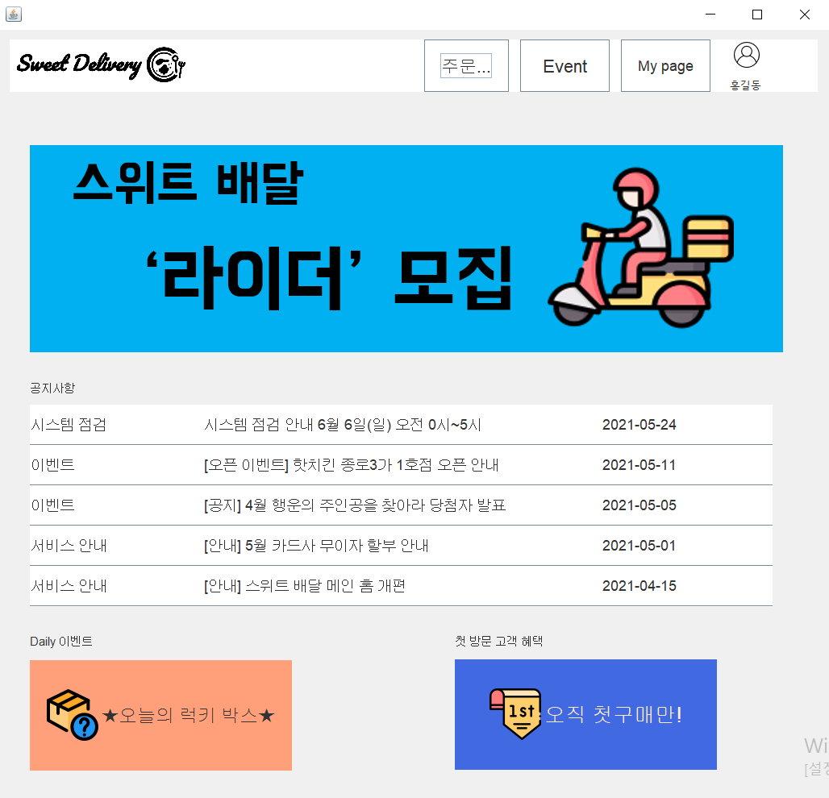
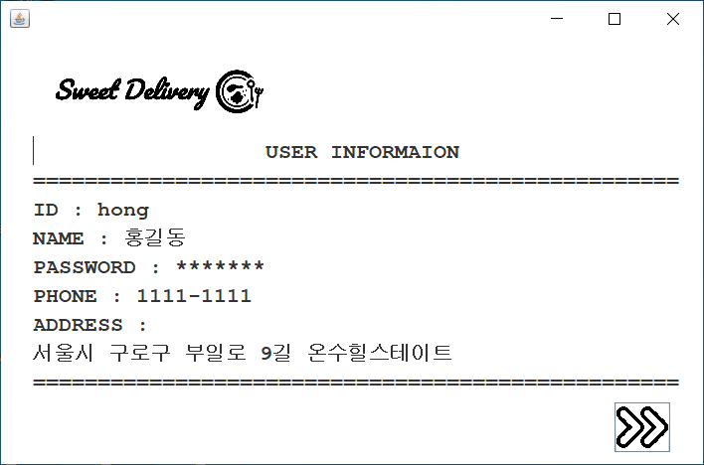
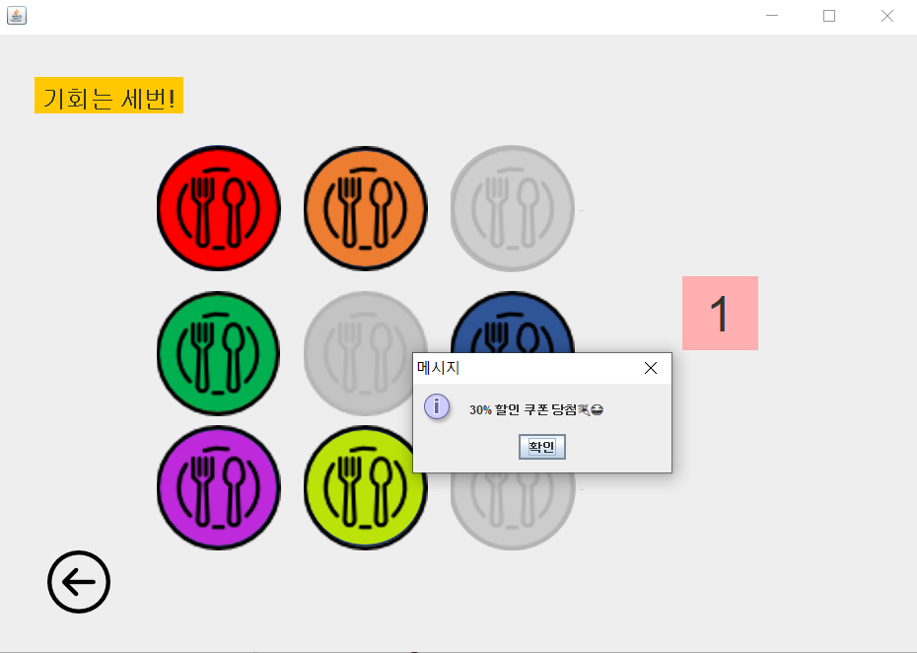
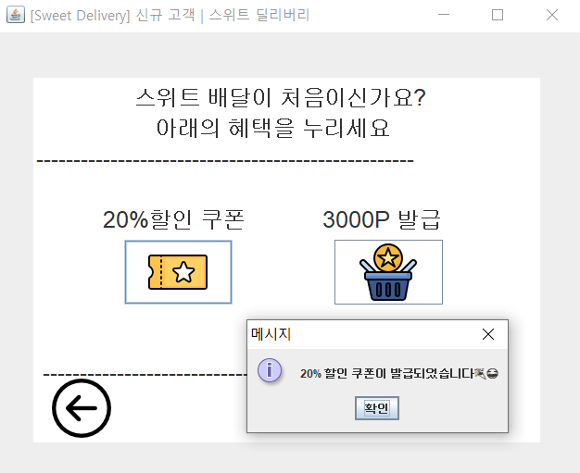
모든 이미지 출처 : www.flaticon.com

Slide 5
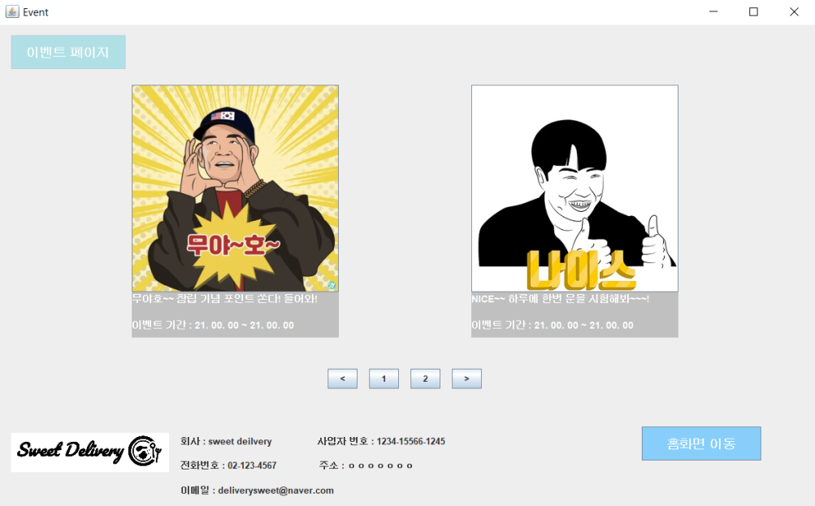
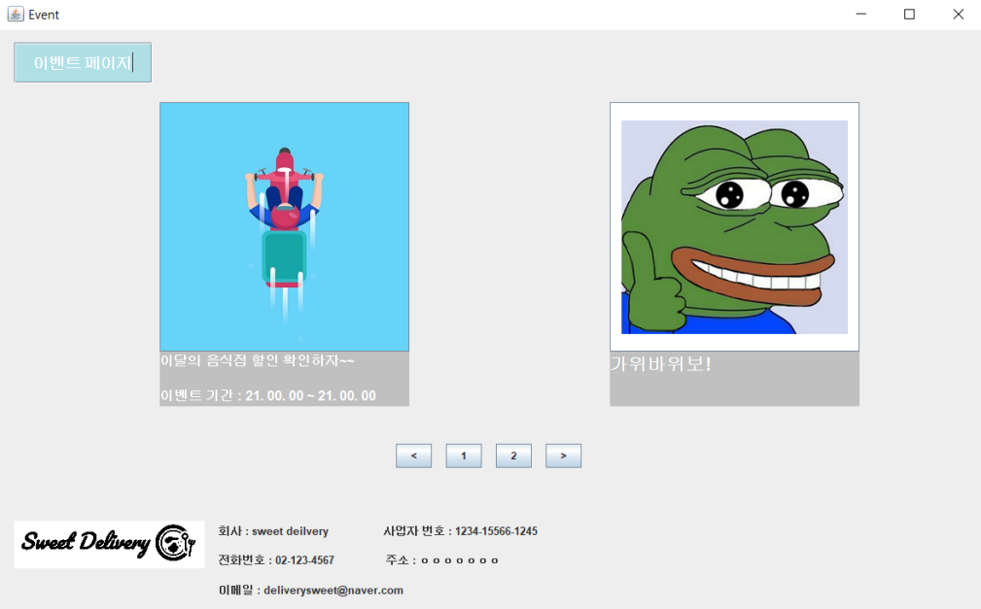
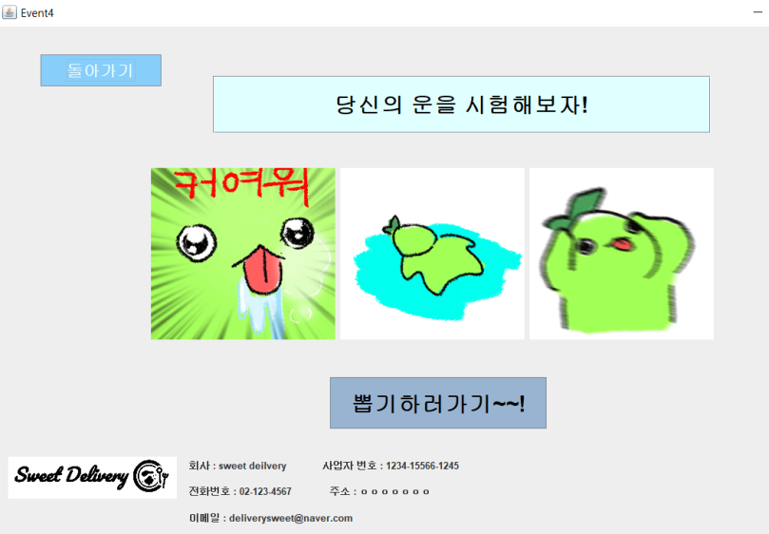
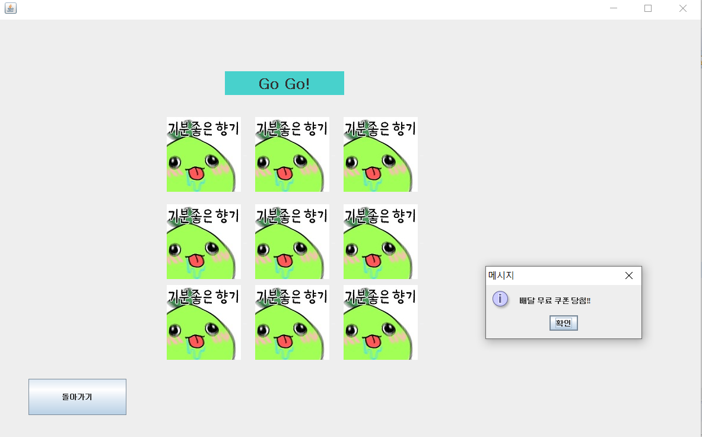
https://www.urbanbrush.net/

Slide 6
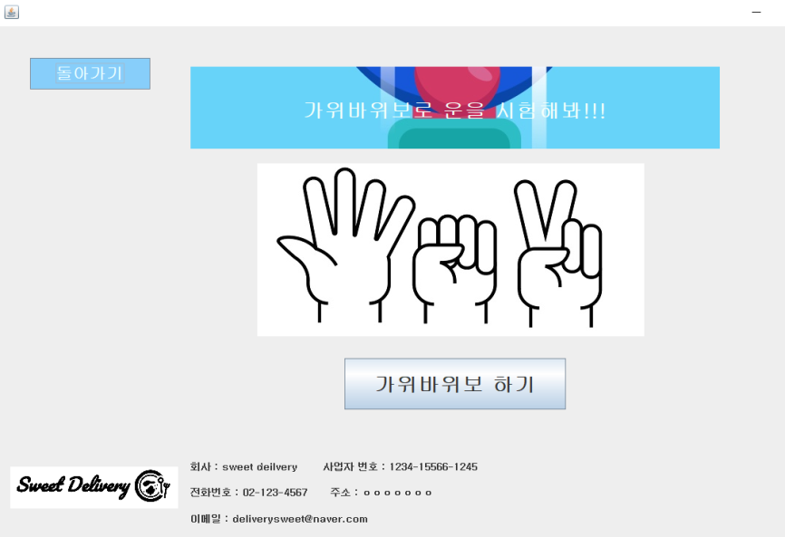
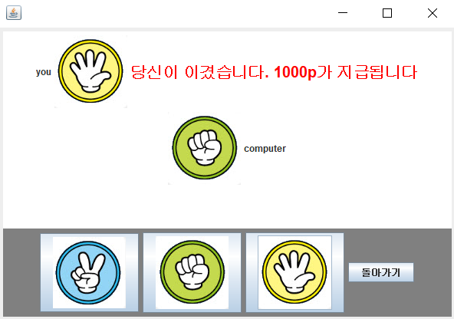
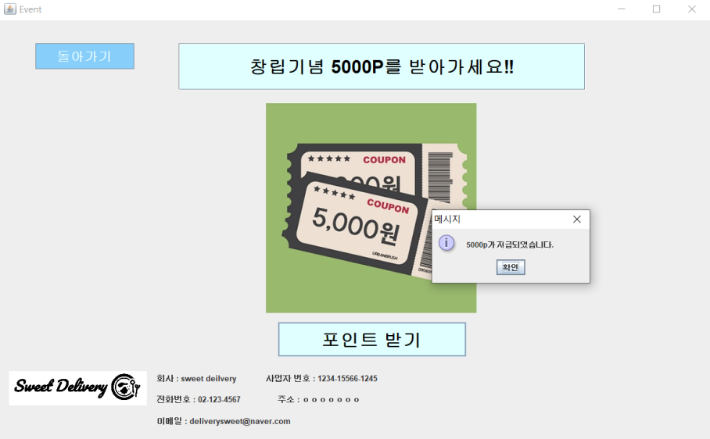
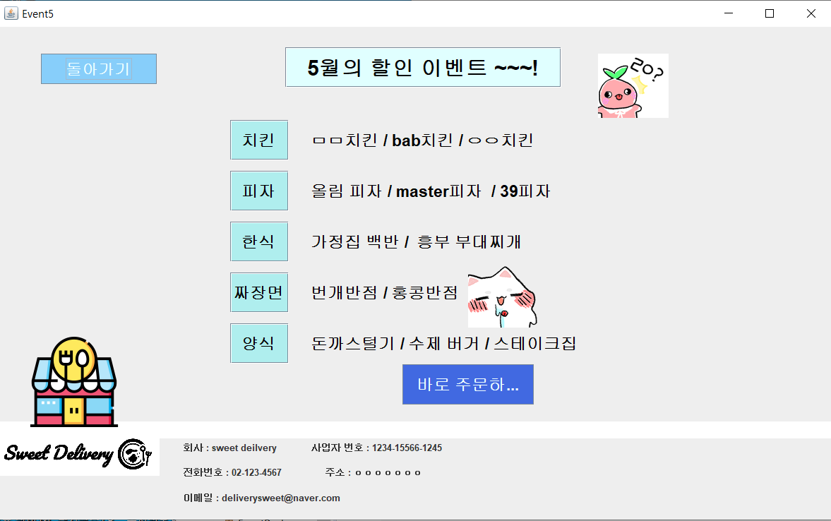

Slide 7
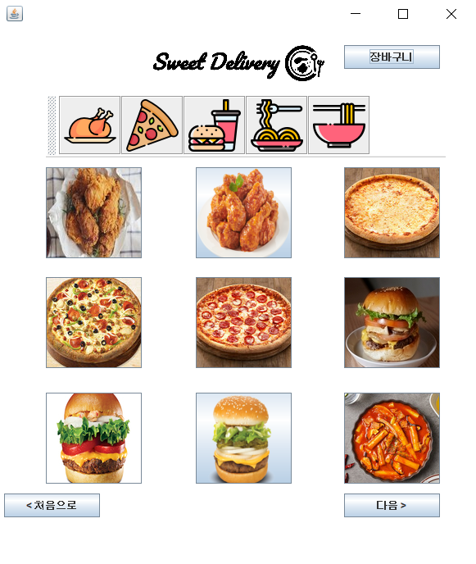
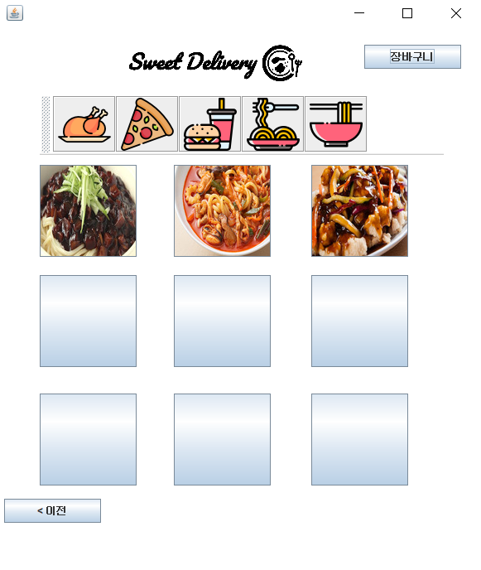
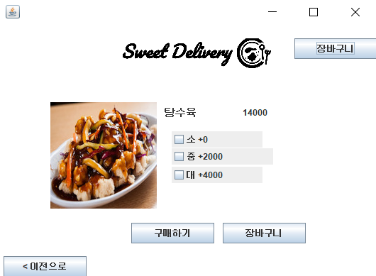
모든 분류 아이콘
www.flaticon.com by Freepik
치킨
https://www.youtube.com/watch?v=o9FjzEC_ATI
https://myongjiblog.wordpress.com/2018/08/14/양념치킨/

Slide 8
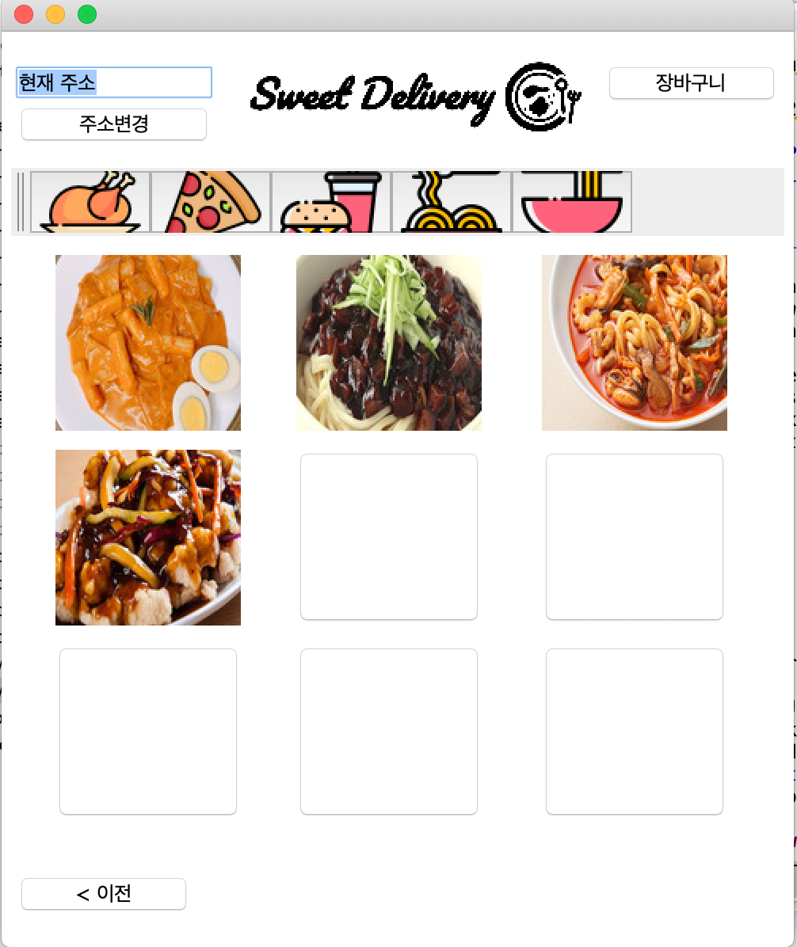
피자
https://web.dominos.co.kr/goods/detail?dsp_ctgr=C0101&code_01=RPZ010SL&dough_gb=203
https://www.7thpizza.com/menu/menuView/42
https://web.dominos.co.kr/goods/detail?dsp_ctgr=C0104&code_01=RPZ007SL&dough_gb=104
햄버거
http://m.sommeliertimes.com/news/articleView.html?idxno=10753
https://newsis.com/view/?id=NISX20210122_0001314744
http://newyk.astroweb.co.kr/index.php/topic/view?id=265
분식
http://emart.ssg.com/item/itemView.ssg?itemId=1000037285689&siteNo=6001&salestrNo=2034
https://www.10000recipe.com/recipe/6954859
중국집
http://blog.naver.com/PostView.nhn?blogId=skinnysparrow&logNo=220833882792
https://www.kurly.com/shop/goods/goods_view.php?&goodsno=68232
https://aseura.com/탕수육-고기-부위-2가지는/

Slide 9
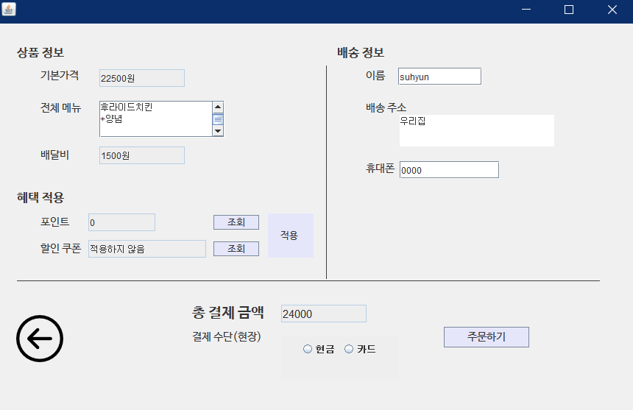
폰트- 나눔 바른고딕
https://hangeul.naver.com/font
(네이버 한글한글아릅답게)
www.flaticon.com

Slide 10
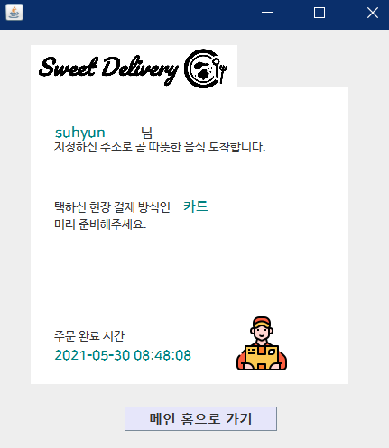
로고: https://www.squarespace.com/logo/#N4IghgrgLgFgpgExALigJwnAvkA
폰트- 나눔 바른고딕
https://hangeul.naver.com/font
(네이버 한글한글아릅답게)
www.flaticon.com

