Slide 1



STUDENT NAME: . suia.k
REGISTER NO:312209016
NAANMUDHALVAN ID
asunm1351unm135122/c
DEPARTMENT: B.Com General
COLLEGE: CTTE college for women

Slide 2


Slide 3



Slide 4



Slide 5



Slide 6
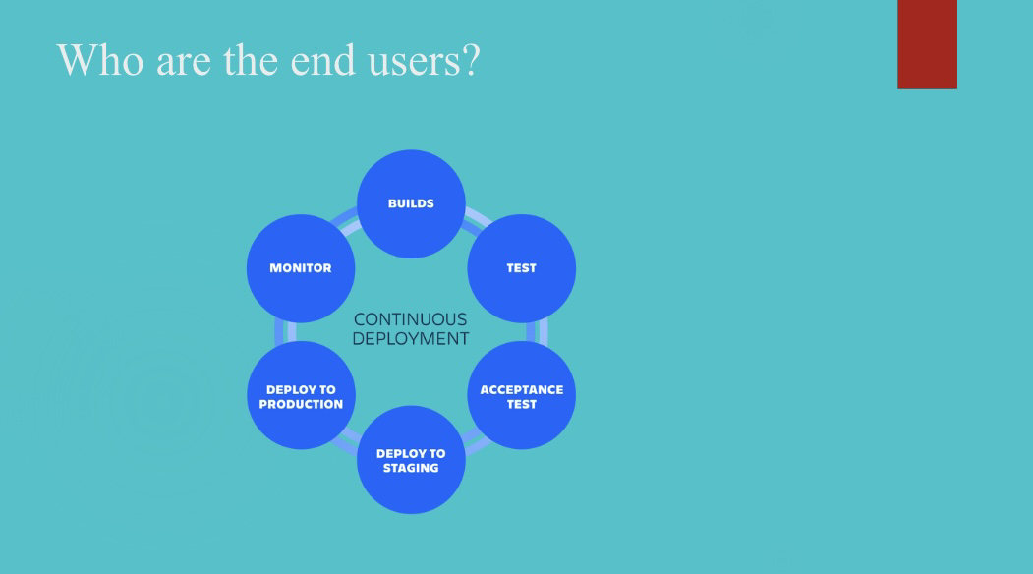


Slide 7



Slide 8
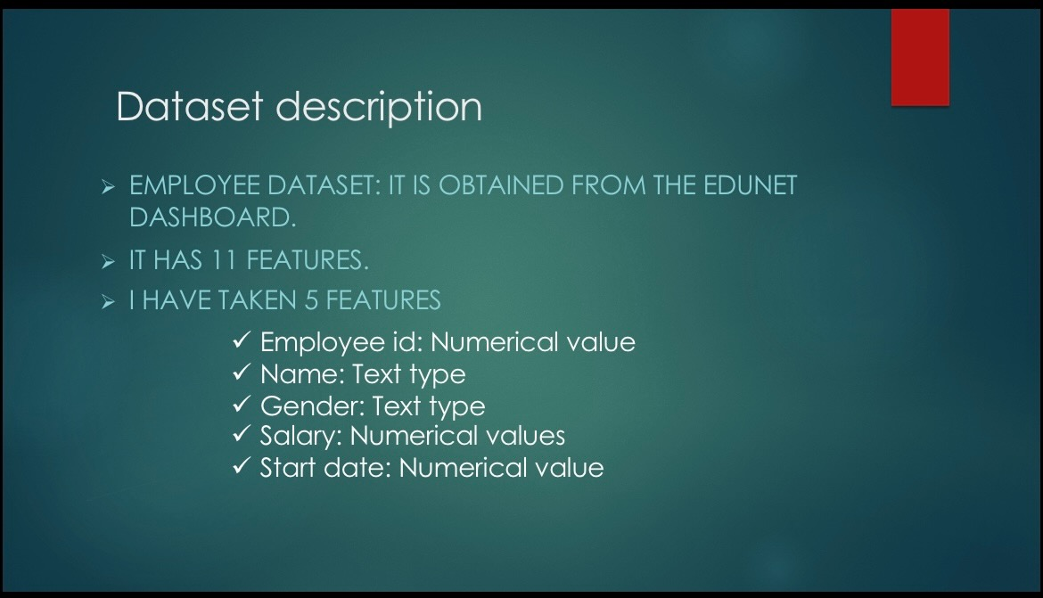
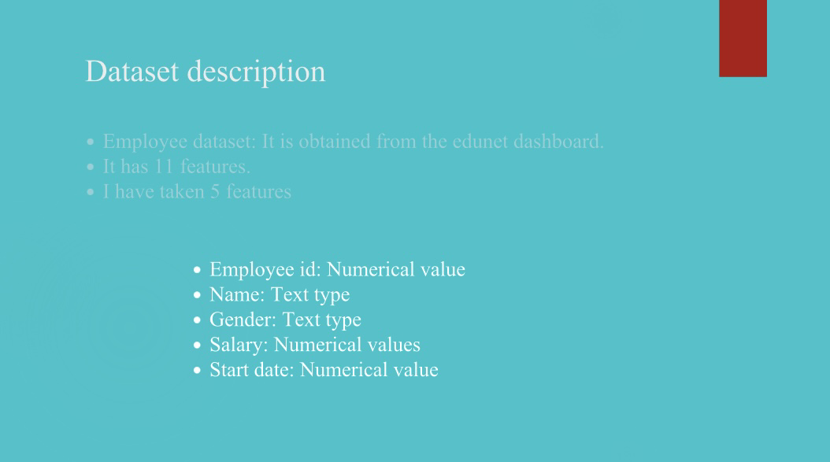

Slide 9



Slide 10
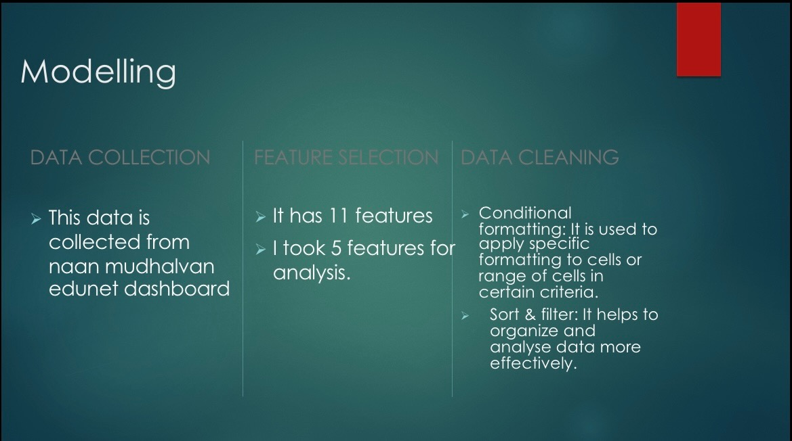


Slide 11
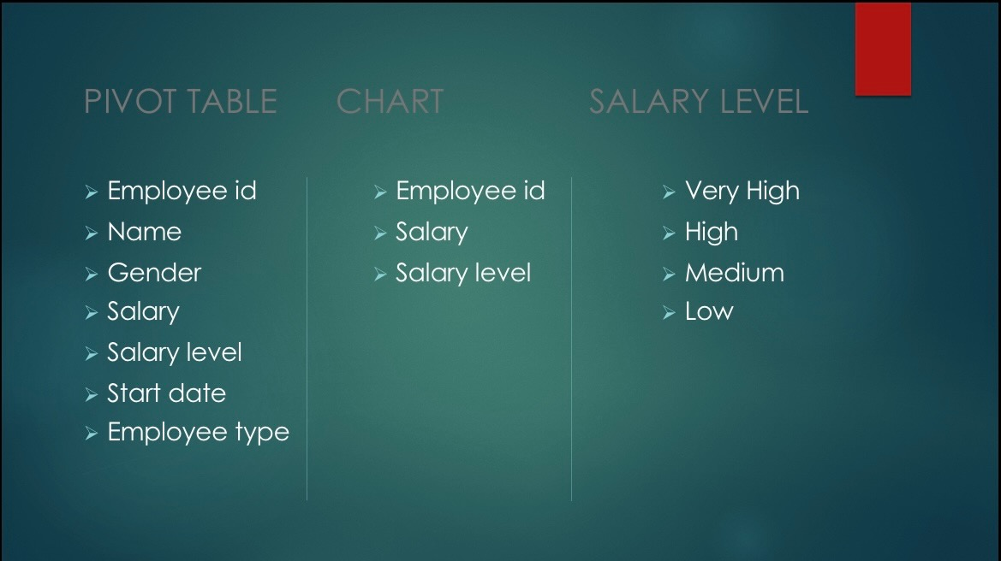


Slide 12
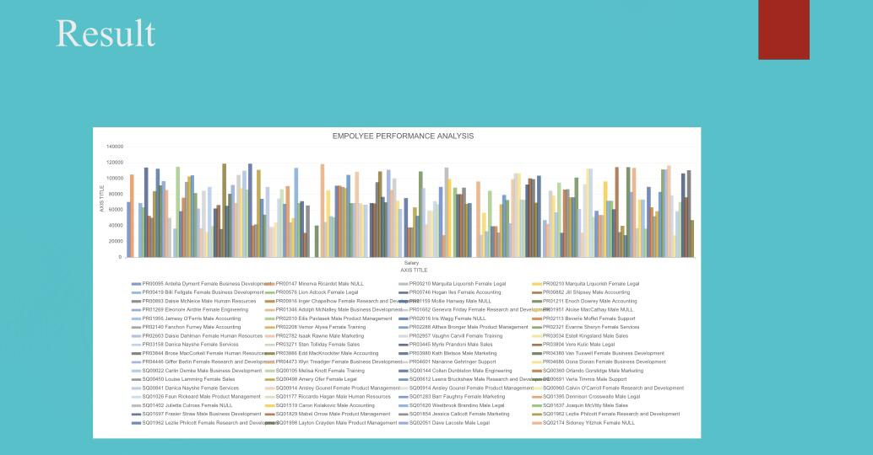
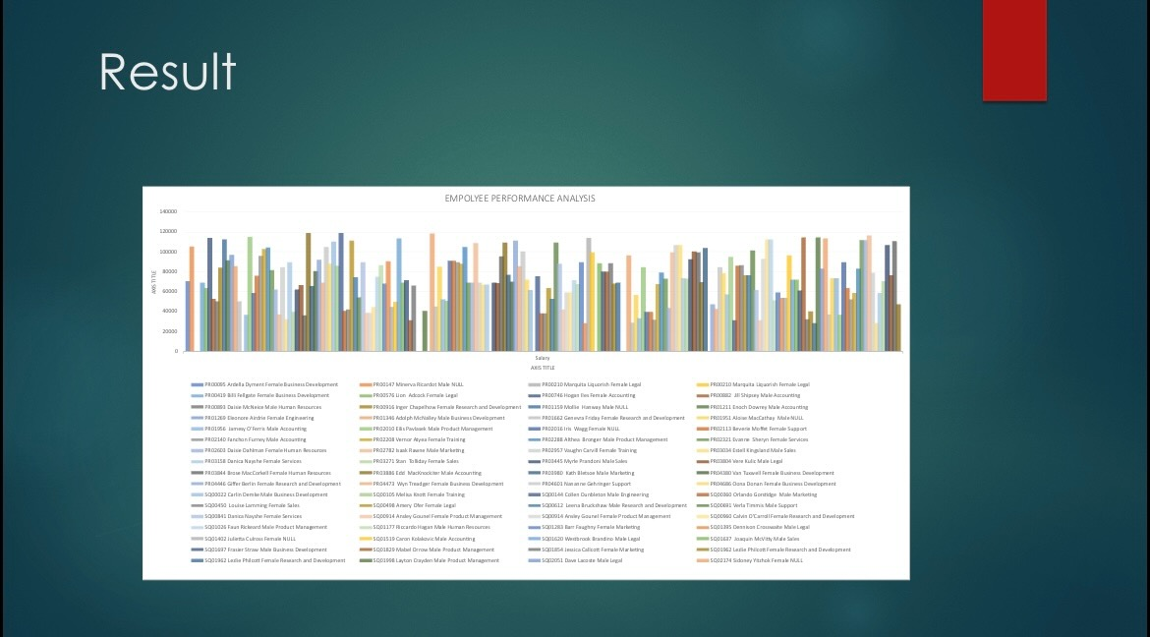

Slide 13



