Slide 1
Event Congestion Command Center
Predicting traffic-event impact for the Bengaluru Traffic Police
Flipkart Gridlock 2.0 × BTP
Built on real ASTraM data - 8,173 actual traffic events (Nov 2023 - Apr 2024). No simulations.
Team Abhijeet Kumar · Sujaatali Agharia · Muskan Jarwal
Notes:
Bengaluru loses enormous time to traffic events — breakdowns, tree falls, construction, rallies. The police need to know WHICH events will shut a road and WHERE to put their people. We built a command center on the REAL provided dataset — 8,173 events — not simulated data.

Slide 2
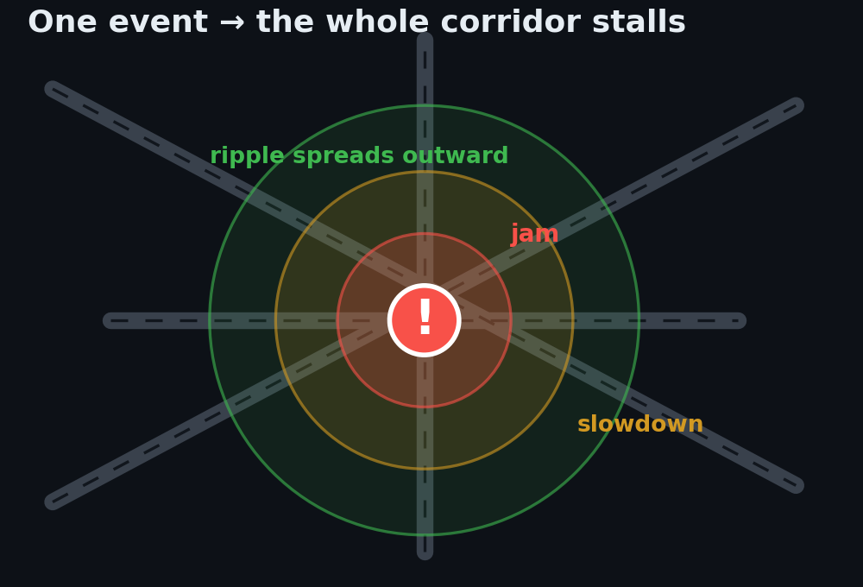
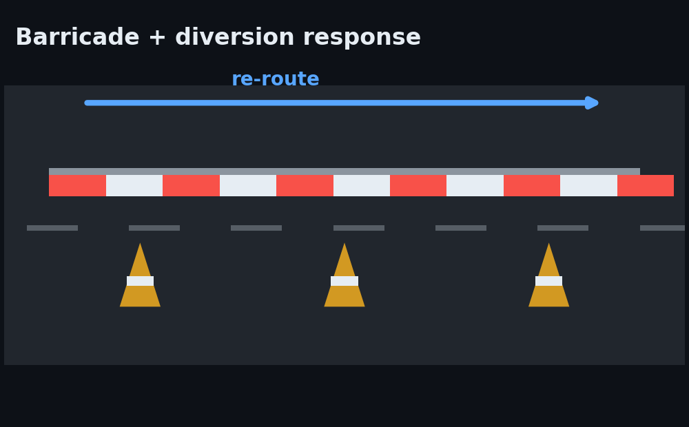
THE PROBLEM · WHY IT MATTERS
Traffic events break the city - and today's response is reactive guesswork
THE PROBLEM
Rallies, festivals, construction, tree-falls and breakdowns trigger sudden, localized traffic breakdowns.
94% are unplanned - they hit without warning.
WHY IT'S HARD TODAY (THE NEED)
• Event impact isn't quantified in advance • Manpower is experience-driven
• No post-event learning - the same mistakes repeat
OUR INTUITION
The history already holds the answer. Learn from 8,173 real past events to predict an event's impact,
flag closure risk, and recommend the response - before officers are committed.
“How can historical + real-time data forecast event traffic impact and recommend optimal manpower, barricading & diversion?”

Slide 3
THE DATA · HOW WE BUILT IT
From raw log to model-ready
Three small scripts run in sequence on the raw ASTraM file. No data invented - every new column is derived from fields already in the log.
STEP 1
STEP 2
STEP 3
add_locality_hotspot.py
add_region.py
add_time_features.py
→ locality_hotspot
→ region
→ hour · day · weekend · night · band
Problem: 38% of events sat in a useless "Non-corridor" blob.
Group events into broad city zones
Expose the daily rhythm of events.
→
→
• Named corridors → keep their name
• Non-corridor → snap GPS to a
~1 km grid (0.009°) cell
• Name each cell = most common
locality parsed from address
(fallback: police_station)
• Cells < 5 events → "Other"
• 3×3 grid over the data's bbox →
8 zones (South/Central/North ×
West/Central/East)
• Each event tagged by its GPS location (no coords → "Unknown")
• Backup geo-signal: when a specific locality is too sparse, the model leans on its wider zone
• Parse start_datetime in IST
• Derive hour, day_of_week,
is_weekend, is_night, time_band
• Bands surface the two peaks:
late_night (2 AM freight) +
morning_rush (10 AM–noon)
• ISO8601 parse → no dropped rows
Raw CSV (46 cols, many 98–99% empty) → Step 1 → Step 2 → Step 3 → astram_enriched.csv (53 cols · 8,173 rows · model-ready)
We enriched the data , we didn't replace it - the whole pipeline re-runs from the raw file the organizers gave us.

Slide 4
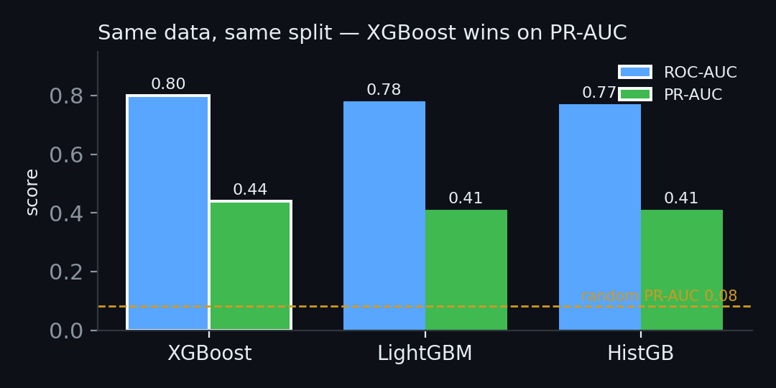
MODEL SELECTION
We tested 3 models - a fair bake-off
Same data, same 75/25 split, same imbalance handling. We let the data pick the winner.
Model | ROC-AUC | PR-AUC ⭐
XGBoost 🏆 | 0.80 | 0.44
HistGradientBoosting | 0.77 | 0.41
LightGBM | 0.78 | 0.41
Why PR-AUC? Closures are rare (8.3%).
PR-AUC is the honest metric for catching rare events - so it's our tiebreaker.
Same held-out 25% · PR-AUC = the rare-event tiebreaker.
XGBoost won on PR-AUC - the metric that matters for rare events. That's the model we kept.
Notes:
We didn't pick a model and hope. Three industry-standard gradient-boosted models, identical conditions. XGBoost won on PR-AUC — the metric that matters when the thing you're predicting is rare. So that's our closure-risk engine.

Slide 5
MODEL PERFORMANCE
How good is it ?
⚠ Only 8.3% of events cause a closure. So "accuracy" is misleading - a model that says "never close" scores 92% and is useless.
We measure what counts: do we catch the real closures?
Metric | Score | What it means
PR-AUC | 0.44 | ~5× better than random (0.08)
ROC-AUC | 0.80 | Ranks a closure above a non-closure 4 of 5 times
Recall | 54% | Catches 54% of real closures (at our 0.40 threshold)
Backtest | 4.2× | Flagged events actually closed 4.2× more often
“We'd rather show a true 0.44 than a fake 0.99.” Every number is on data the model never saw.
Notes:
Because closures are rare, accuracy is a trap — 92% is the do-nothing baseline. We report PR-AUC and recall instead: ~5x better than chance, catches 57% of closures, and history shows flagged events closed 4.3x more often. Honest, tested, on unseen data.

Slide 6
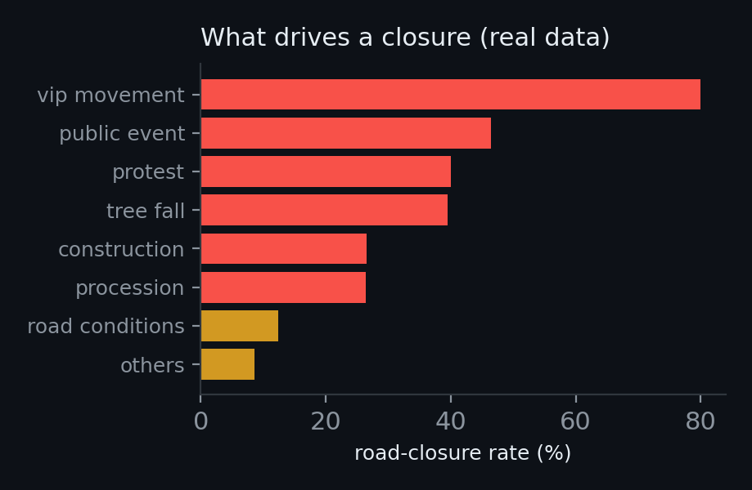
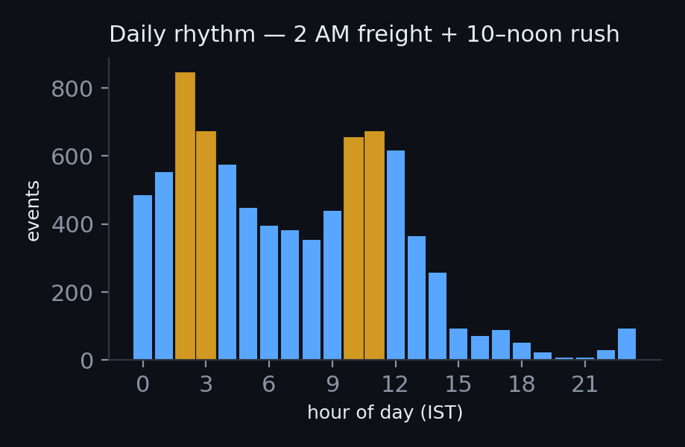
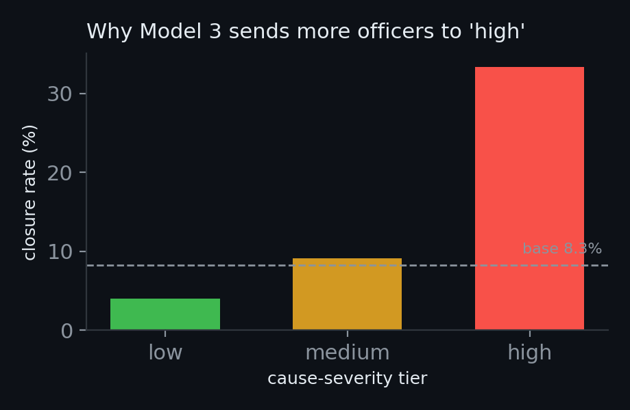
THE SYSTEM
Three models, one command center
Each model answers one question - and each claim is backed by the real data shown below it.
MODEL 1
MODEL 2
MODEL 3
Closure Risk
Hotspot Forecaster
Recommendation
Will this event shut the road?
→
Where & when do events cluster?
→
What should the police do?
INPUT event cause · location · time
METHOD XGBoost classifier (one-hot)
OUTPUT closure probability + risk tier
INPUT location × hour × day-of-week
METHOD Poisson rates + EB shrinkage
OUTPUT expected events per cell (risk map)
INPUT Model 1 risk + Model 2 hotspots
METHOD transparent rules (documented)
OUTPUT officers · barricade · pre-position
✓ PR-AUC 0.44 · ROC 0.80 · recall 54%
✓ −27% MAE vs naive · rank corr 0.32
✓ backtested 4.2× closure lift
Predict impact → locate hotspots → recommend response — every number above is from the held-out data.
Notes:
Three models working together. Model 1 scores an incoming event's closure risk. Model 2 tells us where and when events cluster, by real neighborhood. Model 3 turns risk into action: how many officers, barricade or not, and where to pre-position. All explainable — no black box.

Slide 7
MODEL 3 · RECOMMENDATION LOGIC
How recommendations are made — transparent, not guessed
Closure risk (Model 1) + the cause's closure tendency → a fixed, explainable officer/barricade grid. No black box.
CAUSE ‘CLOSURE TENDENCY’
MANPOWER GRID
how often each cause historically forced a road closure (from ASTraM)
officers = closure-risk tier × cause tendency
HIGH (≥ 25% closed)
vip_movement, public_event, protest, tree_fall, construction, procession
Risk \ Cause | High | Med | Low
High (≥0.40) | 8 | 6 | 5
Med (0.20–0.40) | 5 | 4 | 3
Low (<0.20) | 3 | 2 | 2
MEDIUM (8 – 25%)
road_conditions, water_logging, others
LOW (< 8%)
vehicle_breakdown, accident, congestion, pot_holes
Examples
tree_fall @ 83% → High × High → 8 officers + barricade
accident @ 16% → Low × Low → 2 officers, no barricade
⚠ ‘Tendency’ = chance of road closure, NOT injury severity. An accident is ‘low’ because <8% needed a full closure — a tree fall almost always blocks the road.
No ‘optimal’ claims — every threshold is a documented policy choice BTP can tune, and the closure model is backtested (flagged events closed 4.2× more often).

Slide 8
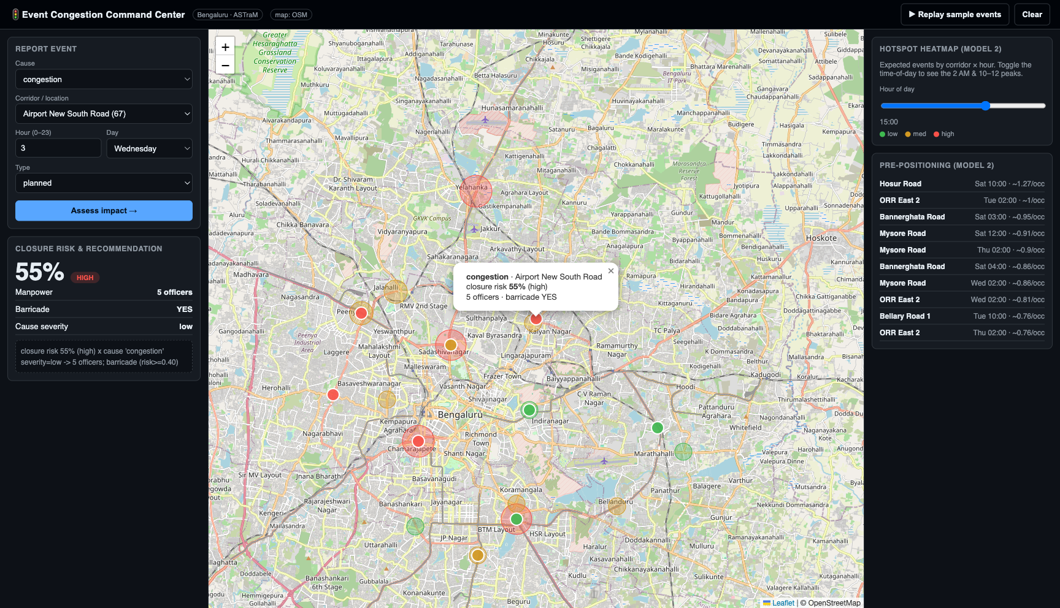
LIVE DEMO
The dashboard - report an event, get a plan
Report an event → closure risk % + officer/barricade recommendation + city hotspot map, in real time.
Notes:
LIVE DEMO. Open the dashboard, hit 'Replay sample events' for a hands-free walkthrough — events stream onto the map spanning low to high risk. Show: report form -> risk % -> recommendation panel -> hotspot heatmap (drag the hour slider to reveal the 2 AM & 10-12 peaks) -> pre-positioning list. Use the replay button, not live typing, so it's deterministic.

Slide 9
WHY YOU CAN TRUST THIS
our edge
🎯 Real held-out metrics
Every score is on 25% of data the model never saw. We report PR-AUC & recall - right for rare events, not flattering accuracy.
🐛 We caught & fixed a leakage bug
A timestamp-parsing glitch was secretly inflating our score (116 events). We found it, fixed it at the source, and report the honest post-fix number.
📋 Recommendations are backtested, not “optimal”
No deployment ground truth exists in the data, so we never claim optimal. We verified vs history: flagged events closed 4.2× more often.
🔁 Validated two ways
Random split AND a strict time-based split (train past → test future). PR-AUC held: 0.44 → 0.46. No temporal leakage.
⚖️ We tune for recall on purpose, and we own the cost
At our 0.40 threshold precision is ~0.20 - more false alarms - but a missed road closure costs police far more than a wasted check. The threshold is a dial BTP can set.
“We'd rather present a true 0.44 than a fake 0.99.”
Notes:
The slide we're proudest of. We could have shown 92% accuracy and hoped. Instead: honest metrics, we caught our own leakage bug, recommendations backtested against real history, and we validated under both random and time-based splits. If you're judging on rigor, this is where we earn it.

Slide 10
IMPACT & ROADMAP
What it means for BTP and what's next
IMPACT TODAY
• Proactive: pre-position patrols at predicted hotspots before incidents happen.
• Reactive: instant closure risk + response the moment an event is reported.
• Explainable - officers can see why, so they trust it.
ROADMAP (not yet built)
• Live ASTraM feed integration
• MapmyIndia for map, traffic & diversion routing
• "Blast radius" impact-zone visualization
• Learning loop from real deployment outcomes
Honest about what's live today vs. what comes next.
Notes:
Impact: proactive + reactive, and explainable so officers trust it. Roadmap is clearly labeled NOT YET BUILT — live feed, MapmyIndia routing/diversions, blast-radius zone, and a learning loop. We keep the line honest between what works today and what's future.

Slide 11
Thank you
Event Congestion Command Center
Honest models, real ASTraM data, a demo that runs live.
Flipkart Gridlock 2.0 × Bengaluru Traffic Police · Questions welcome

